Slide 1
Class 2a – Agricultural Land

Slide 2
MN Statute 273.13 subd. 23
273.13 Subd 23 – Consists of 15 paragraphs. Nine of fifteen relate directly to agricultural classification (2a).
Agricultural homestead - Ag
Agricultural Land - Ag
Rural Vacant Land – Not Ag
Managed Forest Land – Not Ag
Agricultural Land defined Confinement and over 10 acres – Ag
Agricultural land defined under 10-11 acres – Ag
Agricultural land use by another For Ag Purposes – Ag
This section Supersedes Local definitions of Min-Max acres – Ag
Agricultural Products defined – Ag
Agricultural/Commercial industrial Split Class – Ag
HGA listing requirements – Ag
Airport Landing Area – Not Ag
Commercial Aggregate not mined – Not Ag
Commercial Aggregate Not mined conversion to mined – Not Ag
Definitions in (c) and (d) are not rules – Not Ag

Slide 3
Class 2a agricultural land consists of parcels of property, or portions thereof, that are agricultural land and buildings. Class 2a land may be homestead or non-homestead depending on ownership, occupancy and active farming scenarios. There can be split class records that are non-agricultural. Ex. Cell tower on an agricultural property would create a split class – part agricultural and part commercial

Slide 4
What qualifies for the agricultural classification?
A minimum of 10 contiguous acres used to produce agricultural products in the previous year
Agricultural products are defined by statue
Agricultural products must be for sale
Livestock, dairy animals/products, poultry, furbearing animals, nursery, fruit and vegetables
Fish bred for sale and consumption
Game birds and waterfowl
Insects that are primary bred to be used as food for animals
Wild Animals – deer, elk, moose, ostriches, emus,, rheas, & llamas

Slide 5
Agricultural Production 2a
Means – raising, cultivating, drying or storage of agricultural products for sale, or storage of machinery or equipment used in support of agricultural productions by the same farm entity
Grain bins, sheds, or grain elevators – if stand alone – must be the owners crops or machinery
Land that is enrolled in RIM, CRP, or similar state or federal conservation program is deemed as used for agricultural purposes
Land must be classified as agricultural since 2002 assessment or,
In the year prior to its enrollment in the conservation program
New – up to three acres of land used to provide environment benefits
Buffer strips, old growth forest restoration or retention or retention ponds
Grading, sorting, and packaging of raw agricultural products for sale

Slide 6
House / Garage and Site
It is important to identify
Allocation of value used for state aids, referendum market values, property tax refund calculations, disabled veterans market value exclusion, etc.
Land value should be uniform within taxing entity unless justifiable
example: site next to a lake may have a different value due to the influence of the water

Slide 7
Dwelling(s) on 2a property
Assessors must split one acre and tie that value to the dwelling. Four possible scenarios listed below:
Class 2a HGA (1.00% class rate) if homesteaded by the owner or a qualifying relative
Class 4bb(2) (1.00% class rate) non-homestead dwelling if only dwelling on parcel
Class 4b(3) (1.25% class rate) non-homestead dwelling on parcel containing two or three residential units
Class 4c(12) (1.00% class rate) Seasonal Recreational use dwelling
Remember any farm buildings located on the one-acre site area should not be included in the HGA.

Slide 8
Split Class – When Commercial
Wholesale & Retail Sales
Store located on farm dedicated to selling product (ex. Cheese) is commercial class
Processing raw agricultural product
If building/room is used as the process to produce a product is commercial
Ex. Building that houses maple syrup evaporator to produce product for sale
Ex. Room where animal feed is bagged for later sale
Warehouse or Storage of processed goods
Building that stores products for later sales
Ex. Building stores seed to sell to farmers
Ex. Walk-in cooler that stores process meat for later sale even if on the farm
Office Facilities
Building that is used for commercial entity
Ex. Office used for the selling of seed

Slide 9
Resources to help determine if agricultural
State verification form available in Virtual Room
GIS and Parcel Maps
Production/Product Sale information
Rental/ Lease information
Schedule F on income tax

Slide 10
2a Class can be Summarized into Four Statutory Categories:
10 -10.99 Acres No Dwelling and 11 plus acres with or without dwelling. 10 or more contiguous Acres Agricultural Purposes -273.13 subd.23 (e)(1)
Less than Ten acres Exclusively used for Agricultural Purposes and no dwelling – 273.13 subd.23 (f)(1)
Less than 11 acres including a dwelling 273.13 subd.23 (f)(2)
Intensive Livestock or Poultry Confinement Operation – 273.13 subd.23 (e)(2) Property of any Acreage, with or without dwelling.

Slide 11
Apparent Production Use
Common Characteristic
Defined boundaries – panel fences, barbed wire, gates, manure pits, bunker silos, cattle passes, calf hutches, chicken coop, field boundaries
Physical Manipulation – clearing of trees, irrigation, drainage tile, cultivation, harvesting of products
Fiscal and Administration Impacts – expenses incurred, income realized, production related licenses, county feedlot permit pulled

Slide 12
If less than 10 acres
If land is intensive or exclusive than it may qualify – below is list of criteria
How many acres are used for agricultural in relation to overall acres
Crop being raised and sold on the agricultural acres
Exclusive use – poultry or hog confinement, fur bearing animals,
Insects bread for food for animals, bees and apiary products, game birds and waterfowl
Composition of agriculturally used acres – contiguous or noncontiguous
Whether the configuration of the agriculturally used acreage lend themselves to agricultural production

Slide 13
Horticultural and Nursery Stock
Includes potted flowering plants, potted perennials, sod sprigs and plugs, food crops
Classed as Agricultural if building is used to grow stock
Does not qualify for agricultural is only used for display or for selling product
Nursery stock is defined as a plant intended for planting or propagation, including – trees, shrubs, vines, perennials, biennials, grafts, cuttings, etc.
Horticultural Stock is tree, bush, tree nuts, cut flowers, potted ornamental grasses

Slide 14
Farm Land

Slide 15
Non-production agricultural land – 2b
Land not in production – waste, woods, lakes, streams, rivers, rock piles, ravines, etc.
Need to identify and separate out these areas from the production land
2a land is production – 2b is non-production
Exceptions – if nonproduction 2b land is interspersed within the production land than it should be considered 2a. General rule – if 10 acres or more than it is practical to separate.
Marginal land that is not black and white if it is 2b – consider the below guidance
How interspersed is the 2b within the field
Alternate uses of the land – how feasible to till, accessible, zoning requirements
Any setbacks that would prevent it from being farmed
Could it be split off and sold separately

Slide 16
Stewardship Programs

Slide 17
State Property Tax Programs
Green Acres – to protect farm land from value increases due to non-agricultural uses
Rural Preserve- similar to GA but for 2B property
Sustainable Forest Incentive Act (SFIA) – preservation of forest land
2c Managed Forest Land Programs – lower class rate - .65%
Native Prairie – is exempt
Applied through the Assessor Office

Slide 18
Green Acres
Property is the homestead of owner/ child/ sibling/ member/ shareholder/ partner of a family farm entity
Bare land must be farmed in conjunction with the property that contains the homestead
Must meet the within 4 township requirements
Property is nursery/greenhouse

Slide 19
Must be 2a productive agricultural land and primarily devoted to agricultural use
At least 10 acres in size
There is a high value and low value
High value is market and value based on sales
Low value is determined by state and that is what is used to generate property taxes

Slide 20
Rural Preserve
2b rural vacant land that was properly enrolled in Green Acres for taxes payable 2008 or own class 2b property that is part of an agricultural homestead that is enrolled in Green Acres
Must be contiguous to the Green Acres property
Cannot be enrolled in Green Acres, Open Space, Metropolitan Agricultural Preserves, or SFIA
Have no delinquent taxes
All must be under the same ownership
Value and taxes calculated the same as Green Acres

Slide 21
Withdrawal from Rural Preserve
Property owner must pay back deferred taxes for current and back two years
If property owner deferred special assessments, must pay that as well
Application through the county assessor’s office
Due by May 1 and must include map identifying area that they wish to enroll

Slide 22
Sustainable Forest Incentive Act
Property owner can receive $7 for each qualifying acre enrolled
Land cannot be developed
Must follow a forest management plan
Must be enrolled for a minimum of 8 years
Must have 20 or more contiguous acres
Must be at least 50% forest land as defined by MN Statue 88.01, subd. 7

Slide 23
Restrictions
It cannot be classed as 2c Managed Forest Land
It cannot be enrolled in the following:
Reinvest in Minnesota - RIM
Conservation Reserve Enhancement Program - CREP
Conservation Reserve Program - CRP
Green Acres
Agricultural Preserves
Rural Preserves
It cannot be used for residential or agriculutral purpose

Slide 24
Class 2c Manage Forest Land
Owners of forest land who actively follow a qualifying forest management plan may receive a reduction of the class rate to .65% instead of 1%

Slide 25
Qualifications
Must be at least 20 acres of forested land
Can be contiguous
Must have a forest management plan registered with the DNR within the last 10 years
Maximum of 1,920 acres per taxpayer may be enrolled statewide

Slide 26
Restrictions
The property cannot be used agriculturally
Property cannot be enrolled:
Sustainable Forest Incentive Act
CRP
CREP
RIM
Green Acres
Apply through the County Assessor Office by May 1st

Slide 27
State and Federal Conservation Programs
RIM – Reinvest in Minnesota
CRP – Conservation Reserve Program
CREP – Conservation Reserve Enhancement Program
WRP – Wetland Reserve Program
EQIP – Environmental Quality Incentives Program
WHIP – Wildlife Habitat Incentive Program

Slide 28
Reinvest in Minnesota
Conservation reserve program
To protect and improve water quality, reduce soil erosion, enhances wildlife habitats, flood control, and ground water recharge
It is usually perpetual
Managed by the Minnesota Board of Water and Soil Resources
Administered by the Farm Service Agency
Enroll environmentally sensitive land
Contracts are for 10 – 15 years
Goal is to re-establish valuable land cover, improve water quality, prevent soil erosion, and reduce wildlife habitat

Slide 29
Conservation reserve enhancement program
Wetland reserve program
Country’s largest private-land conservation program
Administered by the Farm Service Agency
Targets high-priority conservation concerns identified by a State
To establish long-term conservation and wildlife practices and protection
Land eligible
Wetlands farmed under natural conditions
Lands that become wetland due to flooding
Riparian areas
Permanent or 30 year
Expired as of 2/7/2014

Slide 30
Environmental Quality incentive program
Wildlife habitat
incentive program
Agricultural Act of 2014 (enacted on 2/7/2014) repealed the WHIP program
Plan and implement conservation programs
Receive financial assistance to implement approved conservation practices

Slide 31
Questions?

Slide 32
Land Valuation

Slide 33
Valuation of Land
There are many ways to value land
By acreage – used commonly in rural areas in lots that are bigger in size
By front foot – used commonly in cities with lots and blocks
By square foot – used commonly in commercial and industrial properties
By a fixed value – for very irregular properties

Slide 34
There are many approaches to value land across Minnesota. They can all work if used consistently.
Some counties merely grade on 2 types of soil-till and non-till.
Some counties grade using high ground and low ground.
Many use some type of “quality” based soil grading.
No matter which type of grading strategy is used annual analysis is needed to maintain accurate levels of assessment.
Notes:
Minnesota is a large diverse state and the soils vary-so do market conditions.

Slide 35
ABC tillable
Some counties grade on this premise:
A. Best soils
B. Average soils
C Low or more prone to flooding soils
This is the oldest method for determining land vlaues.
Notes:
They may even have subgroups within these ABC grades.

Slide 36
CER (crop equivalency rating)
Although this type of land valuation is no longer support by the MN extension office it is still used in come counties in the state. It is different from CPI in what it looks at to determine soil capabilities.
Soil properties
climate
Prevalent crop combinations
Market value of crops and cost of production
Rating are the same as CPI (100 – 0)
Specific to MN

Slide 37
CPI (crop productivity index)soil ratings
Based on physical and chemical properties and hazards of flooding or ponding
Water capacity
Slope
Soil moisture status
Cation-exchange capacity – how well the soil holds nutrients
Organic matter
Salinity
Each different type of soil has a productivity rating assigned to it.
100 highest 0 the lowest.
You will see soil being marketed based on these CPI soil ratings.
Notes:
These productivity ratings are based on each soil type ability to produce a major crop,

Slide 38
Why consider converting to a CPI based soil rating system?
Today we typically see most tillable farmland advertised and marketed with the CPI soil rating listed as part of the marketing effort.
Notes:
We used to use windows 2.0, we used to use horses to pull farm machinery, we used kerosene lamps to light our homes, and we used land lines for phone service-this is just another technological change that we can utilize to improve our assessment practices.

Slide 39
Soil Properties
Soil properties are determined by field examination of the soils and by laboratory index testing of some benchmarks.
Shallow borings are made
Identify and classify the soils
Delineate them on the soil maps
Test verify field observations
Based on the USDA soil surveys done in Minnesota
The USDA and the County Soil Conservation Services conducted a comprehensive survey
Each soil type was tested, graded, and mapped out by a team of soil scientists

Slide 40
The University of Minnesota worked with each county to utilize this original soil survey.
Soils were assigned a CER (Crop Equivalency Rating).
These CER Soil ratings were utilized and recorded on CRV’s and supported by the University of Minnesota until about 2009.
The technology has changed and CPI Soil ratings were found to more accurate.
Notes:
Each 40 acre tract had an assigned CER rating-regardless of whether till or woods.
Anyone remember getting FSA aerial photos and overlaying a little plastic sheet on a parcel and counting the dots to determine the acreage of a field?

Slide 41
What is the differences between the two soil rating systems?
CER Ratings CPI Ratings
Assumes a moderate level of management. Assumes a moderate level of management.
Growing degree days used Growing degree days not used
Average rainfall used Average rainfall not used
Production costs were factored in Production costs not considered
Chemical/physical soil properties not used Chemical/physical soil properties used
Drainage not considered a factor Soil drainage is factored in
Same soil CER will vary by county Same CPI soil type is the same throughout the state
The CPI Soil Rating more accurately reflects the actual productivity of soils and is based largely on the each soil types actual ability to produce a crop.
Notes:
Corn the mostly widely grown crop in the state formed the basis for these CPI soil ratings.

Slide 42
McLeod’s Transition
From ABC to CPI

Slide 43
How to convert from ABC or CER to CPI soil ratings
GIS mapping capability is required
Each parcel has a GIS overlay with the soil types.
Each soil type is mapped.
These revisions are entered into the valuation schedule and valuation system each county has in place.
Notes:
So far none of the townships converted has seen the aggregate value change by more than 2%-however some individual parcels may move up or down more than that.

Slide 44
This may not be applicable or warranted in each county.
Some counties with minimal agricultural activity may not need CPI conversion.
Some counties may just utilize a high ground-low ground method, or till and non-till.
But in a county with actual agricultural production, CPI conversion should be considered.

Slide 45
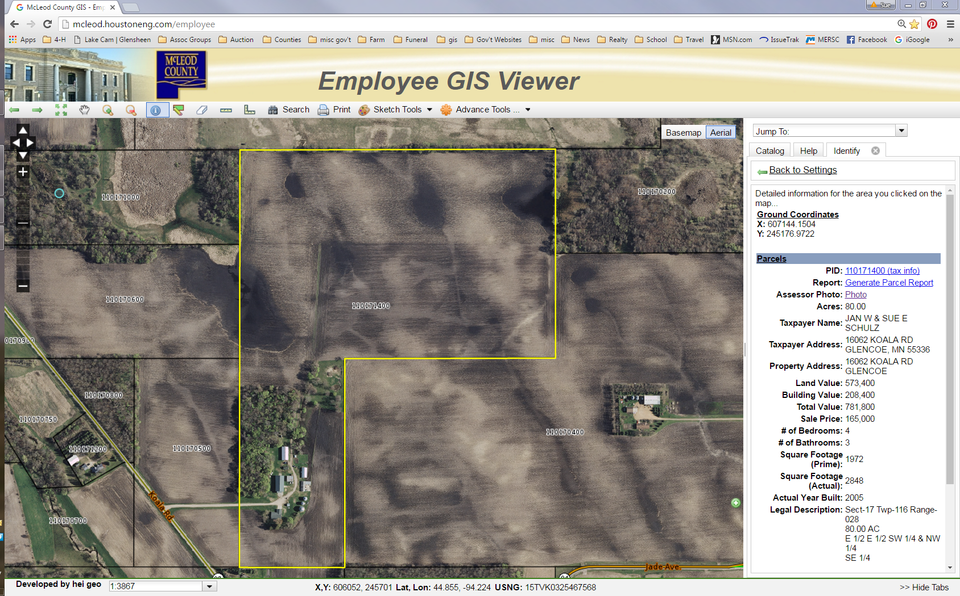

Slide 46
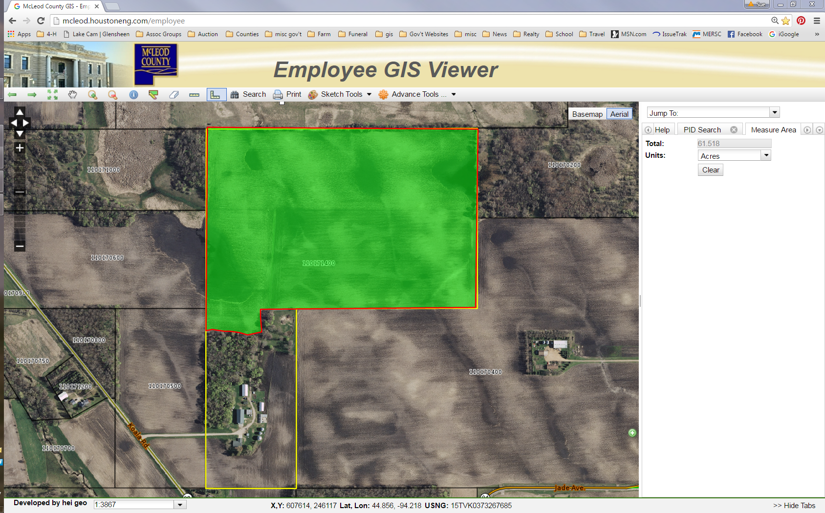

Slide 47
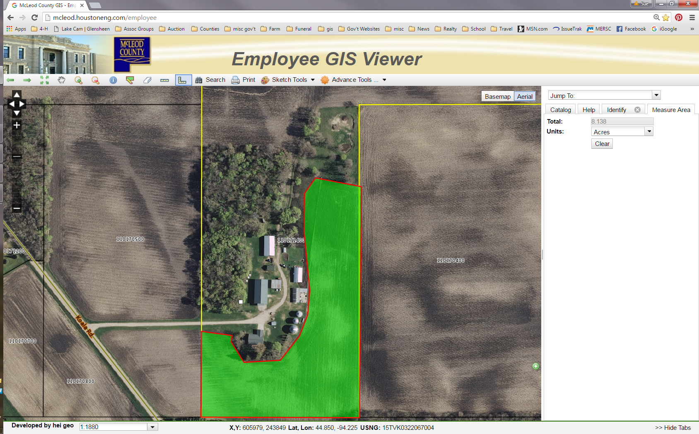

Slide 48
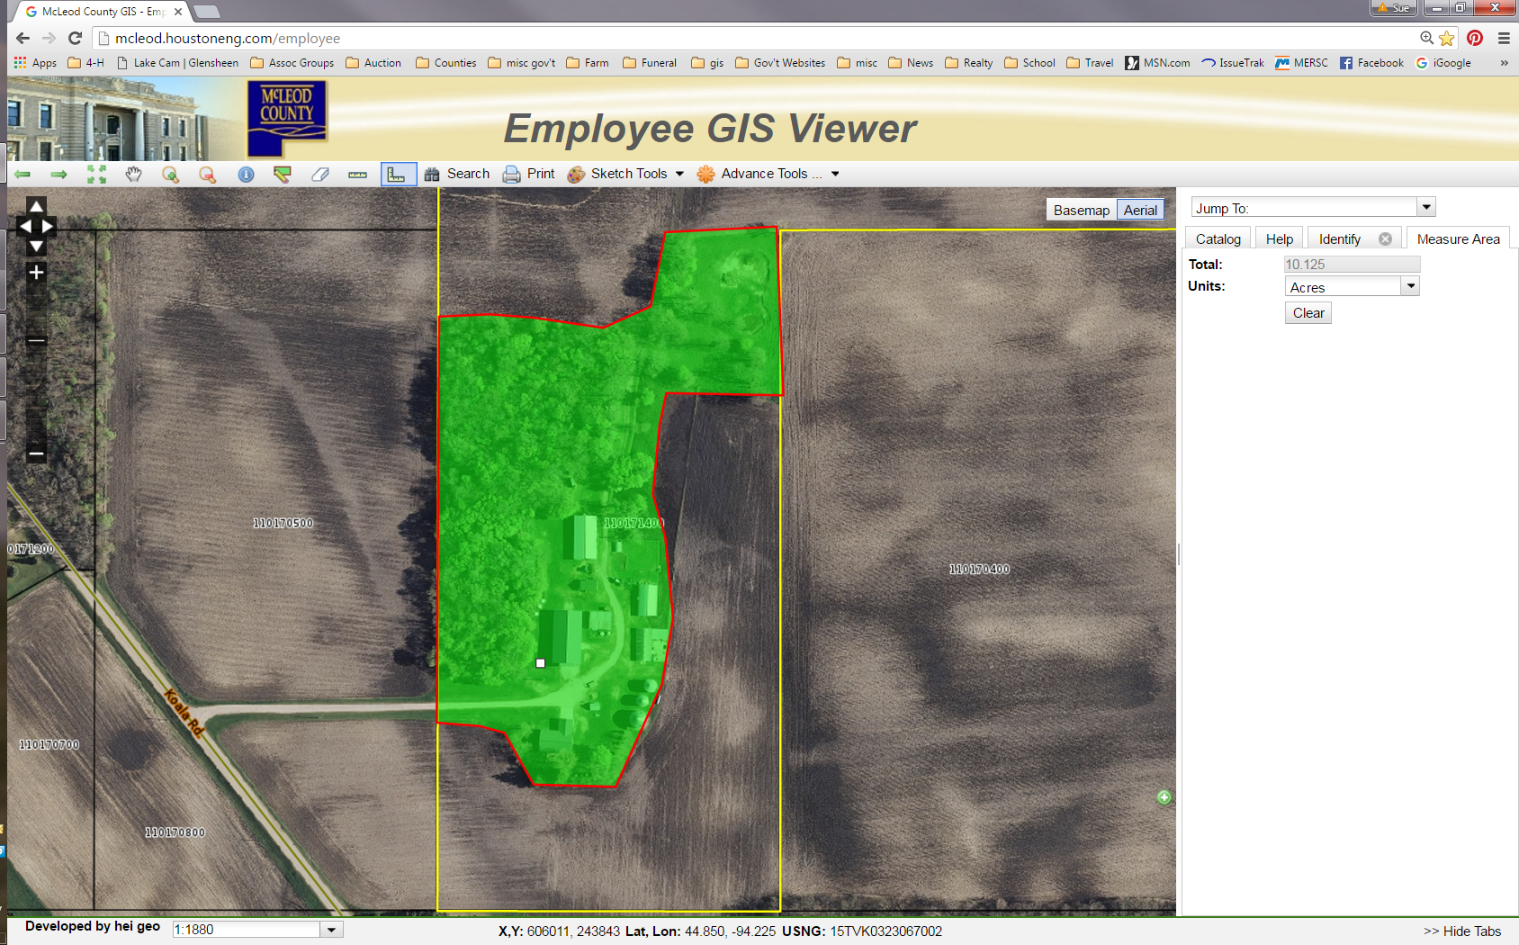

Slide 49
Parcel detail
CPI DETAILS - TILLABLE
MUSYM | SOIL NAME | GIS ACRES | TAX ACRES | CPI RATING
1075 | Klossner-Muskego complex, ponded | 0.76 | 0.77 | 5
1213C | Cokato-Storden complex, 6-12 percent slope, eroded | 11.44 | 11.58 | 84
109 | Cordova clay loam | 8.53 | 8.63 | 87
1213B | Cokato-Storden complex, 6-12 percent slope | 6.06 | 6.13 | 92
1207B | Cokate-Le Sueur complex, 1 to 6 percent slope | 18.25 | 18.46 | 97
Total |  | 45.04 | 45.57
LAND USE TYPE | GIS ACRES | TAX ACRES
DITCH | 1.89 | 1.92
PASTURE | 0.76 | 0.77
RIM/CRP | 18.33 | 18.55
ROAD | 2.63 | 2.66
TILLABLE | 45.04 | 45.57
WASTE A | 4.02 | 4.07
WOODS | 0.43 | 0.43
TOTAL | 73.1 | 73.97

Slide 50
ABC Breakdown
A 108,299.18 Acres
B 58,881.18 Acres
C 58,891.01 Acres
Sub C 3730.82 Acres

Slide 51
CPI Breakdown
91-100 143,142.83 Acres
81-90 63,543.34 Acres
71-80 12,471.52 Acres
61-70 4,429.21 Acres
51-60 708.34 Acres
41-50 1,633.31 Acres
31-40 181.36 Acres
21-30 2.26 Acres
11-20 370.72 Acres
0-10 2,959.31 Acres

Slide 52
 |  | 2015 Farm Land Values
 | A | B | C | Sub C
Acoma | 8900 | 7200 | 5900 | 4600
Bergen | 8900 | 7200 | 5900 | 4600
Collins | 8900 | 7200 | 5900 | 4600
Glencoe | 8900 | 7200 | 5900 | 4600
Hale | 8900 | 7200 | 5900 | 4600
Hassan Valley | 8900 | 7200 | 5900 | 4600
Helen | 8900 | 7200 | 5900 | 4600
Hutchinson | 8900 | 7200 | 5900 | 4600
Lynn | 8900 | 7200 | 5900 | 4600
Penn | 8900 | 7200 | 5900 | 4600
Rich Valley | 8900 | 7200 | 5900 | 4600
Round Grove | 10000 | 8100 | 6800 | 5100
Sumter | 8900 | 7200 | 5900 | 4600
Winsted | 8900 | 7200 | 5900 | 4600

Slide 53
 |  |  |  | 2016 Farm Land Values
 | CPI 100-91 | CPI 81-90 | CPI 71-80 | CPI 61-70 | CPI 51-60 | CPI 41-50 | CPI 31-40 | CPI 21-30 | CPI 11-20 | CPI 0-10
Acoma | 7000 | 6700 | 6000 | 5500 | 5000 | 4400 | 4000 | 3500 | 3100 | 2800
Bergen | 7000 | 6700 | 6000 | 5500 | 5000 | 4400 | 4000 | 3500 | 3100 | 2800
Collins | 7000 | 6700 | 6000 | 5500 | 5000 | 4400 | 4000 | 3500 | 3100 | 2800
Glencoe | 7000 | 6700 | 6000 | 5500 | 5000 | 4400 | 4000 | 3500 | 3100 | 2800
Hale | 7000 | 6700 | 6000 | 5500 | 5000 | 4400 | 4000 | 3500 | 3100 | 2800
Hassan Valley | 7000 | 6700 | 6000 | 5500 | 5000 | 4400 | 4000 | 3500 | 3100 | 2800
Helen | 7000 | 6700 | 6000 | 5500 | 5000 | 4400 | 4000 | 3500 | 3100 | 2800
Hutchinson | 7000 | 6700 | 6000 | 5500 | 5000 | 4400 | 4000 | 3500 | 3100 | 2800
Lynn | 7000 | 6700 | 6000 | 5500 | 5000 | 4400 | 4000 | 3500 | 3100 | 2800
Penn | 7000 | 6700 | 6000 | 5500 | 5000 | 4400 | 4000 | 3500 | 3100 | 2800
Rich Valley | 7000 | 6700 | 6000 | 5500 | 5000 | 4400 | 4000 | 3500 | 3100 | 2800
Round Grove | 7000 | 6700 | 6000 | 5500 | 5000 | 4400 | 4000 | 3500 | 3100 | 2800
Sumter | 7000 | 6700 | 6000 | 5500 | 5000 | 4400 | 4000 | 3500 | 3100 | 2800
Winsted | 7000 | 6700 | 6000 | 5500 | 5000 | 4400 | 4000 | 3500 | 3100 | 2800

Slide 54
Value Changes
 | Agricultural
 | 2015 | 2015 | 2015 |  | 2016 | 2016 | 2016 |  | Overall | Tillable
 | Land | Building | Tillable |  | Land | Building | Tillable |  | Change | Change
Acoma | 107,787,800 | 12,621,500 | 96,600,900 |  | 98,371,300 | 13,003,800 | 86,963,800 |  | -8 % | -10 %
Bergen | 131,936,900 | 18,701,000 | 118,190,400 |  | 115,605,900 | 18,415,100 | 101,830,400 |  | -11 % | -14 %
Collins | 137,619,200 | 8,289,300 | 132,286,100 |  | 122,463,300 | 8,635,500 | 116,671,900 |  | -10 % | -12 %
Glencoe | 136,032,700 | 10,449,600 | 129,642,500 |  | 121,619,900 | 10,342,800 | 115,009,300 |  | -10 % | -11 %
Hale | 129,902,600 | 14,779,800 | 117,465,900 |  | 118,702,500 | 14,212,800 | 106,585,800 |  | -8 % | -9 %
Hassan Valley | 128,828,800 | 10,141,100 | 122,518,400 |  | 116,441,200 | 11,967,100 | 109,878,400 |  | - 8 % | --10 %
Helen | 145,630,900 | 17,904,600 | 135,721,600 |  | 130,310,000 | 17,766,400 | 120,530,900 |  | -9 % | -11 %
Hutchinson | 118,843,700 | 14,824,500 | 107,259,200 |  | 106,904,000 | 16,053,000 | 94,906,800 |  | -8 % | -12 %
Lynn | 123,774,300 | 10,228,700 | 116,178,500 |  | 107,821,500 | 10,987,400 | 100,304,200 |  | -12 % | -14 %
Penn | 144,443,900 | 8,023,800 | 137,851,800 |  | 128,834,300 | 7,455,800 | 122,386,700 |  | -11 % | -11 %
Rich Valley | 135,305,600 | 15,615,700 | 122,612,200 |  | 121,104,200 | 16,158,300 | 108,575,100 |  | -9 % | -11 %
Round Grove | 176,079,000 | 3,752,700 | 171,600,200 |  | 141,280,800 | 3,906,300 | 136,994,400 |  | -19 % | -20 %
Sumter | 140,427,000 | 8,966,100 | 134,834,400 |  | 120,626,800 | 8,563,500 | 115,786,100 |  | -14 % | -14 %
Winsted | 130,493,900 | 21,880,700 | 117,926,400 |  | 115,285,300 | 22,076,900 | 102,528,500 |  | -10 % | -13 %

Slide 55
Sales Ratio
We are required to be between 90-105% of Market
Our sales study runs from October to September of each year
Our Agricultural ratio to the 2016 assessment is 104%
Our Agricultural ratio as of March for the 2017 assessment (with the CPI valuations) is 100%

Slide 56
If your county utilizes ABC type soil grading/ratings
you can apply CPI indexs to these as well.
Or you can simply have a single aggregate CPI rating

Slide 57
Here is how Stearns County soils were bracketed.
CPI soil rating 96----100===A1 soil
CPI soil rating 90------95===A2 soil
CPI soil rating 85------90===A3 soil
CPI soil rating 80------84===B1 soil
CPI soil rating 75------79===B2 soil
CPI soil rating 70------74===B3 soil
CPI soil rating 60------69===C1 soil
CPI soil rating 50------59===C2 soil
CPI soil rating 0--------49===C3 soil
Notes:
The bracketing process is critical to a successful CPI conversion if you use an ABC soil rating system-think it thru!
Each county is unique-if your highest CPI rating is 80 and you utilize an ABC type of breakdown-80 would be A soil.
Even though CPI soil rating are consistent throughout the state- xyz loam has a CPI of 97-each county has unique markets.

Slide 58
What does this mean for landowners
Soils will be graded more uniformly
Soils will be graded like they are being marketed
Estimated market values and Green acres values will be more uniform and accurate.
This data will also be made available to the public, so it can be utilized in purchasing or selling farmland and may even become a factor in farmland rental prices.
Notes:
This is why we keep the aggregate CPI soil rating of the tillable land on each parcel.

Slide 59
McLeod County’s Next Step
Using sales start stratifying
Ratios
To high on smaller parcels
To low on large parcels that are wall to wall tillable
Border values an issue on the west
Using GIS pull out all parcels that are wall to wall tillable
Keep base price per acre but will be making an adjustment to large farm parcels that are all tillable

Slide 60
Questions?

Slide 61
Land Management

Slide 62
Types of Land Management
Irrigration
Tiling
Terracing
Contour Farming
Manure Management
Grazing Practices

Slide 63
Irrigation
Natural
Pivot
Traveling Gun

Slide 64
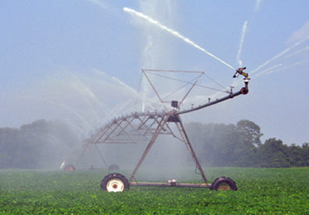
Center Pivot Irrigation
Notes:
If market conditions indicate properties that are irrigated-one may consider some type of multiplier.

Slide 65
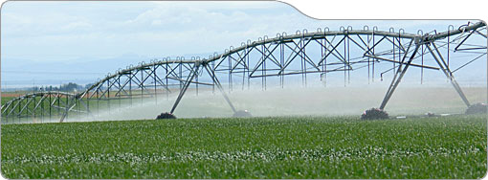

Slide 66
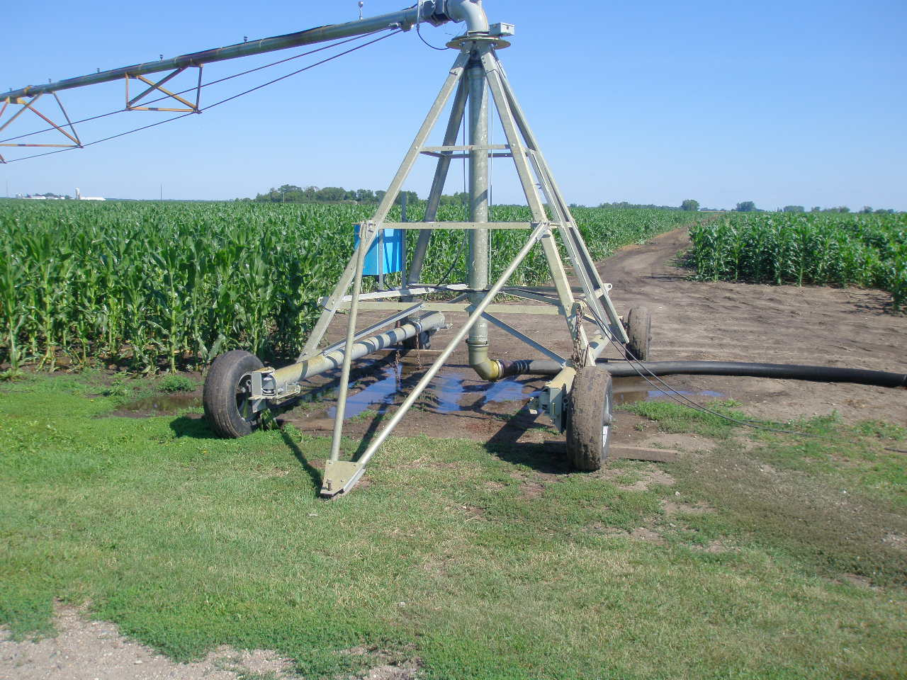
A portable center pivot-used on smaller fields

Slide 67
Traveling Irrigation Gun
Notes:
TRAVELING IRRIGATON GUN
This is referred to as a travelling gun for irrigation. It is anchored by a cable – usually to a tractor, and winches it way across the field, while applying water. Much more labor intensive than a center pivot system. But it doesn't leave a non-irrigated wedge in the corners of the field like a center pivot system.

Slide 68
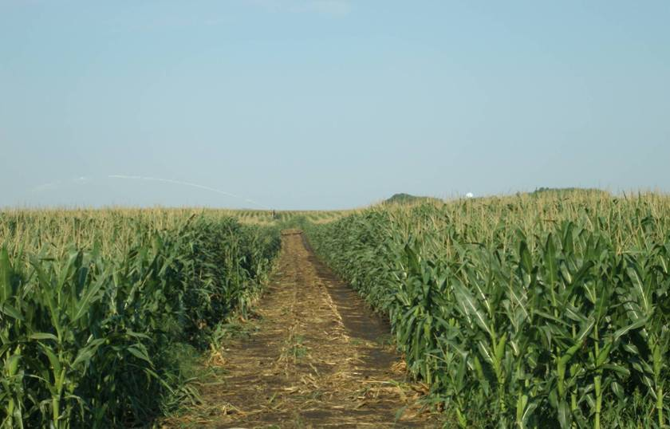
Path from a Traveling Gun
Notes:
This is the path from a travelling gun irrigation system

Slide 69
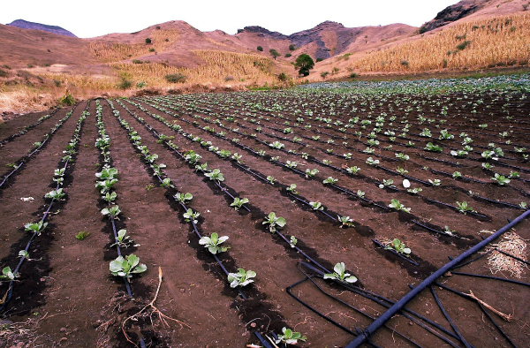
Drip Irrigation
Notes:
Used on smaller acreages mostly

Slide 70
Tiling
Most common type of tiling is the use of corrugated plastic tubing – they have small perforations to allow water entry.
There is commonly a tile inlet at lower areas where water is more likely to pool.
Tile is put in at a slope to help with the drainage.

Slide 71
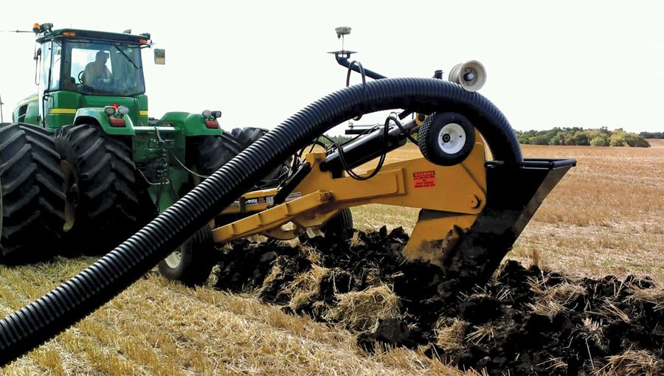

Slide 72
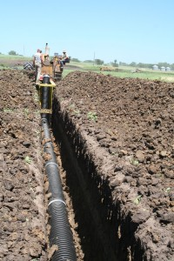

Slide 73
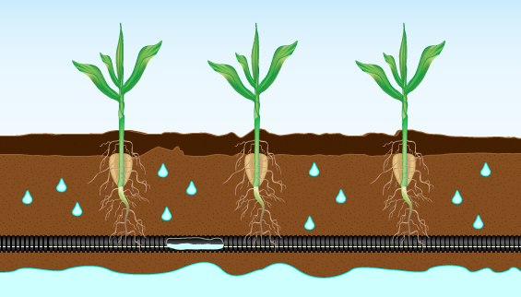

Slide 74
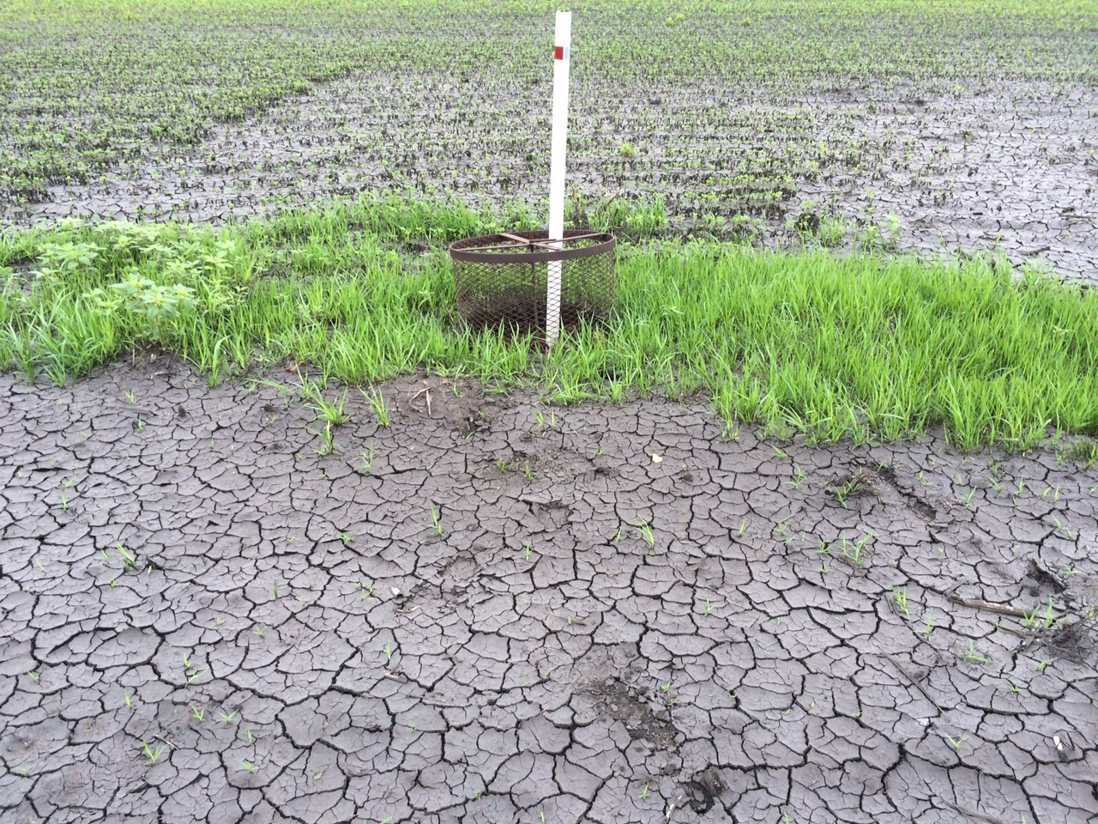
Tile inlet in field
Notes:
This tile inlet acts much like the drain on your bathtub. It allows excess surface water to drain into the underground tile. Most crops will die if covered with water for more than 24 hours. The post with a plastic jug on top is to mark this tile inlet-so the farmer doesn’t drive over it with large equipment.

Slide 75
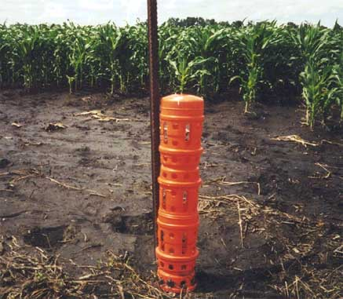
Types of Tile inlets

Slide 76
Tile Outlet
Notes:
Tile outlet-this shows where a tile line drains into a drainage ditch.

Slide 77
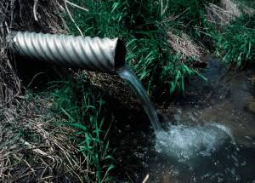

Slide 78
Terrace
Notes:
This terrace is a berm constructed parallel to the slope to reduce erosion. Water will collect and drain out thru the tile inlet in the center of the lowest point upstream of the terrace. These are often funded by the SCS.
Since hay is or can be cut on the terrace-this is 2a land.

Slide 79
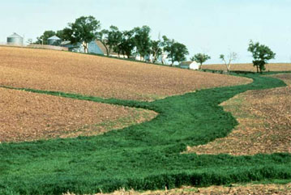
Grassed waterway
Notes:
On soils that have steep slopes erosion can be a real issue. If the land is farmed following the contour of the hill this erosion can be greatly reduced. The water can be redirected to a grassed waterway, where it flows away. Very often the soil conservation service offers cost sharing dollars and design help with these projects. These can also receive cost share funding.
2a impractical to separate.

Slide 80
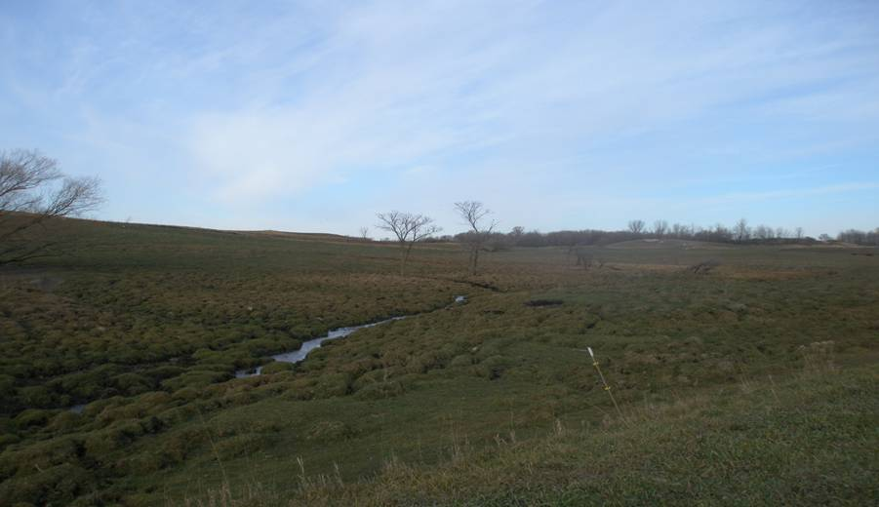
Gully in a pasture
Notes:
This illustrates what water can do when left to run its course. Think of this as a very small grand canyon. This steep slope coupled with a gully is the primary reason this land is in pasture and not tilled Sometimes this type of land may qualify for a program to take it out of production to reduce erosion.

Slide 81
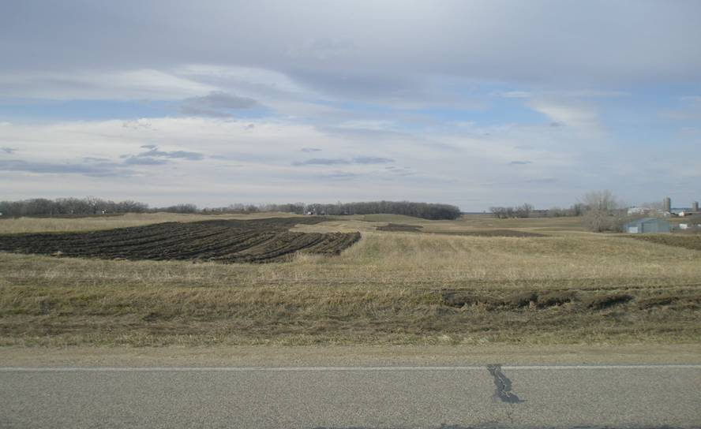
Contour Strip Tillage
Notes:
Fields are laid out to parallel to the slope-this reduces runoff and erosion on steep slope. Frequently these strip also have grassed waterways to allow excess rainfall to run off without eroding the soil. These can also receive government funding.

Slide 82
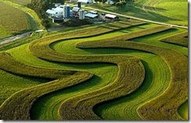
Contour strips

Slide 83
Buffer Strips
Perennial vegetation along rivers, streams, and ditches
The buffer must be 50’ along the public waters
The buffer must be 16.5’ along public ditches
Deadlines
November 1st 2017 is the deadline for public waters
November 1st 2018 is the deadline for public ditches

