Slide 1
Module 1 – Classification

Slide 2
Statutory reference is the basis of your classification decision.
Subdivision 23 directs the classification for Property Class 2.
That includes:
2a Agricultural
2b Rural Vacant Land
2c managed forest land
2d Airport landing area
2e Commercial aggregate not mined in a county that did not opt out, 5 paragraphs, 9 of fifteen relate to 2a.
Notes:
Our focus will be 2a and 2b.

Slide 3
Class 2a – agricultural land consists of parcels of property, or portions thereof, that are agricultural land and buildings. Class 2a – land may be homestead or non-homestead depending on ownership, occupancy and active farming scenarios. Split class – Ex. Cell tower on an agricultural property would create a split class part agricultural and part commercial

Slide 4
Agricultural Production
Means – raising, cultivating, drying or storage of agricultural products for sale, or storage of machinery or equipment used in support of agricultural productions by the same farm entity
Grain bins, sheds, or grain elevators – if stand alone – must be the owners crops or machinery
Land that is enrolled in RIM, CRP, or similar state or federal conservation program is deemed as used for agricultural purposes
Grading, sorting, and packaging of raw agricultural products for sale
Notes:
RIM – CRP or similar
Land must be classified as agricultural since 2002 assessment or,
In the year prior to its enrollment in the conservation program
New – up to three acres of land used to provide environment benefits
Buffer strips, old growth forest restoration or retention or retention ponds

Slide 5
What qualifies for the agricultural classification?
A minimum of 10 contiguous acres used to produce agricultural products in the previous year
Agricultural products are defined by statue – if not on the list then cannot be classified as agricultural
Agricultural products must be for sale
Notes:
Livestock, dairy animals/products, poultry, furbearing animals, nursery, fruit and vegetables
Fish bred for sale and consumption
Game birds and waterfowl
Insects that are primary bred to be used as food for animals
Wild Animals – deer, elk, moose, ostriches, emus,, rheas, & llamas

Slide 6
House / Garage and Site
Must determine and list separately -
It is important to identify
Allocation of value used for state aids, referendum market values,
property tax refund calculations, disabled veterans market value
exclusion, etc.
Site Value should be uniform within taxing entity unless justifiable
Notes:
example: site next to a lake may have a different value due to the influence of the water

Slide 7
Dwelling(s) on 2a Property
Assessors must split one acre and tie that value to the dwelling. Four possible scenarios:
Class 2a HGA (1.00% class rate) if homesteaded by the owner or a qualifying relative
Class 4bb(2) (1.00% class rate) non-homestead dwelling if only dwelling on parcel

Slide 8
Dwelling(s) on 2a Property
Class 4b(3) (1.25% class rate) non-homestead dwelling on parcel containing two or three residential units
Two or more houses on one parcel
Class 4c(12) (1.00% class rate) Seasonal Recreational use dwelling
Remember any farm buildings located on the one-acre site area should not be included in the HGA.

Slide 9
Example 1:
Howard has a house with attached garage where he parks his car. These buildings are located on Howard’s agricultural homestead property.
There are two other detached garages on the property.
One is used for farm equipment storage and the other houses Howard’s boats, ATV’s and lawn equipment.

Slide 10
Example 1:
Which of the three garages should be part of the HGA?
Should 2 of them be included?

Slide 11
Example 2:
Theresa has two houses on a farm and uses one house as her homestead residence.
The second house is storage only, not lived in, and no utilities are connected.

Slide 12
Example 2:
Should the second house be included as part of the HGA?
Should it be 4b(3) instead? - 2nd house on a agricultural parcel
Perhaps non-HGA 2a Ag buildings?

Slide 13
Example 3
Gail has 3 wells on a farm where she homesteads.
One well is used to service the house, the second well is to water the cattle, and the third is used for center pivot irrigation.
What class should the value of each well be given?

Slide 14
Split Class – When Commercial
Wholesale & Retail Sales
Processing raw agricultural product
If building/room is used as the process to produce a product is commercial
Warehouse or Storage of processed goods
Building that stores products for later sales
Office Facilities
Building that is used for commercial entity
Notes:
Store located on farm dedicated to selling product (ex. Cheese) is commercial class
1st bullet Ex. Building that houses maple syrup evaporator to produce product for sale
2nd bullet Ex. Room where animal feed is bagged for later sale
3rd bullet Ex. Building stores seed to sell to farmers
3rd bullet Ex. Walk-in cooler that stores process meat for later sale even if on the farm
4th bullet Ex. Office used for the selling of seed

Slide 15
County Policy on Agricultural Classification
You may be required to make some subjective decisions to determine statutory requirements are met before classifying a property as class 2a.
Notes:
Example –
Appraiser Charlene in Green County granted Ag class to a property that typically has 4-6 Hereford beef cattle pastured on 15 acres.
Appraiser Millie in the same County denied Ag class for a property in a different township that has 10 Holstein steers pastured on 18 acres.
The property owner that was denied Ag class is upset. How should the County Assessor solve this problem?
What may happen if the inconsistency is not resolved?

Slide 16
Resources to help determine if agricultural
State verification form available in Virtual Room
GIS and Parcel Maps
Production/Product Sale information
Rental/ Lease information
Schedule F or Schedule E on income tax
Create a county policy – apply consistently within your county.
Notes:
We require a schedule F or schedule E

Slide 17
What the survey can help you discover
How is the acreage arranged? Contiguous and size determinations
Who is using the land?
Who do you get the information from?
Preceding year classification – what was the land being used for the previous year
Product for sale – what was the product? When did it occur?
Burden of proof is on the property owner.
Can appeal to the local and/or county board

Slide 18
Contiguous Definition
Statute language: "Contiguous acreage," for purposes of this paragraph, means all of, or a contiguous portion of, a tax parcel as described in section 272.193, or all of, or a contiguous portion of, a set of contiguous tax parcels under that section that are owned by the same person.
“Contiguous” is defined by the dictionary provided by law.com as “connected or next to, usually meaning adjoining pieces of real estate.” This means a property should not typically be classified as agricultural when there is a total of 10 productive acres if those acres are broken up in small plots.

Slide 19
Contiguous
Two parcels under the same ownership – has implications on 2b Rural Vacant Land
Contiguous portions – relating to property use within a parcel or a group of parcels with common ownership
Determining factor in meeting 10 acre minimum agricultural use
Land deemed impractical to separate does not break up contiguity of agricultural land
Notes:
2b rural must be adjacent – if property owner owns a 10 ac wooded area separate from his 2a land cannot tie into his 2a land
Contiguous means exactly the same ownership – one parcel in one name and the other in same name and an additional does not constitutes contiguous

Slide 20
3 Broad Groups
Acreage Makers – typically greater than 10 acres
The Tweeners- less than 10 acres but may qualify based on intensive or exclusive use, or contiguous to additional land
Exception Takers – seldom qualify as a sole ag use

Slide 21
Apparent Production Use
Common Characteristic
Defined boundaries – panel fences, barbed wire, gates, manure pits, bunker silos, cattle passes, calf hutches, chicken coop, field boundaries
Physical Manipulation – clearing of trees, irrigation, drainage tile, cultivation, harvesting of products
Fiscal and Administration Impacts – expenses incurred, income realized, production related licenses, county feedlot permit pulled

Slide 22
2a Class can be Summarized into Four Statutory Categories:
10 + Acres No Dwelling -- 10 or more contiguous Acres Agricultural Purposes -273.13 subd.23 (e)(1)
Less than Ten acres Exclusively used for Agricultural Purposes and no dwelling – 273.13 subd.23 (f)(1)
Less than 11 acres including a dwelling 273.13 subd.23 (f)(2)
Intensive Livestock or Poultry Confinement Operation – 273.13 subd.23 (e)(2) Property of any Acreage, with or without dwelling.

Slide 23
Acreage Makers
Common
Less Common
Livestock, Dairy Animals/products – Pasture/Barnyard
Common Terms
Rotational Grazing
Fenced Feedlot
Free Range
Curtain Barn
Common Livestock Types
Beef Cattle
Dairy Cattle
Swine
Dairy Goats
Sheep
Horses bred for sale
Farmed Cervidae
Deer
Elk
Moose
Farmed Llamas
Farmed Ratitae
Ostrich
Emus
Rheas – (flightless birds without a keel on their sternum bone) raised for the purpose of producing fiber, meat, or animal by-products or as breeding stock

Slide 24
Acreage Makers
Forage
Hay/Silage – common feedstock of a livestock operation
Alfalfa -
Clover
Sorghum Sudan Grass
Millet
Timothy
Orchard Grass
Reed Canary Grass
Ryegrass
Meadow Hay

Slide 25
Acreage Makers
Grain
Small Grain
Oats, Wheat, Rye
Row Crops
Corn
Soybeans
Edible Beans
Sunflowers
Prevent Plant – during natural disaster where a crop cannot be planted
Fallow – short term idling of land

Slide 27
Land less than 10 acres
Criteria to consider
How many acres are used for agricultural in relation to overall acres
Crop being raised and sold on the agricultural acres
Exclusive use – poultry or hog confinement, fur bearing animals,
Insects bread for food for animals, bees and apiary products, game birds and waterfowl
Composition of agriculturally used acres – contiguous or noncontiguous to another field owned by same person(s)
Whether the configuration of the agriculturally used acreage lend themselves to agricultural production

Slide 28
Notes:
Approximately 1.2 acres

Slide 29
Tweeners
Smaller footprint of land – typically less than 10 acres
Horticultural and Nursery Stock – only for growing of stock
If used for display for selling than commercial
Trees Shrubs, Fruit, and Nut Plants
Vegetables
Poultry and Poultry Products
Trees, grown for sales as a crop
Not sold for timber, lumber, wood or wood products
Maple Syrup Production
Owner is required to be licensed by the MN Department of Agricultural

Slide 30
Horticultural and Nursery Stock
Includes potted flowering plants, potted perennials, sod sprigs and plugs, food crops
Classed as Agricultural if building is used to grow stock
Does not qualify for agricultural is only used for display or for selling product
Nursery stock is defined as a plant intended for planting or propagation, including – trees, shrubs, vines, perennials, biennials, grafts, cuttings, etc.
Horticultural Stock is tree, bush, tree nuts, cut flowers, potted ornamental grasses

Slide 31
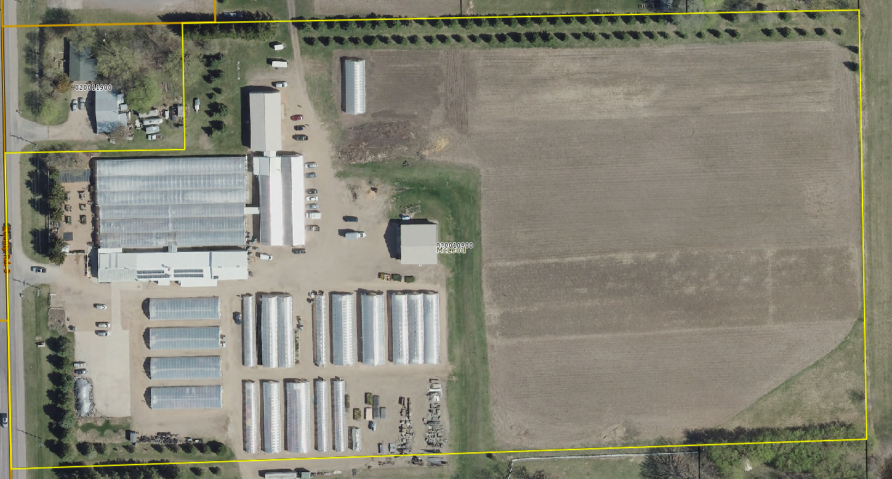
Notes:
6.78 tillable only
We have as split class – they sell product out of part of one building

Slide 32
Exception Takers
Rarely reach 10 acres – seldom qualify as a sole Ag use
Bees and Apiary Products
Honey, bee pollen, sale of the bees themselves
Acreage for bee production is the apiary footprint
Must be owners hives – not rented out
Fur Bearing Animals
Mink most common in MN
MN Statute 97A.105 states these farms must be licensed

Slide 33
Exception Takers
Insects that are primarily bred to be used as food for animals
Game Birds and Waterfowl for game farms and shooting preserves – conditional
Pheasants, Quail, Turkey, Ducks, Geese, etc.
Waterfowl – bird must be raised for use on a shooting reserve licensed under 97A.105
Notes:
Game Birds require 4 conditions
Production must take place on a game farm licensed under section 97A.105
Farm must produce at least 500 birds annually
Owner must provide the assessor annual report
Owner must provide schedule F to the assessor

Slide 34
Exception Takers continued …
Nonprofit equestrian organization – conditional
Property owned & operated by nonprofit for equestrian activities – excluding racing
Commercial Boarding of Horses – conditional
Must be on property that is also used for raising pasture to graze horses or cultivating other agricultural products
If training and giving riding instructions must be to persons that are boarding horse on the premises

Slide 35
Exception Takers continued …
Aquaculture – Conditional
Products for sale and consumption – defined under MN Statute Section 17.47 if on landed zoned for agricultural a use
Drying/Storage of Agricultural Products, Machinery or Equipment
Storage of farmers own equipment, grain or machinery
Notes:
Aquatic Farm – facility used for purpose of culturing private aquatic life in artificial ponds, vats, tanks, raceways and other indoor or outdoor facilities or fish hatcheries licensed under section 97C.211
Fish, Shellfish, Mollusks, Crustaceans, Turtles ..

Slide 36
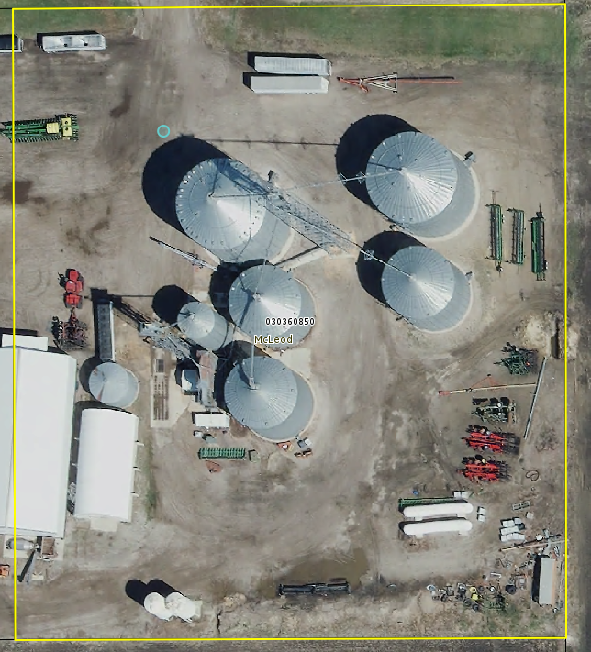

Slide 37
Conservation Programs
They can only continue 2a classification – they do not initiate
Need to be 10 acres or more in size
Qualifying Programs -
RIM – Reinvest in Minnesota
CRP – Conservation Reserve Program
CREP – Conservation Reserve Enhancement Program
WRP – Wetland Reserve Program

Slide 38
Reinvest in Minnesota
Conservation reserve program
To protect and improve water quality, reduce soil erosion, enhances wildlife habitats, flood control, and ground water recharge
It is usually perpetual
Managed by the Minnesota Board of Water and Soil Resources
Is recorded documentation
Administered by the Farm Service Agency
Enroll environmentally sensitive land
Contracts are for 10 – 15 years
Goal is to re-establish valuable land cover, improve water quality, prevent soil erosion, and reduce wildlife habitat

Slide 39
Conservation reserve enhancement program
Wetland reserve program
To establish long-term conservation and wildlife practices and protection
Land eligible
Wetlands farmed under natural conditions
Lands that become wetland due to flooding
Riparian areas
Permanent or 30 year
Expired as of 2/7/2014
Country’s largest private-land conservation program
Administered by the Farm Service Agency
Targets high-priority conservation concerns identified by a State

Slide 40
Local Conservation Programs
The Landowner must
Receive annual payments of at least $50/ acre in exchange for use or other restrictions on the land
Apply to the assessor by February 1st of assessment year
Submit information required by assessor
Copy of program requirements
Agreement between landowner and local agency
Map of the conservation area
Local conservation program – administered by a town, city, home rule charter city, or county

Slide 41
Scenario
A property owner purchased a 3-acre parcel (parcel A).
Parcel A was enrolled in the Conservation Reserve Program (CRP) at the time of purchase.
Under the previous owner, the classification of parcel A was 2a agricultural land due to the enrollment in CRP and being contiguous to agricultural parcels under common ownership.
Parcel B is 5 acres, owned by the new owner, and contiguous to parcel A.
Parcel B does not have any agricultural use.
Parcel B does not contain a structure and is not occupied.
Parcel B is platted.
Parcel B is currently classified as 4bb(1) residential non-homestead, based on the highest and best use.

Slide 42
Question – Does parcel A still qualify for the agricultural classification? If not, what should it be classified as?

Slide 43
Parcel A would not qualify for the agricultural classification because it does not meet the statutory requirements to be classified as agricultural.
Minnesota Statute 271.13, subdivision 23(f)(1) states that acreage that is less than 10 acres in size must be used exclusively in the preceding year for raising or cultivating agricultural products.
Since this parcel has been enrolled in CRP, there are no agricultural products being raised or cultivated, therefore it does not meet the statutory requirements.

Slide 44
Minnesota Statutes allows land that was at one point actively farmed and then enrolled into CRP to be considered an agricultural purpose.
However, the agricultural purposes definitions only relate to situations where there are 10 or more acres of land being used agriculturally.
The exception to the 10-acre rule mentioned above is more restrictive in that it requires the raising or cultivating of agricultural products.
Based on the information provided, it appears that parcel A would be classified in conjunction with parcel B since they are contiguous and owned by the same owner.
Therefore, it appears that the correct classification for both parcel A and B would be 4bb(1) residential non-homestead.

Slide 45
Non-production agricultural land – 2b
Land not in production – waste, woods, lakes, streams, rivers, rock piles, ravines, etc.
Need to identify and separate out these areas from the production land
2a land is production – 2b is non-production
Exceptions – if nonproduction 2b land is interspersed within the production land than it should be considered 2a. General rule – if 10 acres or more than it is practical to separate.

Slide 46
Marginal land that is not black and white if it is 2b – consider the below guidance
How interspersed is the 2b within the field
Alternate uses of the land – how feasible to till, accessible, zoning requirements
Any setbacks that would prevent it from being farmed
Could it be split off and sold separately

Slide 47
Impractical to separate – Example 1
Ross owns and farms a 360 acre parcel which is completely tilled with the exception of a private drainage ditch that goes through the center of the parcel. The acreage in the ditch and on the downslope into the ditch totals 6 acres.

Slide 48
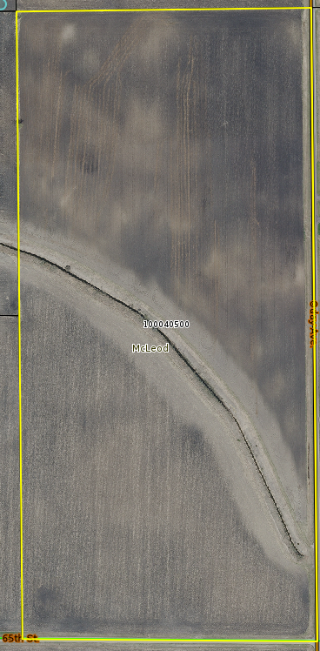
Notes:
Impractical to separate

Slide 49
Impractical to separate – Example 2
Horace owns a parcel of 2a tillable farm land that is 80 acres in size. There is a public highway along the north side of the parcel and a swamp in the southern portion of the property that is 4 acres.

Slide 50
Notes:
Impractical to separate

Slide 51
The swamp should be considered impractical to separate from the 2a productive land. The road right of way is an easements and should carry a $0 value and would not be classified as 2b. The parcel would then be entirely 2a land.

Slide 52
Impractical to separate – Example 3
Collette owns 40 acres in a suburban city.
There is 32 acres of 2a tillable. There are 3 large rock piles that are about one acre in size each.
There are also 5 acres of wooded land that is split into two parcels and each of these parcels are currently being listed for sale for residential development.
Building site areas have been cleared on each of these parcels.
Should the entire parcel be 2a land including the rock piles and woods?
Should the woods be classed residential vacant land due to the listing for sale and clearing of land?
Notes:
We would have the rocks as impractical to separate but we would separate the woods.

Slide 53
Intensive Confinement (Subd. 23. Class 2 (e)
Use of property the driving characteristic to agricultural classification
Property of any acreage used for intensive livestock or poultry confinement – 2a
Property can be homestead but may not qualify for Green Acres
Acreage must be contiguous and used during preceding year for intensive livestock or poultry confinement operation
Subjective Variable
What is intensive
What is confinement
MN statute does not define what is intensive, confinement or pasture

Slide 54
Things to look at
Does it need a feedlot permit
Animal feedlot means a lot or building or combination of lots and buildings intended for the confined feeding, breeding, raising, or holding of animals
This does not include any land used as a pasture
Is it subject to Minnesota Pollution Control Agency oversight
Rules found in Chapter 7020 in MN Administrative Rules
Animal Units
Develop schedule to use to determine whether intensive
Assessor must verify production in the preceding year
Notes:
See page 26 in manual for reference

Slide 55
Less than Ten acres Exclusively used for Agricultural Purposes and no dwelling – 273.13 subd.23 (f)(1)
Exclusively - entire parcel, border to border, used for an agricultural purpose
Cannot be split classed
Can be homestead and linked allowed by statue
Does not qualify for actively farming due to size

Slide 56
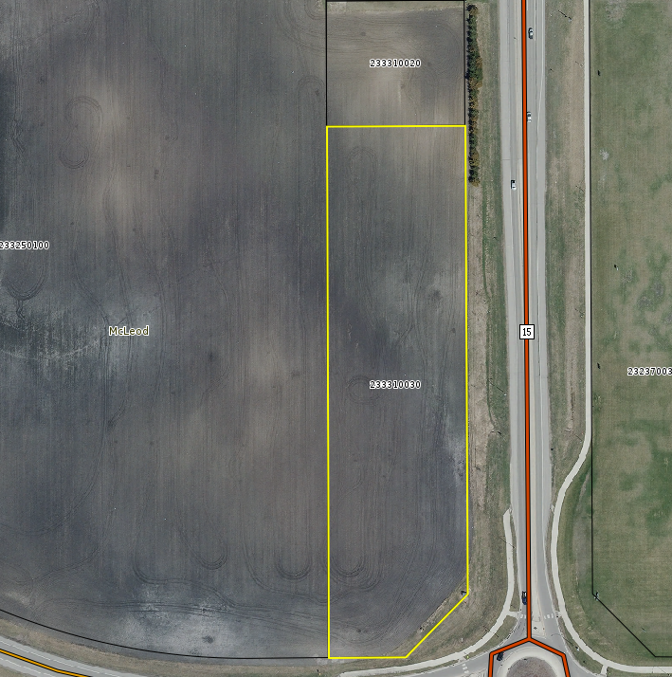

Slide 57
Less than 11 acres including a Dwelling – MN Statute 273.13 subd. 23 (f)(2)
Intensive Grain Drying, Grain Storage, Machinery or Equipment Storage
Requires same farm entity/ownership
Intensive Nursery
To produce nursery stock – not horticultural stock
Intensive Market Farming
Cultivation of fruits/vegetables or production of animal or other ag products
For sale at local markets
For sale by organization farmer is affiliated with to local market
Sell to a restaurant would not qualify

Slide 58
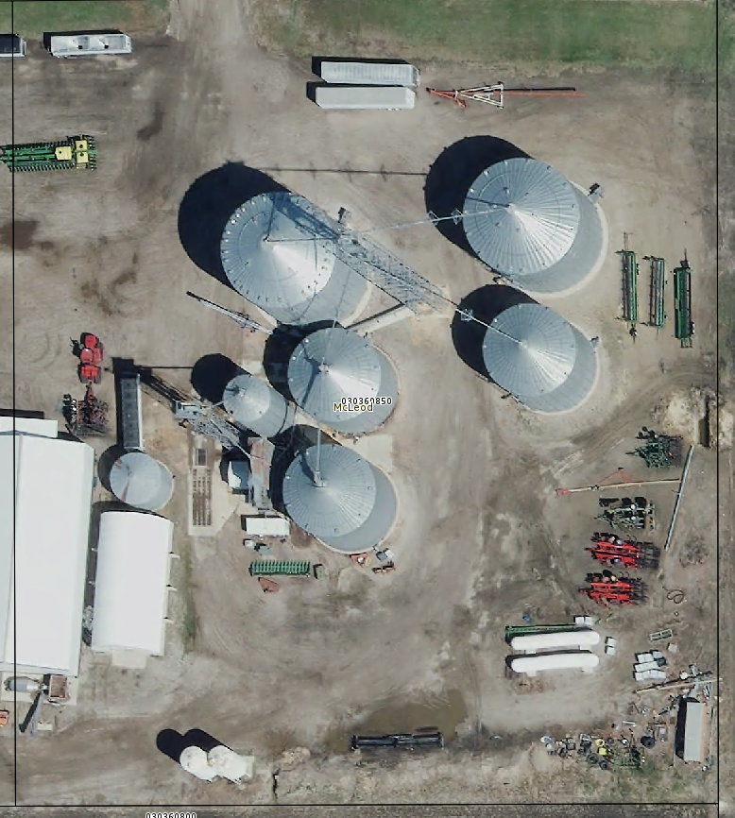
Notes:
Rented land and was ag
Now residential

Slide 59
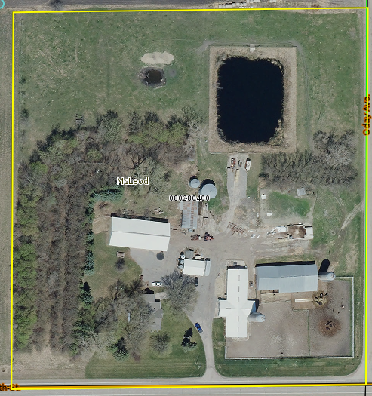
Notes:
Dairy operation

Slide 60
Scenario
The parcel is 9.02 acres and contains a homesteaded residence.
The property consists of growing apples, plums, pears and a raspberry patch.
The apples, plums, pears and raspberries were donated to a food shelf as well as sold via a stand on a friend’s property.
They estimate their profit from selling was approximately $60.
They provided a receipt for the donation that indicates they donated approximately 685 pounds of fruit to the local food shelf.
The property owner also has future plans to grow and sell cucumbers to pickle and sell to local restaurants.
Approximately .63 acres are used for fruit tree production.
Approximately .16 acres that would likely be used for a garden patch to support their intention of growing cucumbers in the future.
The property was originally classified as 1a residential homestead.
The Local Board of Appeal and Equalization has since changed the property’s classification to 2a, agricultural.

Slide 61
Question 1 – Does this property in whole or in part qualify for the agricultural classification?
From the information provided, it appears the property does not qualify for the agricultural classification.
Typically, the property must have at least 10 contiguous acres of agricultural land that is used for an agricultural purpose to qualify for the agricultural classification.
Minnesota Statute 273.13, subdivision 23(f) provides an exception to the 10-acre minimum law for parcels that are less than 11 acres, improved with a structure, and have less than 10 acres of agricultural use. To qualify for this exception, there are specific requirements that must be met.

Slide 62
The first requirement is that the agricultural acres are used in the preceding year for an intensive use.
The three intensive uses listed in statute are:
1. for an intensive grain drying or storage operation, or for intensive machinery or equipment storage activities used to support agricultural activities on other parcels of property operated by the same farming entity;
2. as a nursery, provided that only those acres used intensively to produce nursery stock are considered agricultural land; or
3. for intensive market farming; for purposes of this paragraph, "market farming" means the cultivation of one or more fruits or vegetables or production of animal or other agricultural products for sale to local markets by the farmer or an organization with which the farmer is affiliated.

Slide 63
Based on the information provided, it appears that while agricultural products are being produced, those agricultural products are not being sold to or at local markets.
Additionally, the Department of Revenue has advised assessors to consider the income generated by the agricultural production and the amount of labor required to produce the product when determining whether a property meets the requirements for intensive market farming.
Since the agricultural products are not being sold to or at a local market and the income generated is a small amount, it appears that the statutory requirements are not met, and the property cannot be classified as agricultural.
Based on the primary use of the structure the correct classification of this property is residential.

Slide 64
Question 2 – If the entire parcel doesn’t qualify for the agricultural classification, should the county split classify the property for the portions that have an agricultural use?
When a property has multiple uses, the assessor must split-classify the property according to those uses. Before an assessor can split classify, the property must first meet the requirements for the classifications that the assessor is considering.
In this scenario, the agricultural production does not meet the requirements for the agricultural classification. Therefore, a split classification would not be appropriate.

Slide 65
Classification Scenarios
Under 10 acres intensive Ag equipment storage.
Ricardo farms 1500 acres in Purple County.
He owns a parcel with a 6 acre site that has over 20,000 square feet of pole building area that contains well over a million dollars in Ag equipment.
He only rents tillable land and doesn’t own any land other than this 6 acre parcel.
What’s the correct class of the 6 acre parcel?
Notes:
Agricultural – as long as it is his own equipment in the shed

Slide 66
Classification Scenarios
A market farmer has 3.5 acres of production on a 5 acre parcel. They sell chickens grown on the property for meat and they sell produce grown in fields at a local farmers market. Their Schedule F shows $20,000 in gross income from this property last year. They are certified organic. What is the correct class?
What if they sell most of their product at a Twin Cities farmers market 150 miles away?
Does the class change if the parcel contains the homestead residence of the owner?
Notes:
We would have it intensive – they file schedule F and their gross income is significant.

Slide 67
Classification Scenarios
A 3 acre parcel that is zoned commercial has frontage on an interstate highway interchange with a traffic count of 12,000 vehicles per day. It is completely tilled and farmed every year.
What is the correct class of this parcel?
Does the classification of this parcel have an impact on how you would value the parcel?
Notes:
We would classify as ag but value as commercial – highest and best use

Slide 68
Classification Scenarios
A farmer owns a grain storage facility with a storage capacity of 200,000 bushels. He also has a separate structure on this property that processes feed for the farmers own beef cattle.
If the feed is only used for the farmers own cattle, should the feed mill be classed 3a commercial/industrial?
Notes:
All the property should be ag – since it is for his own use

Slide 69
Classification Scenarios
A 27-acre parcel has 16 acres of woods, along with a building site and 8 surrounding acres containing a residential home and 3 greenhouses.
Annual plants and vegetables are grown in the greenhouses and sold at an offsite location.
The parcel also has a small apple orchard and a small plowed area for strawberry production for personal use. The greenhouses, orchard, and strawberry field total less than ten acres.
Does the parcel qualify for agricultural classification due to the greenhouses and other fruit production?

Slide 70
Answer:
According to MN Statute 273.13, subdivision 23, paragraph f(2)(ii), contiguous acreage that is less than 10 acres can be classified as agricultural if it was used
“as a nursery, provided that only those acres used intensively to produce nursery stock are considered agricultural land.”
This would mean that only the land that is specifically used for the greenhouses may be classified as agricultural as long as all other requirements are met, and the remaining acreage does not appear to qualify for agricultural classification.

Slide 71
An owner of a property 120 acres in size cuts hay on 5 separate fields, each less than 10 acres in size but together total about 15 acres. The owner has no livestock of his own, no active pasture or other tillable land on the property, and he sells the hay to nearby ranchers.
Can the small fields of hay totaling 15 acres be combined to reach the 10-acre minimum threshold for agricultural classification?

Slide 72
Answer:
No, to qualify for the agricultural classification there must be a minimum of 10 contiguous acres used for agricultural purposes. This does not include separate fields of smaller acreage combined to equal 10 acres.

Slide 73
Owners live on a 5-acre property being used for market farming. Approximately 2 acres are being used to grow organic produce and another 2 acres is used as pasture for a mobile chicken coop. They raise 20 different types of produce and the chickens produce eggs for local market sale. The property owners provided a Schedule F for the past 2 years.
Does this property qualify for agricultural classification?

Slide 74
Answer:
Market farming is the cultivation of fruits or vegetables or production of animal or other agricultural products for sale to local markets by the farmer or an organization with which the farmer is affiliated. There is no minimum acreage or income requirement in statute. It appears, from the information provided, that this parcel would meet the qualifications to be considered for the agricultural classification.

Slide 75
There is a 4 acre parcel of vacant land within city limits that is being marketed currently for commercial use, but currently it is tilled with alfalfa (border to border) by a local horse owner (not the owner of the land), who hays the land and uses 75% of the crop for his horses, but sells the rest to other horse or cattle owners. No rent changes hand between the owner of the land and the horse owner taking the alfalfa.
Does this parcel qualify for the agricultural classification?

Slide 76
Answer:
Based on the current use of the property, this parcel would qualify for the
agricultural classification. Zoning is considered when an assessor is reviewing the highest and best use of the vacant property. Because at least some of the crop is being sold for animal feed, that satisfies the requirement that the product must be sold.
If the hay was strictly used for pet horse feed for the operator and not sold, this parcel would not be Ag.

Slide 77
An 80 acre property is used by the owners to harvest and process forestry products,
including firewood, logs, live edge slabs, lumber, saw logs and woodchips. The owners
believe that this qualifies them for agricultural classification. Should this property qualify?

Slide 78
Answer:
Even though MN Statute 273.13 subdivision 23 mentions trees as an agricultural crop, trees are defined as “grown for sale as a crop, including short rotation woody crops, and not sold for timber, lumber, wood, or wood products…”
Therefore, this parcel would not qualify for the agricultural classification, and should be split classified as commercial and either rural vacant land or managed forest land if the owner qualifies and if his/her application is approved.
It should be noted that the commercial classification would be limited to 10 acres around the building site that includes the sawmill and/or firewood processing area.
As with any commercial or industrial split classification in a rural setting, care must be taken to identify the amount of income producing activity and if that meets the threshold of a commercial or industrial property tax classification in your county.

Slide 79
Swine confinement barns are owned by a person who does not own the livestock, which contain both nursery and finishing hogs. The owner of the hog barn is considered the caretaker and a custom feeder, for which the livestock owner compensates her. She is raising the nursery and finishing hogs to market weights, when they will be delivered to slaughter plants.
What is the classification of the swine confinement barns, given that the owner does not own the livestock?

Slide 80
Answer:
It appears the swine confinement barns should be classified as agricultural. Swine confinement would appear to be a part of raising an agricultural product, which would then qualify it as an agricultural purpose, per MN Statute 273.13, subdivision 23(i).
Statute restricts the origins of production when an agricultural product is stored or dried, however swine confinement would not appear to be defined as storage.

Slide 81
A property owner resides on a 25 acre parcel. 10 acres are classified as residential
homestead and 15 acres are classified presently as rural vacant land. All of the land is used to tap maple trees to produce sap for maple syrup, and the owner has a wholesale food processing license from the Minnesota Department of Agriculture.
Should the owner’s property be classified as agriculture?

Slide 82
Answer:
For any property used to produce maple syrup to qualify for the agricultural
classification under MN Statute 273.13, there must be 10 contiguous acres or more used during the preceding year for production for sale of an agricultural product.
To be an agricultural product, maple syrup must be “taken from trees grown by a person licensed by the Minnesota Department of Agriculture under chapter 28A as a food processor.”
Since both qualifications are met, the property qualifies for agricultural classification. Keep in mind that a commercial split classification may be necessary if the processing and bottling of the syrup occurs on the property. In some areas, the sap may be hauled miles on trucks to a larger scale processing facility that may take in sap from other producers.

Slide 83
Questions?

Slide 84
Agricultural Homestead

Slide 85
T
H
E
B
A
S
I
C
S
Ownership
The first element to determining whether a property qualifies for homestead.
Multiple owners
Multiple types of ownership options

Slide 86
Individual Ownership
Sole owner
Married couples
Siblings
Unrelated individuals
Ownership

Slide 87
Entity Ownership
Limited partnerships
Limited liability partnerships
Limited liability companies
Trusts
Corporations
Member/Partner/Shareholder
Ownership

Slide 88
Entity Ownership
Family Farm
Must be registered with Dept. of Ag
Ownership

Slide 89
Ownership

Slide 90
Trust Ownership
Trustee, Grantee, Beneficiary not eligible for homestead
Type of trust does not matter
Grantor = Owner
Trusts are entities
Relative of grantor is eligible
Ownership

Slide 91
Occupant must be a Minnesota Resident
Occupant can be a relative to the owner/grantor
Requirements for occupied ag homestead are minimal
Occupant cannot claim another ag homestead
If relative, only one per family
Not occupied = special agricultural homestead
Occupancy

Slide 92
Linkage
Starts at the home – base parcel
Closest parcel should be linked first
All parcels need to be within 4 township/cities of the base parcel
Multiple owners – watch percentages on deed
Multiple types of ownership options – not all can be linked
Example – if base parcel in corporations, LLC, LLLP, ect. it cannot be linked to property in their own name
If base parcel is in their own name can be linked to parcels in corporations, LLC, LLLP, ect. up to the tier limit
Base parcel ownership must be shareholder in the corporations, LLC, LLLP etc.

