Slide 1
Special Agricultural Homestead

Slide 2
Special Agricultural Homestead
Basic Requirements
Agricultural Property is at least 40 acres
Cannot claim another agricultural homestead in MN
Must live w/in four cities/townships of the agricultural property.
Owner and farmer, when applicable.
Must be a MN resident

Slide 3
Special Agricultural Homestead
Individually Owned
Who is farming?
Qualifying person
Owner/owner’s spouse
Qualifying relative of the owner
Farmer must live w/in 4 cities/townships
Must be actively farming the property
If an entity is farming – owner or relative must be a member

Slide 4
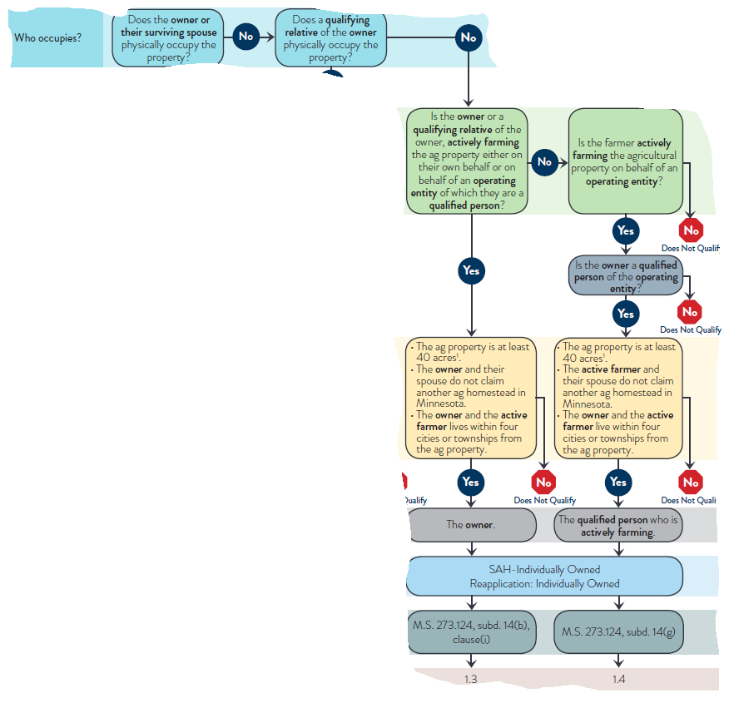
Special Agricultural Homestead

Slide 5
Special Agricultural Homestead
Entity Owned
Qualified person of the entity is the applicant
Percentage of ownership interest does not matter
Family farm entities must have 12 or fewer members
Spouses are not automatically a separate member
Entities do not have relatives
Qualified person of the owning entity must be actively farming
Up to 12 active farmers can establish separate ag homesteads for the entity

Slide 6
Special Agricultural Homestead
Entity Owned – 12 Full Homesteads
Each active farmer must apply and meet the requirements
No fractional homestead
Example: Entity A owns, 6 members and all 6 are active farmers.
Each member submits an application and meets the requirements.
Each member qualifies for a full ag tier at .5% class rate

Slide 7
Special Agricultural Homestead
Entity Owned
2019 law change
Property can be owned by one entity and operated by another entity
Requirements
Active farmer is a member of both entities
Both entities must be family farms and registered with MDA

Slide 8
Special Agricultural Homestead
Scenario
Entity A owns five 80-acre agricultural parcels
Entity B operates the parcels
Members of Entity A are Dad, Son, Daughter
Members of Entity B are Son and Cousin
Son is listed as the active farmer for Entity B
Son lives near all 5 parcels
Son does not claim another ag homestead
Son has submitted a homestead application for all five parcels
Notes:
Yes they qualify for special ag

Slide 9
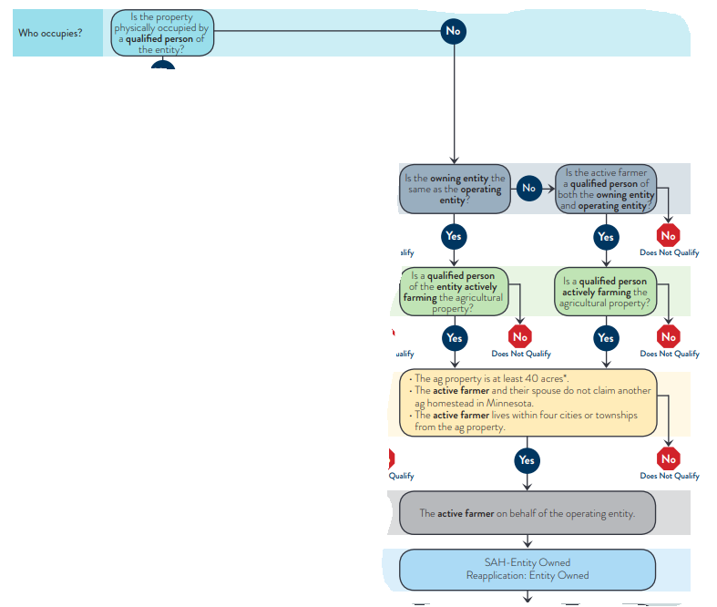
Special Agricultural Homestead

Slide 10
Special Agricultural Homestead
Trust Owned
Very similar to individually owned
Grantor must meet the requirements for special ag homestead
Grantor/Trustor is the person(s) who created the trust
Farmer/operator must also meet requirements
If an entity is operating, grantor must be a member of the entity

Slide 11
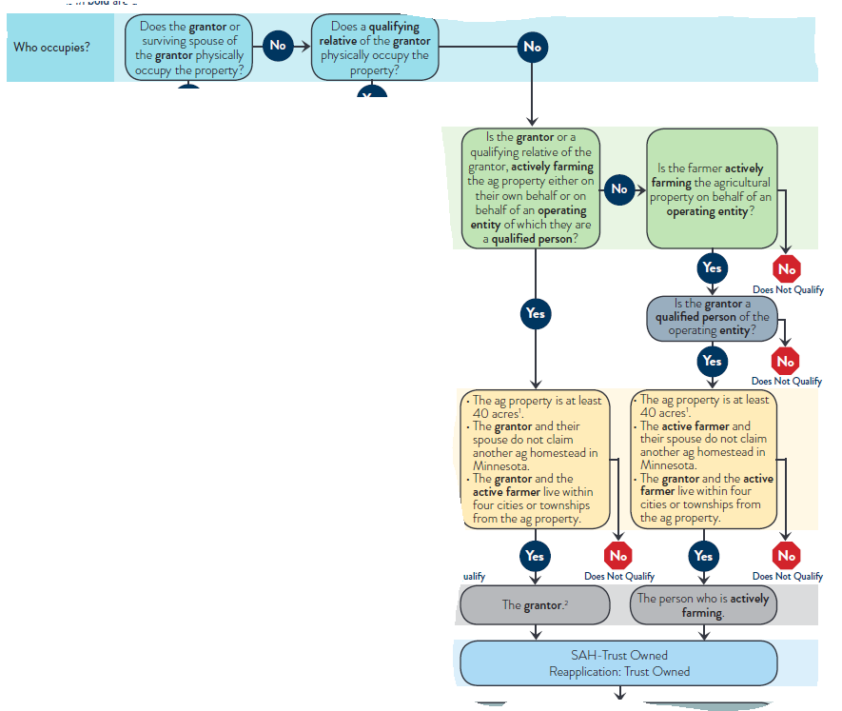
Special Agricultural Homestead

Slide 12
Operation of the Farm
How do you administer actively engaged in farming? Policies in Place?
Actively Farming
273.124 sub 14
Full Participation
Actively Engaged in Farming
273.124 sub 8
Entity owned and occupied
Day to Day Decisions
Labor
Administration and Management
Financial Risk
Less participation
Decision making
Administration and Management
Some labor

Slide 13
Establishing Special Ag Homestead
EMP – established main parcel
This is the parcel where the homestead is established/begins
Property owner can choose where they want to establish, they cannot rescind once its established.
EMP is established, then link to other parcels
Rule of thumb:
Establish First – use flowcharts
Link second – use checklist

Slide 14
Establishing Special Ag Homestead
Applications
Do not use as a checklist, use as a data collection tool
Assessors must verify information in addition to collecting applications
Income tax forms and FSA forms are not required by statute, counties are allowed to require it per policy
Assessors must use the application that is created by Revenue
Applications were updated in 2019

Slide 15
Establishing Special Ag Homestead
Re-Applications
Required for all unoccupied special agricultural homestead properties
Assessors must use the one-page application that is created by Revenue.
Re-applications were updated in 2020
Re-applications are used only when there have been no changes to the property
Ownership, farmer, sales etc…
If something has changed, a new application should be submitted

Slide 16
Establishing Scenarios
Scenario:
The Stone Family Farm Partnership consists of a mother, father, son, and daughter.
The Stone Family Farm Partnership owns a 350-acre farm.
The daughter and her husband farm the land held by the partnership but do so through a family farm corporation in which they are the only shareholders.
No one lives on the farm.
The daughter and son-in-law live in a residential property that is within four townships of the farm.
All are Minnesota residents.
Question: Does this property qualify for agricultural homestead?

Slide 17
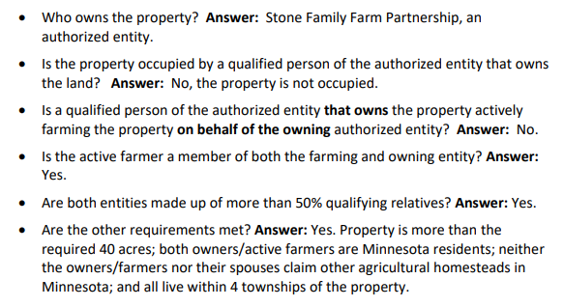
Establishing Scenarios

Slide 18
Linking Special Ag Homestead
Extending homestead benefits from the EMP to non-contiguous ag parcels
Ownership is important!
Cannot link EMP to parcels with different ownership*
Must qualify for the agricultural classification before linking
Notes:
Emp established main parcel

Slide 19
Linking Special Ag Homestead
Individual Ownership
Owner A can link to parcels owned by Owner A and Owner B
Trust Ownership
Owner A can link to Owner A Trust (assuming Owner A is the grantor)
This includes spouses
Spouse 1 Trust (spouse 1 is grantor) can link to Spouse 2 Trust (spouse 2 is grantor).
*Exception to the Rule

Slide 20
Linking Special Ag Homestead
Other Requirements – each parcel must meet these requirements
Same Ownership
A qualified person must be farming the land
40 acres
Owner/grantor and farmer must live w/in 4 cities/twps
EMP is operated by an entity, then non-contiguous parcels must be operated by that same entity

Slide 21
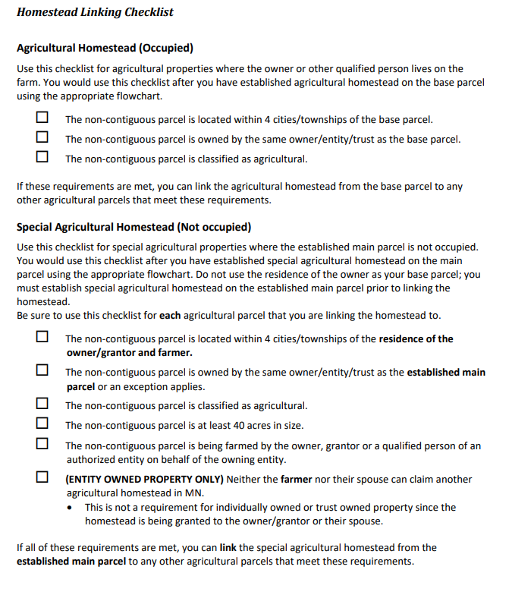
Linking Special Ag Homestead
Found on page 74 of Module 4

Slide 22
Linking Scenarios
Finding the answer:
Step 1: Review where the owners live
Step 2: Verify that the non-contiguous parcels are located w/in 4 cities/townships of their residence
Step 3: Determine the EMP, review flowchart to verify all requirements are met.
Step 4: Once special ag homestead is established, then review the remaining parcels for linking. Use the checklist for each parcel.
Answer: EMP qualifies, the remaining parcels would qualify through linking.

Slide 23
Linking Scenarios
Scenario:
XYZ LLLP owns five parcels of non-contiguous agricultural property
All five parcels are unoccupied.
XYZ is made up of 3 shareholders: Jim, Joe, and Sarah.
Parcels 1–3 are farmed by Jim, a qualified person of the entity.
Parcels 4 & 5 are farmed by Joe, a qualified person of the entity.
Both farmers live in town which is within 4 cities/townships of the five parcels.
Neither of the farmers or their spouses claim another ag homestead
Question: Which of these parcels qualify for special agricultural homestead?

Slide 24
Linking Scenarios
Finding the answer:
Step 1: Must establish if qualify for special agricultural first, then link.
Things to consider: number of farmers and number of possible homesteads for this entity.
Step 2: Once EMP is established, now review parcels for linking
Notes:
Pull up admin manual for answer, page 77

Slide 25
Linking Scenarios
• Who owns: XYZ LLLP.
• Who occupies: Property is unoccupied.
• Who farms: Jim, a qualified person of the authorized entity on behalf of XYZ LLLP.
• Is the ag property at least 40 acres: Yes.
• Does the qualified person who is actively farming claim another ag homestead in MN: No.
• Does the qualified person who is actively farming live within 4 cities/townships of the property: Yes.
Since all requirements have been met, parcel 1 qualifies for special agricultural homestead.
Notes:
Pull up admin manual for answer, page 77

Slide 26
Linking Scenarios
Now that special agricultural homestead has been established on the established main parcel (parcel 1), we can now review parcels 2-3 for special agricultural homestead linking.
Using the checklist, all the requirements must be met for parcels 2–3.
The non-contiguous parcel is located within 4 cities/townships of the residence of the farmer.
The non-contiguous parcel is owned by the same owner as the established parcel.
The non-contiguous parcel is classified as agricultural.
The non-contiguous parcel is at least 40 acres in size.
The non-contiguous parcel is being farmed by a qualified person.
Neither the farmer nor their spouse is claiming another agricultural homestead in MN.
Jim, the active farmer would receive the homestead.
Notes:
Pull up admin manual for answer, page 77

Slide 27
Linking Scenarios
Parcels farmed by Jim (Parcel 4)
• Who owns: XYZ LLLP.
• Who occupies: Property is unoccupied.
• Who farms: Joe, a qualified person of the authorized entity on behalf of XYZ LLLP.
• Is the ag property at least 40 acres: Yes.
• Does the qualified person who is actively farming claim another ag homestead in MN: No.
• Does the qualified person who is actively farming live within 4 cities/townships of the property: Yes.
Since all requirements have been met, parcel 4 qualifies for special agricultural homestead.
Notes:
Pull up admin manual for answer, page 77

Slide 28
Linking Scenarios
Now that special agricultural homestead has been established on the established main parcel (parcel 4), we can review parcel 5 for special agricultural homestead linking.
The non-contiguous parcel is located within 4 cities/townships of the residence of the farmer.
The non-contiguous parcel is owned by the same owner as the established parcel.
The non-contiguous parcel is classified as agricultural.
The non-contiguous parcel is at least 40 acres in size.
The non-contiguous parcel is being farmed by a qualified person.
Neither the farmer nor their spouse is claiming another agricultural homestead in MN
The requirements for special agricultural homestead linking have been met, therefore the homestead can be linked from parcel 4 to parcel 5.
Notes:
Pull up admin manual for answer, page 77

Slide 29
The Exceptions to the Rule
Exclusive | Intensive
Less than 10 acres | Less than 11 acres
Entire parcel, border to border | Ag use and residential use
No structure on the parcel | Has a residential structure
Only can qualify for homestead if contiguous to other ag land | Only 4 intensive ways to use the property for it to qualify
Non-contiguous parcels do not qualify | Can qualify for occupied ag homestead
Discussion: when does exclusive and intensive get difficult to administer? What kind of examples/scenarios from your county could you share with us?

Slide 30
The Exceptions to the Rule
Agricultural Relative Homesteads
Property must be occupied and used for the purpose of a homestead by the relative
Qualifies the occupied parcel, contiguous parcels, and non-contiguous parcels
Requirements:
Grandchild, child, sibling, or parent – could be extended in 2021 session
Owner is a MN resident
Neither owner nor their spouse claim another ag homestead
The owner is limited to one ag homestead per family

Slide 31
The Exceptions to the Rule
Agricultural Relative Homesteads
HGA could qualify for residential relative homestead, land then goes to special ag homestead
Relative ag homesteads do not qualify for PTR, they do qualify for the credit
One ag homestead per family
Only individually owned and trust owned qualify
Entities DO NOT have relatives for homestead purposes
Discussion: What does that mean to you? How do you administer one per family in your county?

Slide 32
The Exceptions to the Rule
Value Tier Linking – linking entity owned land when ownership differs.
Non-homestead ag land owned by an entity
Member has an individual & occupied ag homestead parcel located within 4 cities/townships
Member has left over ag tier value from base parcel
Link the remaining ag tier value to entity owned ag land
Not linking homestead benefits, classification is still ag non-homestead
Discussion: How does this work in your county? What scenarios can you share with the group?

Slide 33
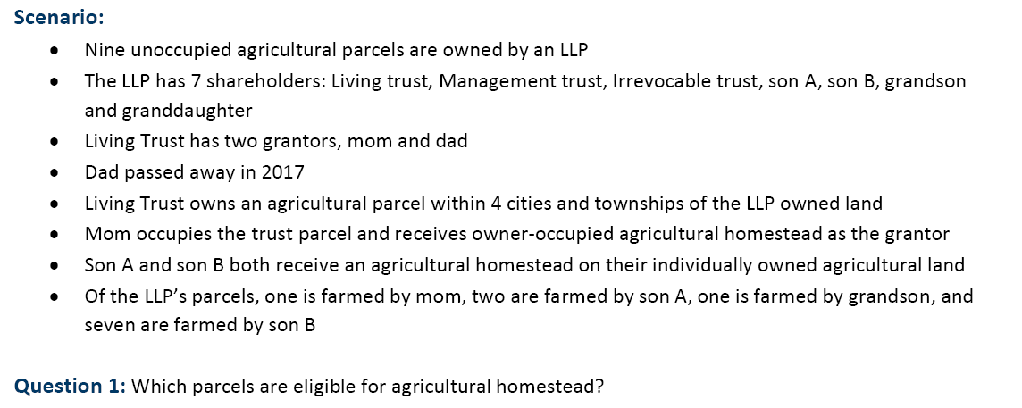
The Exceptions to the Rule
Value Tier Linking – Scenario

Slide 34
The Exceptions to the Rule
Value Tier Linking – Scenario

Slide 35
The Exceptions to the Rule
Fractional Homesteads
Multiple Owners
Evaluate each owner separately
Ownership structure matters with ag land
Number of owners vs percentage of ownership interest
Tenants in Common – deeded interest. Does not apply to spouses.
Joint Tenancy – number of owners

Slide 36
The Exceptions to the Rule
Contiguous Parcels
Ag homestead purposes – contiguous parcels are all included
Parcels must be owned by the same person(s)
Multiple owners can make this difficult
Ownership of each parcel must be exactly the same
No exception for partial linking for contiguous parcels

Slide 37
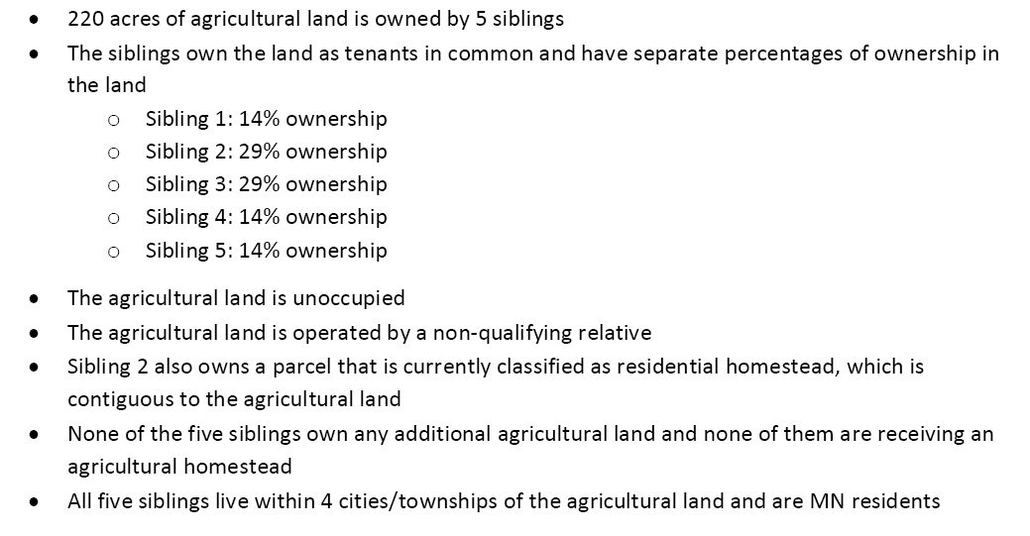
The Exceptions to the Rule
Contiguous Parcels - Scenario
220 acres – owned by 5 siblings
Res Hmstd
Notes:
2020064

Slide 38
The Exceptions to the Rule
Contiguous Parcels - Scenario
Question 1: Can the parcel owned by sibling 2 be classified as agricultural and qualify for a fractional agricultural homestead due to the contiguous agricultural land?
Question 2: If sibling 2 qualifies for an owner-occupied agricultural homestead, can the other 4 siblings qualify for an agricultural relative homestead?

Slide 39
The Exceptions to the Rule
Contiguous Parcels – Scenario – Question 1

Slide 40
The Exceptions to the Rule
Contiguous Parcels – Scenario – Question 2

Slide 41
Additional Scenarios

Slide 42
Entity A owns farmland and is composed of Mom, Dad, Son 1, Son 2, Daughter 1, and Daughter 2
Entity B is listed by the Farm Service Agency (FSA) as the operator of the property and is composed of the same members
Daughter 2 is no longer farming any of the property
Daughter 2’s husband assists with the operation of the farm and is actively farming the entity owned agricultural land
Question: Is the daughter’s husband able to qualify property that he is farming for special agricultural homestead?
Notes:
2020007

Slide 43
Answer:
No. In order to establish special agricultural homestead for entity-owned property, a qualified person of the farming entity must be actively farming the land. In this situation, daughter 2’s husband is not a qualified person of either entity, and would not be able to establish special agricultural homestead. Therefore, the entity would only be allowed to establish up to four full special agricultural homesteads, one for each member who is actively farming, if all other requirements are met. Please note that because the owning and operating entities are different, daughter 2’s husband would need to be a member of both entities in order to establish special agricultural homestead.

Slide 44
A married couple jointly owned 22 parcels of land
The husband recently passed away
“Tract A” consists of 120 acres, including the home where the wife lives
Tract A has been split into three separate parcels with different ownership:
Parcel 1: 6 acres, the wife fully owns and occupies, is not used for intensively agricultural production
Parcel 2: 15 acres, owned 50% by the wife, 25% by son A, and 25% by son B
Parcel 3: 99 acres, owned 50% by the wife and 50% by Family Trust
All three parcels are contiguous to each other
The husband and wife are the sole grantors of the family trust
Son A owns and occupies his own agricultural homestead
Son B lives in town, he owns and farms agricultural land and is receiving a special agricultural homestead
Both sons live within four cities or townships of the parcels in question
Notes:
2019098

Slide 45
Question 1:
Does parcel 1 qualify for the agricultural classification?

Slide 46
Answer:
No. Minnesota Statutes 273.13, subdivision 23(e) states that agricultural land must consist of “contiguous acreage of ten acres or more”, or acreage used for intensive or exclusive use. Contiguous acreage is further defined as “all of, or a contiguous portion of a tax parcel…or…a set of contiguous tax parcels…that are owned by the same person” (emphasis added). There are no exceptions within 273.13 that allow partial ownership or trust ownership to be considered the same as individual ownership. Since parcels 2 and 3 both have different ownership structures than parcel 1, they cannot be included when determining the acreage of parcel 1.
Therefore, parcel 1 would not meet the agricultural classification requirements and would not be able to receive an owner-occupied agricultural homestead. The parcel would be able to receive a residential homestead if all other conditions are met.

Slide 47
Question 2:
How should homestead be administered on parcels 2 and 3?

Slide 48
Since parcel 2 and 3 are unoccupied, special agricultural homestead will need to be established on each parcel.
Remember, homestead must be established before any linking may take place.
Parcel 3:
50% owned by wife: if all requirements are met, it would qualify for 50% special agricultural homestead.
50% owned by Family Trust: if all requirements are met, it would qualify for 50% special agricultural homestead.
As long as all requirements are met, parcel 3 would receive a full special agricultural homestead going to the wife; she is the sole owner of her 50% share, and the grantor/surviving spouse of the grantor of Family Trust
Since the wife is receiving a special agricultural homestead on parcel 3, she would be able to link to any other agricultural parcels that she and/or the trust owns, assuming that all linking requirements are met. Minnesota Statute 273.124, subdivision 21(f) allows the grantor of a trust to link homestead with their individually owned land and vice-versa.

Slide 49
Parcel 2:
No one can currently establish occupied agricultural homestead on parcel 2 because the parcel is not occupied.
No one can establish special agricultural homestead on parcel 2 because each owner is already receiving an agricultural homestead and the parcel contains fewer than 40 acres.
Son A could link to his 25% ownership of parcel 2 from his agricultural base parcel that he occupies, assuming all linking requirements are met.
Son B would not be able to link from his established main parcel to parcel 2 due to the unoccupied linking requirement that the noncontiguous parcel is at least 40 acres.
According to the information provided, it appears parcel 2 would qualify for a 75% special agricultural homestead, with the other 25% classified as agricultural non-homestead.
Neither son would be able to link to any Family Trust-owned land regardless of its homestead status. When establishing or linking agricultural homestead for property owned by trusts, the grantor of the trust and the spouse of the grantor are considered the owners. The beneficiaries of the trust are not considered to have ownership interest.

