Slide 1
FAIR FARM RENTAL AGREEMENT AND AG UPDATE
Nathan Hulinsky
huli0013@umn.edu

Slide 2
agenda
Land Rent
Net Farm Income
Current Topics

Slide 3
What is a Fair Farmland Rental Rate Agreement for 2022?
Notes:
Welcome to Today’s workshop to help you in the process of determining what is a fair farmland rental rate for 2016

Slide 4
Agricultural Business Management Team Website: http://www.extension.umn.edu/agriculture/business/ Go to University of Minnesota Extension website Select Agriculture Select Agricultural Business Management You will find useful information on: Rental rates, Crop budgets and Farm Bill
Notes:
Our ABM team has a website that has the majority of the information presented today under the Land Economics tab. Everything you see today can also be found in the 2017 farm resource guide that will be available in January.

Slide 5
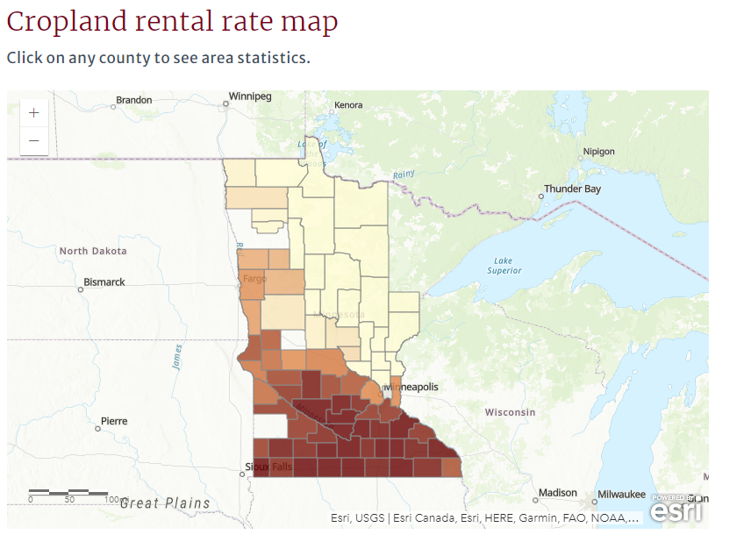

Slide 6
Cropland Rental Rates for Minnesota Counties
Prepared by:
David Bau, Extension Educator, Extension Regional Office, Worthington
Dale Nordquist, Rann Loppnow and Pauline Van Nurden - Center for Farm Financial Management, U of MN
8/2021
Center for Farm Financial Management: http://www.cffm.umn.edu/
Here you will find county farmland rental information under Publications,
Farm Management,
County Rental.
Notes:
Annual rent publication

Slide 7
Cropland Rental Rates – FINBIN
 | Average |  |  |  | 2020 |  |  |  | 2021 | 2022
 | 2016 | 2017 | 2018 | 2019 | Avg | Median | 10th Pctile | 90th Pctile | NASS Data | Est.
West Central
Big Stone | n/a | n/a | n/a | n/a | n/a | n/a | n/a | n/a | 158 | _____
Chippewa | n/a | n/a | n/a | 206 | n/a | n/a | n/a | n/a | 200 | _____
Douglas | 107 | 119 | 122 | 122 | 131 | 108 | 50 | 175 | 110 | _____
Grant | 178 | 193 | 182 | 187 | 181 | 144 | 63 | 204 | 176 | _____
Lac qui Parle | n/a | n/a | n/a | n/a | n/a | n/a | n/a | n/a | 164 | _____
Otter Tail | 120 | 110 | 112 | 110 | 115 | 117 | 50 | 156 | 86 | _____
Pope | 134 | 141 | 140 | n/a | n/a | n/a | n/a | n/a | 143 | _____
Stevens | n/a | n/a | n/a | n/a | n/a | n/a | n/a | n/a | 163 | _____
Swift | n/a | n/a | n/a | 120 | 148 | 150 | 108 | 219 | 188 | _____
Traverse | n/a | n/a | n/a | n/a | n/a | n/a | n/a | n/a | 182 | _____
Wilkin | 133 | 134 | 132 | 129 | 139 | 127 | 87 | 165 | 133 | _____
Yellow Med. | n/a | n/a | n/a | n/a | n/a | n/a | n/a | n/a | 196 | _____

Slide 8
Cropland Rental Rates – FINBIN
 | Average |  |  |  | 2020 |  |  |  | 2021 | 2022
 | 2016 | 2017 | 2018 | 2019 | Avg | Median | 10th Pctile | 90th Pctile | NASS Data | Est.
Central
Benton | 113 | 103 | 109 | 103 | 117 | 89 | 53 | 149 | 95 | _____
Carver | 202 | 197 | 174 | 172 | 192 | 200 | 130 | 254 | 209 | _____
Kandiyohi | 220 | 229 | 212 | 211 | 215 | 205 | 160 | 251 | 213 | _____
McLeod | 188 | 209 | 211 | 201 | 199 | 192 | 99 | 236 | 219 | _____
Meeker | 176 | 179 | 181 | 178 | 187 | 193 | 128 | 226 | 190 | _____
Morrison | 97 | 82 | 82 | 112 | 94 | 85 | 37 | 151 | 88 | _____
Renville | 222 | 217 | 215 | 190 | 214 | 219 | 175 | 259 | 220 | _____
Scott | 206 | 191 | 183 | 190 | 188 | 175 | 113 | 234 | 199 | _____
Sherburne | n/a | n/a | n/a | n/a | n/a | n/a | n/a | n/a | 54 | _____
Sibley | 252 | 237 | 232 | 219 | 220 | 216 | 169 | 259 | 250 | _____
Stearns | 183 | 169 | 162 | 150 | 170 | 160 | 79 | 245 | 152 | _____
Todd | 67 | 66 | 74 | 76 | 75 | 64 | 28 | 107 | 80 | _____
Wadena | n/a | n/a | n/a | n/a | n/a | n/a | n/a | n/a | 35 | _____
Wright | 154 | 146 | 172 | 161 | 161 | 167 | 83 | 200 | 177 | _____

Slide 9
Cropland Rental Rates Trends
Percent Change in Land Rental Rates | 2016-2020 | 2019-2020
Northwest | 3.2% | 3.5%
North Central | n/a | n/a
West Central | 6.2% | 4.6%
Central | -3.6% | 2.6%
East Central | 27.6% | 2.1%
Southwest | -4.1% | 1.3%
South Central | -5.2% | 1.3%
Southeast | -7.5% | -0.7%

Slide 10
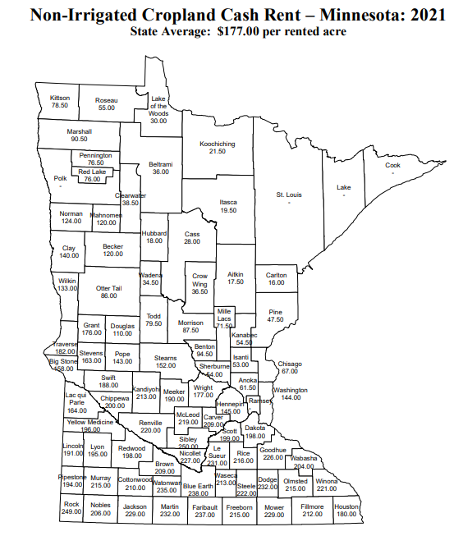
Cropland Rental Rates – USDA

Slide 11
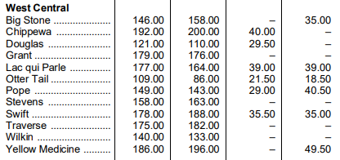
Cropland Rental Rates – USDA

Slide 12
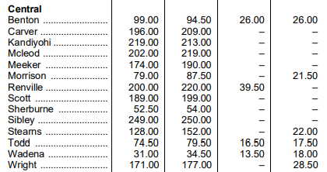
Cropland Rental Rates – USDA

Slide 13
CRP Rates
State | County | 2020 | 2021
Minnesota | Benton | 93 | 99
Minnesota | Douglas | 133 | 121
Minnesota | Grant | 167 | 179
Minnesota | Morrison | 71 | 79
Minnesota | Polk | 109 | 113
Minnesota | Stearns | 134 | 128
Minnesota | Todd | 65 | 75

Slide 14
2022 Crop Budgets
FINBIN Data
www.finbin.umn.edu

Slide 15
Corn Budget
Corn | 10 Year Ave | 2021 Actual | 2022 Projected | Your Farm
Yield | 166.53 | 138.32 | 170
Price | $ 3.90 | $ 5.31 | $ 6.00
Total Production Return/Acre | $ 649 | $ 734 | $ 1,020
Misc Income/Acre | $ 54 | $ 104 | $ 35
Gross Income (with other income) | $ 704 | $ 838 | $ 1,055
Expenses
Seed | $ 99 | $ 94 | $ 105
Fertilizer | $ 126 | $ 128 | $ 250
Chemicals | $ 30 | $ 33 | $ 50
Crop Insurance | $ 20 | $ 23 | $ 25
Fuel & Machinery | $ 158 | $ 153 | $ 190
Other | $ 88 | $ 78 | $ 90
Total Expenses | $ 521 | $ 508 | $ 710
Available for Rent & Farmer Return | $ 182 | $ 331 | $ 345
Land Rent (area avg) | $ 153 | $ 152 | ?
Net Income | $ 30 | $ 179 | ?

Slide 16
Soybean Budget
Soybeans | 10 Year Ave | 2021 Actual | 2022 Projected | Your Farm
Yield | 44.79 | 39.21 | 42
Price | $ 9.99 | $ 12.26 | $ 14.00
Total Production Return/Acre | $ 447 | $ 481 | $ 588
Misc Income/Acre | $ 36 | $ 44 | $ 30
Gross Income (with other income) | $ 484 | $ 525 | $ 618
Expenses
Seed | $ 55 | $ 48 | $ 60
Fertilizer | $ 24 | $ 24 | $ 50
Chemicals | $ 39 | $ 47 | $ 75
Crop Insurance | $ 17 | $ 18 | $ 20
Fuel & Machinery | $ 93 | $ 93 | $ 150
Other | $ 41 | $ 38 | $ 50
Total Expenses | $ 270 | $ 268 | $ 405
Available for Rent & Farmer Return | $ 214 | $ 257 | $ 213
Land Rent (area avg) | $ 144 | $ 147 | ?
Net Income | $ 70 | $ 110 | ?
Notes:
Labor is less for soybean in budget as less bushels to handle, used $35 for soybeans. At 49 bushels a farmer needs $8.16 per bushel to cover direct costs of $400, $9.67 to cover direct and overhead costs of $474 per acre, add labor and price increases to $10 .39 and after government payments & other income it lowers to $10.18.

Slide 17
Spring Wheat Budget
Spring Wheat | 10 Year Ave | 2020 Actual | 2022 Projected | Your Farm
Yield | 50.5 | 49.64 | 53
Price | $ 5.81 | $ 8.48 | $ 11.00
Total Production Return/Acre | $ 293 | $ 421 | $ 583
Misc Income/Acre | $ 43 | $ 35 | $ 35
Gross Income (with other income) | $ 336 | $ 456 | $ 618
Expenses
Seed | $ 25 | $ 24 | $ 30
Fertilizer | $ 74 | $ 88 | $ 200
Chemicals | $ 22 | $ 31 | $ 50
Crop Insurance | $ 8 | $ 5 | $ 12
Fuel & Machinery | $ 87 | $ 71 | $ 125
Other | $ 35 | $ 18 | $ 40
Total Expenses | $ 251 | $ 238 | $ 457
Available for Rent & Farmer Return | $ 85 | $ 217 | $ 161
Land Rent (area avg) | $ 114 | $ 131 | ?
Net Income | $ (28) | $ 87 | ?

Slide 18
Markets
Sources:
Central grain and mgex

Slide 19
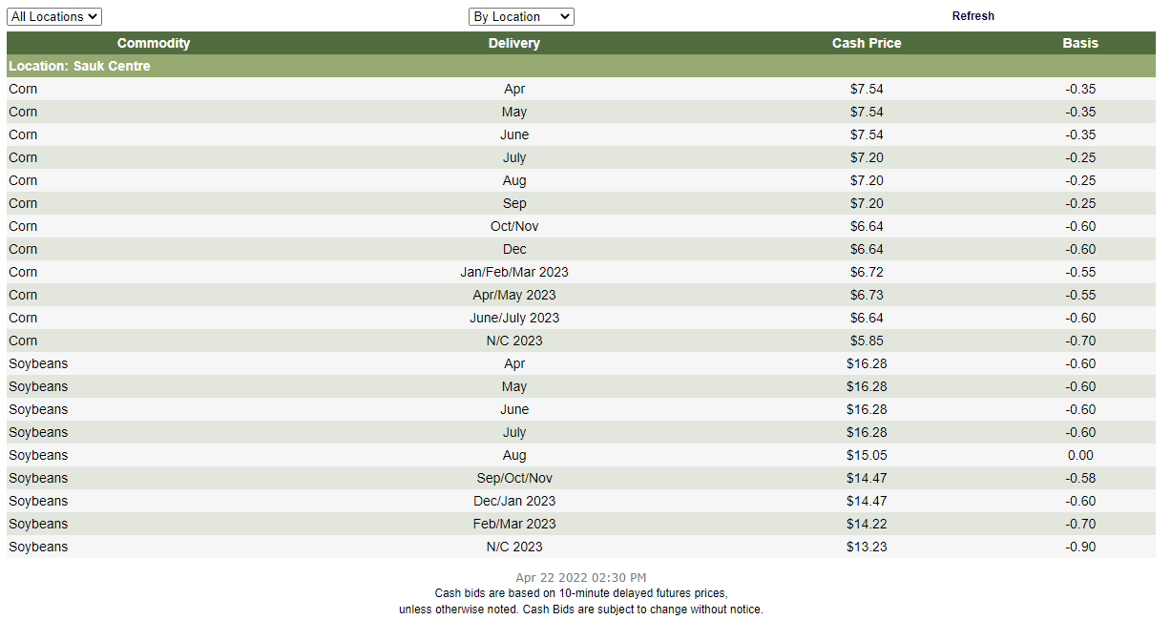
Central Grain Sauk Centre

Slide 20
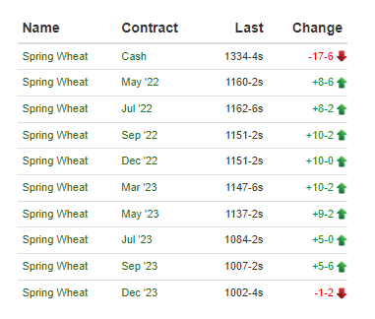
MGEX 4/22/2022

Slide 21
Input Cost Trends
Notes:
There is a definite trend in increasing input costs.

Slide 25
Acceptable Price Worksheet
Notes:
This worksheet helps a farmer determine a breakeven price for their marketing plans.

Slide 26
ACCEPTABLE PRICE WORKSHEET 2022
 | CORN |  | SOYBEANS
CROP INCOME | EXAMPLE | YOUR FARM | EXAMPLE | YOUR FARM
(A) Crop Acres | 400 |  | 400
(B) Yield Bushels/Acre | 180 |  | 50
(C) Price $/Bushel | 3.25 |  | 9.00
(D) Government Payments | 30 |  | 0
Total Income Per Acre (BxC)+D | $615 |  | $450
Page 9
Notes:
Average farm in marketing groups averaged 800 acres and assuming 50-50 rotation between corn and soybeans. Using slightly higher yields of 180 for corn and 49 for soybeans in example, but farmer would put their numbers in the your farm columns. Prices are $3.25 for corn and $9.00 for soybeans with government payments of $30 per acre for corn and $0 for soybeans, these are the average 2015 farm bill payments received in fall 2016 we do not know what the 2016 payments will pay in fall of 2017 though we expect the ARCO payments to be even lower than 2015 payment.

Slide 27
ACCEPTABLE PRICE WORKSHEET 2022
CROP EXPENSES
Seed | 119 |  | 57
Fertilizer | 105 |  | 22
Herbicide & Insecticide | 37 |  | 45
Crop Insurance | 19 |  | 18
Fuel and Oil | 22 |  | 16
Repairs | 40 |  | 26
Crop Drying | 20 |  | 0
Machine Lease/Hire | 11 |  | 7
Custom/Hired Labor | 4 |  | 3
Land Rent | 205 |  | 202
Crop Marketing | 4 |  | 4
Miscellaneous Crop Expenses | 10 |  | 10
Operating Interest | 14 |  | 9
(E) DIRECT EXPENSES / ACRE | 610 |  | 402
Notes:
Here are the direct expenses very similar to previous worksheets.

Slide 28
ACCEPTABLE PRICE WORKSHEET 2022
Utilities | 5 |  | 3
Farm Insurance | 10 |  | 7
Miscellaneous Farm Expenses | 29 |  | 21
Interest | 7 |  | 4
Non-Cash Depreciation | 55 |  | 37
(F) OVERHEAD EXPENSES / ACRE | $106 |  | $72
(G) TOTAL EXPENSES / ACRE (E+F) | $716 |  | $474
(H) FARM CROP EXPENSES (A x G) | $286,400 |  | $189,600
Notes:
Here are overhead cost and total for corn is again $729 for 2017 and $474 for soybeans. You take these numbers multiplied by 400 acres for each crop and you get $291,600 total cost for corn and $189,600 for soybeans.

Slide 29
ACCEPTABLE PRICE WORKSHEET 2022
FAMILY LIVING EXPENSES |  | EXAMPLE | YOUR FARM
(I) Family Living Expenses |  | 85,000
(J) Proportion of Income Derived From Row Crops |  | 60%
(K) Living Expenses Allocated to Row Crops (IxJ) |  | $51,000
This would be a family living cost of $63.75 per acre
based on 800 acres of cropland in example
Average family living cost $60-$70 per acre
Notes:
You add in family living cost or labor charge here and determine how much family living costs need to come from row crops. Example is $63.75 per acre based on 800 farm and marketing groups we work with have cost in the $60 to $70 range.

Slide 30
ACCEPTABLE PRICE WORKSHEET 2022
PRICE CALCULATION CORN SOYBEANS
 | EXAMPLE | YOUR FARM | EXAMPLE | YOUR FARM
(L) Farm Crop Expenses (H) | $286,400 |  | $189,600
(M) Living Expenses ( Crop acres (A) / total acres x K) | $25,500 |  | $25,500
(N) Less – Expected Payment (AxD) | $12,000 |  | $0
(O) NET EXPENSES (L +M – N) | $299,900 |  | $215,100
(P) Expected Crop Yield Per Acre | 180 bu. |  | 50 bu.
(Q) Total Expected Yield (A x B) | 72,000 |  | 20,000
ACCEPTABLE PRICE (O / Q) | $4.16½ |  | $10. 75½
Notes:
At the bottom of the worksheet you sum up all the numbers above. 400 acres of corn input cost $291,600 half family living labor charge $25,500 minus government payments of $12,000 leaves $305,100 to be cover by crop. Using 180 bushels times 400 acres equals 72,000 bushels divided into $312,300 leaves breakeven at $4.23¾. For soybeans $189,600 plus $25,500 minus government payments of $0 leaves $215,100 divided by 19,600 bushels determine breakeven of $10.97½ . Both prices are well above what is currently available.

Slide 31
Landlord Worksheet
Agricultural Business Management Website:
https://extension.umn.edu/managing-farm

Slide 32
Landowner’s Cash Rent Worksheet
Example Your Farm
(A) Farm Size in Acres 156 ___________
(B) Value per Acre $6,500 ___________
(C) Total Farm Value (A x B) $1,014,000 ___________
(D) Desired Return on Investment (C x 2.5%) $25,350 ___________
(E) Real Estate Taxes (A x $50.00) $7,800 ___________
(F) Liability Insurance $200 ___________
(G) Other Cash Costs (repairs, pump, Etc.) 0 ___________
(H) Total Desired Return (D+E+F+G) $33,350 ___________
DESIRED RENT PER ACRE (H/A) $213.78 ___________

Slide 33
Landowner’s Cash Rent Worksheet
Example Your Farm
(A) Farm Size in Acres 156 ___140_____
(B) Value per Acre $6,500 __$3,500___
(C) Total Farm Value (A x B) $1,014,000 _$490,000__
(D) Desired Return on Investment (C x 2.5%) $25,350 _ $12,250__
(E) Real Estate Taxes (A x $50.00) $7,800 __$3,900___
(F) Liability Insurance $200 ___$200____
(G) Other Cash Costs (repairs, pump, Etc.) 0 _____0_____
(H) Total Desired Return (D+E+F+G) $33,350 _ $16,150___
DESIRED RENT PER ACRE (H/A) $213.78 __$115.36___

Slide 34
Land Values
www.landeconomics.umn.edu

Slide 35
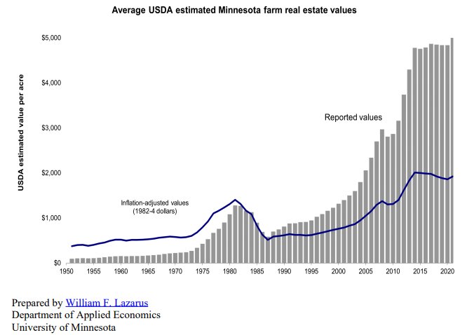

Slide 36
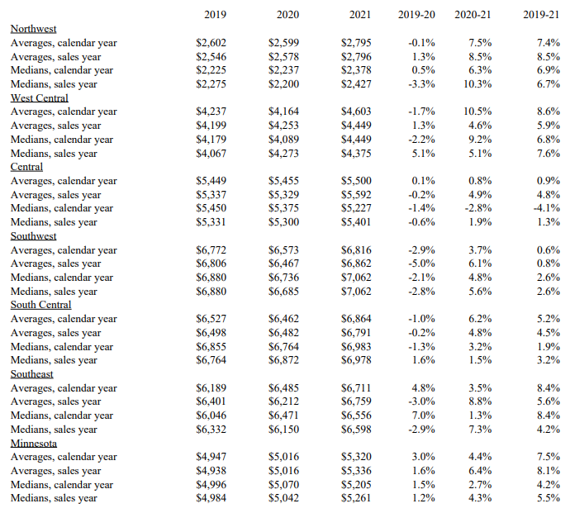
Notes:
file:///C:/Users/huli0013/Downloads/sp2202%20Minnesota%20Farm%20Real%20Estate%20Sales%20Study.pdf

Slide 37
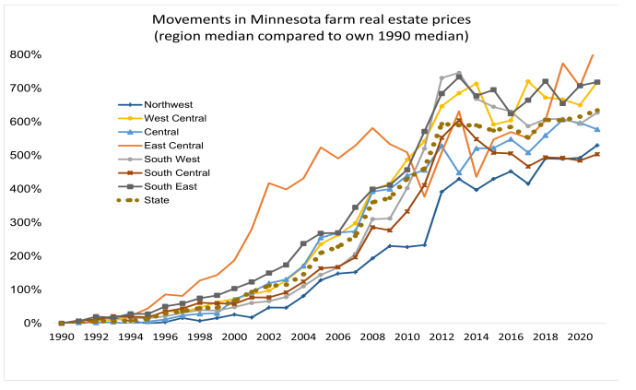

Slide 38
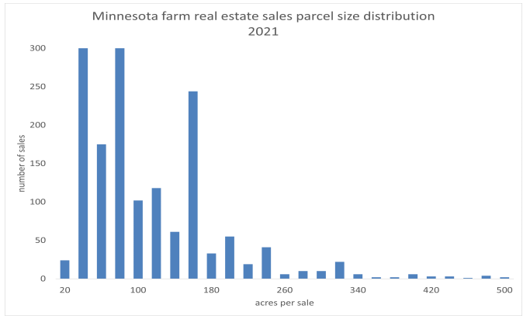

Slide 39
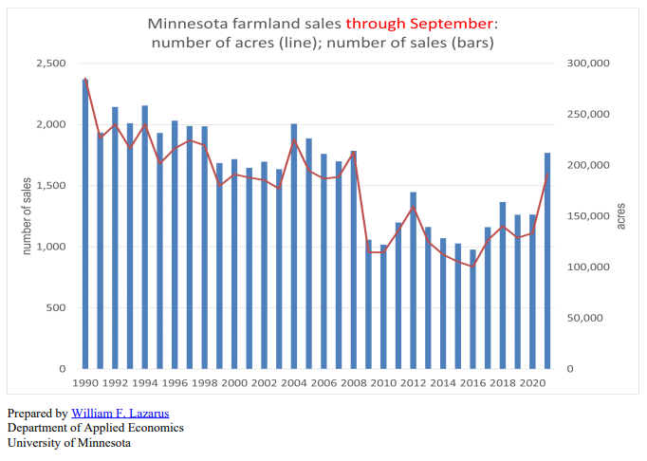

Slide 40
Minnesota Farmland Sales 2020 and 2019
Average Farmland Sales from Minnesota Land Economics
William Lazarus, University of Minnesota http://www.landeconomics.umn.edu
County | Number of Sales 2020 | Average 2020 Per-Acre Price | Minimum 2020 Per-Acre Price | Maximum 2020 Per-Acre Price | Average 2019 Per-Acre Price
Big Stone | 4 | 4,556 | 4,196 | 5,200 | 4696
Chippewa | 16 | 6,488 | 4,452 | 7,753 | 6569
Douglas | 17 | 6,979 | 4,789 | 8,500 | 3082
Grant | 2 | 11,556 | 9,962 | 13,150 | 3653
Lac Qui Parle | 2 | 1,029 | 656 | 1,402 | 4623
Otter Tail | 46 | 2,879 | 1,254 | 9,384 | 2572
Pope | 6 | 2,969 | 1,279 | 4,625 | 4252
Stevens | 8 | 4,195 | 591 | 6,098 | 4750
Swift | 20 | 4,287 | 1,500 | 6,572 | 5275
Traverse | 8 | 4,841 | 3,449 | 5,375 | 5139
Wilkin | 10 | 4,114 | 2,910 | 4,999 | 4531
Yellow Medicine | 16 | 5,310 | 1,775 | 7,450 | 5249
Notes:
“Unhide slide with counties you are talking in and hide previous talk slides.” Here you can see the average sale prices by county for 2014 and 2015 the number of sales in 2015 the minimum sale price in 20145and the maximum price in 2015. This is a great website where you can see these sales listed by township.

Slide 41
Minnesota Farmland Sales 2020 and 2019
Average Farmland Sales from Minnesota Land Economics
William Lazarus, University of Minnesota http://www.landeconomics.umn.edu
County | Number of Sales 2020 | Average 2020 Per-Acre Price | Minimum 2020 Per-Acre Price | Maximum 2020 Per-Acre Price | Average 2019 Per-Acre Price
Benton | 14 | 3,826 | 2,003 | 12,000 | 5,164
Carver | 10 | 7,659 | 3,317 | 12,269 | 6,799
Kandiyohi | 12 | 1,290 | 700 | 3,537 | 5,566
McLeod | 19 | 5,074 | 3,036 | 7,599 | 5,183
Meeker | 16 | 4,519 | 2,875 | 6,750 | 4,227
Morrison | 20 | 3,526 | 600 | 8,645 | 3,568
Renville | 32 | 6,268 | 884 | 9,276 | 5,924
Scott | 11 | 8,609 | 4,637 | 11,951 | 7,884
Sherburne | 3 | 3,765 | 3,125 | 4,333 | 7,756
Sibley | 19 | 6,674 | 4,750 | 9,266 | 6,763
Stearns | 29 | 5,222 | 2,750 | 9,019 | 5,874
Todd | 35 | 2,952 | 1,429 | 6,926 | 2,946
Wadena | 4 | 1,802 | 831 | 2,250 | 3,492
Wright | 22 | 6,518 | 3,550 | 12,350 | 6,938
Notes:
“Unhide slide with counties you are talking in and hide previous talk slides.” Here you can see the average sale prices by county for 2014 and 2015 the number of sales in 2015 the minimum sale price in 20145and the maximum price in 2015. This is a great website where you can see these sales listed by township.

Slide 42
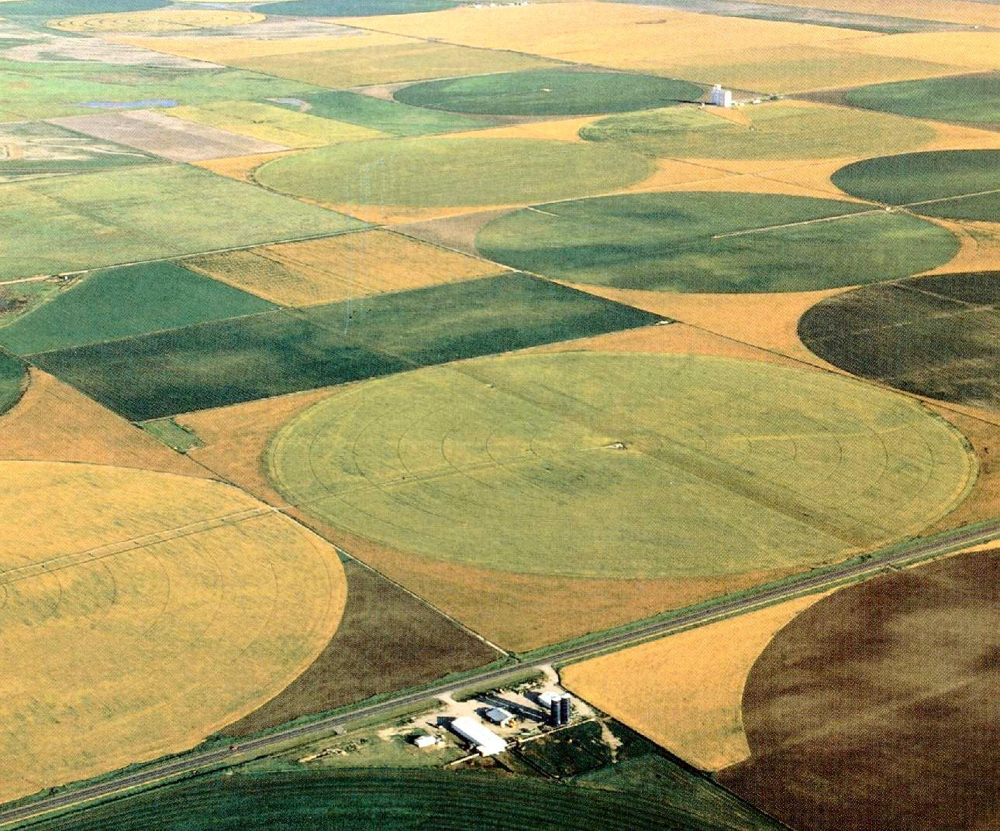
Factors Affecting Rental Rates
Land Quality
Drainage
Fertility
Location and Proximity to Tenant
Size and Shape of Fields
Notes:
Farmer’s have many factors to consider to rent or not to rent: go over list on slide.

Slide 43
Factors Affecting Rental Rates
Rotation History
Farm Bill Program Selection
Rent Payment Dates
Reputation of the Landlord/Tenant
Special Considerations (storage facility, easements)
Notes:
Farmer’s have many factors to consider to rent or not to rent: go over list on slide.

Slide 44
Landlord & Lease Considerations

Slide 45
Landlord Considerations
A landlord is able to take a first lien position in crops grown on rented land.
The landlord’s lien is in the amount of unpaid rent for the crop year.
This lien puts the landlord in first position to be paid if tenant defaults financially.
Notes:
It is always a good idea for a landlord to “stake their claim” if you will for the funds that are due to them.
Landlords are able to file a lien for rent due to them, just like a bank takes a lien on a car that has a loan on it.
The process is above.

Slide 46
Landlord Considerations
This lien is “Perfected” or Secured by filing a UCC-1 Financing Statement.
Obtain legal assistance to file this statement correctly and provide proper notice to tenant and other secured parties.
Must file lien within 30 days of crops beginning to grow.
Discuss filing this lien with your tenant, to keep relations & communications in good standing.
Notes:
Be sure to work with a legal advisor on this. A specific UCC form is needed. This needs to include certain items to be valid. Also, the form needs to be filed correctly with the State of MN and the renter needs to be made aware of the filing.

Slide 47
Why Put a Lease in Writing?
For legal and clarity reasons.
Both Landlord & Renter understand details.
All agreements outlined & can be reviewed.
A guide for heirs.

Slide 48
Lease Items
Name and Address of Landlord & Renter.
Legal Description of land.
Beginning & End Date of lease.
Rent Details
Rent Amount; Due Date(s); Payment Type; Late Payment Considerations.
Insurance Considerations
Who Insures the Property? Who Insures the Crop?
Termination Details
End date; notice requirements; reimbursement consideration for fertilizer, growing crop, tillage, etc.
Amendments & Disputes
Details of how to amend or dispute. Procedure to initiate.

Slide 49
Lease Items
Landowner’s Rights
Ability to enter property. Crop security interest (ensures rent pmt.)
Federal Farm Program
What program is land enrolled in? Other considerations.
Management Participation
Can the landowner participate in management? (For tax and estate planning purposes.)
Partnership & Legal Statement
No intent for partnership, or obligations for liabilities or damages.
Farming practices
What is preferred or prohibited? Fertility maintenance? Weed control? Soil conservation?
Improvements
Can producer improve property? Can producer use improvements already in place (bins, bldg., etc.)?
Property map

Slide 50
AgLease101.org
Home Document Library FAQ For Educators About Ag Lease 101 Contact
Ag Lease 101 helps both land owners and land operators learn about alternative lease arrangements and includes sample written lease agreements for several alternatives. Ag Lease 101 was created by and is maintained by the North Central Farm Management Extension Committee.
Notes:
Ag Lease 101.org is a great website full of rental information. You can find rental forms for cash and flexible agreements that you can fill in online, examples of leases and lease forms for pastures and facilities.

Slide 51
Making Difficult Rent Decisions The Farmer’s Perspective
Deciding to Take More or Give Up Rented Acres:
Ability to Cover Direct Expenses.
Land Quality vs. Rental Rate.
Notes:
Determining whether to let rented acres go is not an easy decision and should not be taken lightly. Your current acre base is supported by a machinery line, adequate labor, and other resources from the farm. These dynamics change when the number of rented acres changes. Therefore, it is important to contemplate factors and questions like the following:
Ability to cover direct expenses? – As you begin budgeting for the coming year and look at cash flow potential, are the rented acres in question able to generate enough potential revenue to cover the direct expenses associated with them – including seed, fertilizer, chemicals, rent, and the like – those expenses that would not be incurred if those acres were not farmed. This is an important starting point in the decision, because if these direct costs can not be covered, then you know you are farming at a loss. If the acres can cover direct expenses, then renting the land for the coming year will help the bottom line of the operation, as the acres are contributing to the other overhead expenses of the operation.
Land Quality vs Rental Rate – Wells Fargo’s Chief Agricultural Economist, Michael Swanson, is known for saying “Farm the best, forget the rest”. Essentially he is saying to only rent the best land. While we know that’s not always possible, it is important to try and rent subpar ground at a discounted rate – as the yield and profit potential is at a disadvantage.

Slide 52
Making Difficult Rent Decisions The Farmer’s Perspective
Deciding to Take More or Give Up Rented Acres:
Financial Position of the Operation.
Other Income Generating Possibilities.
Notes:
3. Financial position of the operation – Assessing the full financial picture of the operation is also important. Some producers that are in a strong financial position can choose to use cash reserves and net worth to farm at a loss for a short period of time. But, this is a risky endeavor and should be carefully evaluated. Remember, farming is a business, with the goal of profit generation. Fully assess your financial position before jeopardizing the future of the operation.
4. If less acres are to be farmed for the coming year, is it possible to use the extra time and potentially equipment for other income generating purposes. Also consider it there are other means to better utilize your time and talents, versus limited profit potential on the proposed acres.
As you can see, the questions regarding whether or not to give up rented acres are important for the short and long term position of the farm. Put thoughtful consideration in to the decision for the best potential outcome.

Slide 53
Making Difficult Rent Decisions The Landowner’s Perspective
Deciding on Rental Rates:
Ability to Cover Costs & Financial Needs.
Strength of Tenant Relationship.
Notes:
Determining whether to reduce rental rates for a current tenant is also a difficult decision, that requires its own thought and consideration. This farmland is an investment that has associated costs and is also expected to provide a return, that may be used for the land owner’s living costs. Therefore, it is important to contemplate factors and questions like the following:
Ability to cover expenses and provide for financial needs? – As the land owner, be sure to pencil out the associated costs you have with the land- taxes, insurance, repairs, and other associated expenses. In addition, what other dollars are you expecting this investment to yield – either as a return on investment or perhaps this is a significant portion of your retirement provisions. Being sure you know the dollars you desire out of the rental contract is the starting point as the land owners works through their end of the transaction. the coming year will help the bottom line of the operation, as the acres are contributing to the other overhead expenses of the operation.
The strength of tenant relationship refers to the tenure of the relationship with the renter. If this is a long standing relationship that you have been pleased with, it is easier to work with tenant and reduce rates during the challenging financial times they are experiencing. This strong relationship likely includes the tenant going above and beyond as a renter – perhaps they keep weeds controlled, mow the property, remove snow, or a variety of other tasks that may or may not be spelled out in the lease. Also, when times were good, did this long-standing tenant treat you well as the land owner by giving you an unexpected bonus or agreeing to increased rental rates? Keeping a dependable tenant that you’ve worked with for a long period of time may be a very important part of this decision for a land owner.

Slide 54
Making Difficult Rent Decisions The Landowner’s Perspective
Deciding on Rental Rates:
Quality of Agronomic Care.
Flexible Lease Option.
Notes:
The land owner also needs to consider the quality job the tenant is doing on their land. Are the fertility levels of the soil maintained, are production practices in line with your values, are sustainable practices used in their production. If they are high quality tenants that are meeting the goals and expectations you have for the land, then it important to negotiate and work with the current tenant. Developing a new tenant relationship takes time and may the quality of the new person’s practices may not align with yours.
Especially if your lease has been a cash lease over time, now may be a great time to look further at a flexible lease arrangement. As shared earlier, this sets a base rental rate, but leaves the “up side” open on the contract. Therefore, if prices, yields, or other factors outlined in the flexible rental contract perform better than initially expected, the landlord will receive an additional payment. Looking at flexible lease arrangements makes sense during this challenging time, as you are able to concede on rental rates and lower the base rent, but then outline the terms of out performing the base standards of the contract.
Determining the “correct” rental rate is difficult in any given year and today’s challenging farm financial times add additional challenges to this decision. Hopefully these factors help you think through the difficult rent decisions, no matter which side of the contract you are on.

Slide 55
Negotiating Skills are Important
Win/Win is the ideal outcome

Slide 56
Invent options for mutual gain
Create a solution that meets both parties interests:
Utilize flexible rent agreements
Add clauses to agreements
Use a margin model
Set up a long-term agreement
???

Slide 57
Insist on using objective criteria

Slide 58
2021 Net Farm Income
Minnesota Farm Business Management Education, Minnesota State
Southwestern Minnesota Farm Business Management Association
FINBIN Center For Farm Financial Management, University Of Minnesota
www.finbin.umn.edu

Slide 59
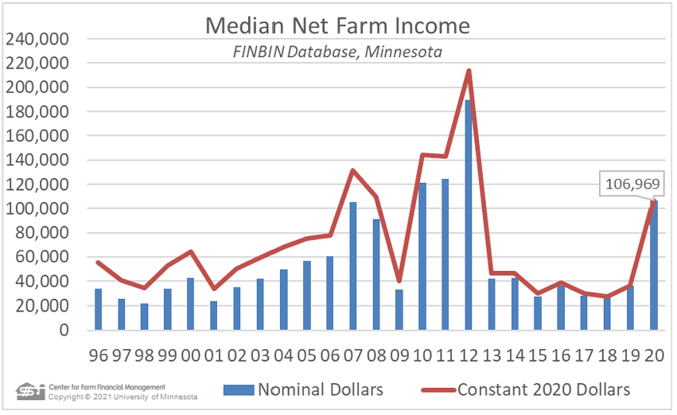
Notes:
chrome-extension://efaidnbmnnnibpcajpcglclefindmkaj/https://www.cffm.umn.edu/wp-content/uploads/2021/05/2020-FINBIN-Report-on-Minnesota-Farm-Finances.pdf

Slide 60
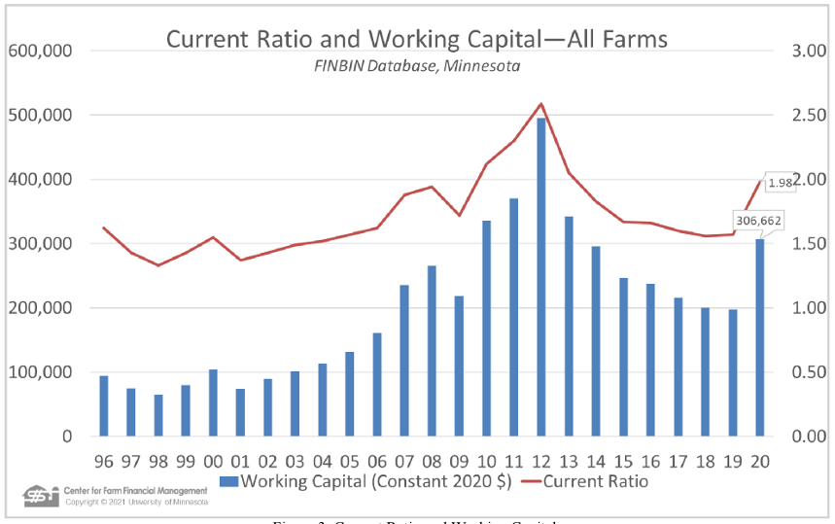
Liquidity
Notes:
Liquidity, based on working capital (current assets minus current debt) and the current ratio, continued its slow slide in 2017. Working capital declined by about $9,000 for the average farm. However, these farms, on average, have consumed $235,000 of working capital over the past five years, more than half of the $439,000 they had at the end of 2012. The current ratio for the average farm was 1.60:1 (Figure 3) at the end of 2017 ($1.60 of current assets to cover each dollar of current debt), down slightly from 2016. The current ratio for MN farms has declined sharply over the past four years. Even with this decline, the average farm was still in a rather strong liquidity position. But given this deterioration, more farms than usual are likely experiencing financial

Slide 61
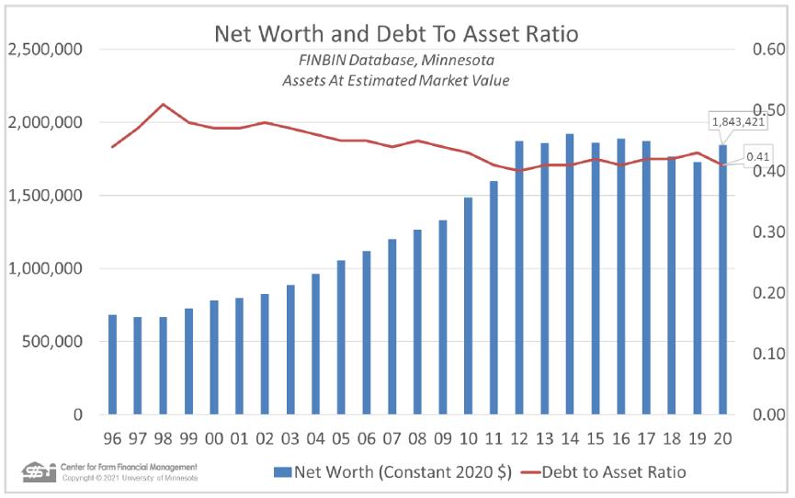
Solvency
Notes:
The average farm’s net worth increased by almost $66,000 in 2017. Of that, just over half was “earned net worth change,” resulting from farm and non-farm earnings exceeding owner withdrawals for family living and taxes.
The average farm’s debt-to-asset ratio was unchanged at 42% when deferred tax liabilities are included. When deferred liabilities are excluded, the ratio was 32%, unchanged from the previous year.

Slide 62
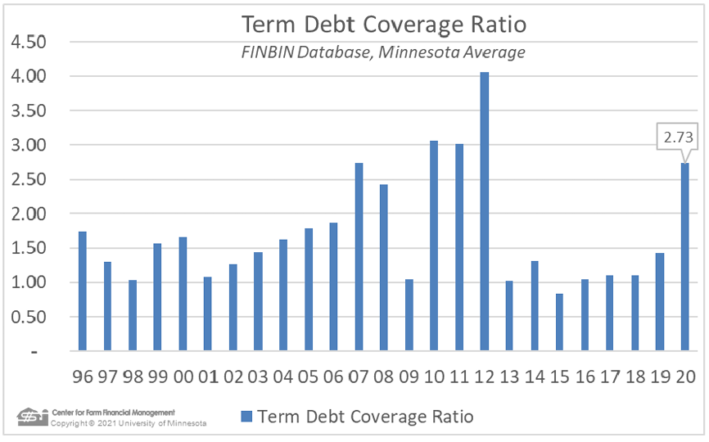
Term Debt Coverage
Notes:
Debt coverage is a primary measure lenders monitor when extending credit to businesses. The term debt coverage ratio (TDCR) compares dollars available for debt repayment after family living and income taxes versus scheduled debt repayment on term (non-current) debt.

Slide 63
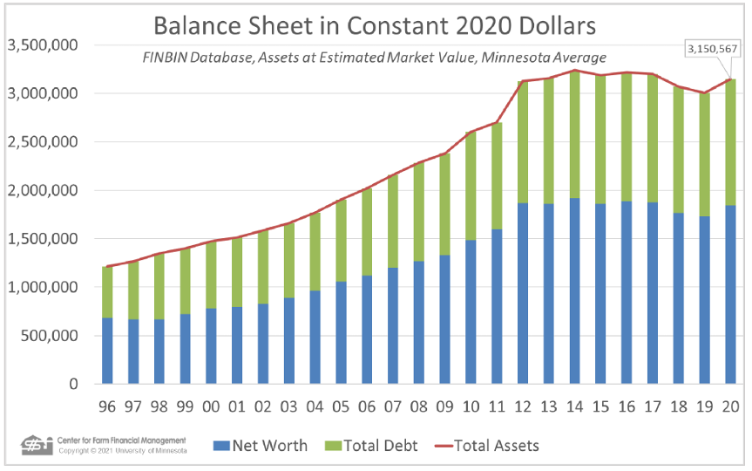
Balance Sheet

Slide 64
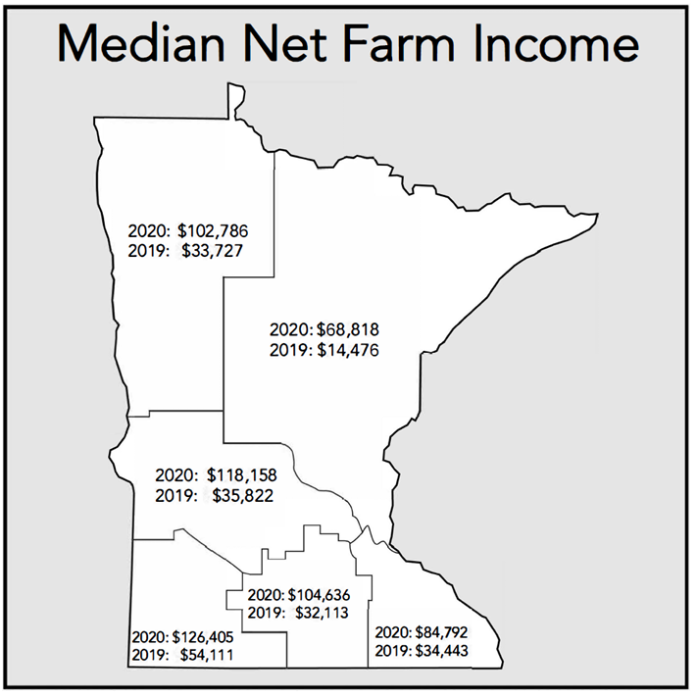
Notes:
Incomes levels varied significantly by region of the state. In most regions, incomes were historically low and retreated from the income levels of the previous year.

Slide 65
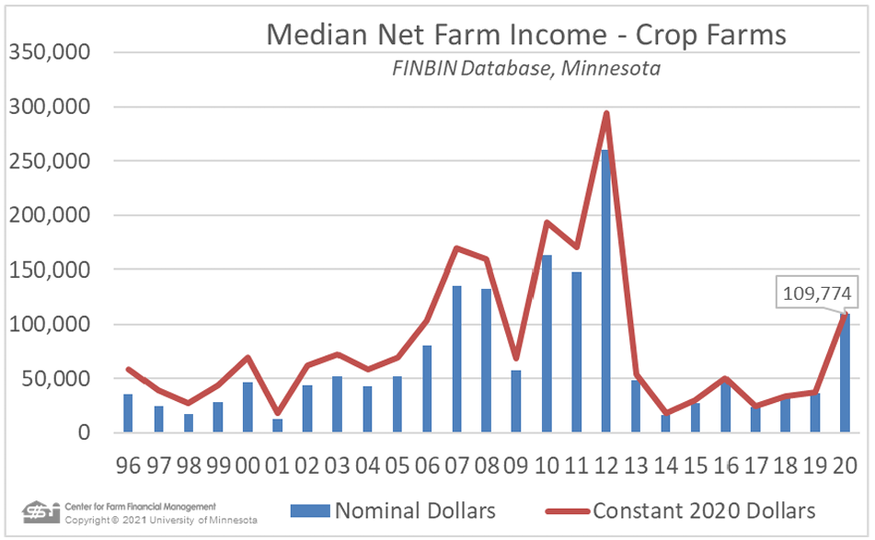
Notes:
The 1163 crop farms in the 2017 group earned a median net farm income of $24,170, down from $46,831 the previous year. 2017 was the fifth consecutive year of low earnings for these Minnesota crop producers. Low earnings have taken a bite out of working capital. Although the average crop farm still has working capital equal to over 30% of gross revenue, the average crop farm has lost almost $300,000 of working capital in the past five years.

Slide 66
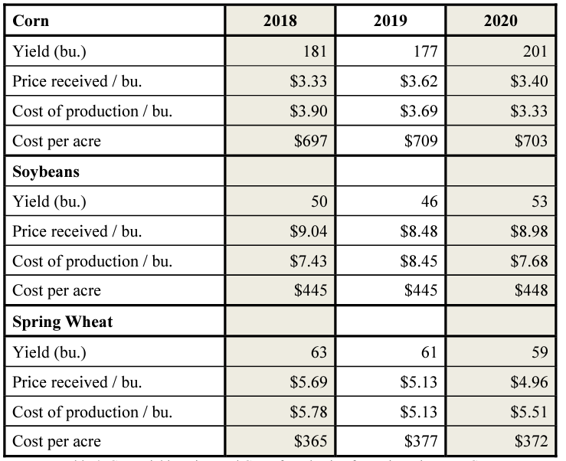
Minnesota Crop Yields
Notes:
Yields for Minnesota’s major cash crops were outstanding for third consecutive year. Corn yields broke the state record previously set in 20164 . Corn yields for farms included in FINBIN averaged 204 bushels per acre, 32 bushels over the average for the previous 10 years. Soybean yields were lower than in 2016 at 48 bushels per acre, but were still 3 bushels above the 10-year average for participating farms. Spring wheat averaged 73 bushels per acre, 22% above the 10-year average for these farms. Sugar beet yields also exceeded the previous 10-year average by 30%.

Slide 67
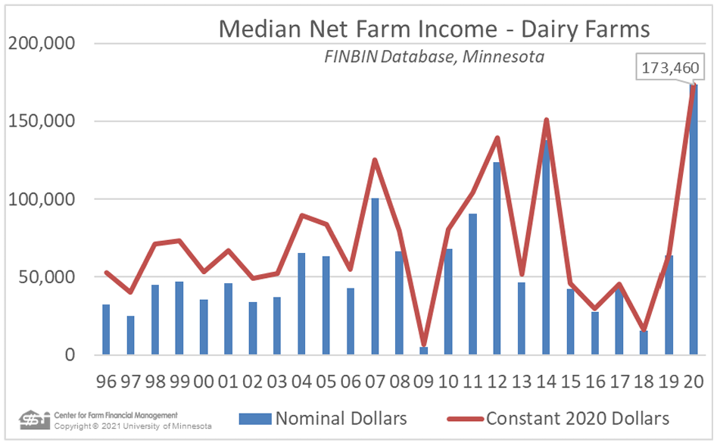
Notes:
Dairy farm earnings were up in 2017, albeit from a very low level. The median net farm income for the 456 participating dairy farms was $42,260, up from $27,666 in 2016. These increased earnings surprised many, given the very low milk price for the last portion of the year. In total, though, milk prices were up for the year, averaging $17.92 per hundredweight (cwt) compared to $16.58 in 2016.

Slide 68
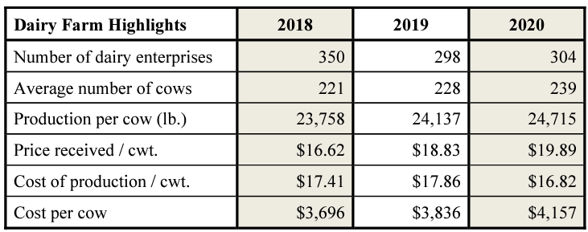
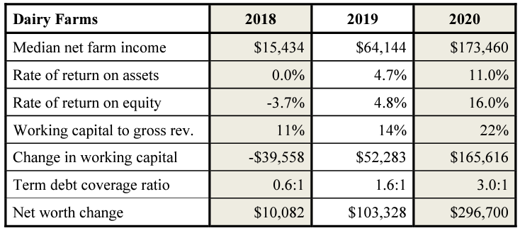
Minnesota Dairy Farms
Notes:
While milk prices increased, the cost of production increased too. On average, it cost $17.22 per cwt to produce milk in 2017, up from $16.79 the previous year. Total expense per cow increased by 4%. Feed cost increased by 2% while hired labor increased 7%. Energy related costs (fuel, custom hire, hauling) as well as repairs accounted for most of the cost increase.

Slide 69
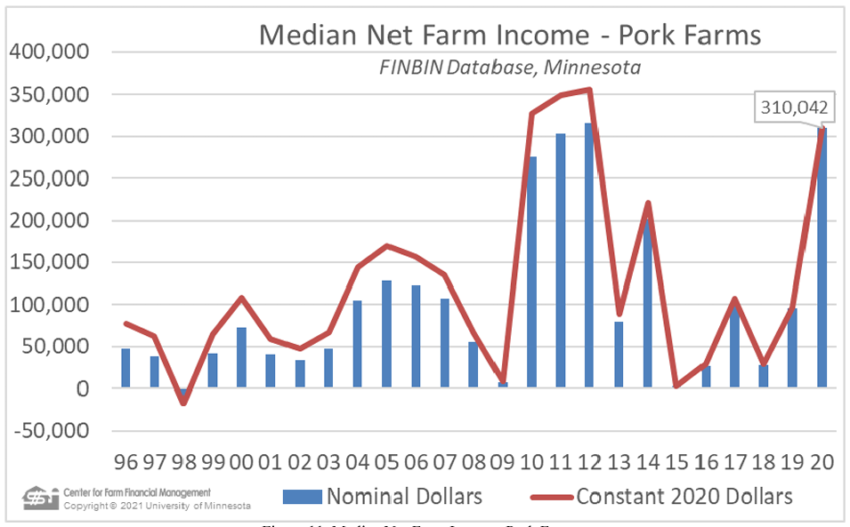
Notes:
Pork production farms were the only farm type that generated significantly higher profits in 2017. The median participating pork producers made $101,307 from farm operations in 2017, up from $26,847 in 2016. While improved profitability is welcome, it is important to note that these operations tend to be some of the largest operations in the database, with very high investment. Rate of return on assets for these farms improved to almost 4%, still low by historical standards.

Slide 70
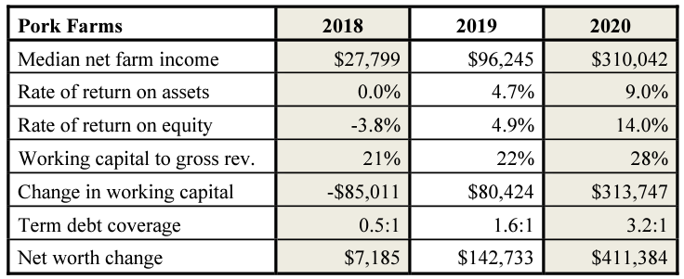
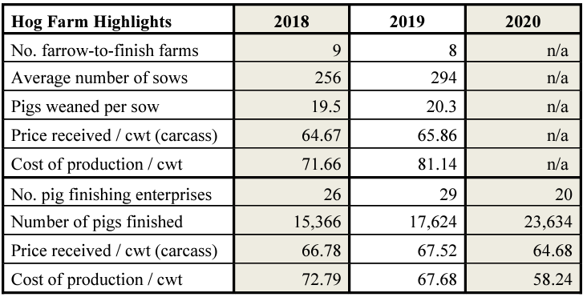
Minnesota Hog Farms
Notes:
Participating pork operations tend to carry more debt than other farm types. The average pork farm’s debt-to-asset ratio stood at 45% at the end of 2016. After losing over $250,000 of working capital in the previous two years, the average farm added over $25,000 to working capital in 2017. Debt coverage was also markedly improved, going from under the 1:1 benchmark for the past two years to 1.3:1 in 2017. The average operation’s net worth increased by $145,000, with almost $100,000 of that resulting from earnings.

Slide 71
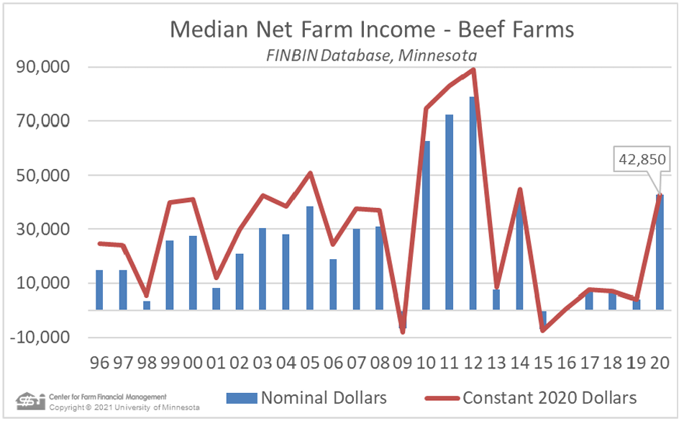
Notes:
Profits for Minnesota beef operations improved slightly but remained very low in 2017. The median of the 172 beef operations in the farm management programs in 2017 made $7,261 from farm operations in 2017, up from 2016 when the median farm made only $647 (Figure 12). This group of farms includes both cow-calf operators and cattle finishers. In 2017, cattle finishers fared much better than cow-calf operations.

Slide 72
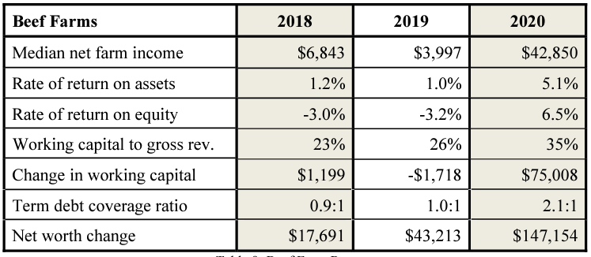
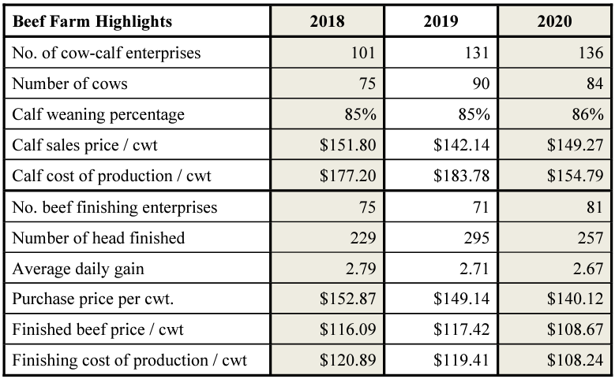
Minnesota Beef Farms
Notes:
While the improvement in profits for beef operations was modest in 2017, the overall financial position of these operations improved substantially. The average farm’s working capital improved by almost $20,000 after deteriorating by over $120,000 in the previous two years. The average farm’s net worth improved by over $40,000. Debt coverage reached the 1:1 level for the first time in three years.

Slide 73
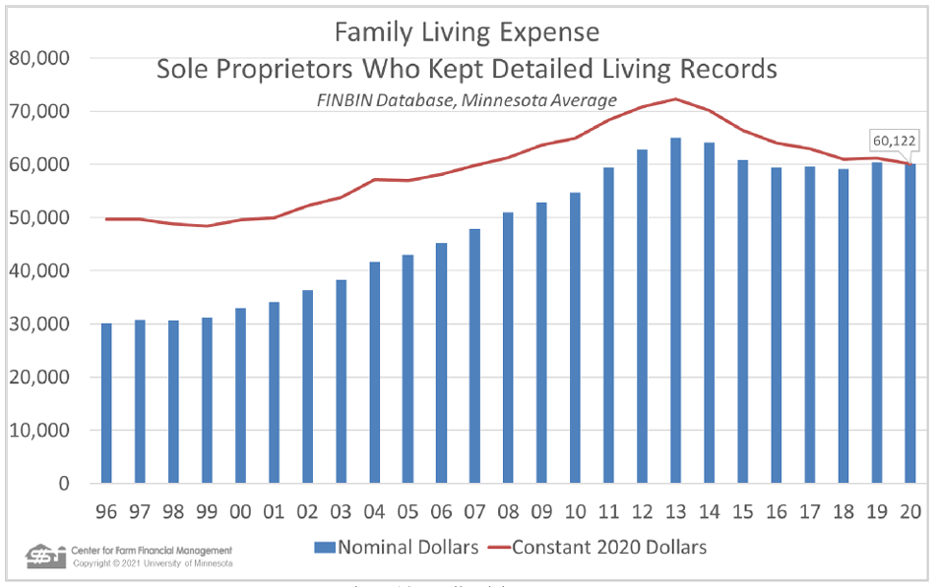
Notes:
For the first time in five years, following the farm income collapse of 2012, family living costs ticked up. Approximately one-quarter of the families included in the Minnesota FINBIN database keep detailed family living records in addition to their farm financial records. The average of these farms spent $59,589 on family living expenses in 2017 when family consumption of farm produce is included (Figure 14). Medical care and health insurance, when added together, were the highest single expenditure at $9,588. Health insurance was down 14% while medical care cost increased by 6%. Food and meal expenses increased by 7%.

Slide 74
Current Topics

Slide 75
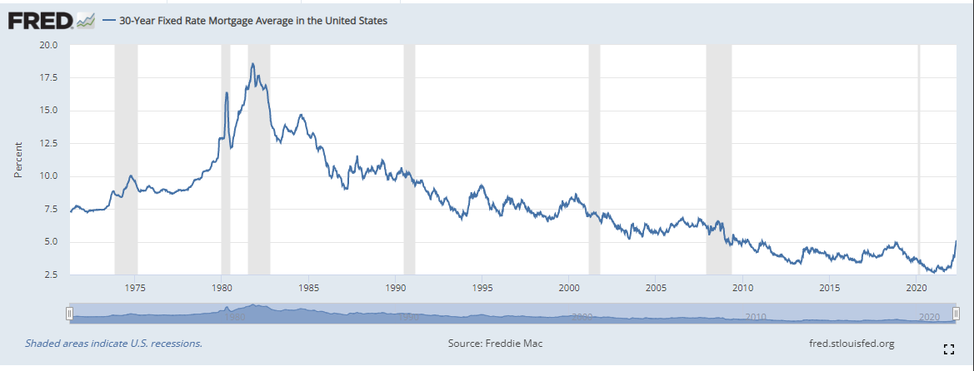
Notes:
https://fred.stlouisfed.org/series/MORTGAGE30US

Slide 76
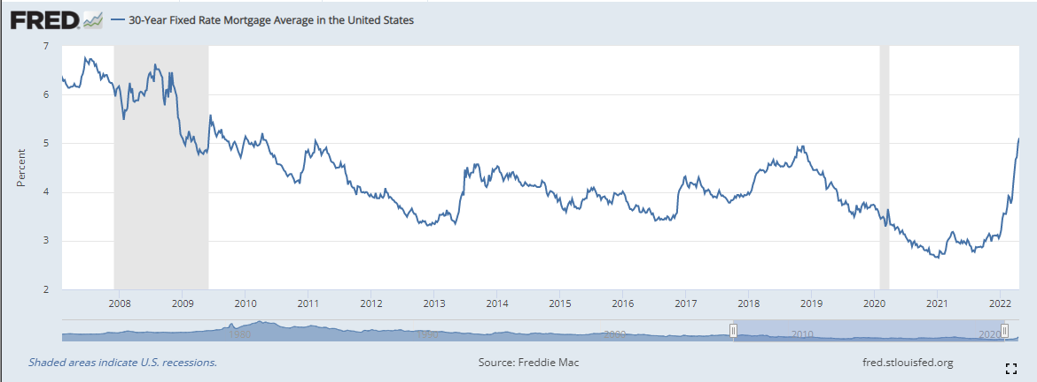
Notes:
https://fred.stlouisfed.org/series/MORTGAGE30US

Slide 77
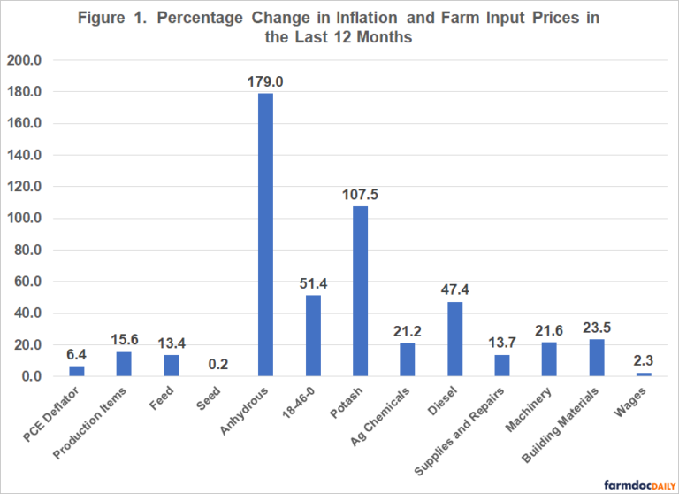
Notes:
https://farmdocdaily.illinois.edu/2022/04/trends-in-general-inflation-and-farm-input-prices.html

Slide 78
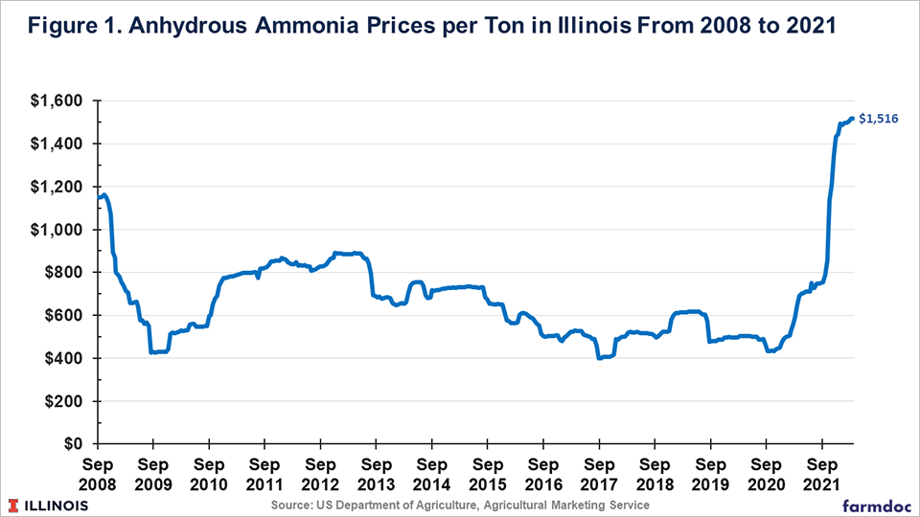
Notes:
https://farmdocdaily.illinois.edu/2022/04/nitrogen-fertilizer-prices-and-supply-in-light-of-the-ukraine-russia-conflict.html

Slide 79
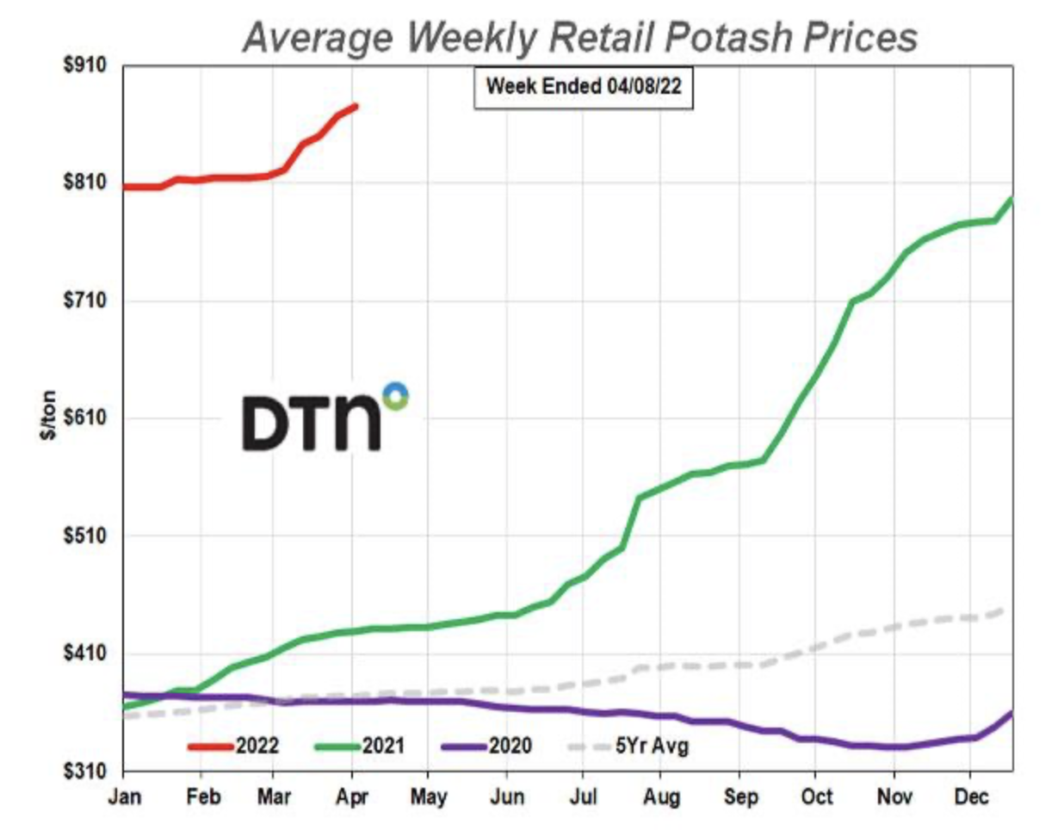
Notes:
https://farmpolicynews.illinois.edu/2022/04/fertilizer-and-food-prices-climb-while-egypt-pays-high-price-for-wheat-corn-extends-gains/

Slide 80
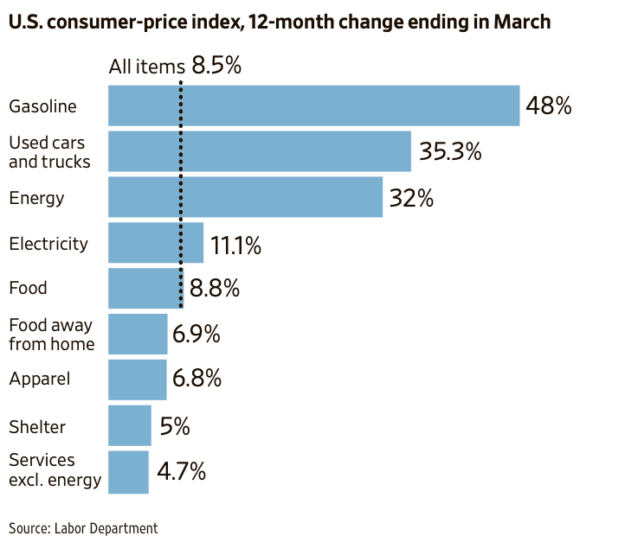
Notes:
https://farmpolicynews.illinois.edu/2022/04/fertilizer-and-food-prices-climb-while-egypt-pays-high-price-for-wheat-corn-extends-gains/

Slide 81
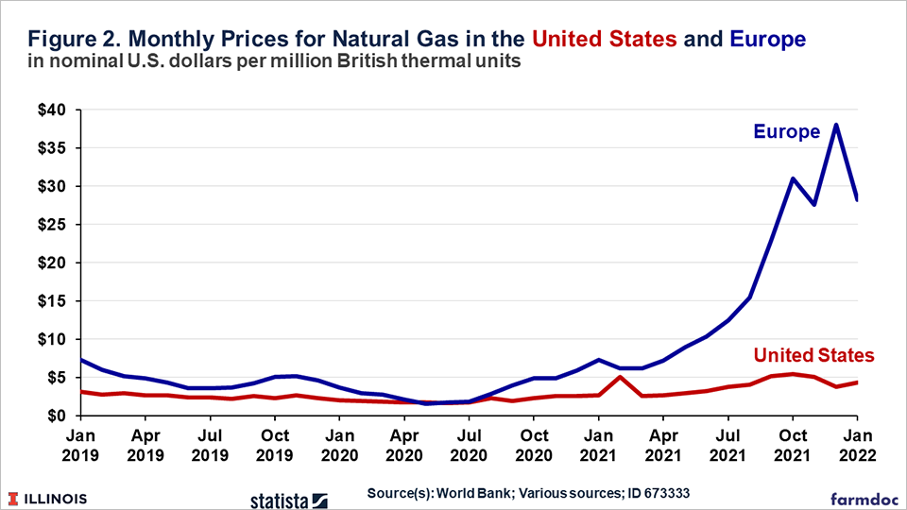
Notes:
https://farmdocdaily.illinois.edu/2022/04/nitrogen-fertilizer-prices-and-supply-in-light-of-the-ukraine-russia-conflict.html

Slide 82
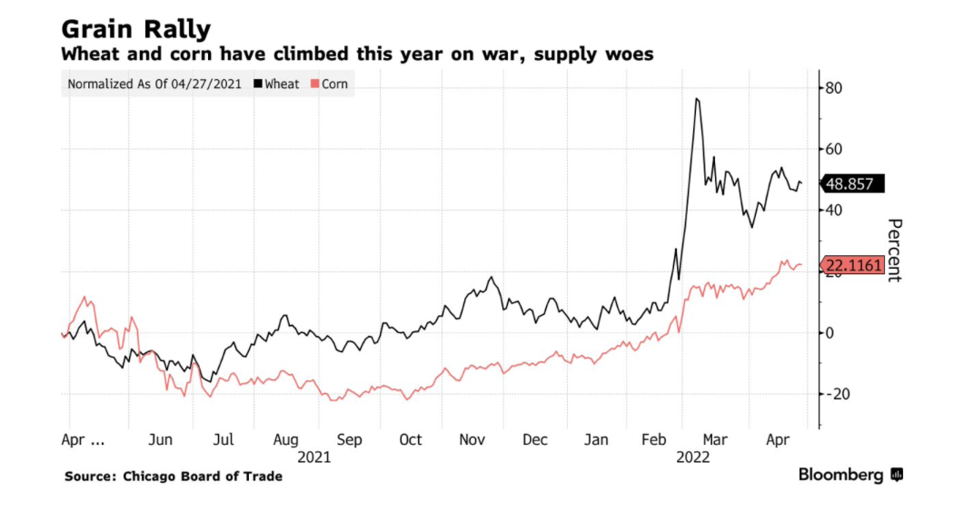
Notes:
https://farmpolicynews.illinois.edu/2022/04/wearing-body-armour-dodging-mines-ukrainian-farmers-press-ahead-cope-with-logistics/

Slide 83
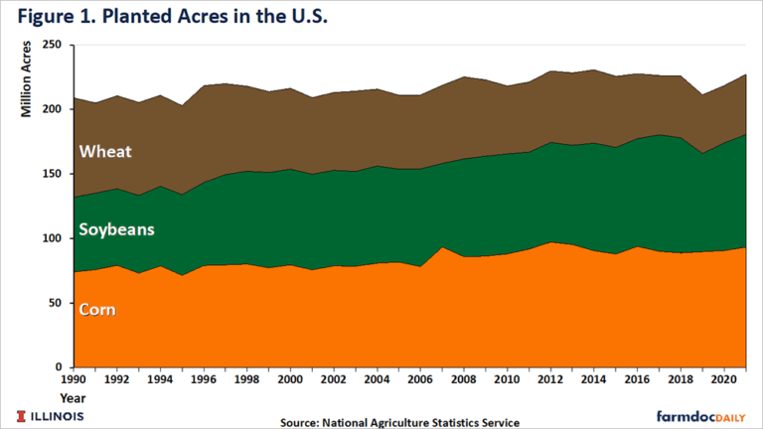
Notes:
https://farmdocdaily.illinois.edu/2022/03/wheat-in-2023.html

Slide 84
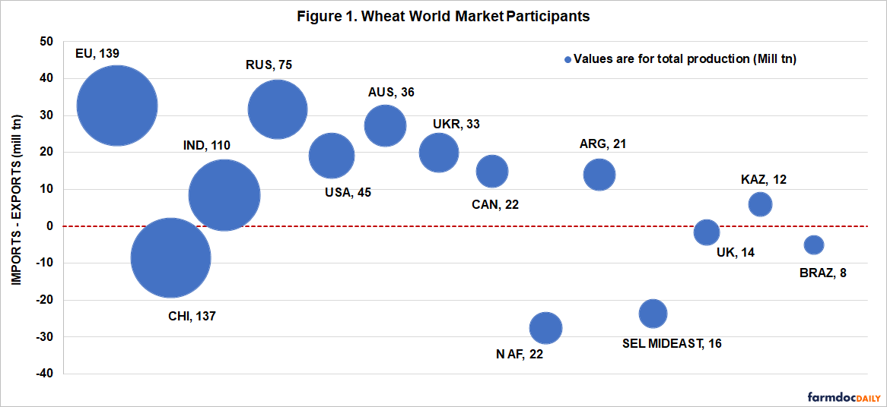
Notes:
https://farmdocdaily.illinois.edu/2022/04/argentina-and-brazil-could-expand-wheat-production-due-to-the-war-in-ukraine.html

Slide 85
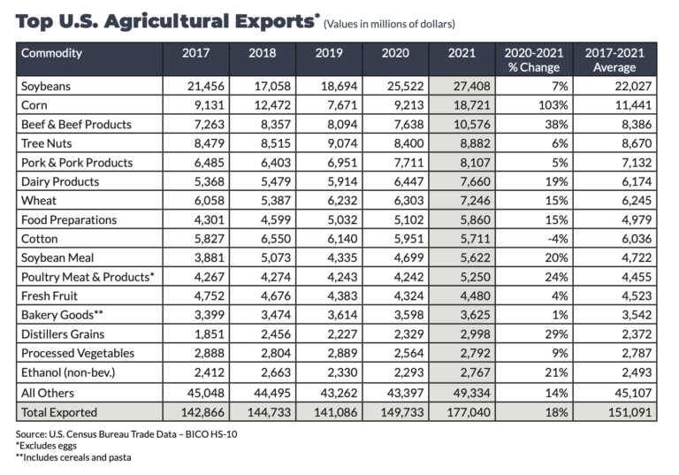
Notes:
https://farmpolicynews.illinois.edu/2022/04/2021-u-s-ag-exports-highest-on-record-corn-the-primary-contributor/

Slide 86
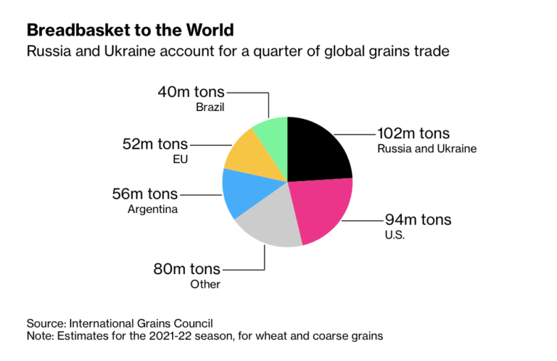
Notes:
https://farmpolicynews.illinois.edu/2022/04/ukraine-march-grain-exports-four-times-less-than-february/

Slide 87
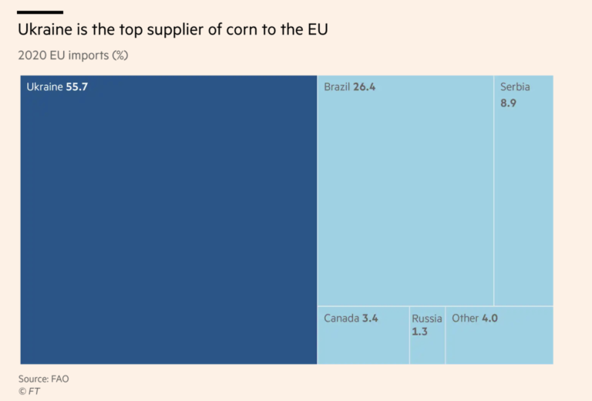
Notes:
https://farmpolicynews.illinois.edu/2022/04/ukraine-increases-planting-forecast-as-eu-farmers-face-headwinds-the-crisis-is-now/

Slide 88
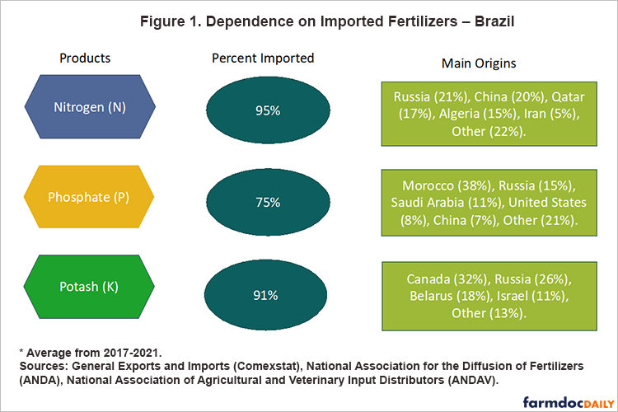
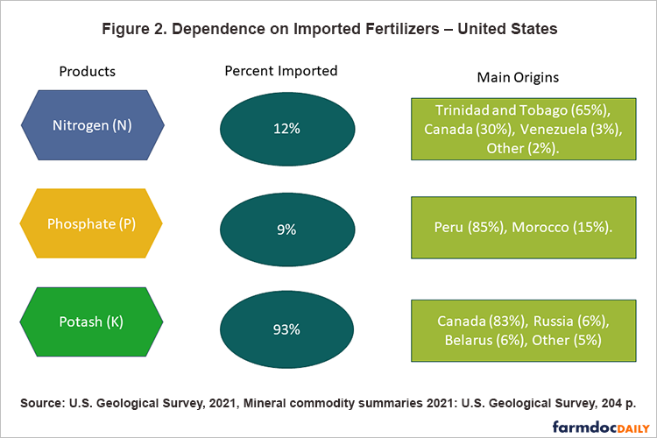
Notes:
https://farmdocdaily.illinois.edu/2022/03/war-in-ukraine-and-its-effect-on-fertilizer-exports-to-brazil-and-the-us.html

Slide 89
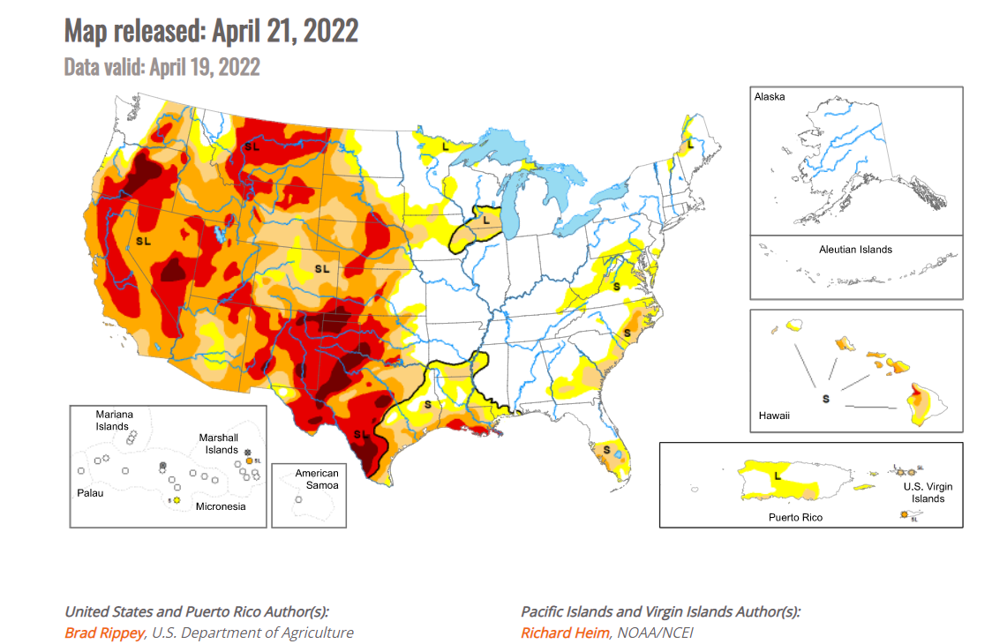
Notes:
https://droughtmonitor.unl.edu/

Slide 90
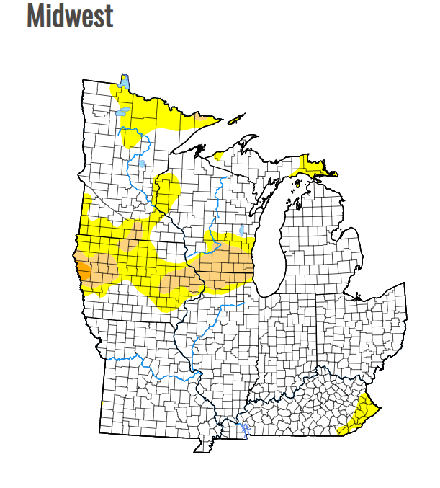
Notes:
https://droughtmonitor.unl.edu/CurrentMap/StateDroughtMonitor.aspx?Midwest

Slide 91
Questions?
huli0013@umn.edu

