Slide 1
Basic Legal descriptions of land
Notes:
Several types: Metes and Bounds (most farmland)
Platted (Lot 1 Block 1)
Government Lots (around lakes and rivers)
Correctional 40’s on the north and west edges of a township.
Since the world is round-think of it like putting postage stamps on an basketball-the correctional 40’s are on the north and west edge of a township to allow for the earths curvature.

Slide 2
Metes and Bounds (most farmland)

Slide 3
Section-Range-Township
Principal Meridian: Reference or beginning point for measuring east or west ranges.
Section: Basic unit of the system, a square tract of line one mile by one mile containing 640 acres.
Township: 36 sections arranged in a 6 by 6 array, measuring 6 miles by 6 miles. Sections are numbered beginning with the northeast-most section, proceeding west to 6, then south along the west edge of the township and to the east
Township Lines - East to west lines which mark township boundaries
Range: Assigned to a township by measuring east or west of a Principal Meridian
Range Lines - North to south lines which mark township boundaries.

Slide 4
Section
Basic unit of the system, a square tract of line one mile by one mile containing 640 acres.
Township
36 sections arranged in a 6 by 6 array, measuring 6 miles by 6 miles. Sections are numbered beginning with the northeast-most section, proceeding west to 6, then south along the west edge of the township and to the east.

Slide 5
Township Section Numbering Sequence

Slide 6
Reading a rectangular legal description.
The easiest way to locate the portion of land described in a legal description is to read it from the back to the front.
Lets walk though Example #1 and Example #2

Slide 7
Example #1: Locating the SE ¼ SW ¼.
1st Step; Locate the SW ¼
2nd Step; Locate the SE ¼ of the SW ¼

Slide 8
Example #1 SE ¼ SW ¼
Step #1 we locate the SW 1/4
Step #1

Slide 9
Step #2 and final step in this example we locate the SE ¼ in the SW ¼.
Step #2

Slide 10
Example #2: Locating SE ¼ SW ¼ SW ¼
1st Step; Locate the SW ¼
2nd Step; Locate the SW ¼ of the SW ¼
3rd Step; Locate the SE ¼ of the SW ¼ of the SW ¼

Slide 11
Example #2 SW ¼ SW ¼ SW ¼
Step #1
Step #2
Step #3

Slide 12
Now we locate the NE ¼ SW ¼ SW ¼ SW1/4
Step #4 10 Acres

Slide 13
Platted (Lot 1 Block 1)

Slide 15
Correctional 40’s on the north and west edges of a township. Since the world is round, a grid of straight lines cannot create perfectly squares. Think of it like putting postage stamps on a basketball-the correctional 40’s are on the north and west edge of a township to allow for the earths curvature.

Slide 16
Government Lots (around lakes and rivers)
They typically meander

Slide 18
Helpful Tips for Inspecting an Ag Property

Slide 19
  Arm yourself with knowledge about agriculture. If they feel you have a basic understanding of agriculture (and they will figure it out), they will be much comfortable speaking to you and confident in your ability to value their property. A very large operation may require several hours to review, depending on the quality of the previous records
  If you don’t know or understand something they are talking about ASK, don’t try to bluff them with assumed information. Most are eager to share knowledge about their livelihood with you.
Notes:
That’s a big goal of this class and this instructor. Think of it like going into medical school-without taking any pre-med basic classes. Or taking algebra without having learned multiplication and division.
Build a foundation of knowledge-the rest can be taught and learned in logical methodical steps!

Slide 20
  Be proactive and upfront.
  If you are reviewing properties in fall and the current sales ratio study indicates that a 20% value increase may be needed for land in this area for the next assessment--TELL THEM FACE TO FACE—BE PROACTIVE it may avoid an angry phone call after the notices go out.
  Market any changes or programs which may affect their property assessment.
Notes:
They also talk to their neighbors-they will spread your message-frame it like you want everyone to hear about it.

Slide 21
Be prepared
  Make sure you have reviewed the property records before driving into the farmyard.
  Make notes on any questions you may want to review with the owner.
  Have all of the owners parcel records with you. Try to review all of the parcels under this ownership at the same time. This may include numerous bare land parcels.
Notes:
Most farmers will know their tillable acres on their various parcels.
I have one farmers 68 years old owning 3000 plus acre-who can tell you everything about every single farm.

Slide 22
  Please don’t wear a suit and tie. This is optional and may be acceptable by some farmers. However 99.9% of them will become defensive or even angry when they see you get out your vehicle.
  Most farmers get bombarded by feed, seed, insurance, and equipment salesmen on a regular basis.
Notes:
Even if you “think” you know it all-never talk down to them. Todays farmers are often educated and professional-treat them that way.

Slide 23
  Be very careful where you park. Farm operations often involve large equipment and trucks. Don’t park in the way of anything if you can avoid it. Most large equipment has blind spots for the operator.
  Stay away from moving parts and animals. Ventilation fan blades and many moving parts rotate so fast that they can not seen. Keep clear! Don’t push any buttons on anything-ever!
Notes:
We lost a farm worker last year in Stearns County-he was run over by a large pay loader-he walked thru and area where he should not have been.
Last spring a neighbor and classmate of mine was blinded in an anhydrous ammonia accident.

Slide 24
Introduce yourself and state your purpose.
  Ask for some of their time to review their property records with you.
  If they state that this is a bad time, set up an appointment.
  Ask if they have any questions of you, or if any structures have issues they will show you.
If you have done your homework ahead of time, the time required can be minimized.
Notes:
Don’t park in the way-blocking any machinery or trucks.

Slide 25
  Be flexible and use your head, if they are in the middle of chores and covered with manure or grease, they may not want to go through their home with you. If they are in the shop, talk to them there. If they are in the office of livestock barn talk to them there.
  They never appreciate you stopping them if they are out in the field, operating a tractor or combine-so don’t.
Notes:
Review as much information as you can with them in person and offer to review the outbuildings by your self and then come back to them with any questions, but make sure to have them accompany you if they want to. This can be a very good opportunity to educate people about assessment practices and procedures.
You will frequently get asked “how much do you have on a particular building-be prepared to give them the most recent value.

Slide 26
If this property is a livestock operation- NEVER ENTER ANY LIVESTOCK BUILDING OR PEN. It may not only be unsafe, but you may violate the protocol for bio-security. This is especially relevant on confinement poultry and hog operations.
Avoid going from one large scale operation directly to another. Your vehicle may have some manure on the tires (yes this will happen) and it may become a source of contamination.
Be prepared to wear plastic boots or any other protective gear as required.
Notes:
Most livestock facilities can be reviewed from the exterior or by an authorized exterior inspection from a doorway, with a reasonable degree of accuracy since most are basic shell type buildings. If the roof has a big sag in it-so will the inside!

Slide 27
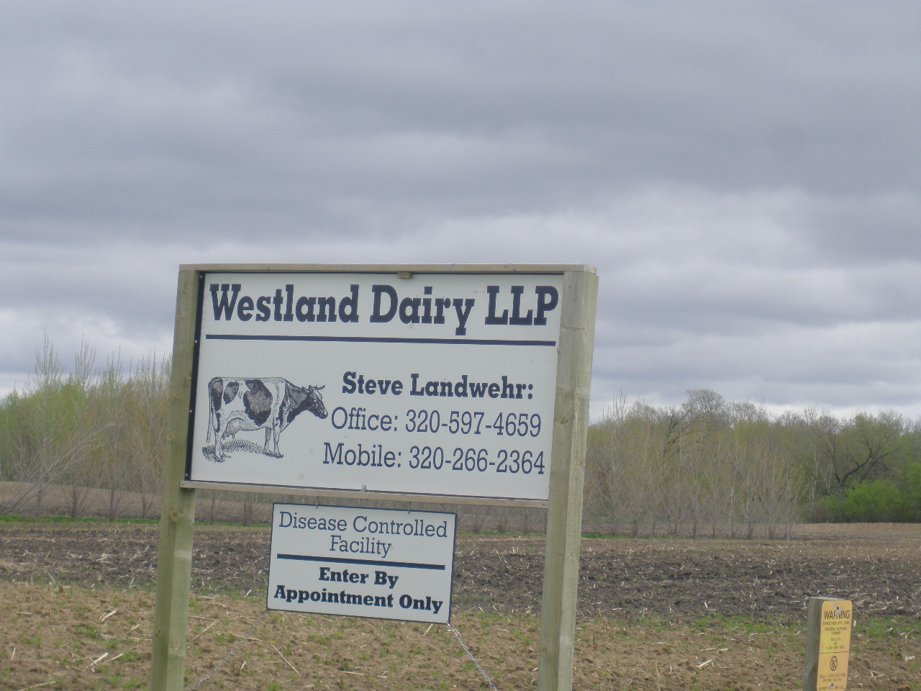
Bio security signage on a large dairy
Notes:
Call before entering!
If we are ever unfortunate enough to have any type of disease outbreak you do not want to be responsible in any way shape or form!
It would be wise for your county to consider a strategy to deal with livestock pandemics.

Slide 28
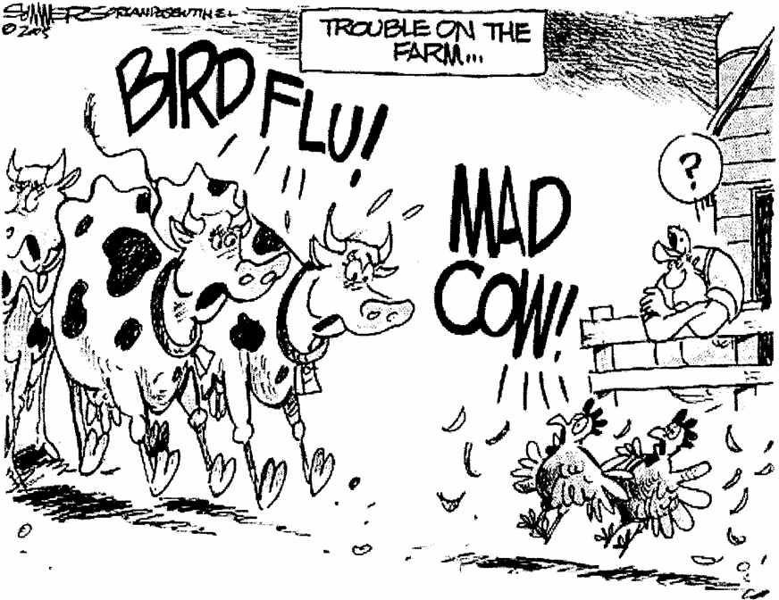
Notes:
Pandemic situations
We may very well have an occurrence or pandemic disease outbreak. If so you will need to develop a strategy to fulfill your assessment duties, during a potential quarantine type situation.
Hopefully your office as well as your county’s emergency management personnel are already thinking about these what ifs, and have a strategy in place. You may want to speak with them
In this type of event many different entities will need to coordinate their strategies.
This is almost like a disaster occurrence, but in reverse. After a disaster you may be required to review many properties in a short time to aid with disaster declarations and such. However in a pandemic situation you may very well be required or not allowed to go from farm to farm for a certain period of time.

Slide 29
Helpful tips for recording data for valuation purposes

Slide 30
Here are two examples of a data sheets to record the information for the same farm. Please note the first example has all the buildings crowded together, with numerous lines and arrows indicating that leans are attached. Imagine attempting to review this with a property owner. Or trying to figure out which building you are looking at

Slide 31
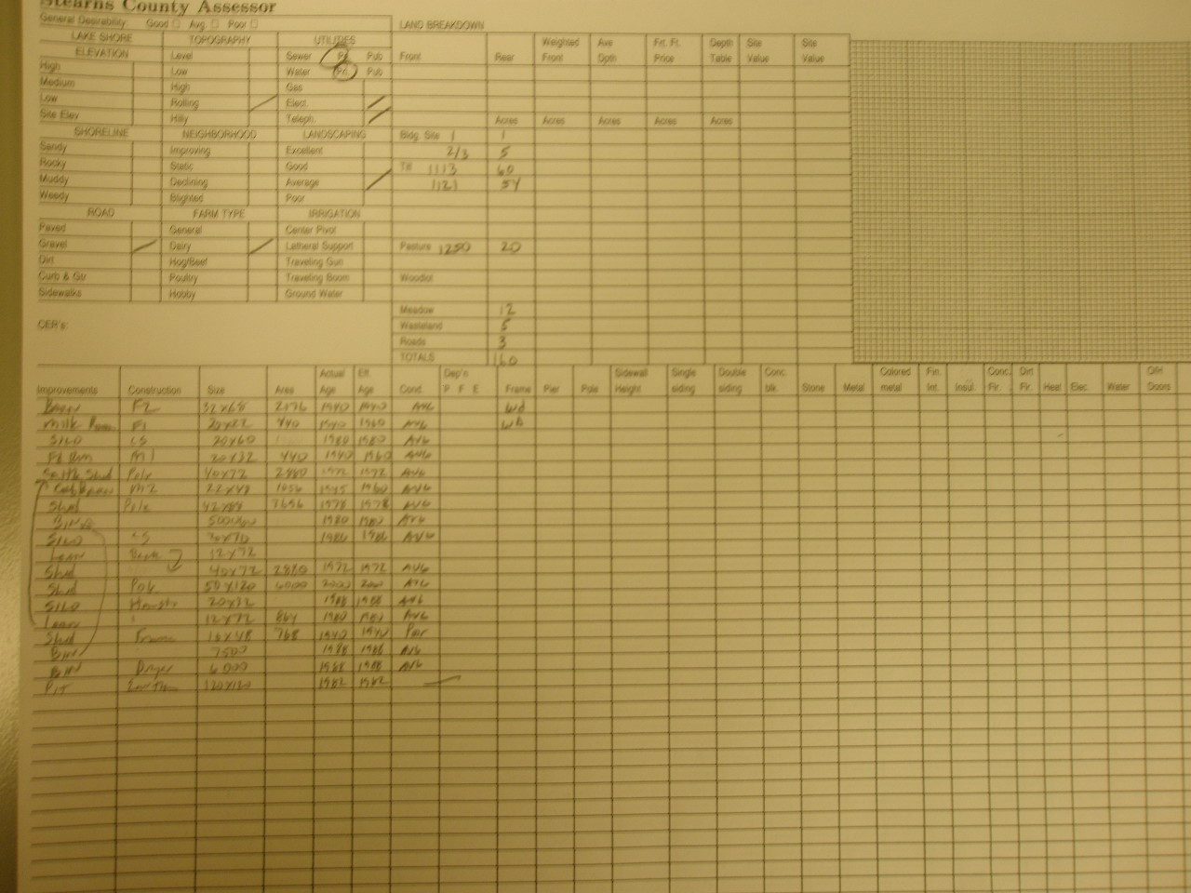

Slide 32
The second example is the same information documented in an orderly form, allowing the buildings with leans to be recorded on adjacent lines. Note spaces have been left between buildings to allow the addition of new structures. You can show this to the property owner and it will be infinitely easier to follow along.

Slide 33
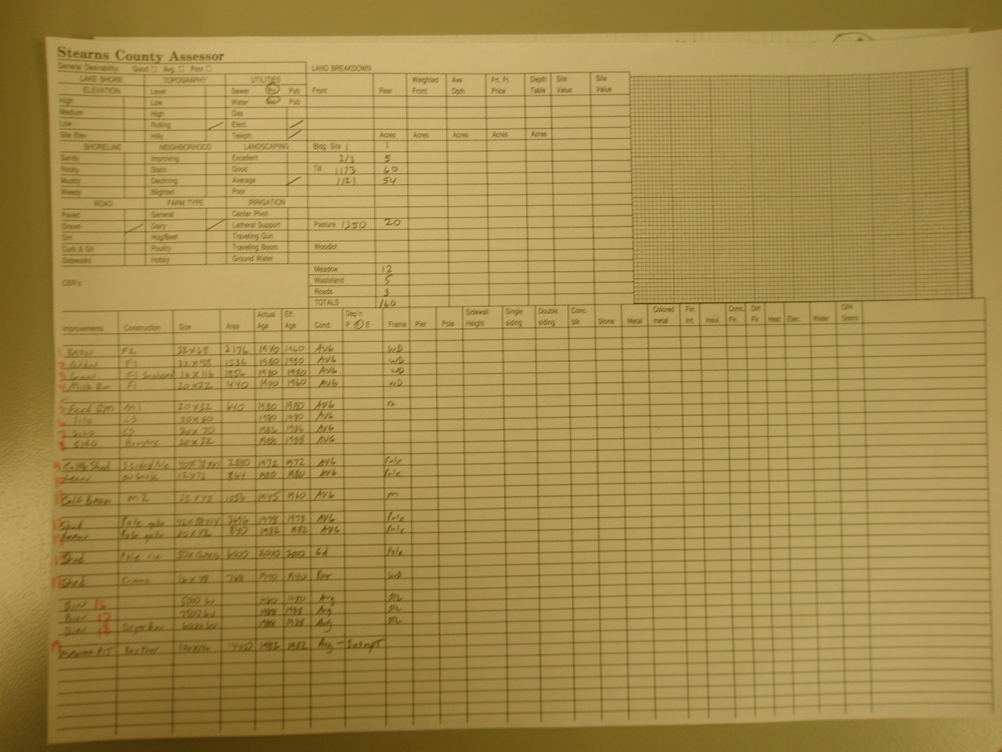

Slide 34
Mark’s most important tip
To aid this process even further I create a rough sketch of medium to large farm sites. On this rough sketch I label and number all the buildings. These numbers are us to sequence the data in the CAMA system.
Notes:
It only takes a few minutes to do this-the next review will take less than ½ the time. This has proven to be an extremely efficient method to ensure that all improvements are accounted for at each review. Should another appraiser follow me at this property, their information is not only accurate but also formatted to facilitate a quicker and more accurate review of this property. If you only use one thing from this class-this better be it!

Slide 35
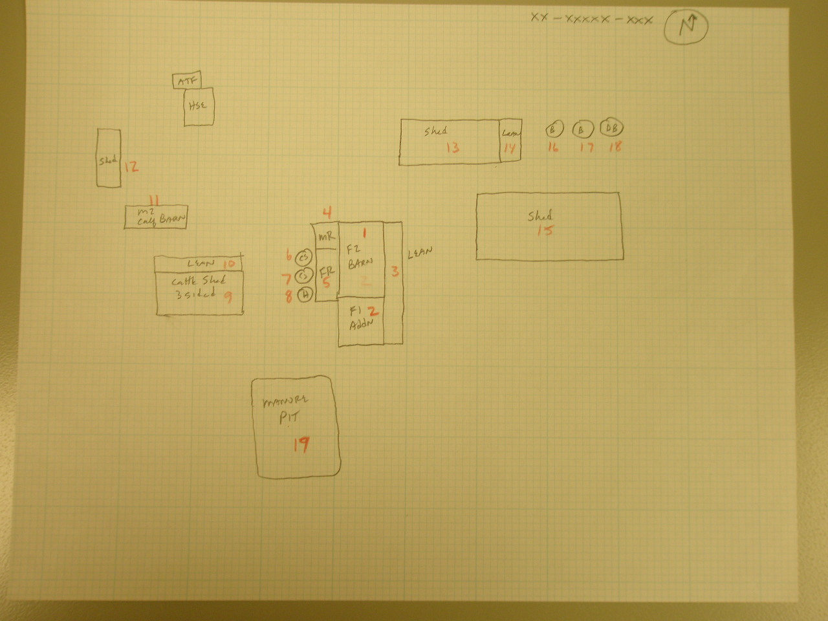
Notes:
Just a simple sketch either manual or electronic to make sure each improvement is accounted for.
I would suggest you number them to correspond with the field card or electronic record.
It is also helpful to put them in a logical order.
For example list the main building and follow with any additions, etc.

Slide 36
If you encounter mid to large farm properties, you may want to consider using this type of technique in your assessment.
Current technology also allows us to utilize the recent aerial photos to document and label each structure on a farm site.
We are now doing this electronically-we eventually will GPS the buildings and all their information.

Slide 37
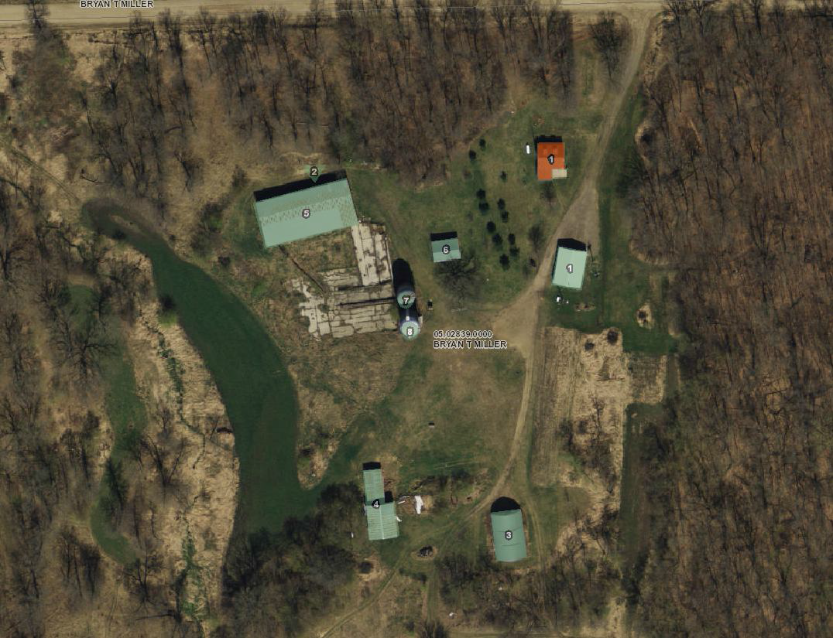
Electronic outbuilding sketch
Notes:
An example of a digital version farm outbuilding sketch

Slide 38
FARM BUILDING
RATES AND DEPRECIATION

Slide 39
Typical agricultural outbuilding rates
These rate ranges are examples of replacement cost new (RCN).
They may not be the actual contributory values for your specific market area.
They are intended only as a reference and are
broad and general in nature.
Different regions/counties may have different contributory values/rates.
Notes:
Do your own homework!
Sources such as the Marshall Swift Valuation Service can be helpful

Slide 40
Additional considerations
Some counties also utilize an additional quality modifiers.
The default should be average for that type of building.
If substandard (used materials, poor workmanship) 10% as a possible negative adjustment.
If high end materials (sidewall height, brick/stone trim, porches, awnings, etc) 10% as a possible positive adjustment.
As always the key would be consistent and uniform application in these rates.

Slide 41
Sample rate ranges
Pole frame sheds for machinery and or livestock:
Old <1980 $4-$6/sf
Newer >1980 $6-$12/sf
Shops
Low-avg quality $15-$18/sf
Good-excellent quality $20-$35/sf

Slide 42
Added considerations that may be considered in the valuation of pole frame buildings and shops:
Concrete floor (should be included with shop rate)
OHD vs sliding doors (OHD’s should be standard on shop rates)
Ext dress (soffits, fascia, cupolas, wainscoting)
Sidewall height (incremental increases starting with +12 ft)
Office areas
Bathrooms
Mezzanine/loft storage
Reductions for one or more open sides

Slide 43
Old frame farm outbuildings
well house, tool sheds, old style machinery storage sheds, granaries, old chicken coops, etc.
$1-$4 sf
Many of these have minimal utility or
Function.

Slide 44
Traditional 2 story barns
$6-$12/SF
Added considerations:
Exterior dress
Are they still in use?
Add for loft or have that built into the rate.
If repurposed-use the rate for that alternate purpose-ie man-cave, house, workshop, etc.

Slide 45
Other types of dairy barns
Curtain sided and tunnel ventilated free stall dairy barns, holding areas, and maternity rooms:
$12-$18/sf
Retro fitted parlors( flat parlors inside old barns) or old parlors built >1980
$ 12-$20/sf

Slide 46
New style parlor/milk, equipment room
$30-$35/sf
Added considerations:
Manure pits (exempt but they do add value), exterior dress, office, sidewall height, employee rooms, bathrooms, sized to facilitate or allow expansion, etc.

Slide 47
Hog barns
Enclosed hog gestation, farrowing, and nursery barns:
$10-$15/sf
Curtain side finishing barns:
$12-$15/sf
Additional considerations; manure pits (exempt but they certainly add value), connecting hallways, loading docks, office, bathroom, etc.

Slide 48
Poultry barns
$6-$10/sf
Additional considerations:
Service rooms, egg rooms, second story, vent doors vs curtain sides, cooling cells, concrete or clay floor, sized to contracting company specifications, is the contract in place?, etc.

Slide 49
Grain bins
Older small bins <2500 bushel-probably only a salvage type value
Bins >2501-10,000 bushels-$1/bu
Bins 10,001-50,000 bushels $1.50-2/bu
Mega bins 50,001 bushel and up $2.50-$3/bu

Slide 50
Again to reiterate these are general guidelines and need to be regionally/county market specific. To review and set your local rate tables, use local resources, as well as national cost guides-such as Marshall Swift Valuation Guide. There are always variations and options that require additional research and good judgement to arrive at the contributory value.
.

Slide 51
Be aware that most agricultural buildings do not contribute the same value as the actual cost to build (RCN). They are built to produce revenue over the economic life of the building.
Generally about 40-60% of cost
You don’t typically find spec built ag facilities.

Slide 52
Depreciation rate guidelines
A good rule of thumb is non-livestock
buildings will depreciate at about 1-2%/yr.
Most livestock facilities will depreciate
between 2 and 3%/yr.
Observed condition is a major
factor in the final determination of value.
Notes:
Some people can break a crowbar!
Wear and tear is normal-but livestock can be tough on a building.
Most livestock facilities are designed to last 25-35 years (economic life).
However they usually require some short lived component replacement during their productive life.
Most short lived components will be replaced 2-3 times during the economic life of the building.
Be aware that economic obsolescence also occurs.

Slide 53
Agricultural outbuilding depreciation guidelines
Generally speaking most agricultural buildings have an economic life expectancy of 30-40 years. For purposes of this illustration I am using 35 year economic life.
During this economic life most livestock buildings will require at least one significant repair, refurbishing, or
remodeling to maintain the desired function.
Some commonly replaced items include replacing
rusty roof and sidewall steel, doors, curtains sidewalls, ventilation fan assemblies, wiring fixtures, plumbing, etc.

Slide 54
The humidity and manure gases from housing livestock lead to corrosion. Also, livestock chewing, pushing, and rubbing on walls can damage wall sheathing. The amount of cleaning and regular maintenance (or the lack thereof) can also contribute to wear and tear.
Any type of structural issue, such as a sagging roof line or leaning/bowing walls can indicate
serious issues for a building. This should be noted and the value adjusted.
We are speaking about an appraisal principle called cost to cure.

Slide 55
The cost to cure can exceed the contributory value of the building. If so, the building may be un-used-or in an altered type of use. .
The personal property inside such as, feeding and milking equipment, and gates are often replaced 2-3 times during the life of these livestock buildings, and is not a factor in assessment.

Slide 56
Depreciation tables
Many assessors will place livestock facilities on an annual table driven depreciation schedule.
In Stearns County we table depreciate most livestock facilities at 2 to 3% per year. At 3% annual depreciation in 23 years the building will be 70% depreciated or it will have 30% remaining
economic life. At this point we stop annual deprecation at 30% residual. If the building is still in
use it will stay at this 30% residual value until it either becomes vacant or re-purposed. If vacant and un-used a salvage value may be appropriate.

Slide 57
For most non-livestock buildings we depreciate at 1-2% year.
So most non-livestock buildings/improvements reach the 30% residual value at 30-35 years.
If the building gets renovated, repurposed or razed react accordingly.

Slide 58
Observed condition will always over ride table depreciation.
Many agricultural building can become functionally obsolete as technology and farming trends evolve.
The best indicator of functional obsolescence is the actual use-are these structures still being used for the same purpose that they were built and designed for?

Slide 59
When appraising rural properties it is quite common to find or observe older farm buildings, that may be obsolete.
Addressing these structures is important, since we are valuing their contributory value.
2 types of obsolescence are common with agricultural properties functional and economic
They are often closely related and can be difficult to determine

Slide 60
    Functional obsolescence
      A design change-livestock facilities have changed significantly over time
      A shed with 10 foot sidewalls-most machinery is now 14-18 feet tall
    The facility may be in average or fair
    useable condition and in use-but may
    still be obsolete

Slide 61
Economic obsolescence
How many of you would like to invest in a shopping mall
A contractual poultry or livestock facility does not have the
contract renewed
The facility may be in decent shape-but without a production
contract, it is not viable
The size or design of a facility may also make it un-profitable

Slide 62
How do you determine this?
  Are these buildings or improvements in use?
    Is the poultry barn still housing birds?
    Is the hog barn still housing hogs?
    Is the dairy barn still used as such?
  Is the current use the same as the original purpose or has it been re-purposed?
  Are there a lot of these dark/unused/vacant/or repurposed structures in the market area? Upright silos is a good example.

Slide 63
You may also develop and use paired sales data to help with this consideration.
Remember you are measuring the contributory value of these structures.
Here are some examples of structures that could be considered obsolete

Slide 64
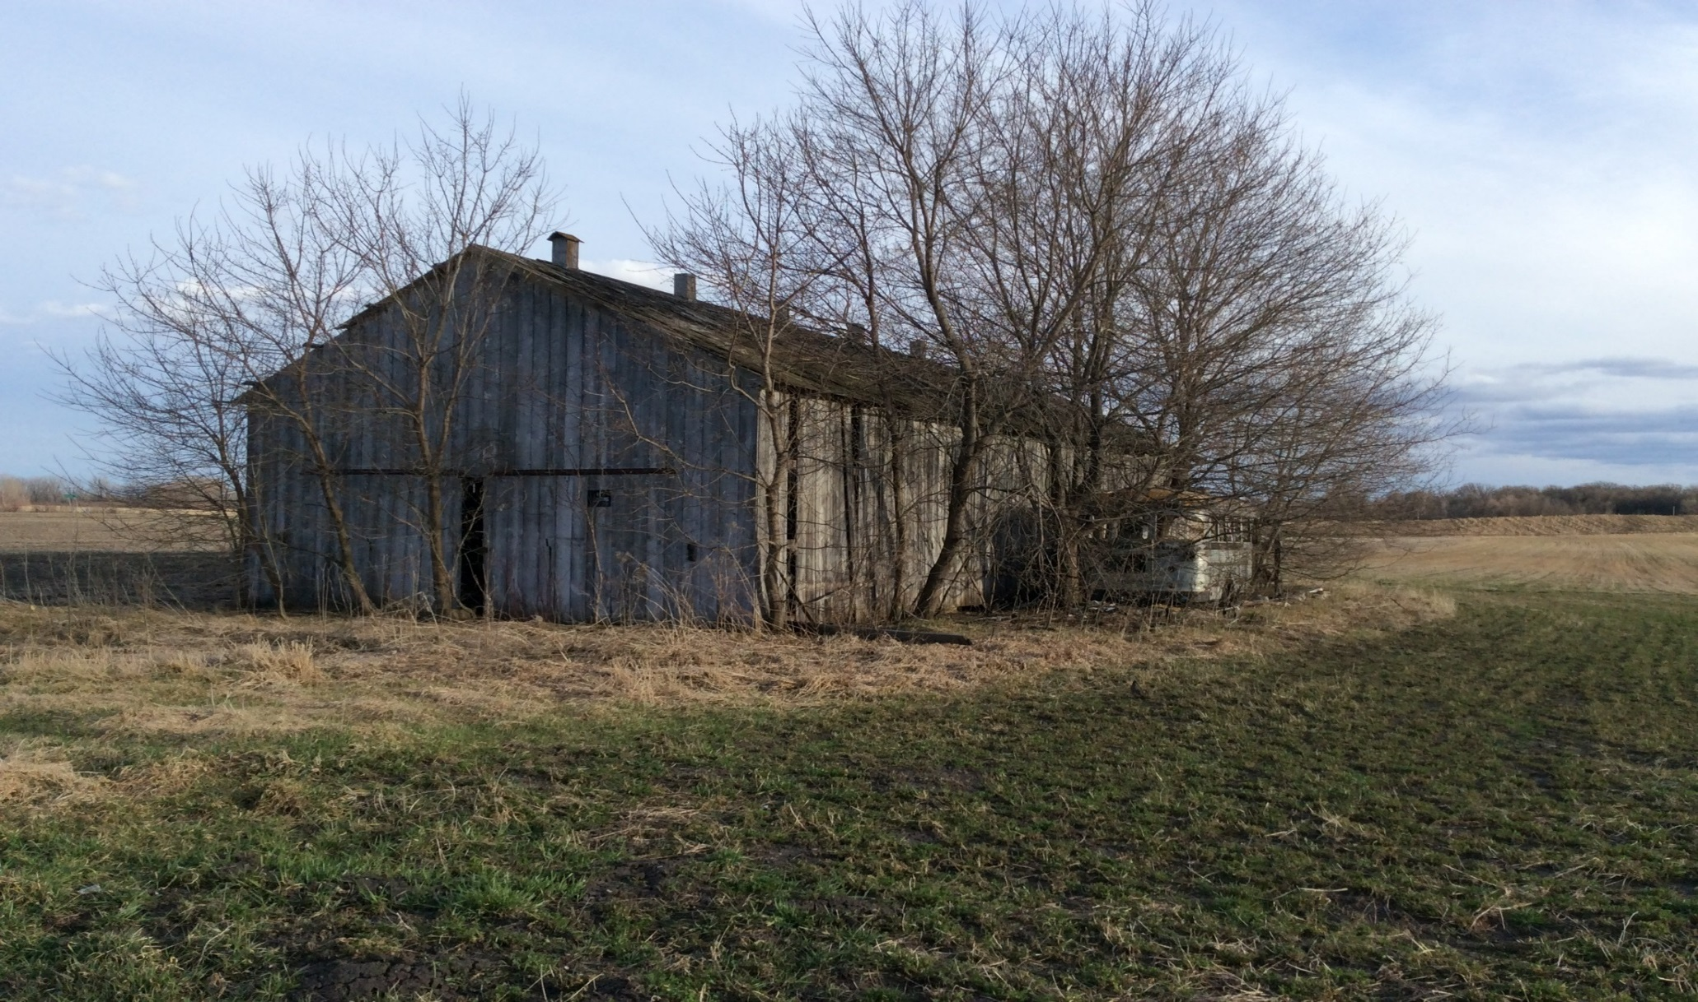
An old tobacco drying shed

Slide 65
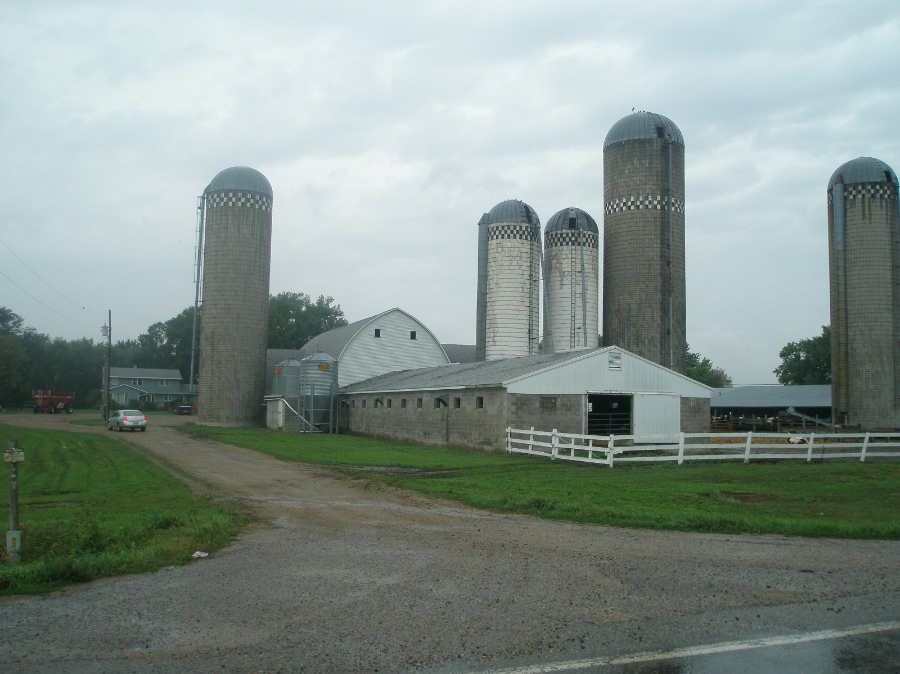
Traditional Dairy Operation
Notes:
Original F2 barn with numerous additions-still in operation

Slide 66
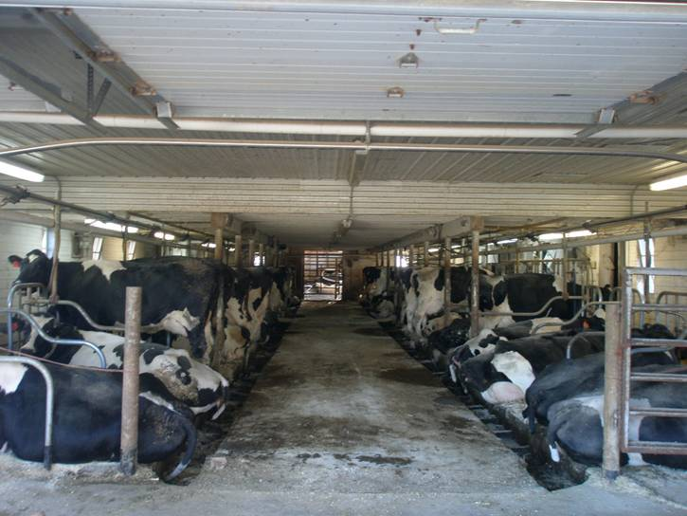
Tie stall barn interior view
Notes:
Note post on back part-original 2 story part-front part one story addition.

Slide 67
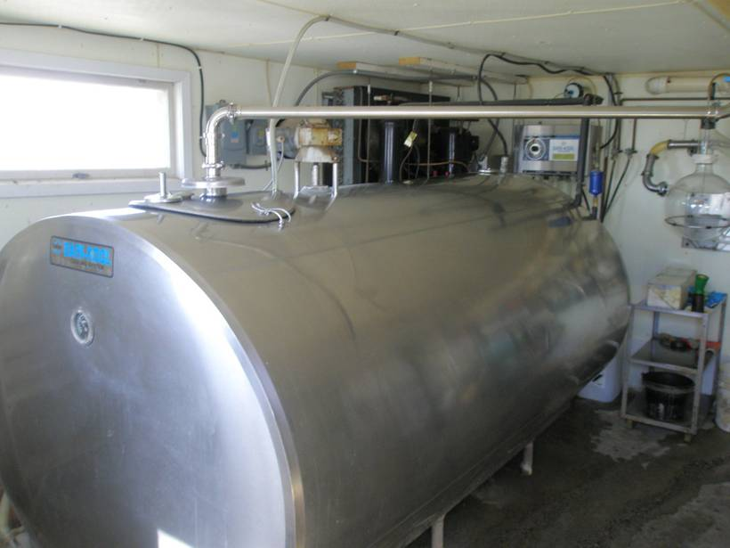
Small bulk milk tank
Notes:
This is from a small 50 cow dairy

Slide 68
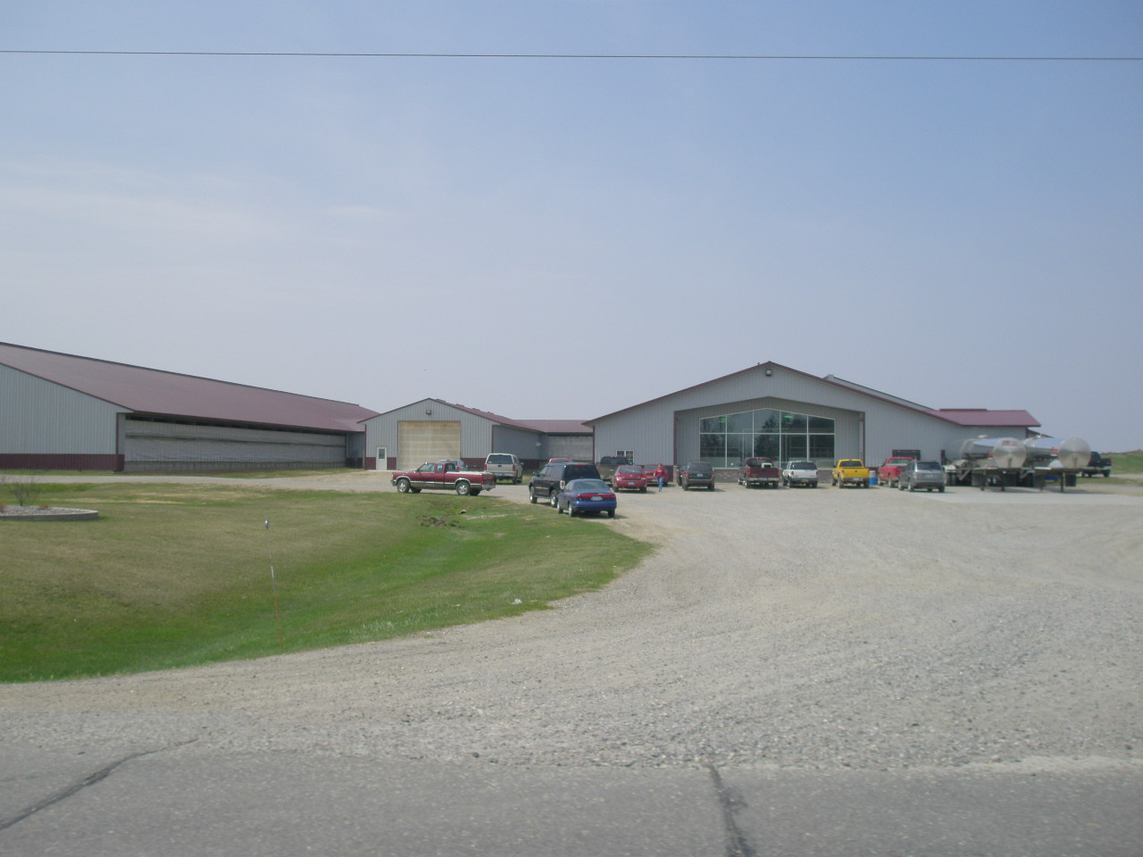
A large 1200 cow dairy
Notes:
Look familiar?

Slide 69
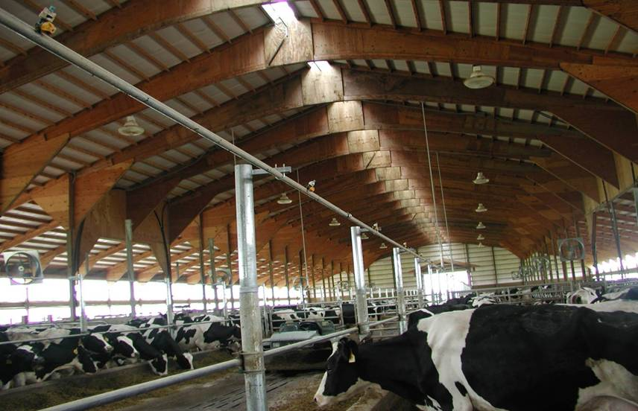
Large Free Stall interior
Notes:
---Curtain wall open ridge
Lactating cows produce a great amount of heat-so these facilities need to be well ventilated

Slide 70
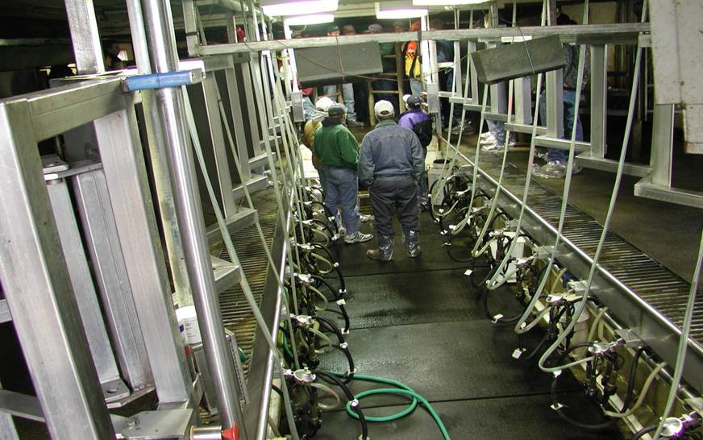
Large milking parlor interior view
Notes:
This is a double 12 unit-where 24 cows are milked at one time

Slide 71
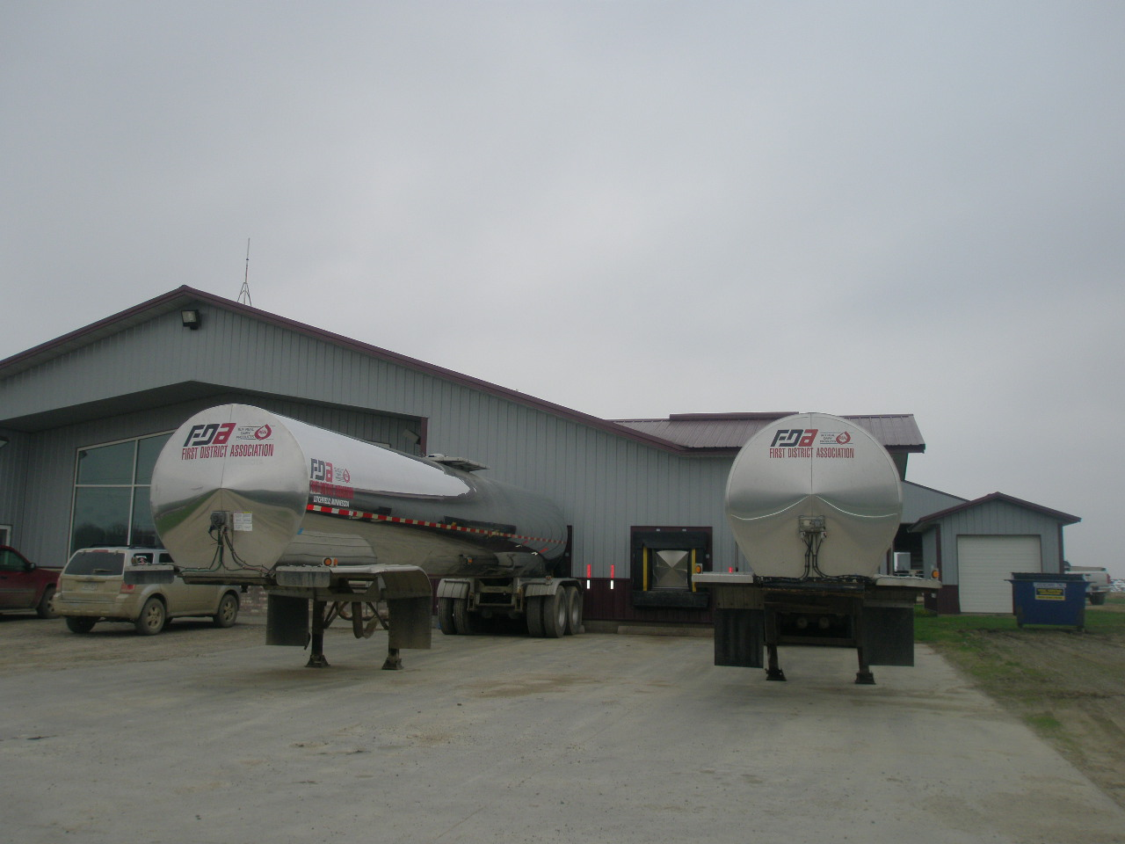
Direct loading of milk to tankers in a large operation. This 1200 cow operation fills a tanker with each milking.
Notes:
This farm is large enough that the raw milk is pumped directly from the cooling plates to tanker trucks.
These tanker trailers take the place of the bulk tank.
This one has 3 bays for tankers.
His milk cooperative/purchaser furnishes the tankers.
Some farmers own their own to allow them to switch to a different purchaser.

Slide 72
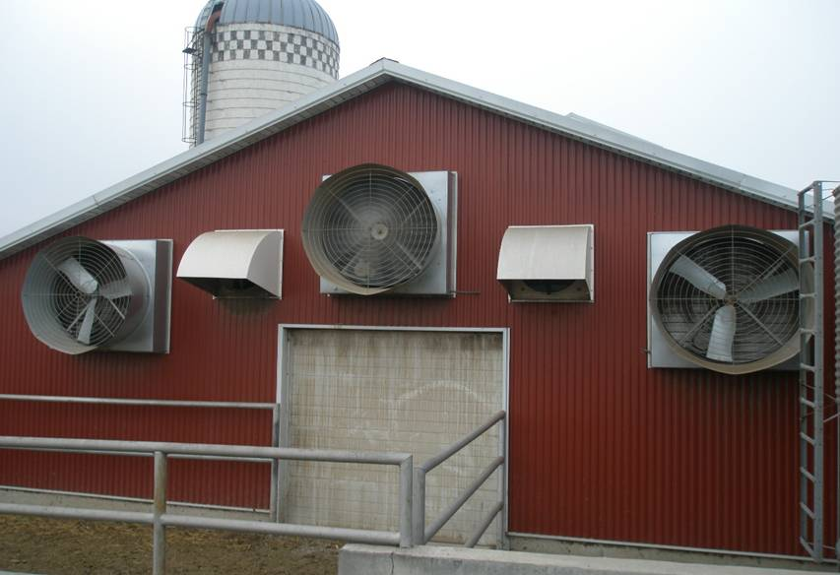
Tunnel Style Ventilation
Notes:
Tunnel style ventilation-all fans are on one end of the barn and massive amounts of air can be moved thru the barn, as temperatures dictates

Slide 73
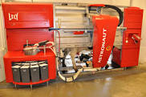
A robotic milking station
Notes:
These cost about $250,000 per unit each unit is capable of milking about 70 cows.
We tend to see these on small/mid sized operations with limited labor.
The cows have a collar with bar coded information and can get milked as often as they feel the need.

Slide 74
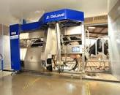
Another brand
Notes:
These units wash the udder, identify each animal and their production-alerting the owner of a decline or change in production. They also self sanitize between each cow. They will notify the farmer electronically on his smart phone or other mobile device of any problems.

Slide 75
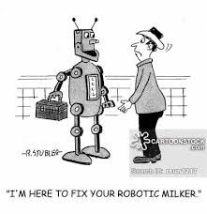
Notes:
Most vendors offer extensive service plans-usually with a 1 hour response time.
Central Minnesota has about 80-100 of these in operation.
They have a user support group to share tips.
They appear to be quite successful.
The owners report the time savings can be used to do a better job of analyzing production data.

Slide 76
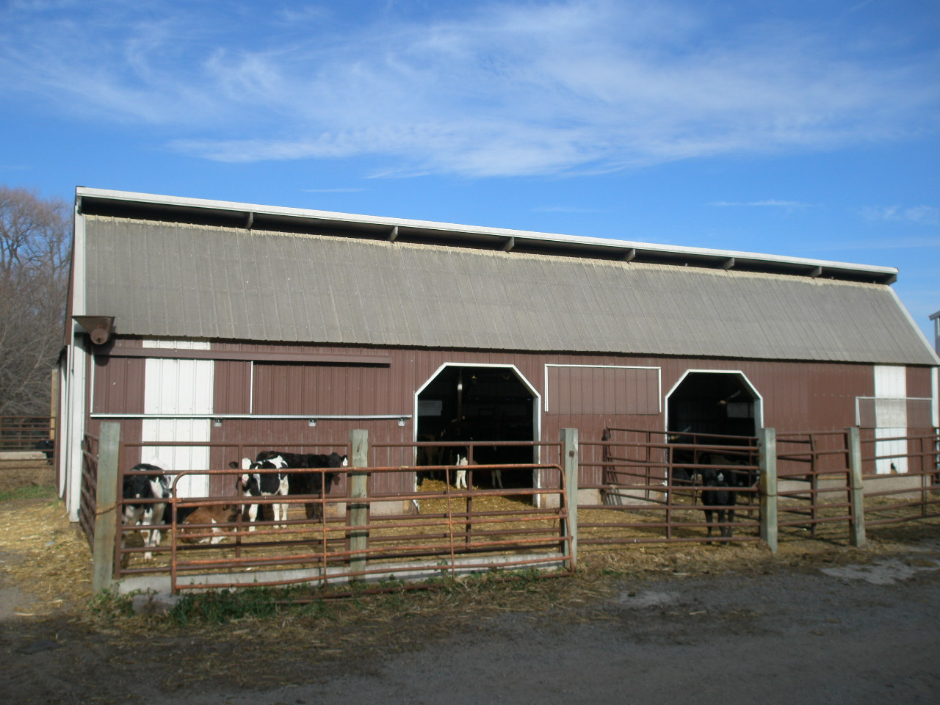
Solar front cattle shed

Slide 77
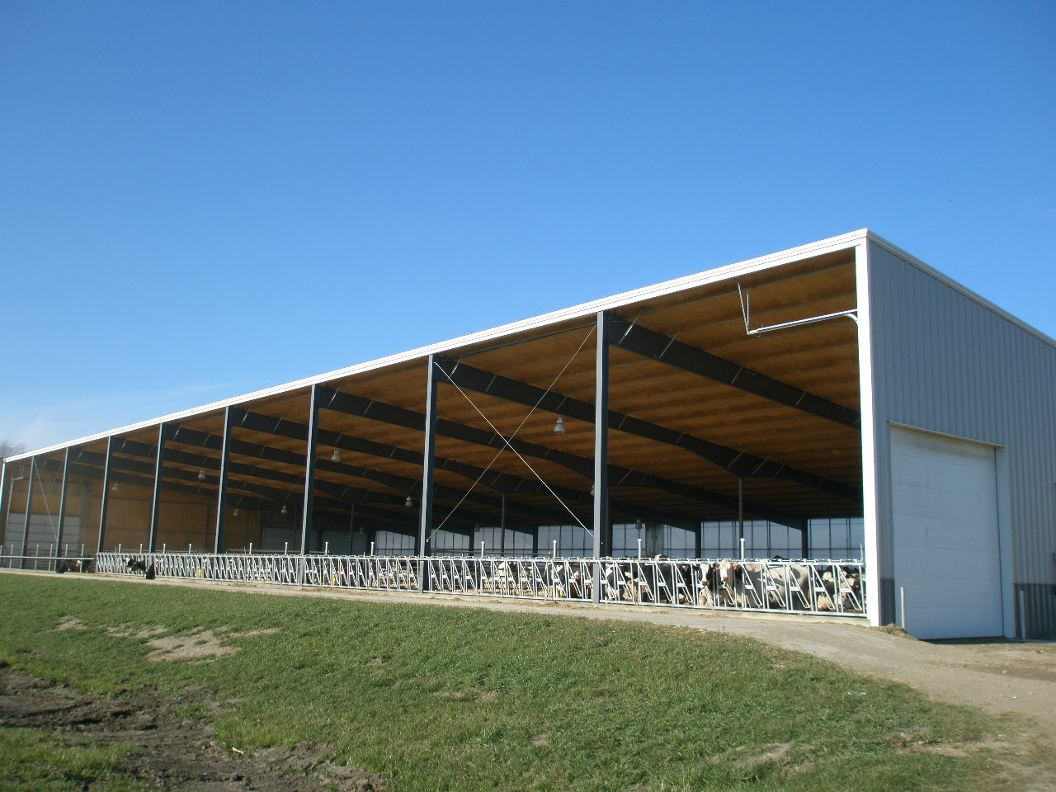
Large open front w/head gate)
Notes:
While the cattle are eating each section of the head gate can be locked to allow treatment or insemination of individual animals

Slide 78
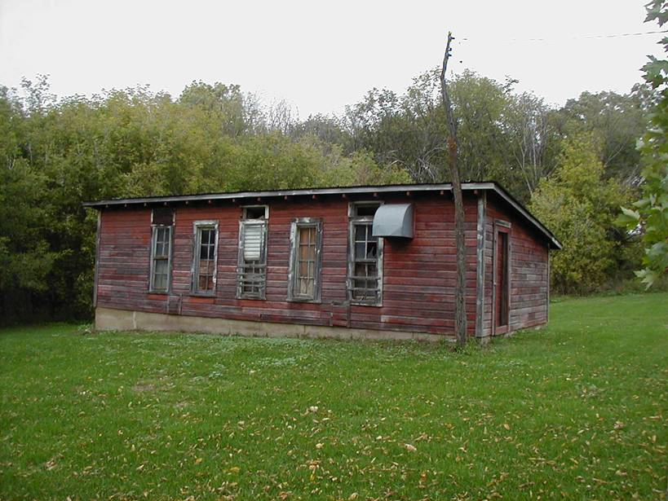
Old classic chicken coop

Slide 79
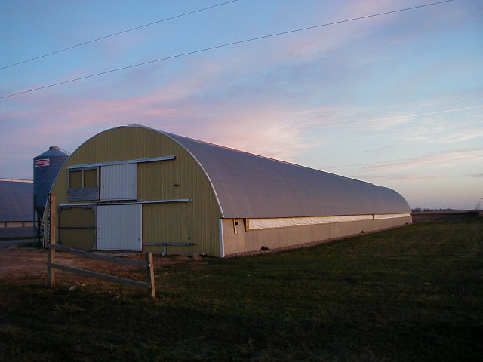
Older two story poultry barn

Slide 80
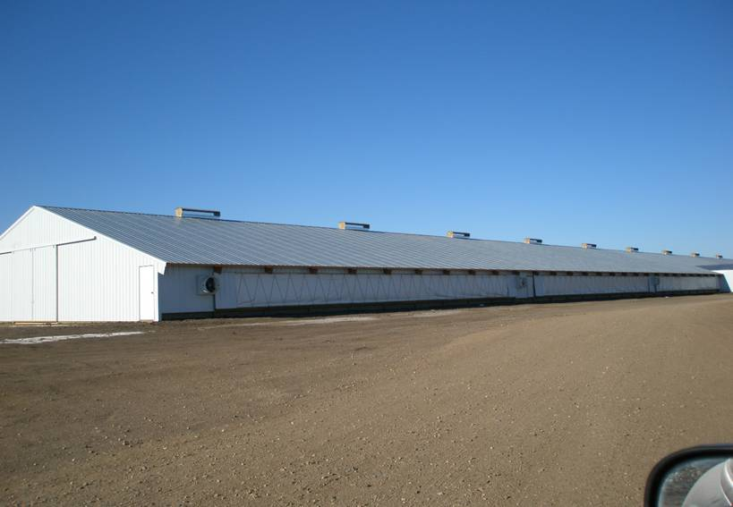
Large Turkey Barn
Notes:
Most newer turkey grower barns now include some type of curtained sides

Slide 81
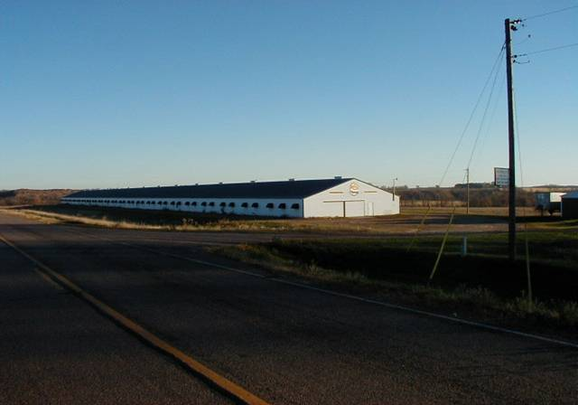
Single story chicken barn

Slide 82
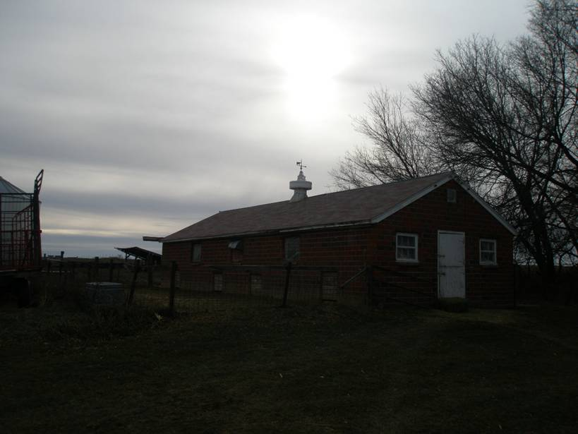
Old red tile hog barn
Notes:
Note the small doors on the side to allow the hogs to enter and exit

Slide 83
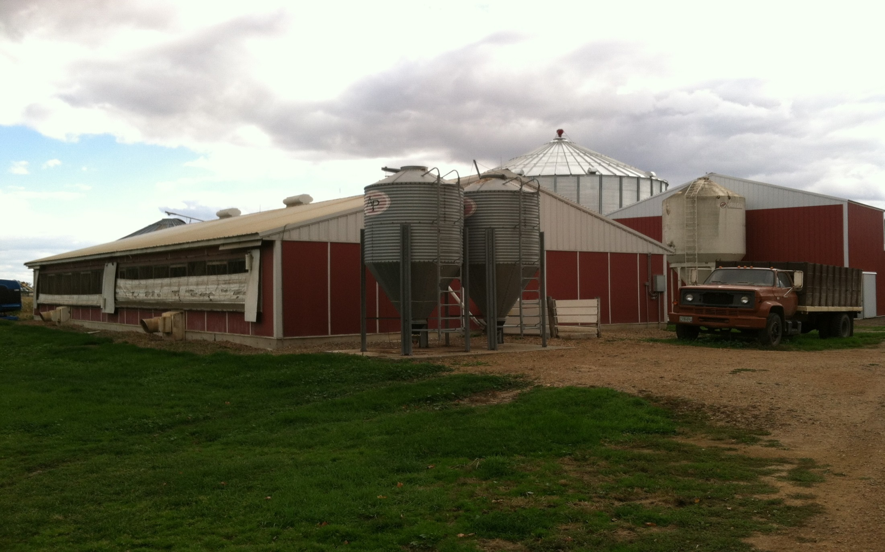
Older hog facilities

Slide 84
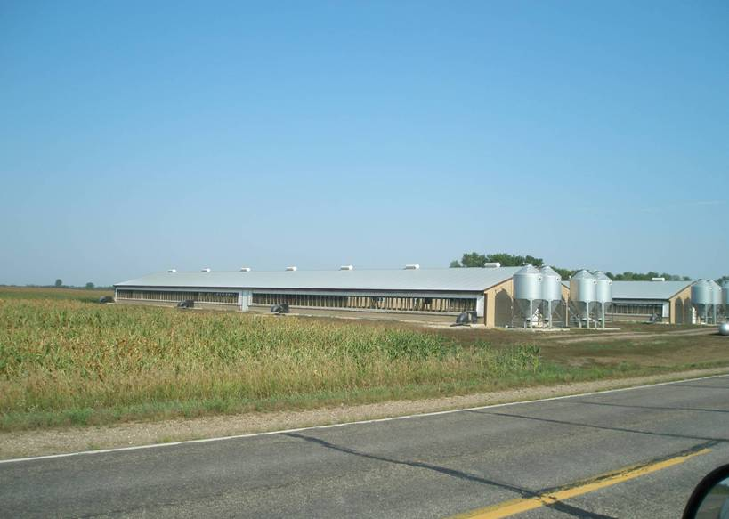
A large curtain sided hog finishing complex
Notes:
Note the exhaust fans along the sides to remove gases from the manure pit

Slide 85
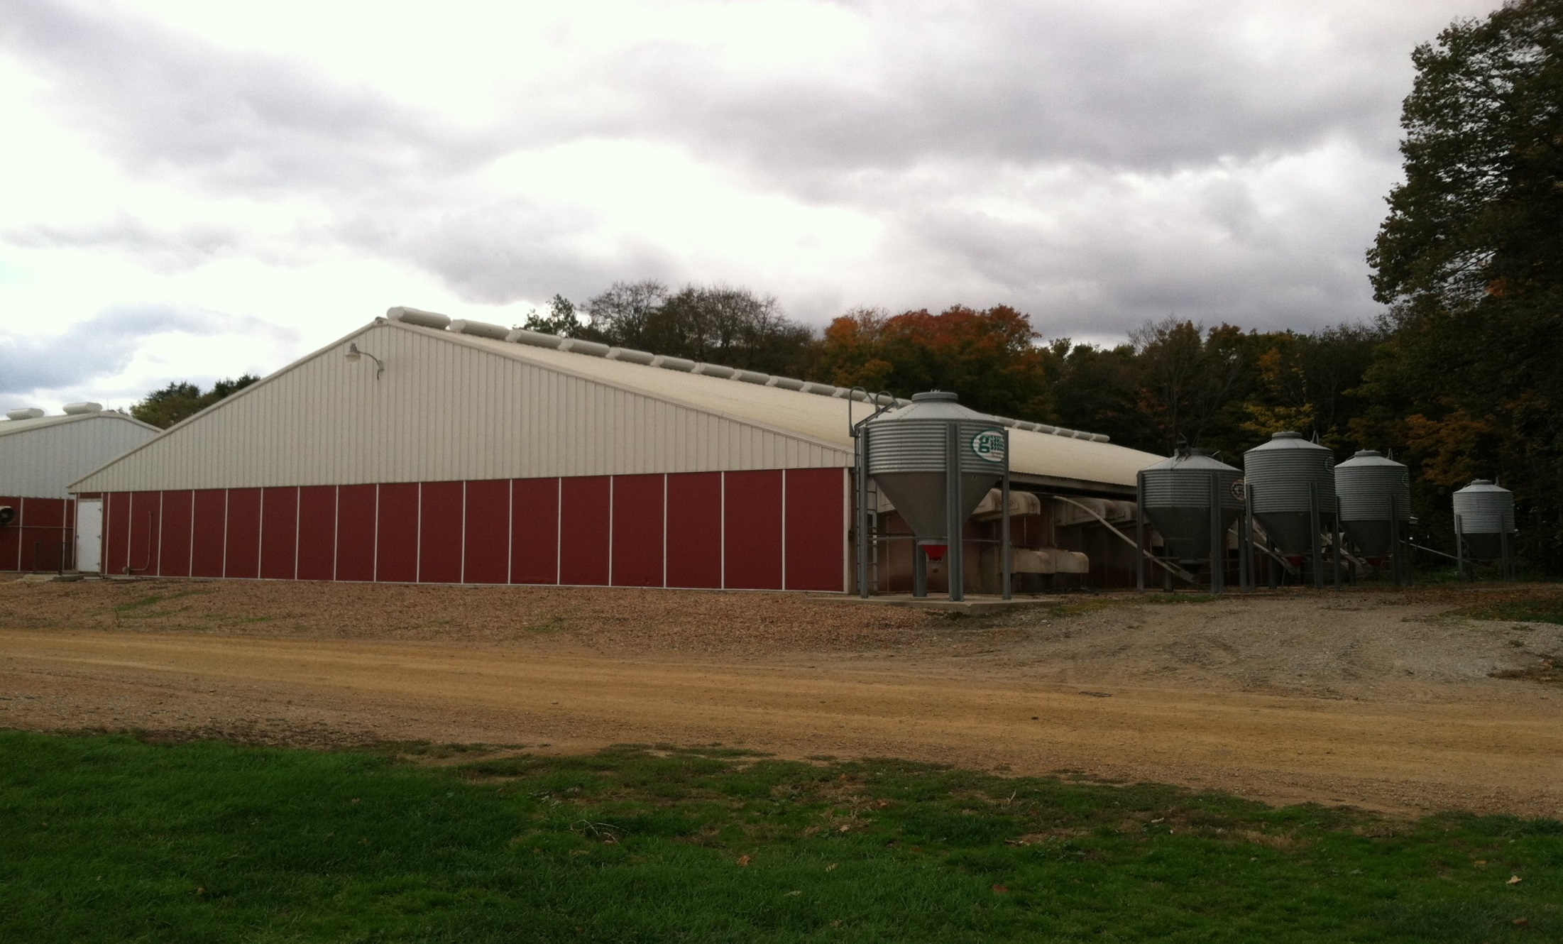
A newer type hog barn-with multiple rooms
Notes:
Most new farrowing/nurseries have multiple rooms within a larger building.

Slide 86
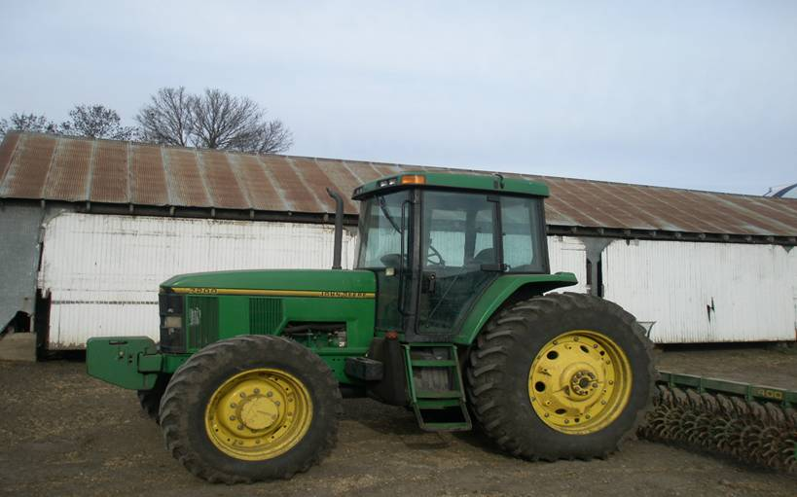
Old shed
Notes:
Note the tractor is 11 feet tall while the shed has 10 foot sidewalls.
Talk about functional obsolescence

Slide 87
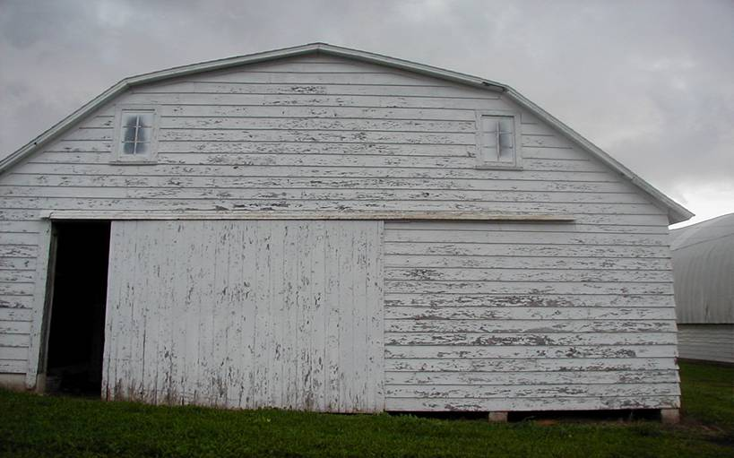
Old style machine shed

Slide 88
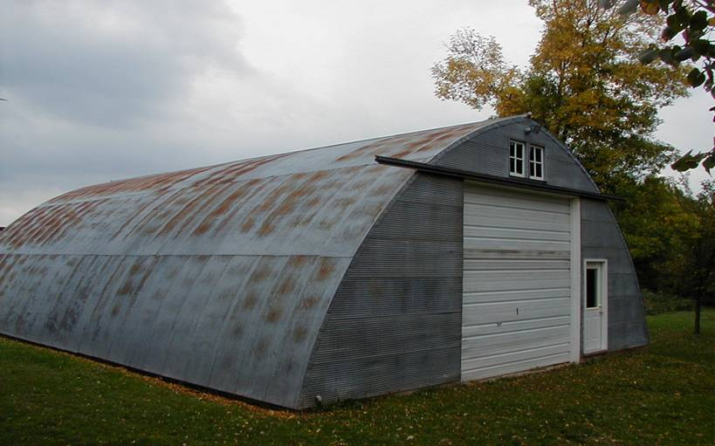
Older Quonset style shed
Notes:
note the sliding doors have been replaced with an overhead door

Slide 89
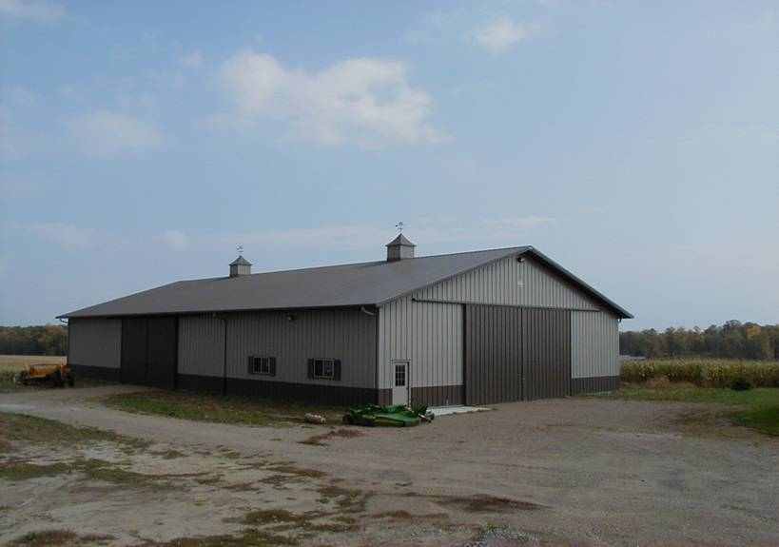
Decorative pole frame shed

Slide 90
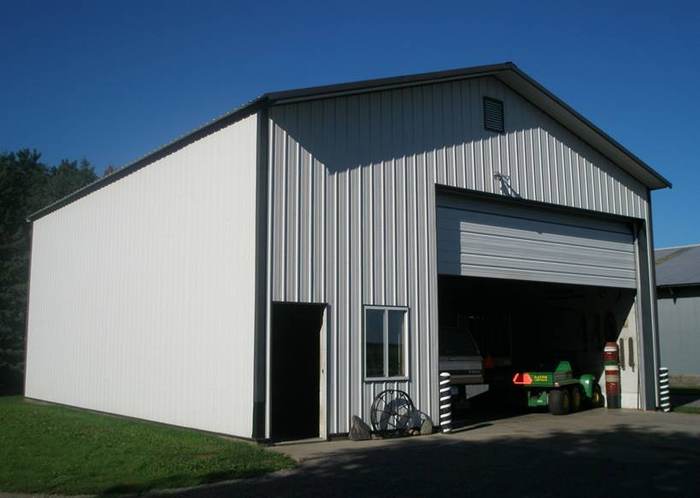
Small farm shop with 18 foot sidewalls

Slide 91
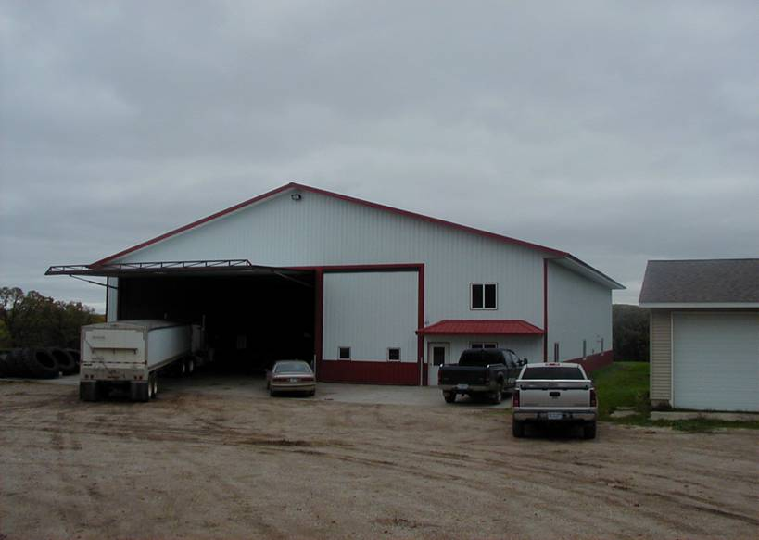
Large Farm Shop
Notes:
This shop includes an office, shower room, and storage area above them. 60 x 140 x 20.
As the equipment gets bigger so does the shop.

Slide 92
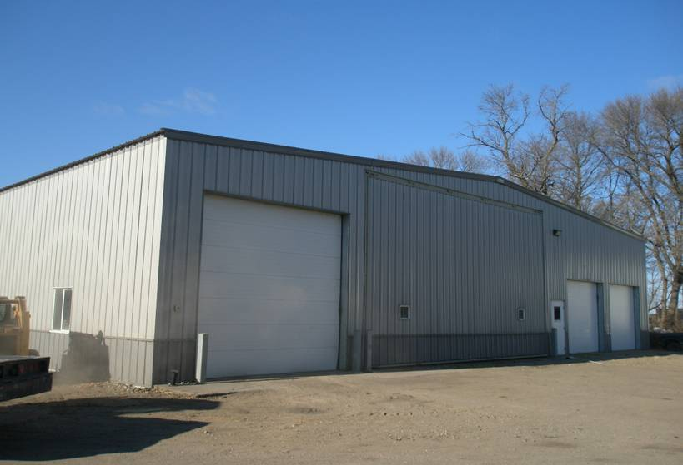
Large Farm Shop
Notes:
Another large shop with metal frame construction.
This one is 60 x200 x 20. The back 100 feet is cold storage.

Slide 93
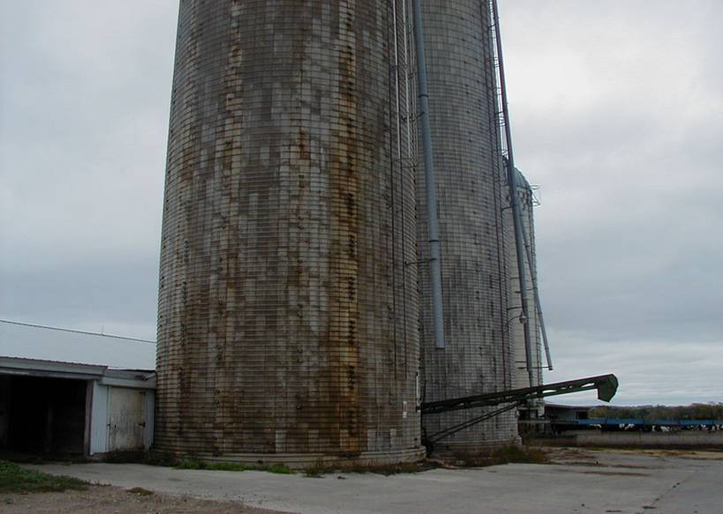
Concrete Stave Silos-rusting-physical depreciation
Notes:
Concrete stave silos-note the one in front has been filled with corn silage that was too wet, causing it to seep. The very acid silage seepage will greatly shorten the life of the silo. They can be relined or replastered to remedy this. However the exterior will always show these stains and rust.

Slide 94
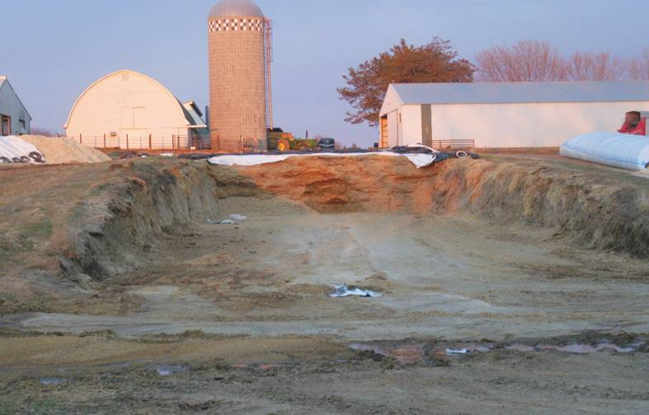
Very low cost silage storage with upright silo
Notes:
Simply a hole dug into a side hill and filled with silage-commonly referred to as a pit silo-probably no additional contributory value.

Slide 95
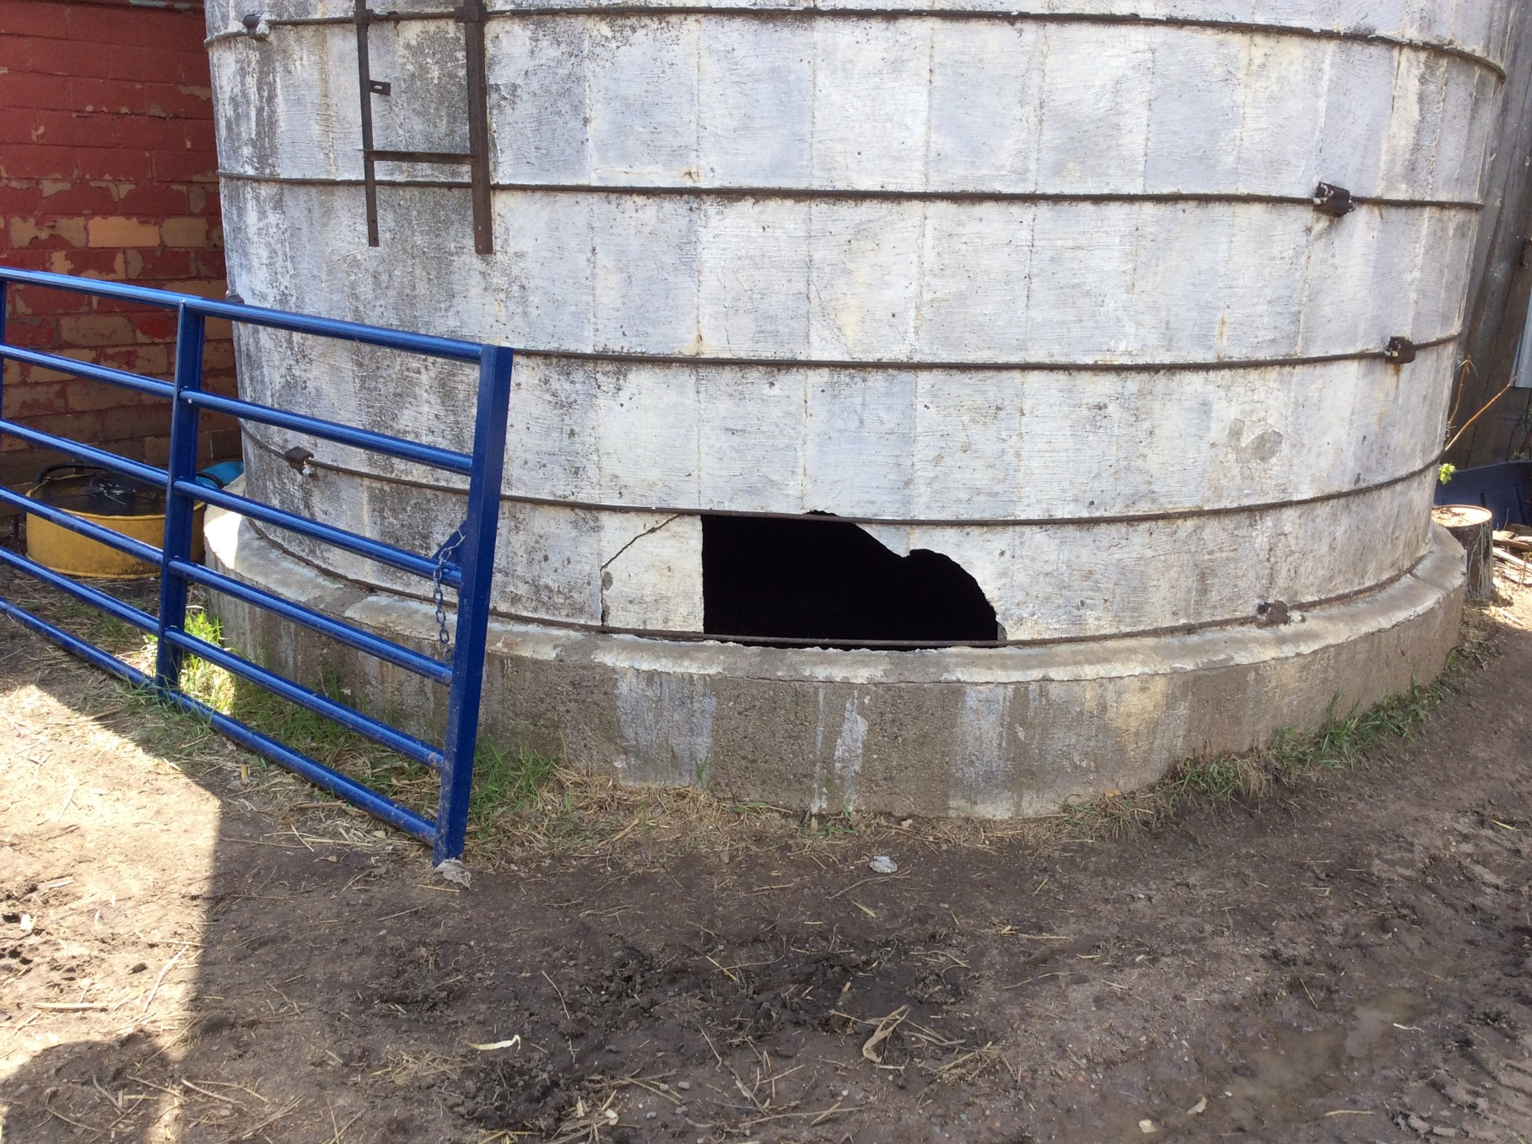
Old silo-probably dangerous to be around?

Slide 96
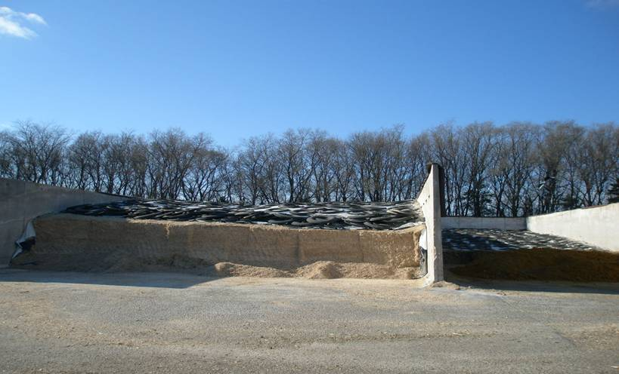
A large bunker silage storage
Notes:
Note the separate compartments for different feedstuffs

Slide 97
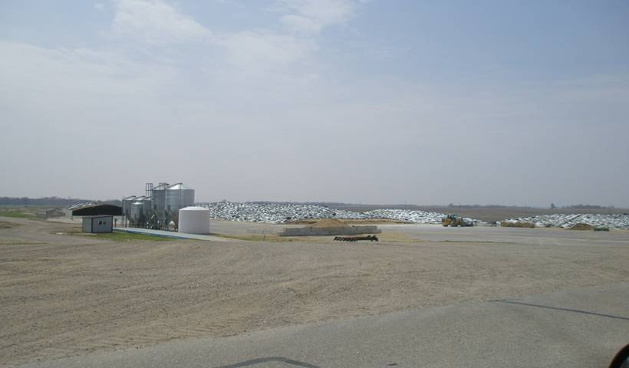
Large Feed Storage 8 acres of asphalt
Notes:
Note the drive on scale and hopper bins to store and weigh the feedstuffs. This operation has 12 acres paved for this purpose. This is a typical feed storage and handling area for a large dairy operation.

Slide 98
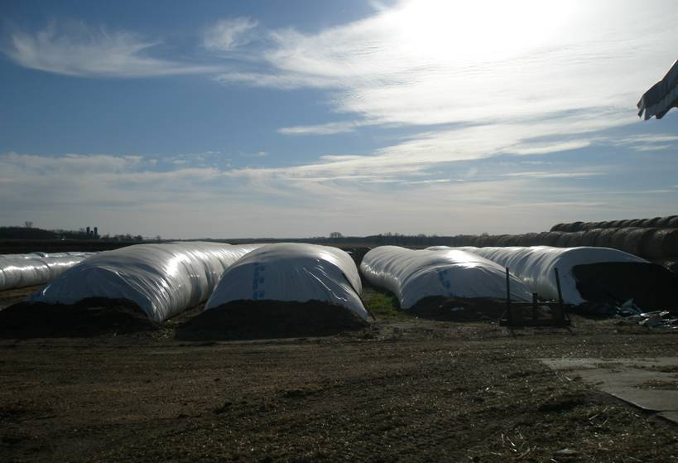
Silage bags-personal property
Notes:
The bag are only used one time and can cost $1,000 or more depending on size

Slide 99
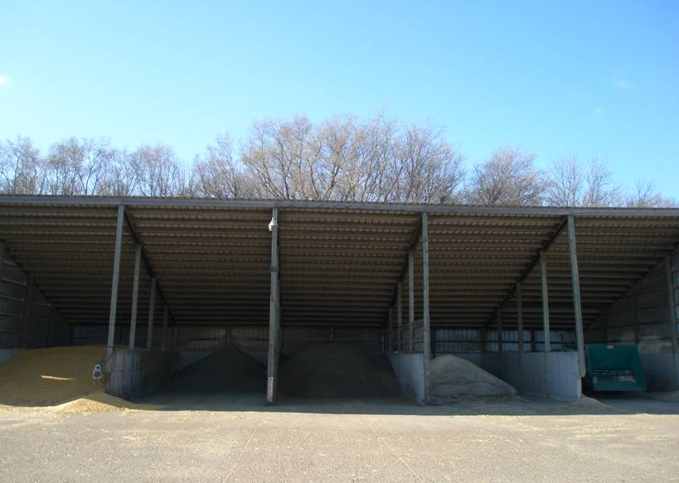
Open front shed-commonly called a commodity shed.
Notes:
Usually found on large cattle operations-used to store bulk feedstuffs prior to mixing with the cattle ration

Slide 100
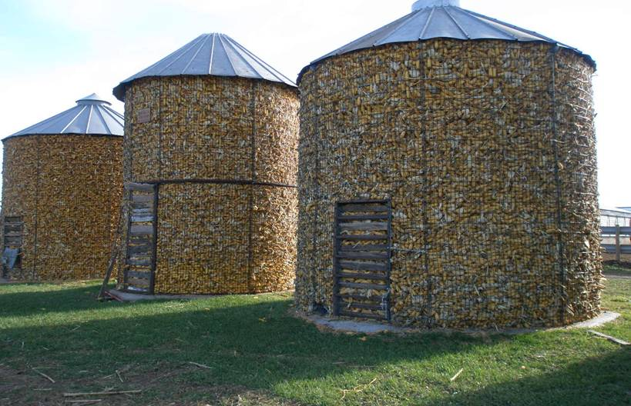
These are wire corn cribs still in use
Notes:
THESE ARE GETTING QUITE RARE-they do make pretty nice gazebo’s

Slide 101
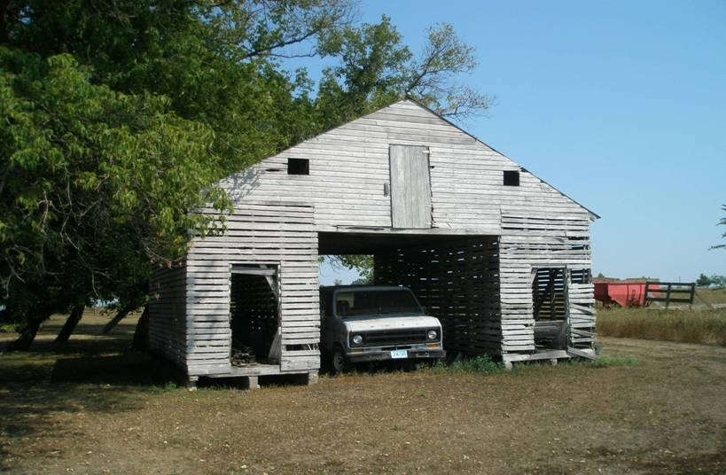
This is a drive-thru corn crib.
Notes:
These still have some storage utility

Slide 102
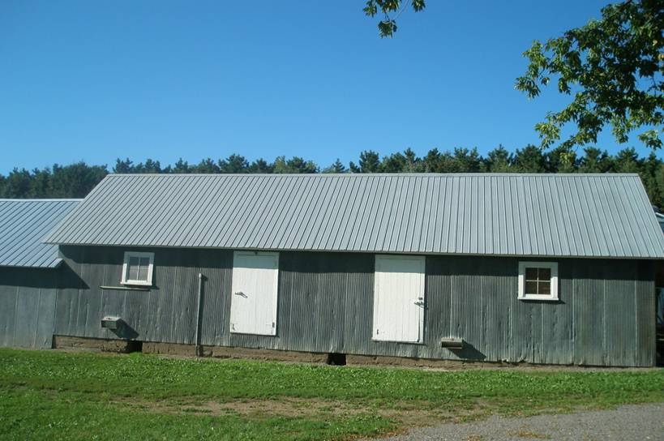
Old Granary
Notes:
An old granary in fair condition.

Slide 103
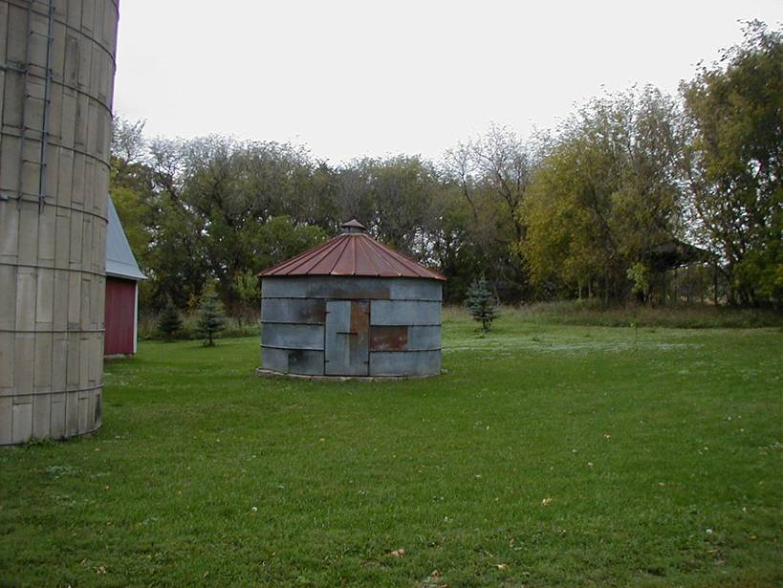
An Old Grain Bin
Notes:
-VERY LOW HIGHEST AND BEST USE! Playhouse-yard shed-kennel?
Many new combine hoppers hold more grain than this bin.

Slide 104
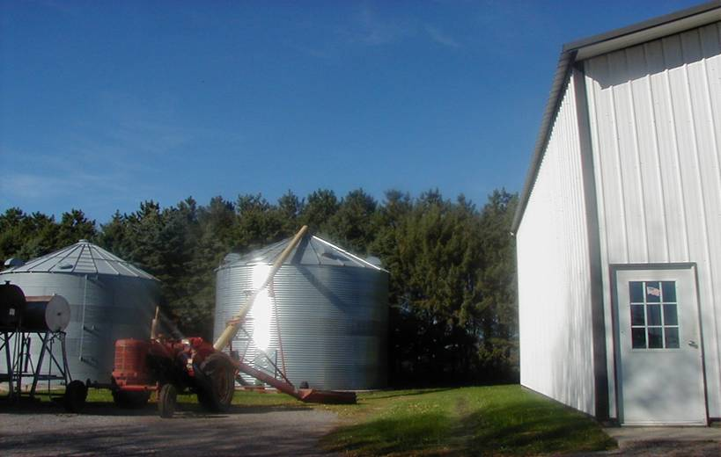
Mid Size Bins
Notes:
Note the auger in place for filling this bin. Typical mid sized bins are 7500-15000 bushels.

Slide 105
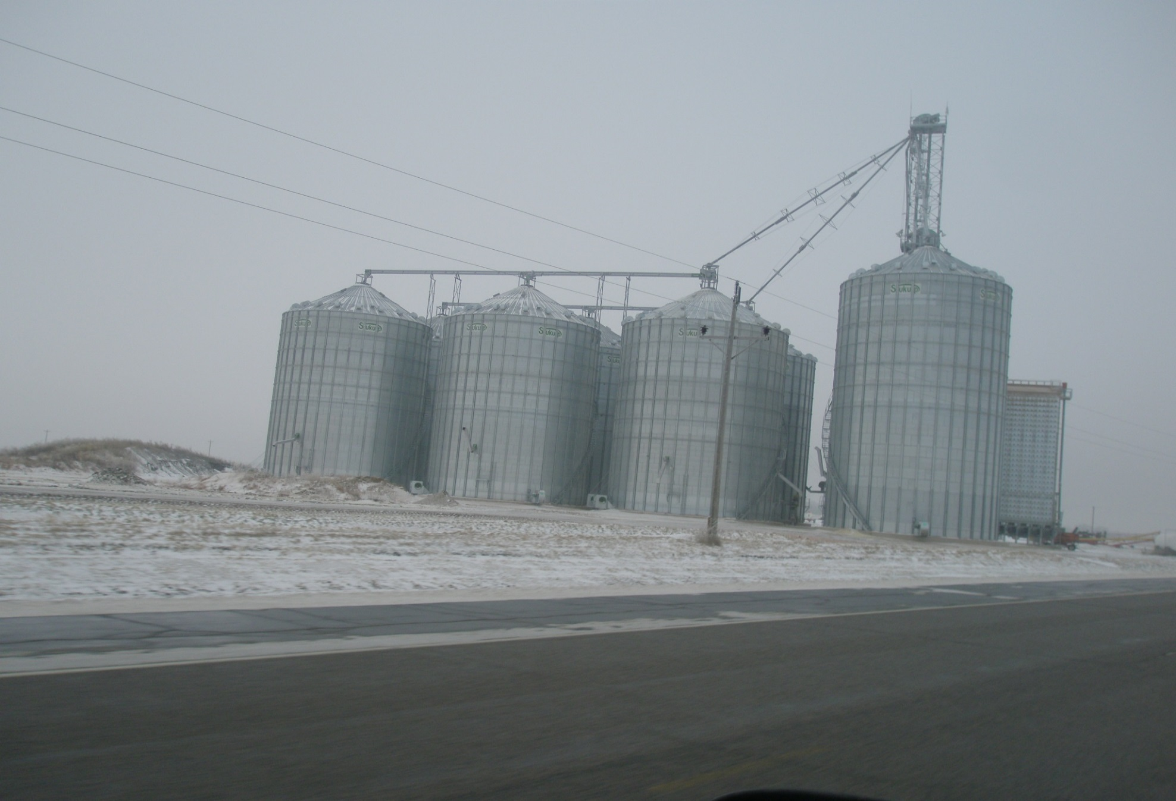
3.5 MILLION BUSHELS OF GRAIN STORAGE
Notes:
This complex has a total capacity of 3 million bushel.
This large operation has 6 of these types of complex’s scattered through out their operation-which spreads out over a 100 mile radius

Slide 106
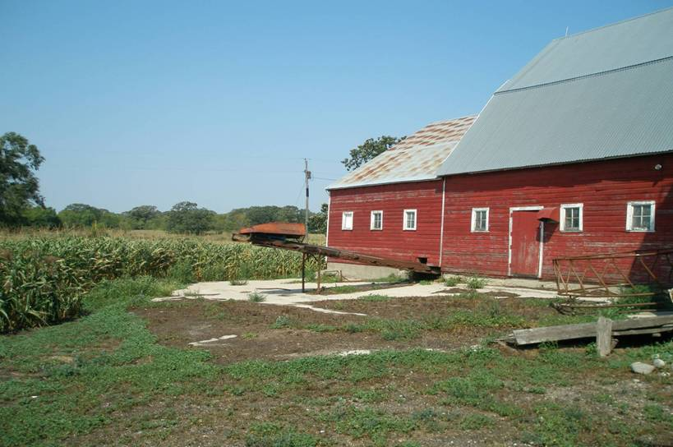
An old dairy barn with a barn cleaner
Notes:
An old dairy barn with a barn cleaner-the manure travels around the gutters and up this chute, it is loaded into a spreader and applied to the land.

Slide 107
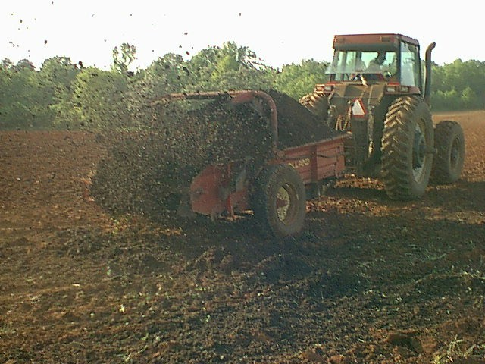
A traditional solid manure spreader
Notes:
Seldom used-more of a small scale hobby producer option.

Slide 108

Earthen Manure Pit
Notes:
Note the tractors and the manure agitators, which stir up the manure prior to emptying. This one holds about 5 million gallons of manure. A large earthen manure pit in process of being emptied.

Slide 109

This shows the manure transfer hose running in a ditch to the field.

Slide 110

Direct field injection of manure-drag hose.
Notes:
Very popular as it reduces odor, reduces de-nitrification losses, reduces field compaction.

Slide 111

A new Slurry store above ground manure storage facility
Notes:
The equipment is used to agitate and unload the waste.
In Minnesota manure storage structures are exempt from taxation.
However they still need to be valued.
The logic-without these facilities most livestock operations would be permitted.

Slide 112

Manure Injector Back view

Slide 113

Pile of Poultry Litter
Notes:
This is a pile of poultry litter. The facility was emptied during the growing season, so it was simply stockpiled in the field until the crop will be removed.
Some livestock producers with dry/solid manure will also stockpile-especially on land where the distance prohibits pumping liquid manure.

Slide 114
Farm buildings repurposed
Here are just a few examples of how some structures are re-purposed.
If this occurs-the value can and will change

Slide 115

Old barn at the end of it’s life

Slide 116

A really cute restored old hog barn

Slide 117

Old Barn remodeled
Notes:
Old Barn Converted to alternative use – Beef Cattle

Slide 118

Old barn converted to shop
Notes:
A good example of a repurposed barn-the loft floor was removed and a large overhead door installed .

Slide 119

Not your Grandpa’s old barn
Notes:
Here is a good example of what you can do if you want to spend about $25-$30/sf or $60,000 on your old barn.
This barn was straightened, resided, new windows, new roof, new concrete floor.
The upper level will be used as an indoor recreational center for this family.
The lower level is part storage, and will become part workshop, and a really cool man-cave!
The old milk room has all the utility connections in it. He was thinking about added a ¾ bath.
You would not have to go too much farther to make this a really unique house!
This is NOT TYPICAL! Even though it is really impressive.

Slide 120

Old barn converted to commercial use a dog training facility

Slide 121

Converted to commercial use-daycare

Slide 122

Old barn converted to a house

