Slide 1
Residential Construction from the Ground UP
Jason Jorgensen - Meeker County Assessor
Erik Skogquist - Contracted Local assessor

Slide 2
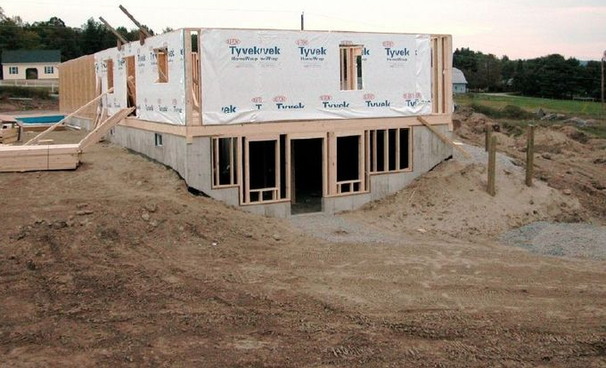
Elevation
What type of home is a property good for?

Slide 3

Typical Basement Styles

Slide 4
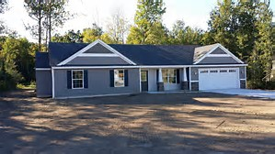
Slab home

Slide 5
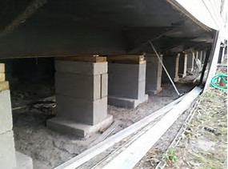
Doublewide on Piers

Slide 6
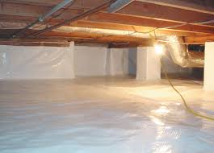
Crawl space

Slide 7
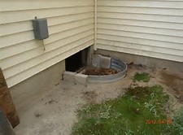
Crawl space entrance

Slide 8
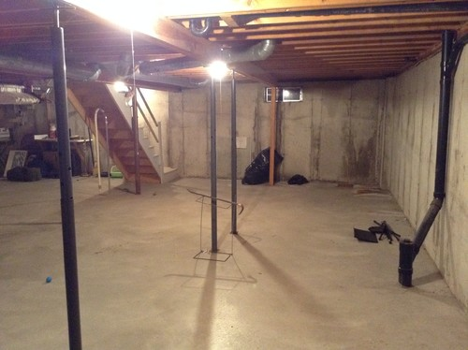
Full Basement

Slide 9
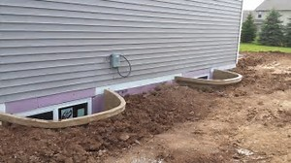
Full Basement with Egress Windows

Slide 10
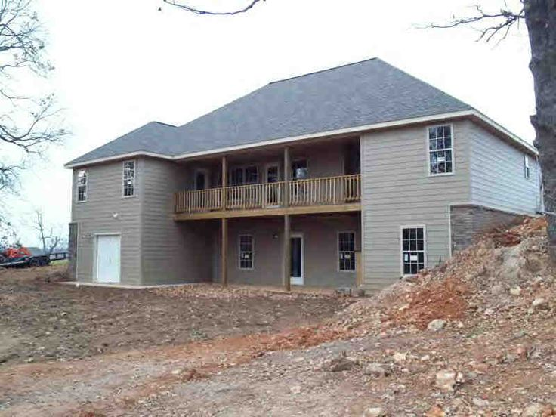
Full Basement with walkout

Slide 11
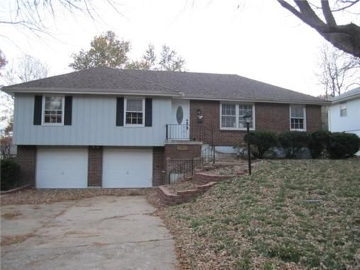
Full Basement with Tuck under Garage

Slide 12
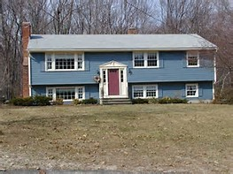
Split Entry/Split Foyer

Slide 13
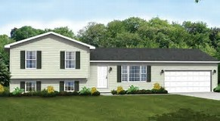
Split Level/ Tri Level Split

Slide 14
Basement/Site Prep options
What parts of the house are underground or unseen?

Slide 15
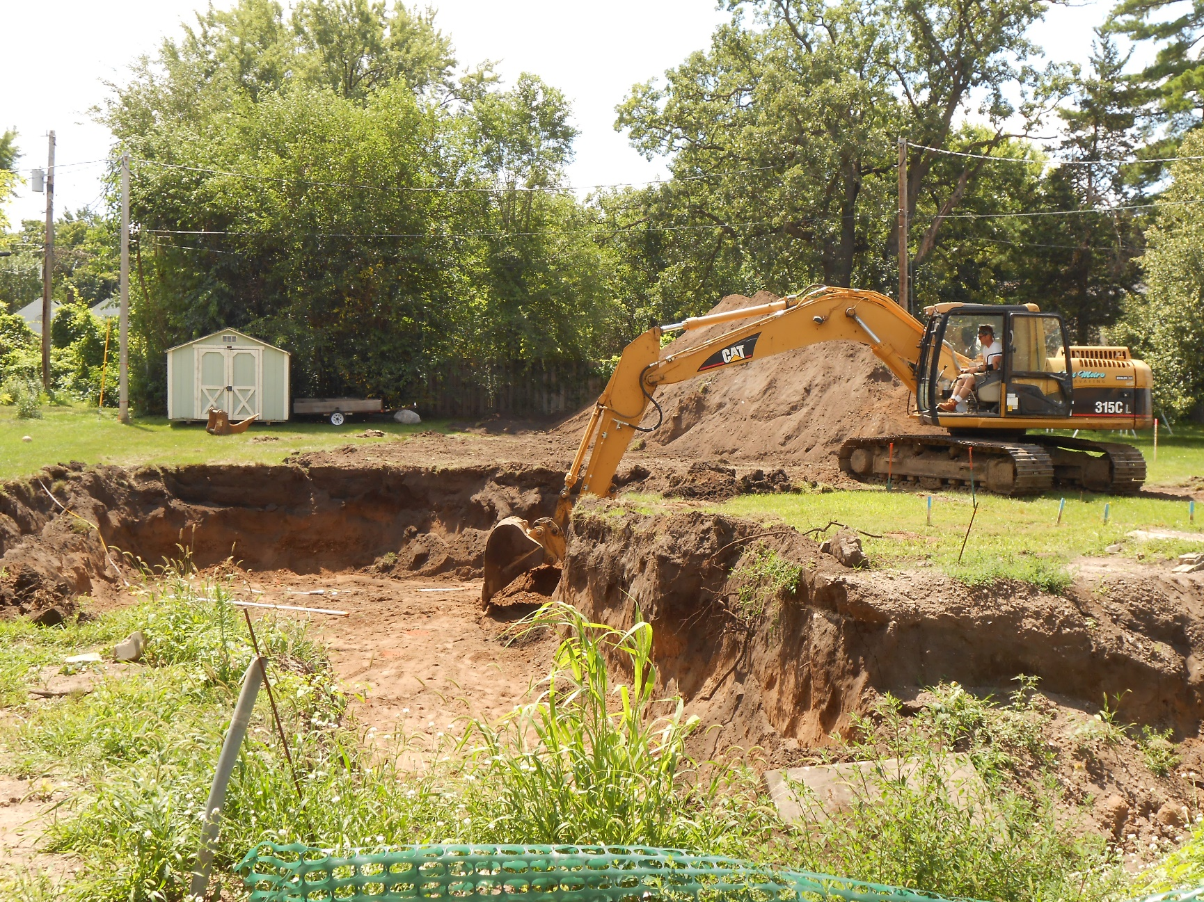
excavation

Slide 16
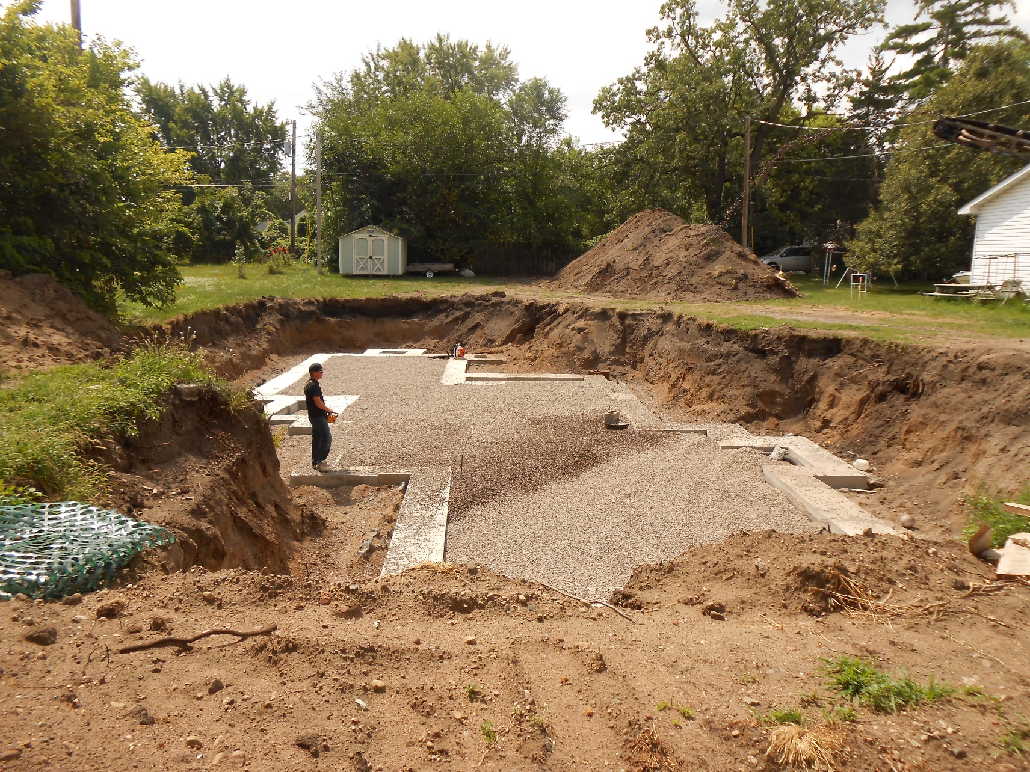
Footing and Gravel Fill under slab

Slide 17
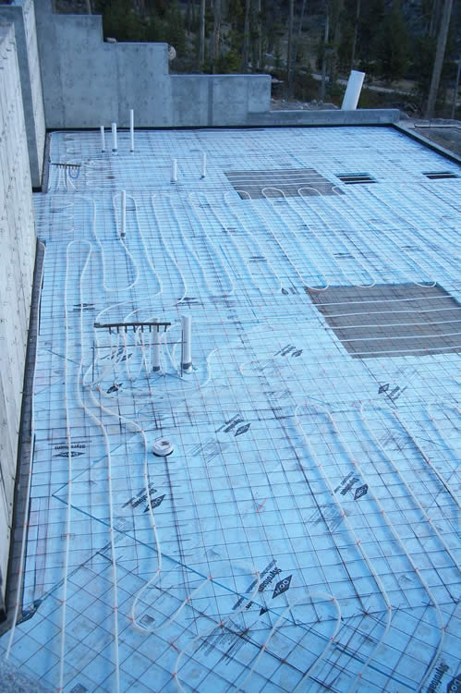
Basement Slab Insulation and In-Floor Heat

Slide 18
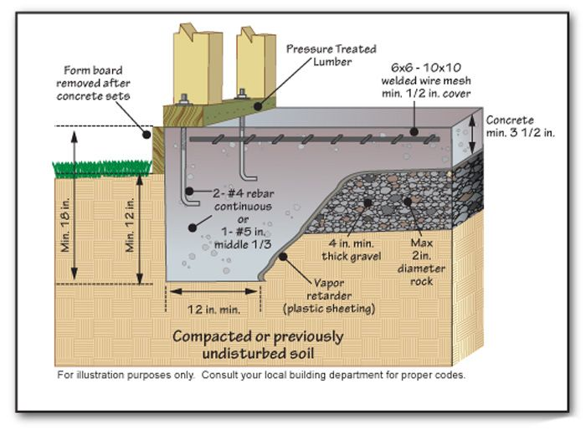
Cutaway for a Slab home

Slide 19
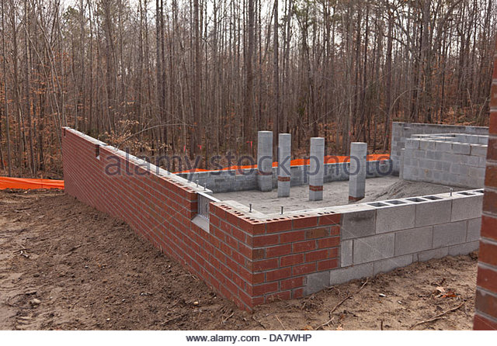
Crawl Space Excavation & Walls

Slide 20
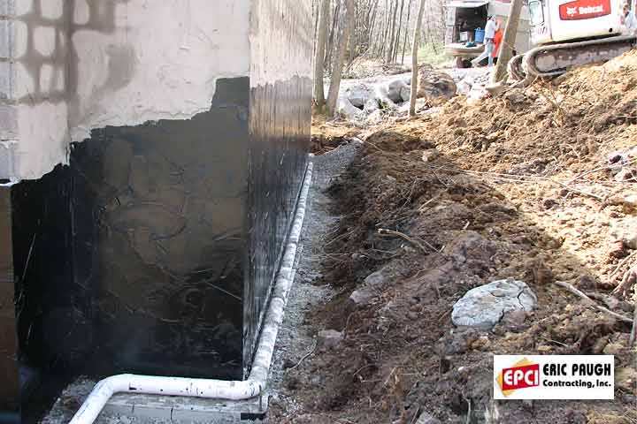
Footing/Drain Tile/Waterproofing

Slide 21
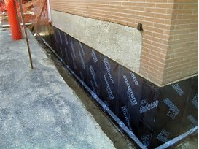
Membrane Waterproofing

Slide 22
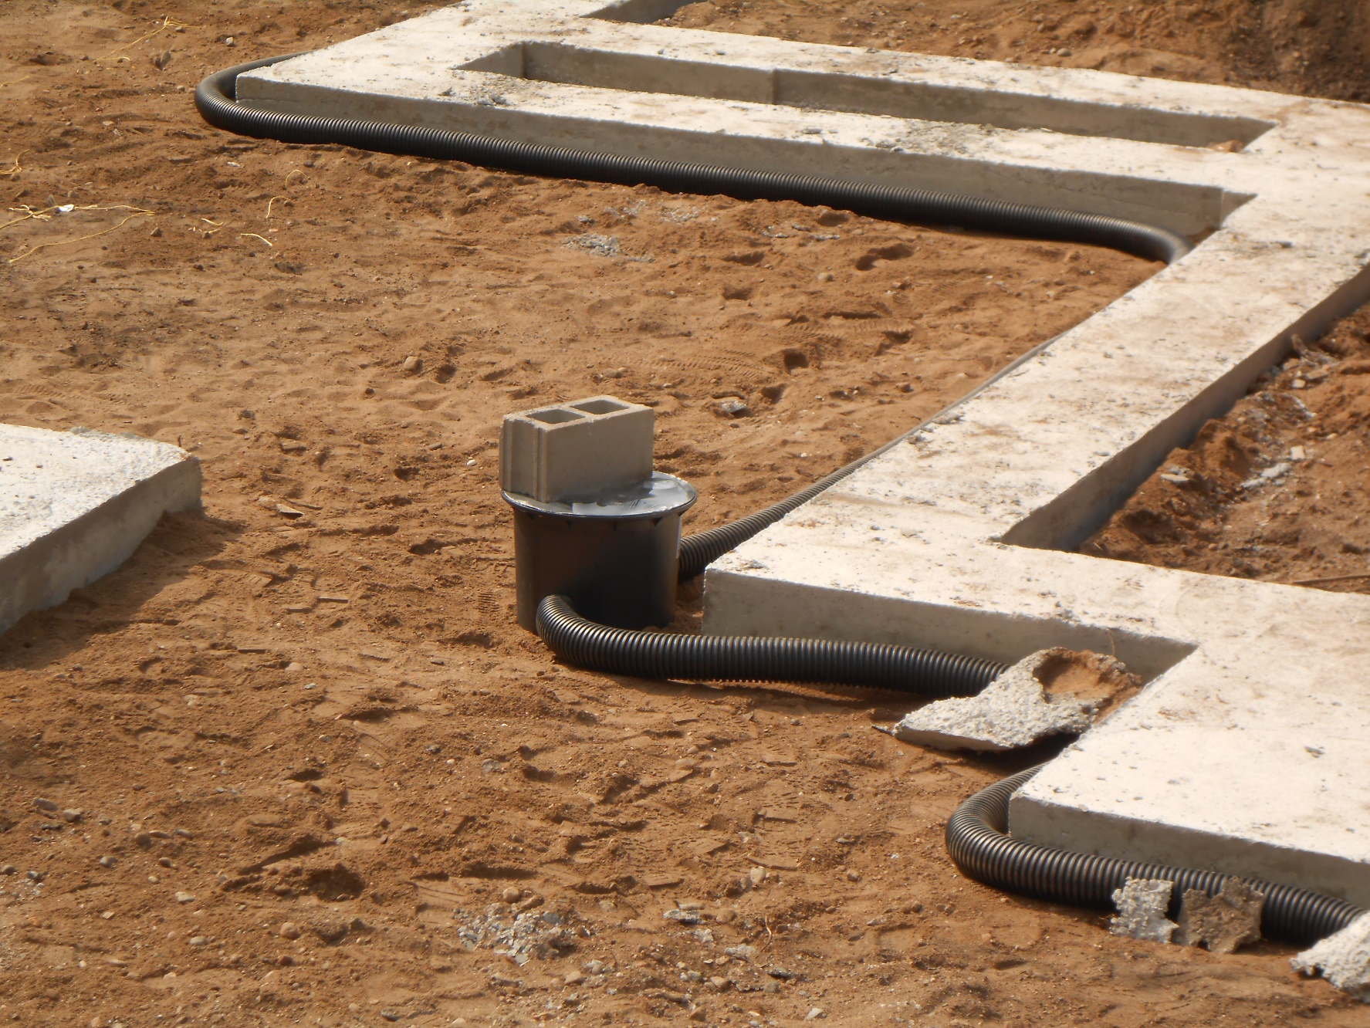
Drain tile into Sump Basket

Slide 23
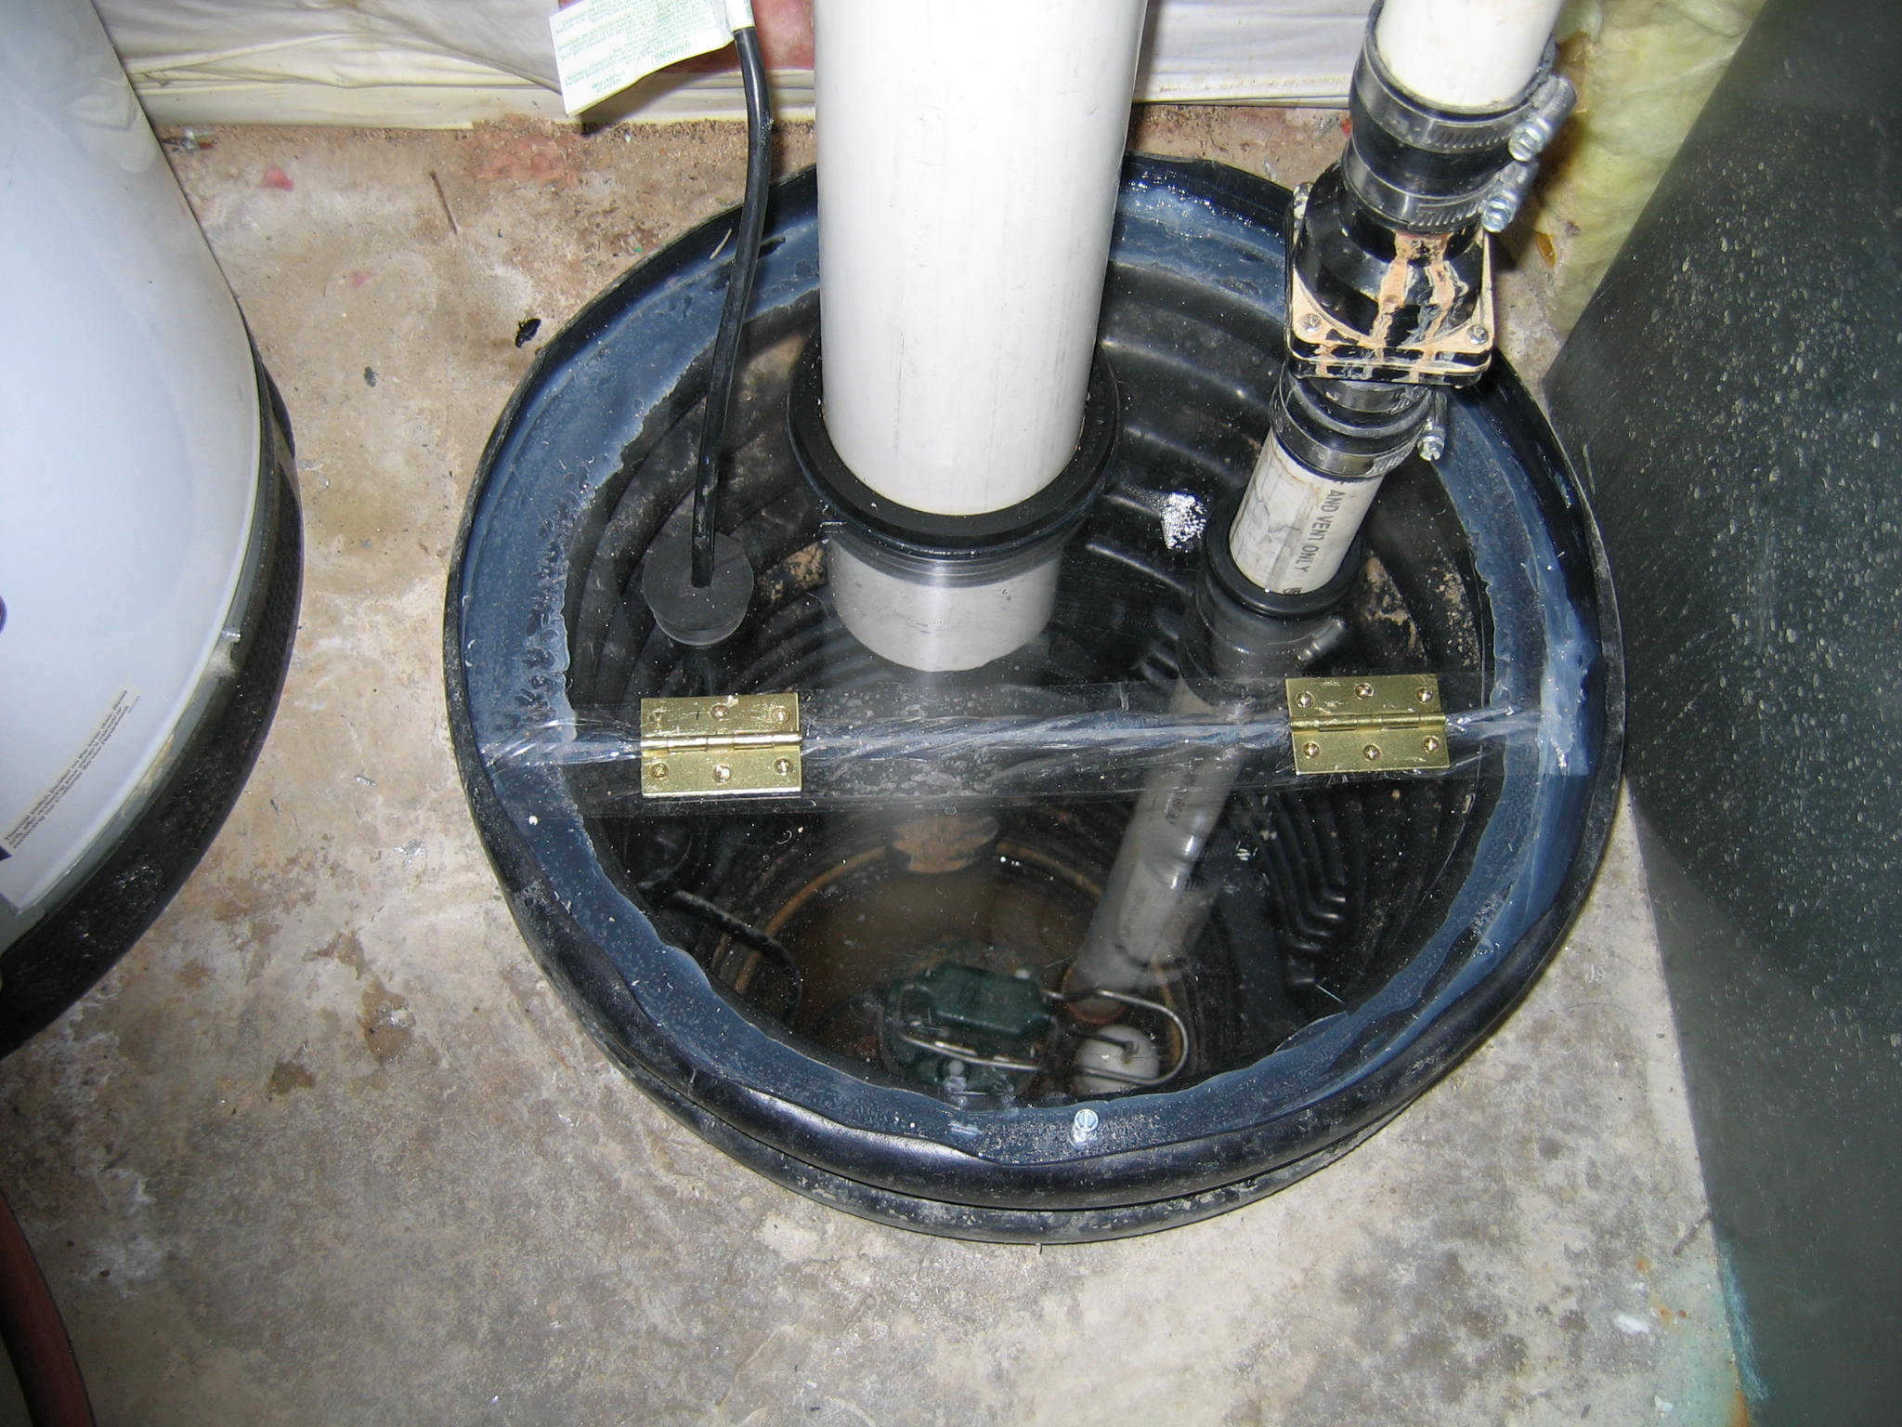
Sump Hole with Radon Mitigation

Slide 24
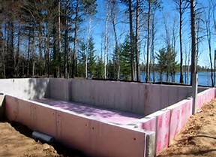
Insulation - Exterior

Slide 25
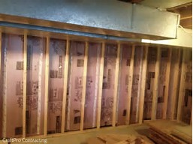
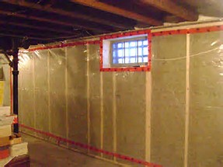
Insulation – interior Solid and Batt

Slide 26
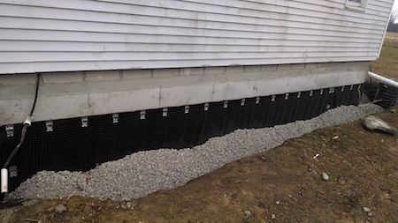
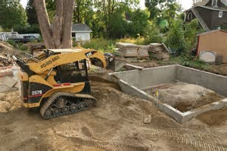
Backfill – Gravel

Slide 27
Basement/ Wall Types
What are the various sizes, styles, and materials used to build a foundation?

Slide 28
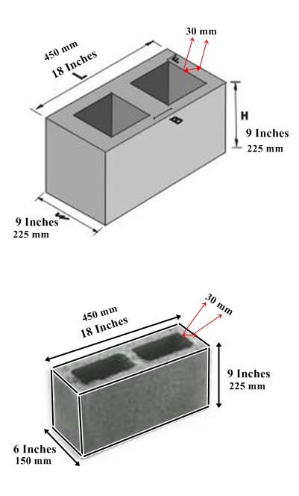
Varied thickness bases on Load

Slide 29
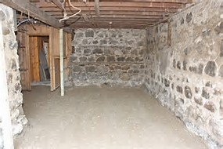
Stone – Older Homes

Slide 30
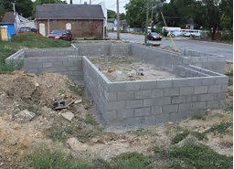
Concrete Block

Slide 31
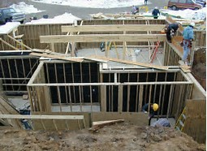
Wood - .40 / .60 treated grade

Slide 32
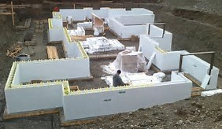
Insulated Concrete Form (ICF)

Slide 33
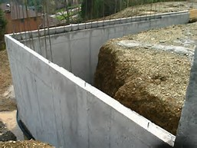
Poured Basement Wall

Slide 34
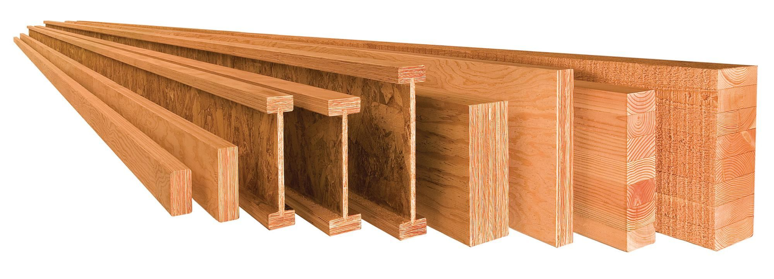
Floor Structural System
What is the floor structure made of and how is it supported?

Slide 35
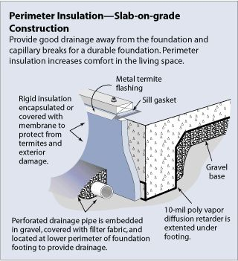
Slab on Grade

Slide 36
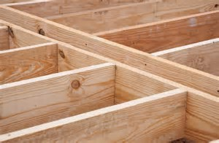
Dimensional Lumber

Slide 37
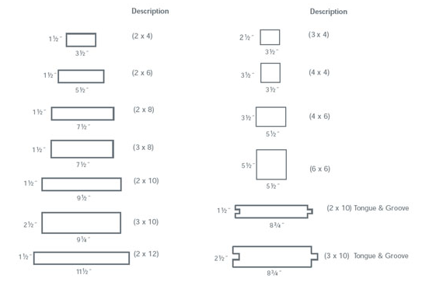
Dimensional Lumber - Sizes

Slide 38
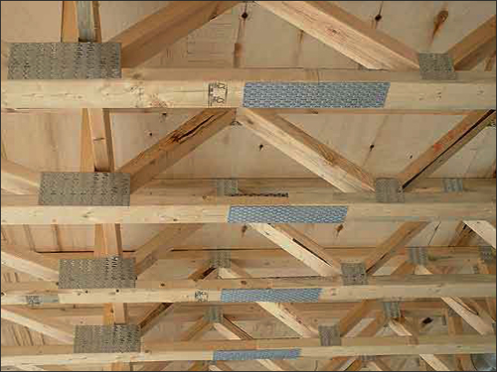
Trusses – Parallel Chord

Slide 39
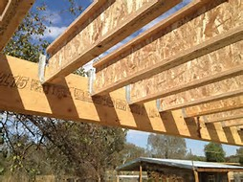
TGI I-Joist

Slide 40
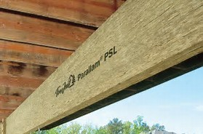
Laminated beams

Slide 41
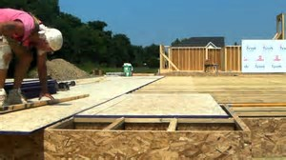
Subfloor – New Construction

Slide 42
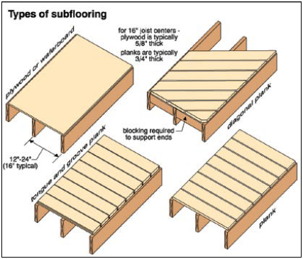
Subfloor - types

Slide 43
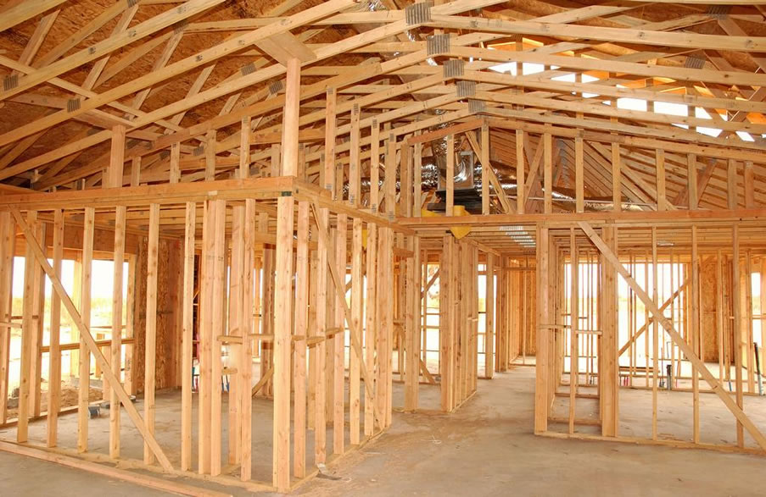
Wall Construction
What is standard, balloon frame, pole frame, log frame, and timber frame construction?

Slide 44
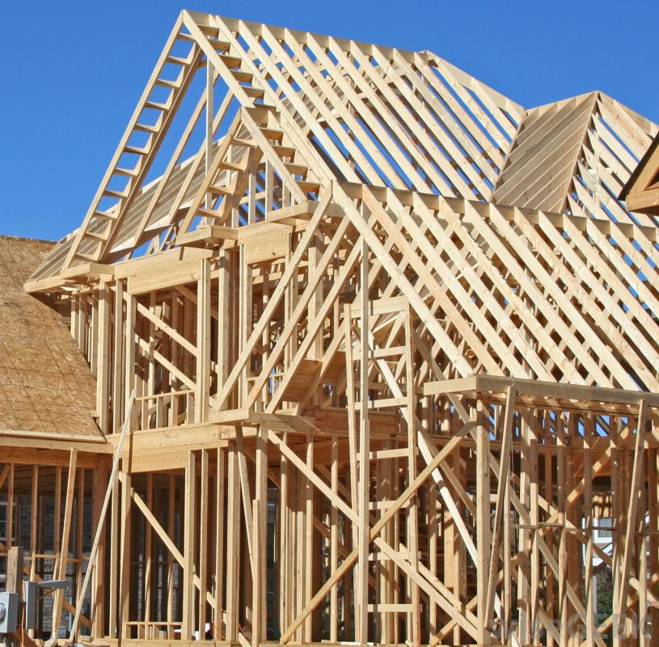
Standard Framing

Slide 45
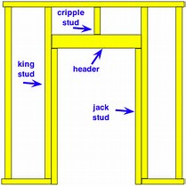
Typical Wall Layout

Slide 46
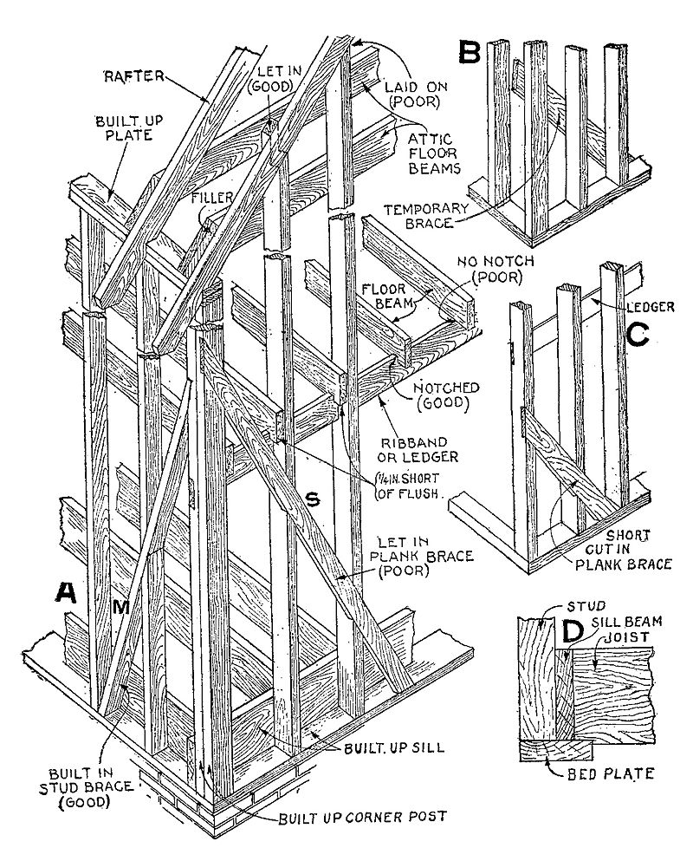
Balloon Framing – Older Homes, Staircases

Slide 47
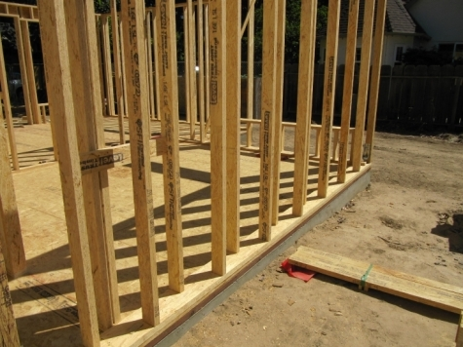
Engineered Studs - Staggered

Slide 48
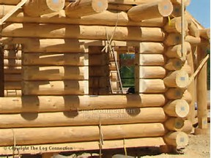
Log Frame

Slide 49
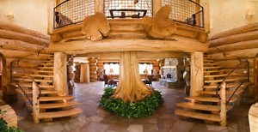
Log Frame – Jason’s House

Slide 50
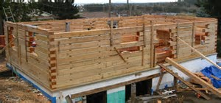
Engineered Square Log

Slide 51
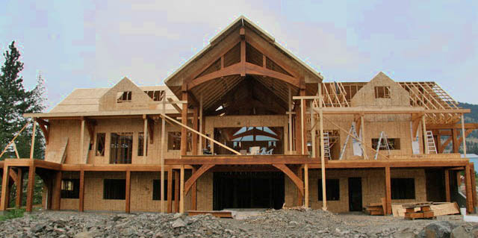
Timber Frame – Continued

Slide 52
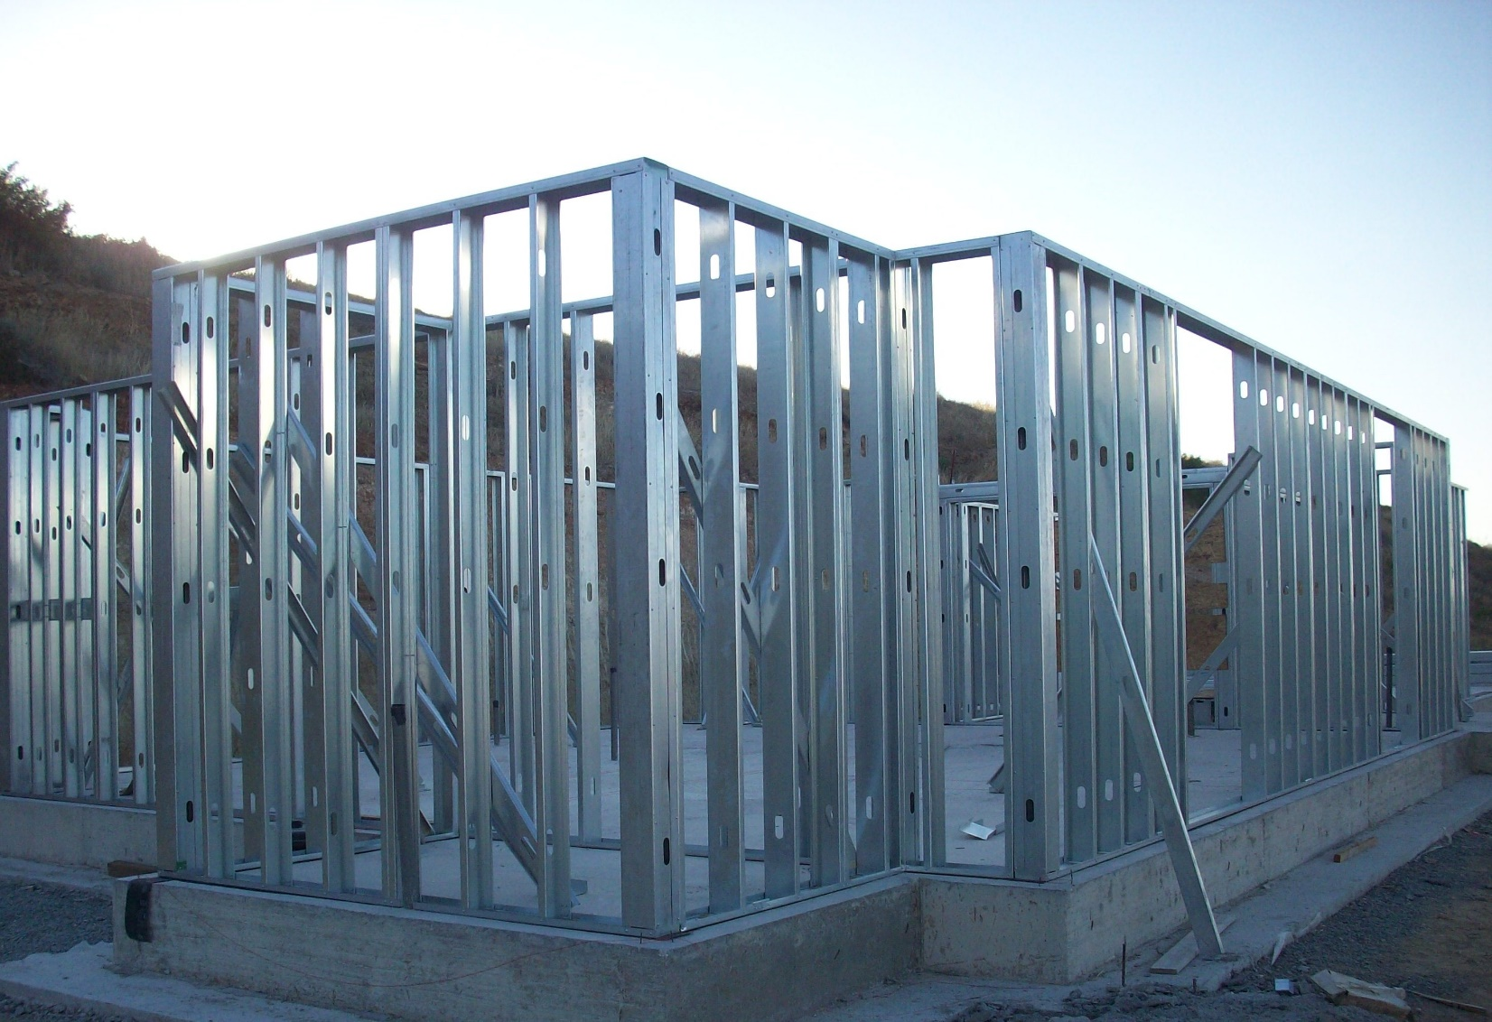
Steel Stud

Slide 53

Pole Frame

Slide 54

Single Wall

Slide 55

Double Wall

Slide 56

Insulation - Batt

Slide 57

Insulation - Batt with Kraft Face

Slide 58

Insulation - Spray Foam

Slide 59

R-Value Variation

Slide 60

R-Value Chart

Slide 61


Insulated Panel

Slide 62

Sheeting – Dimensional

Slide 63

Sheeting - OSB or Wafferboard

Slide 64

Sheeting - Plywood

Slide 65

Sheeting – Builtrite

Slide 66

Vapor Barrier – Tyvek House Wrap

Slide 67

Vapor Barrier – Tar Paper

Slide 68

Vapor barrier – Interior POly

Slide 69
Roof Structure
What are the different roof styles and how are they built?

Slide 70

Common Truss Construction

Slide 71

Truss layout (Attic Trusses)

Slide 72

Types of Truss Design

Slide 73

Factory truss machine and gusset

Slide 74

Homemade truss

Slide 75


TGI I-Joist

Slide 76

Dimensional Lumber

Slide 77

Steel Construction

Slide 78


Roof Styles
Hip Roof
Flat Roof

Slide 79


Roof Style Continued
Gable Roof
Gable Roof with Dormers

Slide 80

Gable and Hip

Slide 81


Roof Styles Continued
Gambrel Roof
Mansard Roof

Slide 82

Roof Pitch = Inch/Inch

Slide 83
Roof Materials
What types of decking and roof covers are there and what are soffits, eaves, fascia?

Slide 84


Decking
Oriented Strand board (OSB) Plywood

Slide 85



Decking Continued
Tung and Groove (T&G) 1x (1x6 1x8, or multiple)

Slide 86


Roofing Materials - Asphalt
3 Tab Architectural

Slide 87



Roofing Materials High End Traditional
Cedar Shingle Clay Tile
Slate

Slide 88


Roofing Materials - Steel
Steel Panel Steel Shingle

Slide 89

Soffits, Fascia, Gutters
(Composite Soffit and Fascia)

Slide 90


Soffits, Fascia, Gutters
Wood Aluminum

Slide 91



Gutter material
Vinyl Seamless Steel
Copper

Slide 92
House Construction Time Lapse Video
https://www.youtube.com/watch?v=SSWsiDkCIyY

Slide 93
Plumbing
What are the different materials used for plumbing a home and where does the good stuff go when you flush it down the toilet?

Slide 94

Plumbing Rough In

Slide 95



Piping Supply and Waste
Copper (Both) Galvanized Steel (Both)
Cast Iron (Waste)

Slide 96


Piping Supply and Waste Continued
PVC (Both) PEX (Supply)

Slide 97

Water heater with Recirculation Pump

Slide 98


Piping Supply and Waste Continued
Typical Septic Mound System

Slide 99
Electrical
Fuses vs Breakers, 100-200 Amp Service and what the heck is Knob and Tube?

Slide 100


Electrical Boxes
Breaker Panel 1950s + Fuse Box Pre 1950s

Slide 101

Wiring Rough in

Slide 102


Wiring types
Romex (copper) Aluminum

Slide 103


Older Wiring types
Cloth Prior to 1960 Knob and Tube 1880s-1930s

