Slide 1
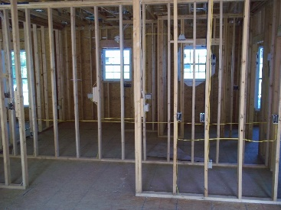
Wiring Rough in

Slide 2
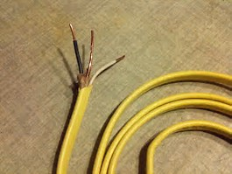
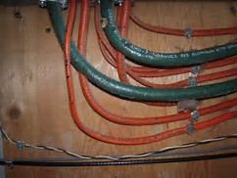
Wiring types
Romex (copper) Aluminum

Slide 3
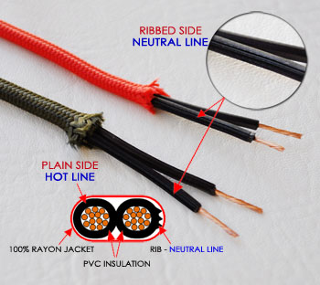
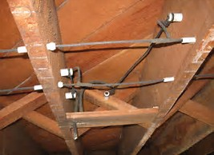
Older Wiring types
Cloth Prior to 1960 Knob and Tube 1880s-1930s

Slide 5
Heating and Cooling
Identifying heating and cooling systems and what are the pros and cons of each.

Slide 6
Old Heating Systems
Fireplace

Slide 7
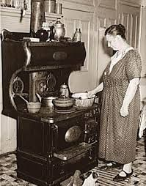
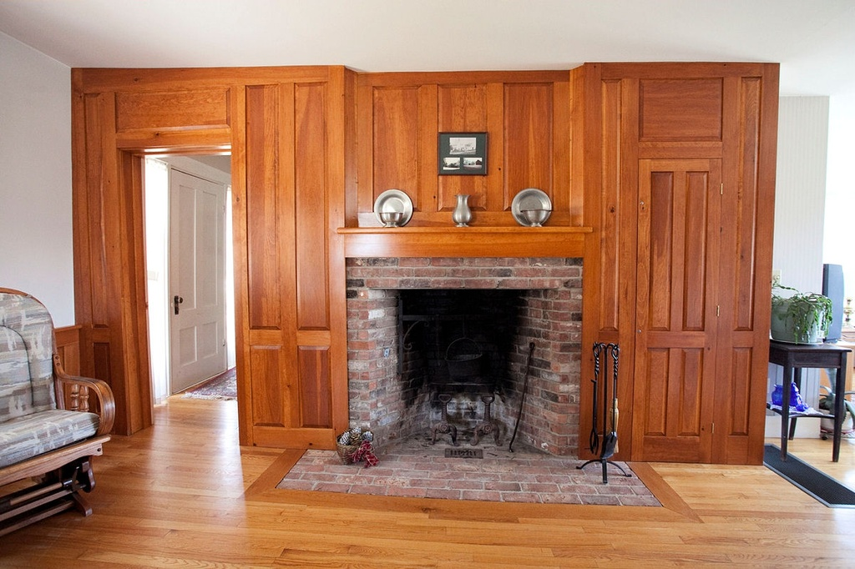
Old Heating Systems
Fireplaces Wood Stove

Slide 8
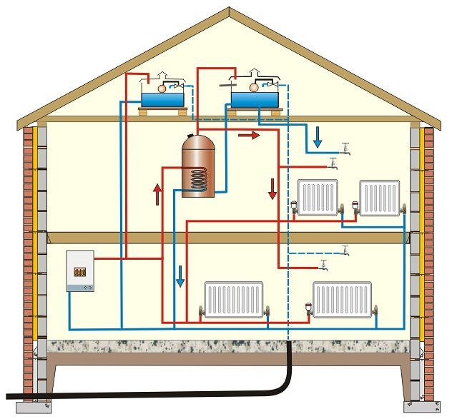
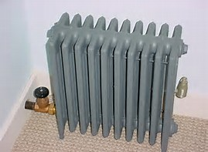
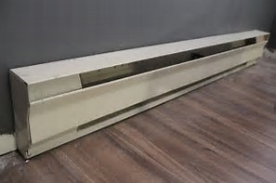
Hot Water or Steam Radiant Heat
Common from 1880s to 1930s

Slide 9
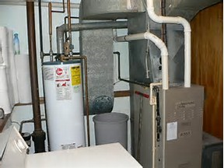
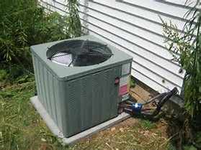
Forced Air Heat and Central Air Conditioning
1930s - Today 1970s - Today

Slide 10
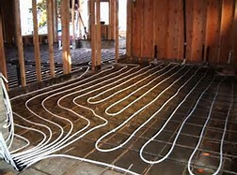
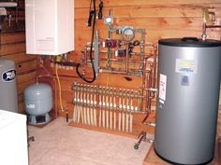
In floor Radiant heat

Slide 11
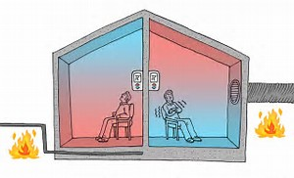
In floor vs Forced Air Heat Distribution

Slide 12
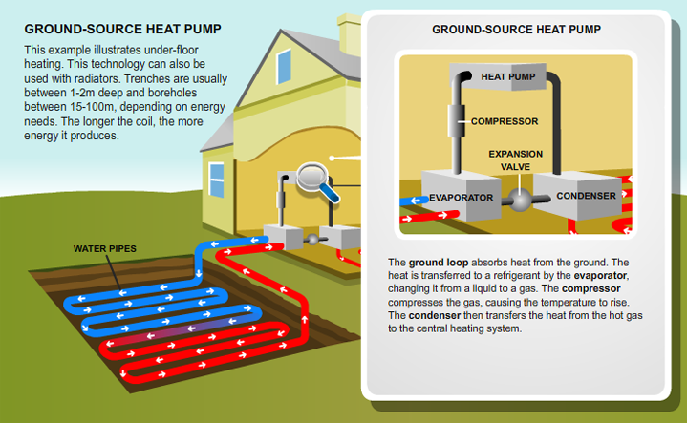
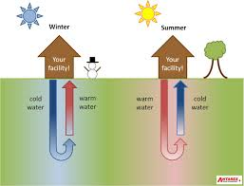
Ground Source Heat Pumps

Slide 13
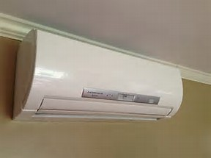
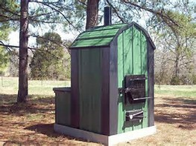
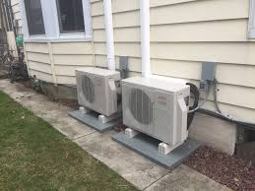
Alternative Systems
Wood Pellet or Corn Burner
Mini-Splits

Slide 14
Windows
What styles of windows are there and how do the very in quality?

Slide 15
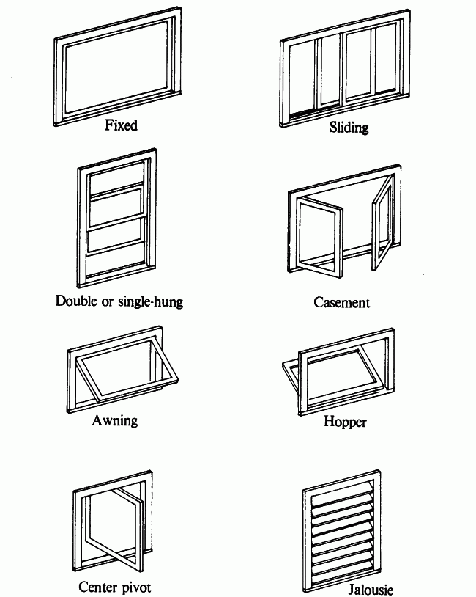
Window Styles

Slide 16
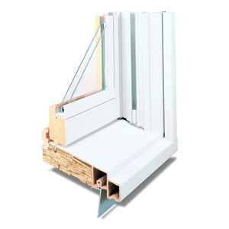
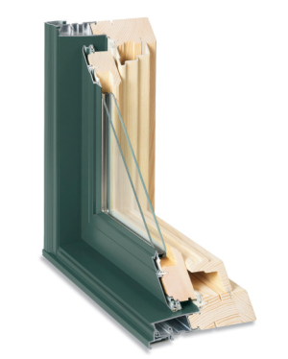
Window Materials
Vinyl Clad Metal Clad

Slide 17
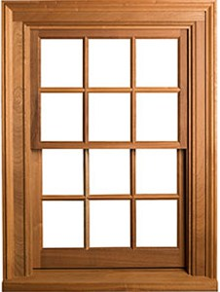
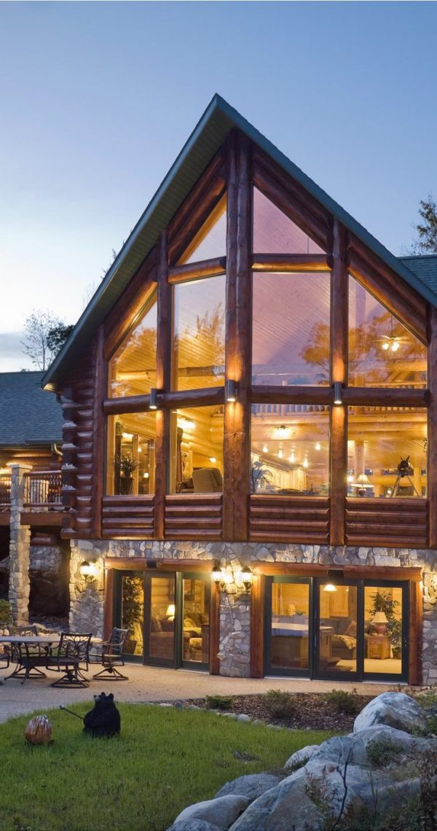
Window Materials Continued
Wood Geometric Design

Slide 18
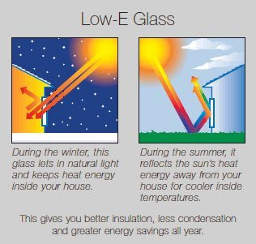
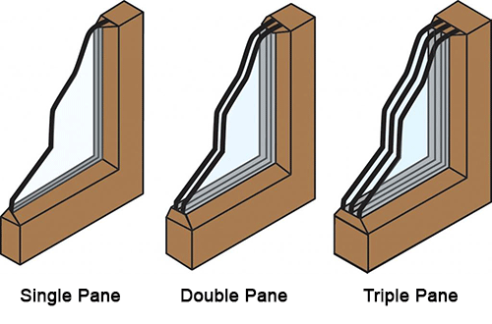
Window Quality

Slide 19
Siding
With countless options for siding how can you tell the difference?

Slide 20
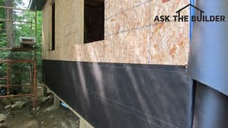
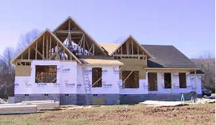
House Wrap under the siding
Tar paper Tyvek

Slide 21
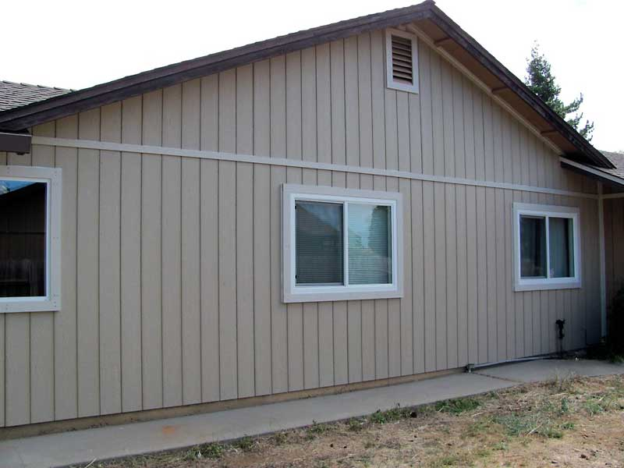
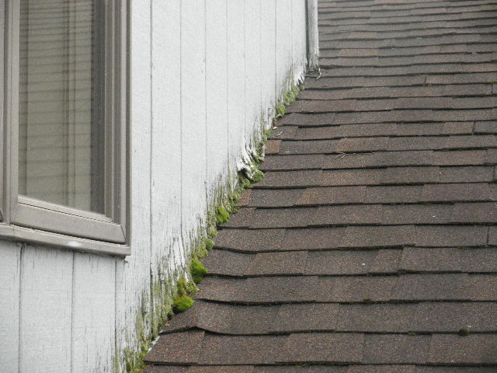
Wood and Wood Products Continued
T1-11 Panel Plywood

Slide 22
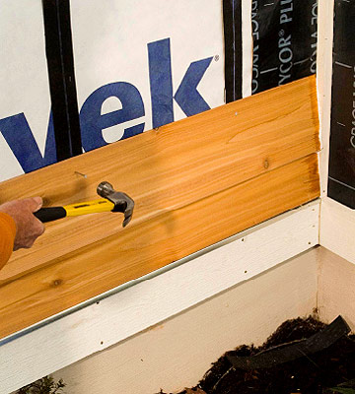
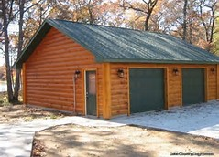
Wood and Wood Products
Wood lap Log siding

Slide 23
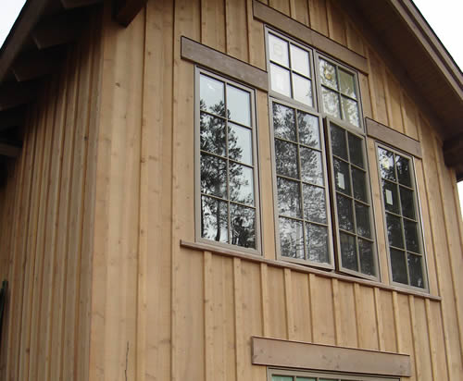
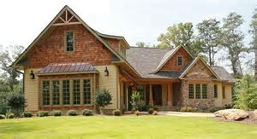
Wood and Wood Products Continued
batt & Board Shakes

Slide 24
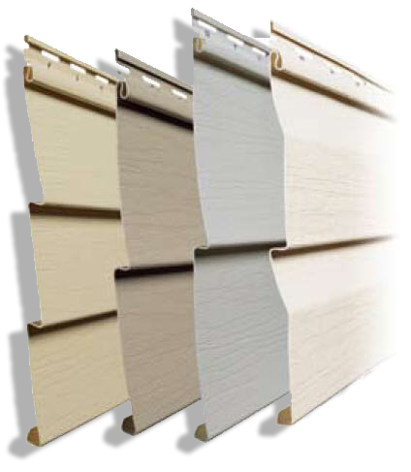
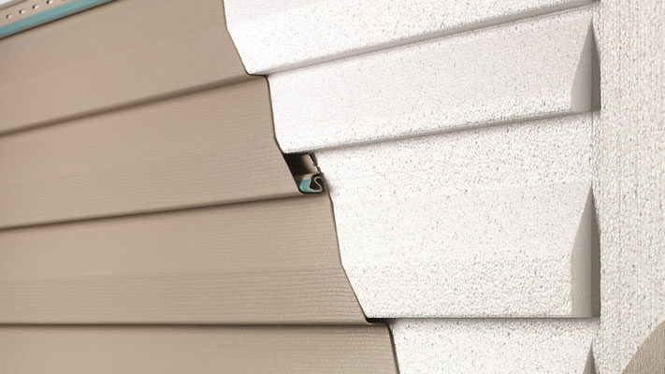
Vinyl Siding
Basic Insulated

Slide 25
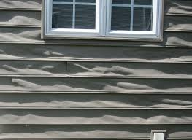
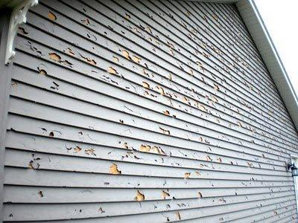
Vinyl Siding Issues
Melting Wholes or Cracks

Slide 26
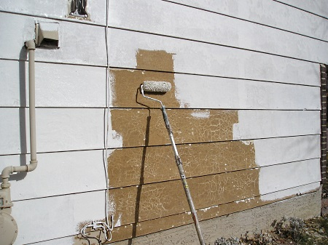
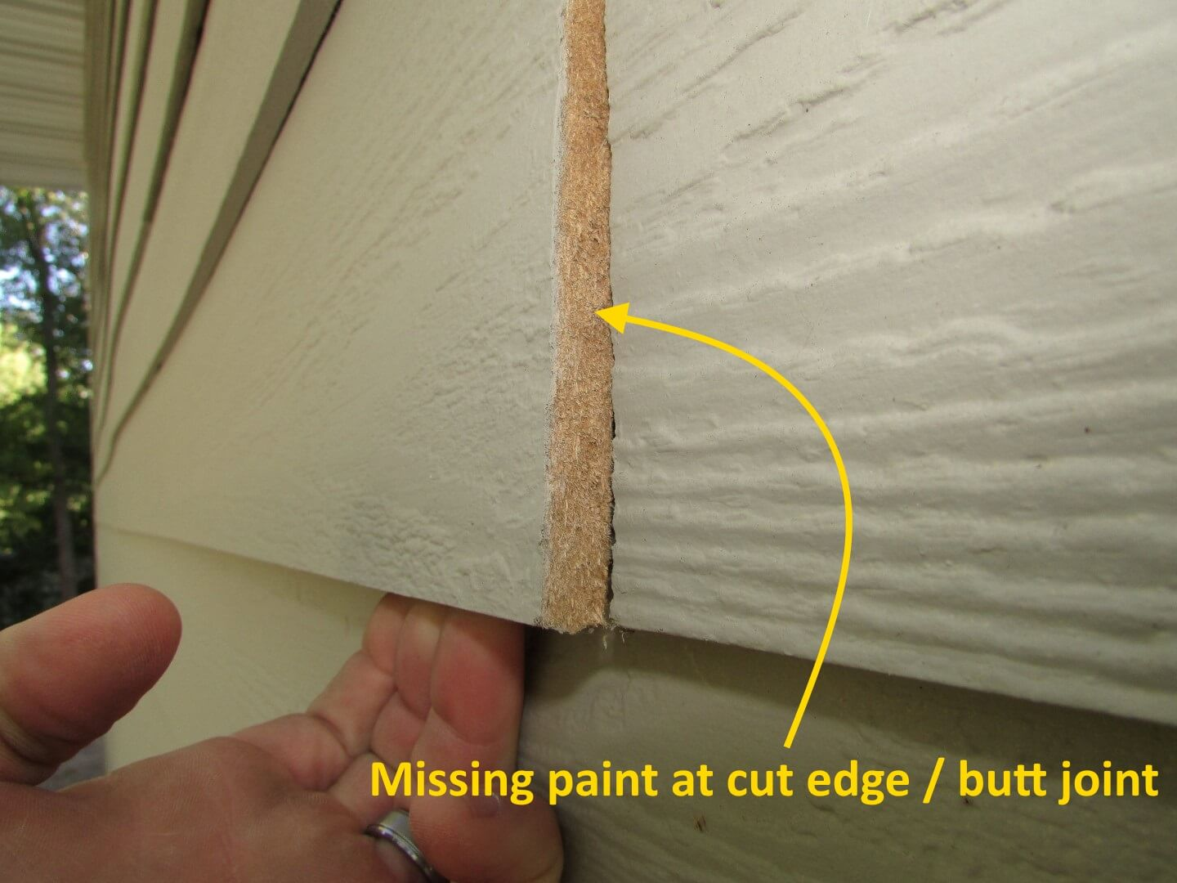
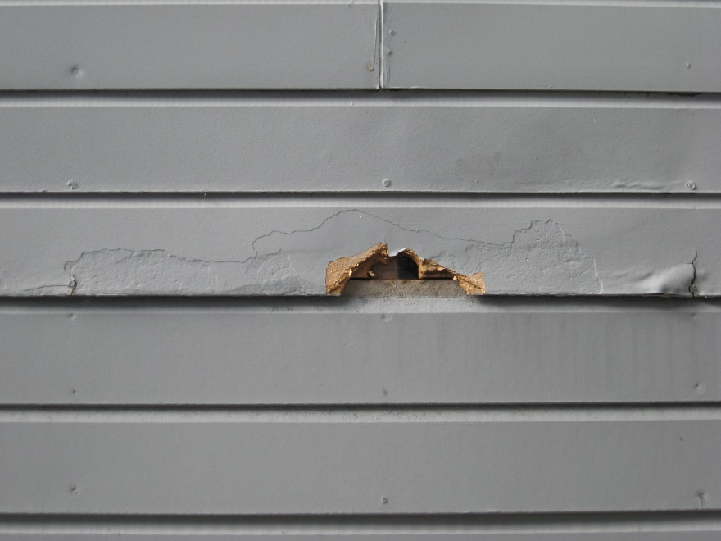
Composite Engineered
Masonite LP Smartside

Slide 27
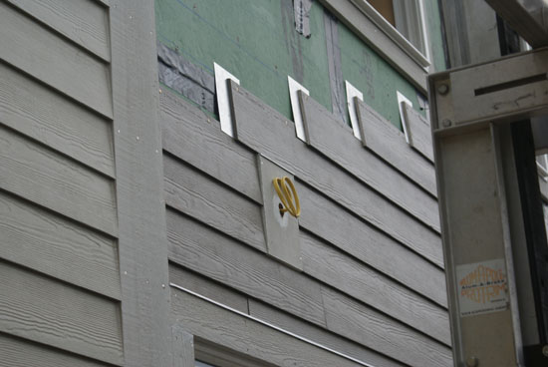
Concrete Products
Asbestos 1920s - 1950s Cement board/1990s -Present

Slide 28
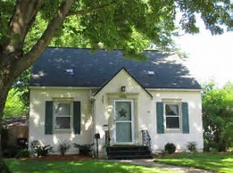
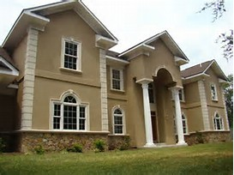
Stucco
Traditional EIFS (Synthetic)

Slide 29
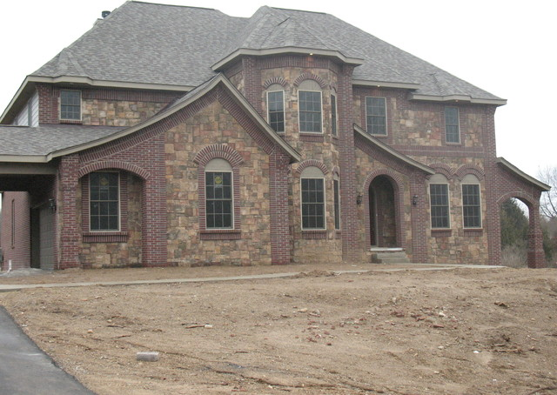
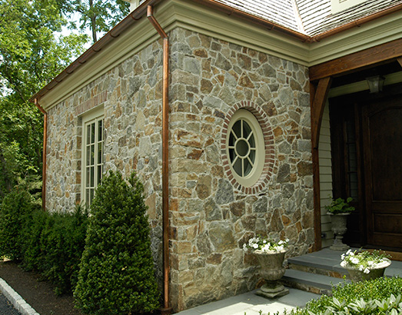
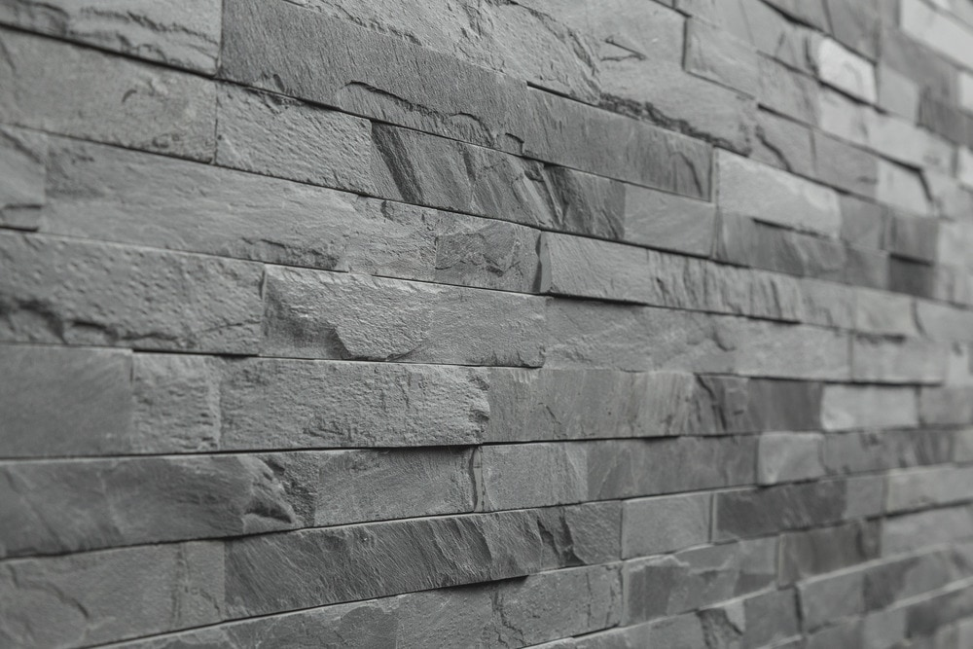
Stone
Cultured Stone/Brick Field Stone
Slate

Slide 30
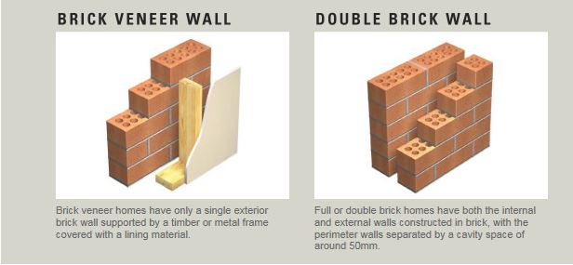
Brick Veneer vs Brick Construction

Slide 31
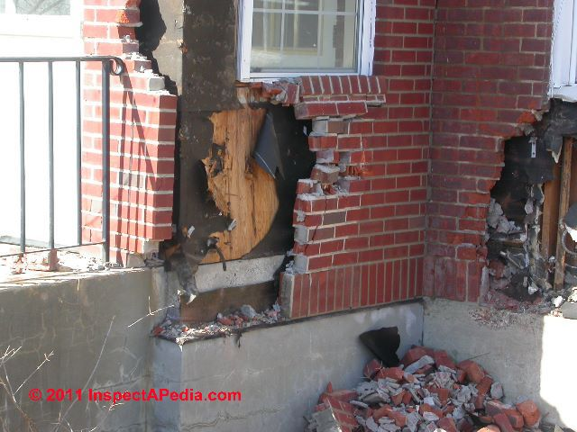
Brick Veneer Options

Slide 32
Full Brick Construction

Slide 33
Metal Siding
Aluminum Steel lap

Slide 34
Metal Siding
Vertical Steel Steel panel

Slide 35
Doors
What are hollow core, 6 panel, custom doors and why does it matter?

Slide 36
Door Construction
Hollow Core 6 panel Custom

Slide 37
Hollow core Doors

Slide 38
Solid Core Doors

Slide 39
Steel Doors

Slide 40
Fiberglass Doors

Slide 41
Custom

Slide 42
Hardware - Low, medium, High End

Slide 43
INTERIOR WALLS AND CEILINGS
Trust me it is more interesting than watching paint dry on a wall…

Slide 44
Typical Wall Finish
Taped & Mudded Drywall 1950s+ Lath and Plaster Pre 1950s

Slide 45
Tongue and Groove (T&G)
Old T&G Ceiling New T&G Carsiding

Slide 46
Paneling
Inexpensive Expensive

Slide 47
Wainscot and sheetrock
Inexpensive Expensive

Slide 48
Alternative Wall materials
Tile Barn Wood

Slide 49
Ceilings
Cardboard Squares over Plaster Suspended Ceiling

Slide 50
Textured over sheetrock/plaster
Popcorn Knockdown

Slide 51
Interior Flooring
Price, style, durability, with countless options and lots of pros and cons…

Slide 52
Carpet
Which is better quality and whY?

Slide 53
Manufactured Tile
Ceramic Porcelain

Slide 54
Natural Stone Tile
Slate, Travertine, marble, Others

Slide 55
Laminate and engineered Flooring
Laminate Engineered Wood

Slide 56
Wood Flooring
Engineered Wood Solid Wood

Slide 57
Wood Flooring Continued
Hardwood Softwood

Slide 58
Linoleum / Vinyl
Basic Upgrade

Slide 59
Linoleum…It’s been around a while
From Erik’s House, Burlap backing says 1914 on label

Slide 60
Concrete
Colored Colored and Stamped

Slide 61
Trims
Quality vs Cheap, what a difference…

Slide 62
Trim Types and Locations

Slide 63
Hardwood Trims Good Quality
Oak Cherry Hickory

Slide 64
Soft and Hardwoods Medium quality
Pine Fir Poplar

Slide 65
Laminated, Vinyl, Composite
Laminate Vinyl Rolled PVC

Slide 66
Other Cost Factors Continued
Crown Molding
More Pieces, More Cost

Slide 67
Other Cost Factors
Narrow vs Wide - More material more cost

Slide 68
Counters and Cabinets
Factory or Custom?

Slide 69
Countertops Least expensive
Many designs, Formica Edged or wood edged

Slide 70
Countertops Stone
Natural Stone (Granite, quartz, etc.)
Engineered Stone (Cambria)

Slide 71
Countertops Stone Alternatives
Tile
Concrete

Slide 72
Countertops Alternatives
Butcher Block
Corian
Stainless Steel

Slide 73
Custom Cabinets, What to Look for
Solid Wood, Good Joining, Amount of Cabinets

Slide 74
Inexpensive cabinets
Pressed Board with a veneers or plywood

Slide 75
Inexpensive cabinets Continued
Pressed Board Less Cost = Less Durability

Slide 76
Floor Plans
Open Floor Plan
Peninsula with Upper Cabinets
Galley Kitchen

Slide 77
Hardware – Hinges and slides
More Cost Less Cost

Slide 78
Hardware - Pulls and Handles
Lesser metal, Thin Coating or paint
Better Solid materials, no coating

Slide 79
bathrooms
Size of the space and materials used are important and make a difference in this highly used space.

Slide 80
Quality of Materials
Low Medium High

Slide 81
Tub styles
Soaker Tubs, Claw foot and Jetted

Slide 82
Tub Materials
Cast Iron Fiberglass

Slide 83
Showers Fiberglass
Prefabricated Fiberglass

Slide 84
Showers Tile
Tile Shower Pan 1960s Vintage Tile

Slide 85
Showers Tile
Ceramic Tile Natural Stone

Slide 86
Shower Fixtures
Inexpensive vs Higher Cost – See and feel the difference

Slide 87
Decks
Size, shape, and materials matter

Slide 88
Decks Low Grade – Basic Materials/Design
Treated Wood Face Screwed
Simple or No Railings

Slide 89
Decks Mid-Grade – Larger, more complex
Cedar Composite (Azek, Trex, etc…)
More Complex Railings

Slide 90
Decks High Grade – The Sky is the Limit
Exotic Woods Custom design
Hidden fastener (mid & High Grade)

Slide 91
Railings – Countless materials and styles
Metal Cable and Picket Glass, Composite

Slide 92
Garages
Pole vs stick built, finished vs unfinished, gravel, plain concrete or epoxy floor, parking cars or man cave?

Slide 93
Interior Finish
Unfinished Fully Finished

Slide 94
Garage Lining
Steel Drywall with Insulation
OSB with Insulation

Slide 95
Garage Heating – Most Common
Space Heat Radiant in-Floor
Ceiling Radiant

Slide 96
Garage Floors – Dirt, Concrete, Epoxy and others

Slide 97
Pole Frame Garages

Slide 98
Stick Built Garages

Slide 99
Depreciation
What is due to wear and tear and what are system failures?

Slide 100
Depreciation
0% Depreciation 100% Depreciation

Slide 101
Structural Failures Foundation/Slab
Step Cracking large cracks and Heaving

Slide 102
Structural Failures Floors/Wall
Structural crack Floor Joist Dry rot

Slide 103
Structural Failures Floors/Wall
Header Failure Physical or External Obsolescence?

Slide 104
Excess Physical Depreciation Interior
Typical Wear and Tear Excess Wear

Slide 105
Excess Physical Depreciation Interior
Roof leaking Excess Carpet Wear
Chipped Asbestos tile

Slide 106
Excess Physical Depreciation Shingles

Slide 107
Excess Physical Depreciation Roof
Roof Sagging Waving Plywood

Slide 108
Excess Physical Depreciation Siding
Wood, Vinyl, Asphalt all Bad Worn Masonite

Slide 109
Physical Depreciation Siding
Typical Peeling, no rot Excess wear – Dry rot

Slide 110
Physical Depreciation Decks
Typical Peeling, no rot Excess wear – Dry rot

Slide 111
Lifespan of Typical house Components
Overall House 100+
Shingles 15-50
Siding 25-50+
Exterior paint 7-10
Windows 20-50
Doors 30-50
Decks 20-25
Driveways 20-50
Flooring 10-100+
Water Pumps/heaters 10-20
Piping 40-70+
Valves/Fixtures 20-40
Furnace 15-20
Central Air 12-15
Kitchen Cabinets 40-50
Countertops 20-50+
Electric Panels 60+
Electrical Wiring 100+

Slide 112
Contact
Jason Jorgensen – Jason.Jorgensen@co.meeker.mn.us
Erik Skogquist –
skog0111@umn.edu

