Slide 1
Elements of Lakeshore Valuation
Presenter: Gary Griffin, SAMA Crow Wing County, MN
MAAO Summer Seminars
May 24th 2018

Slide 2
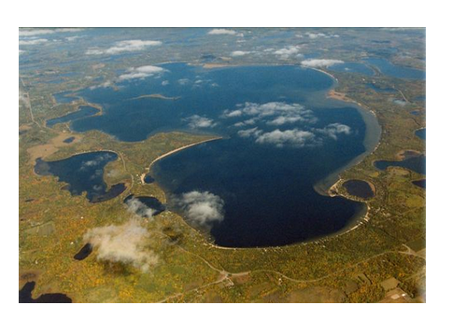
Pelican Lake

Slide 3
Typical buyers are buying access to the water. Amounts paid for lakeshore will depend on the quantity of lakeshore frontage, the quality of the shoreline and the overall usability of the parcel.

Slide 4
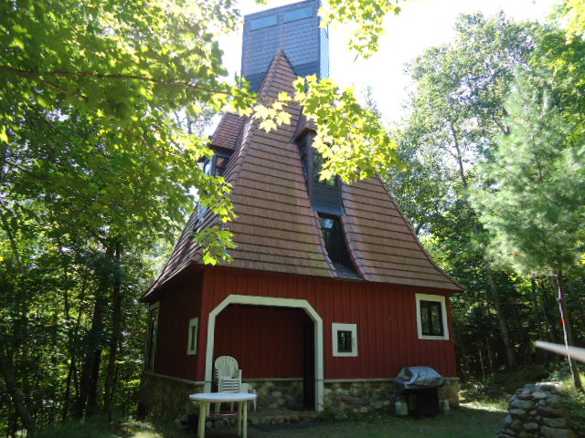
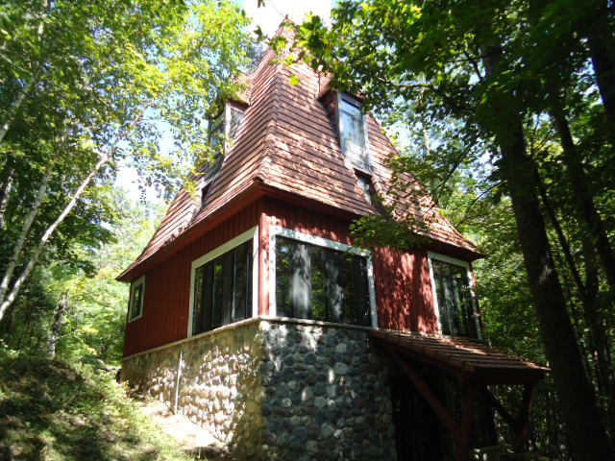
Greater market tolerance for functional/external drawbacks

Slide 5
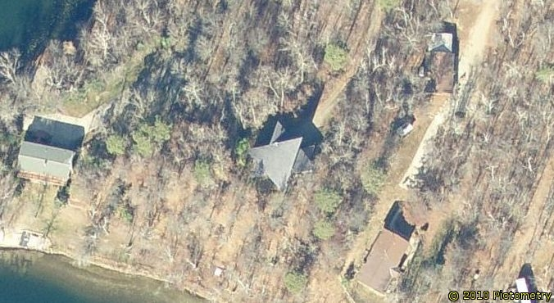
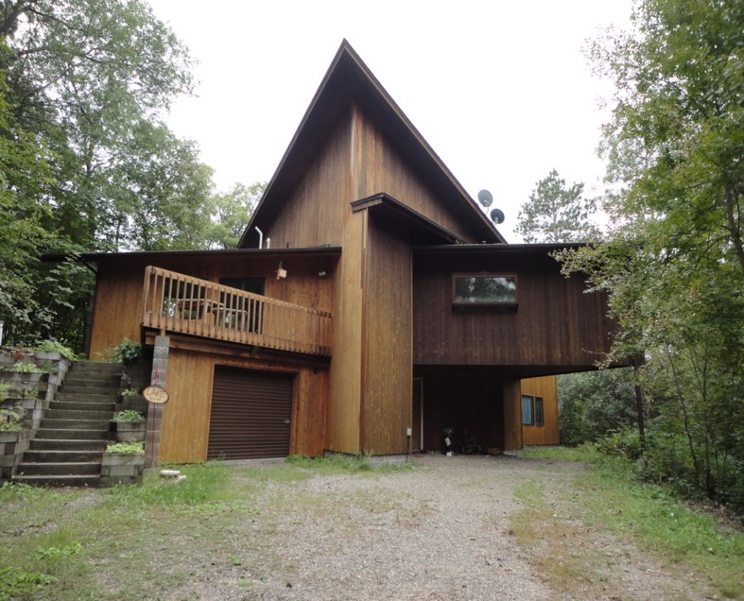

Slide 6
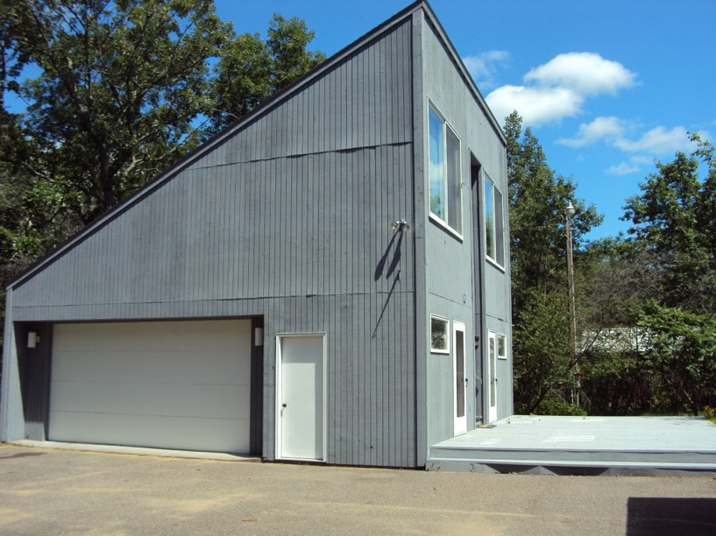
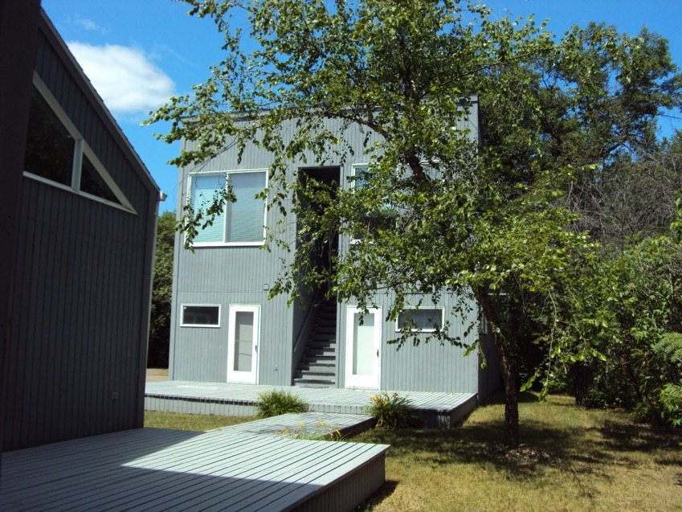

Slide 7
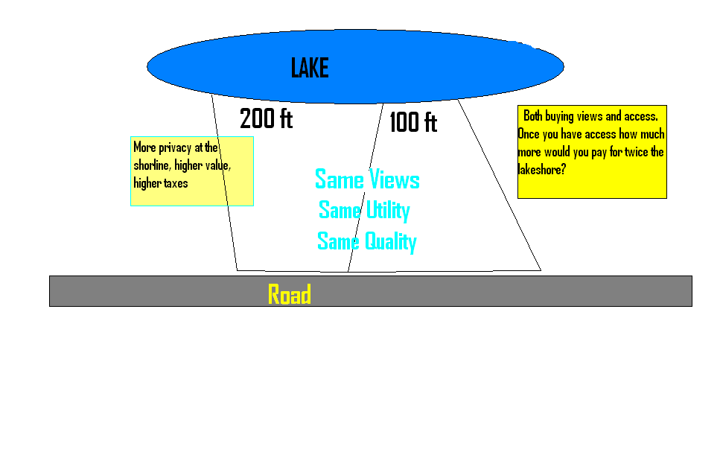

Slide 8
Determining Quantity of Lakeshore
and
Quality of Lakeshore
Visual Inspection
GIS Parcel Map with aerial photos (pictometry)

Slide 9
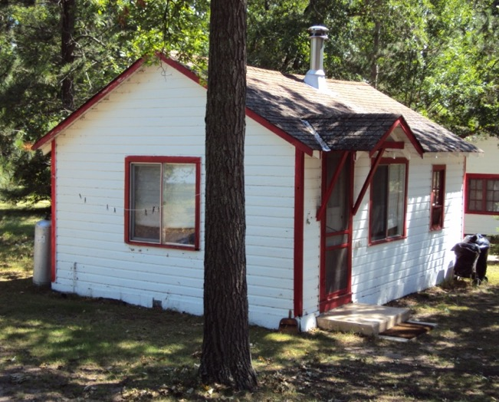
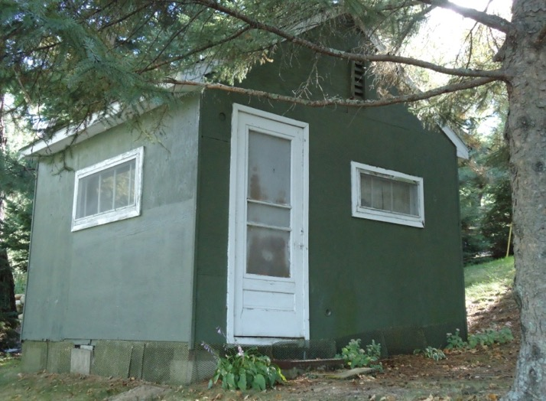

Slide 10
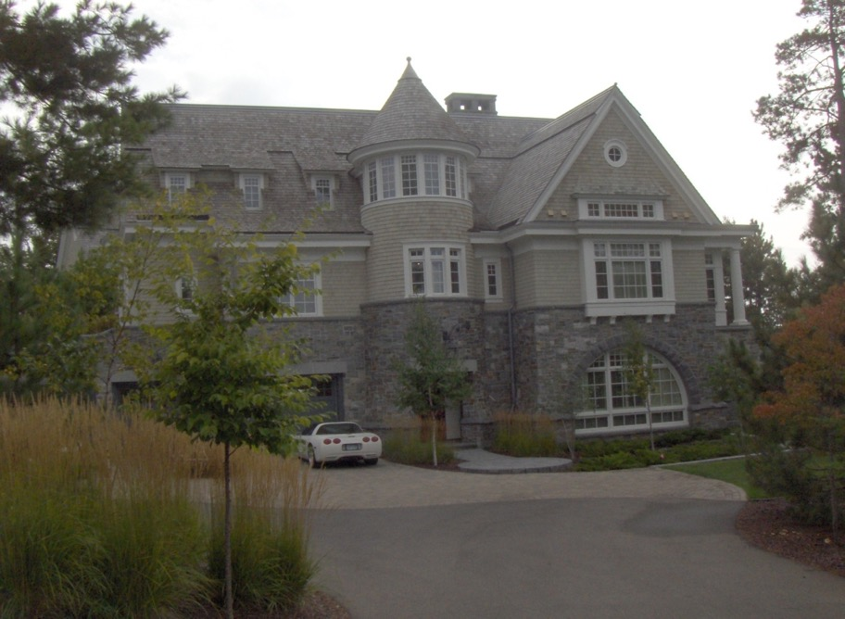
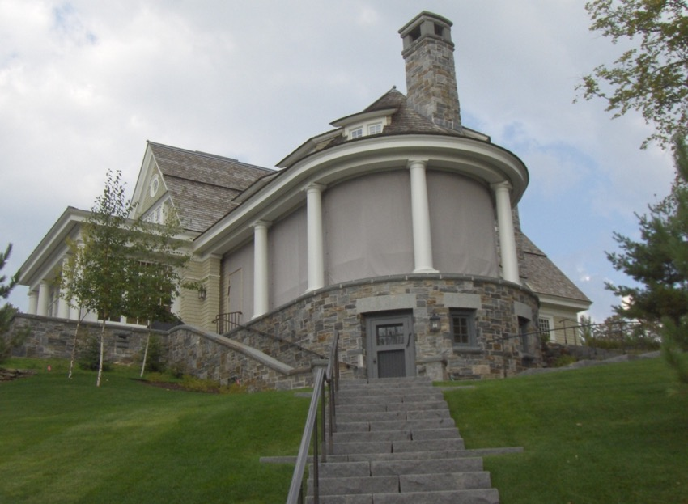

Slide 11
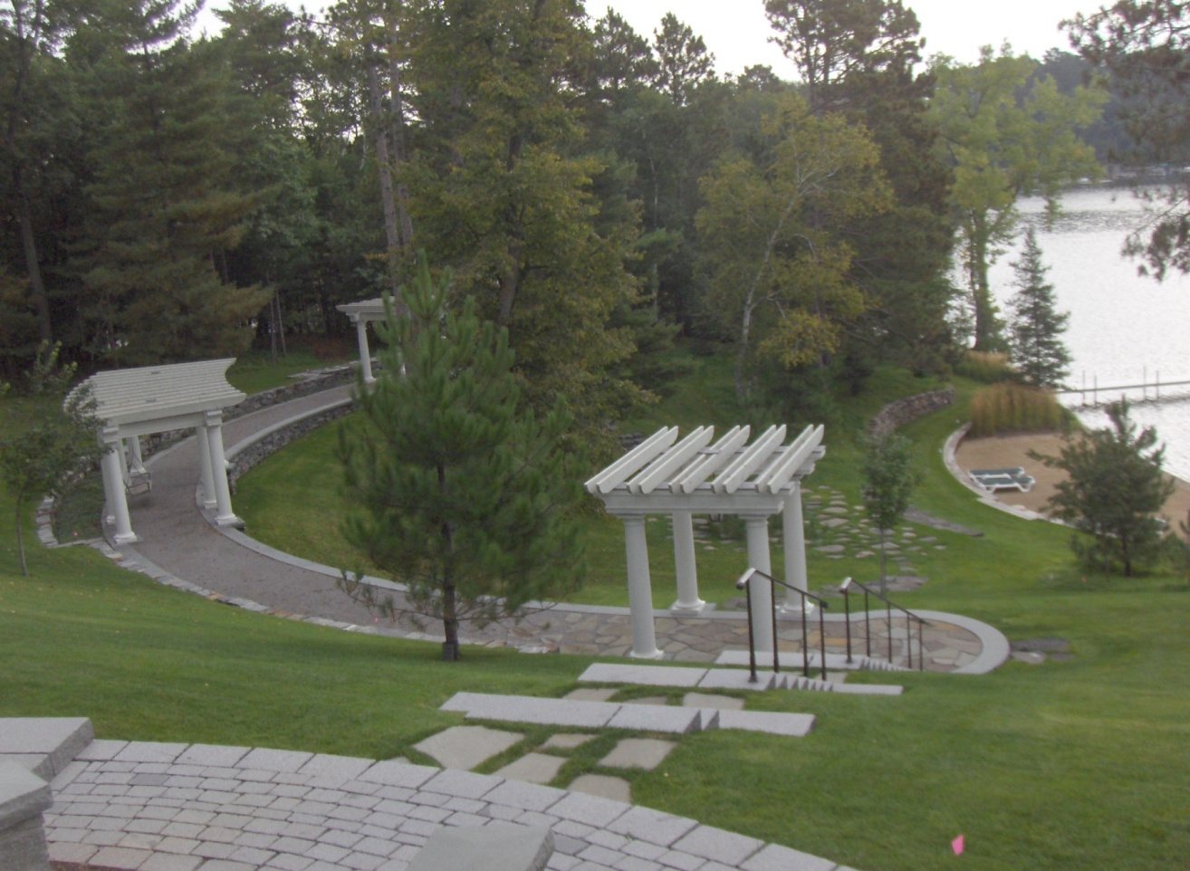

Slide 12
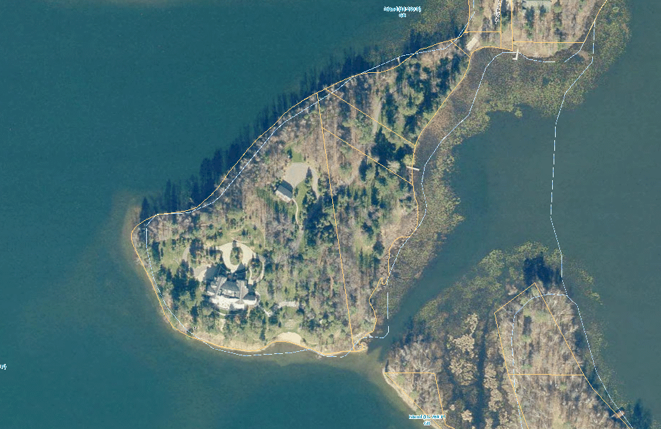
Use GIS to determine amount of shoreline

Slide 13
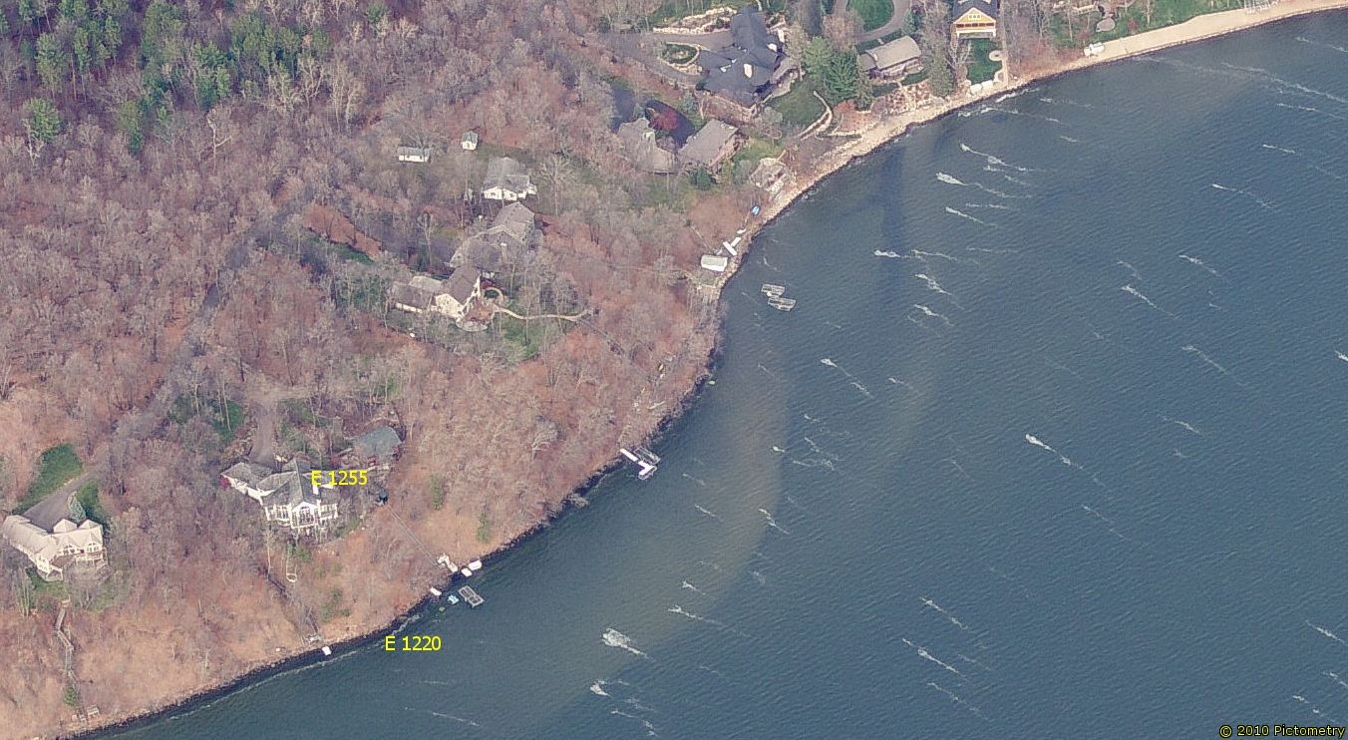
Use pictometry to assist in identifying quality adjustments
*Elevation

Slide 14
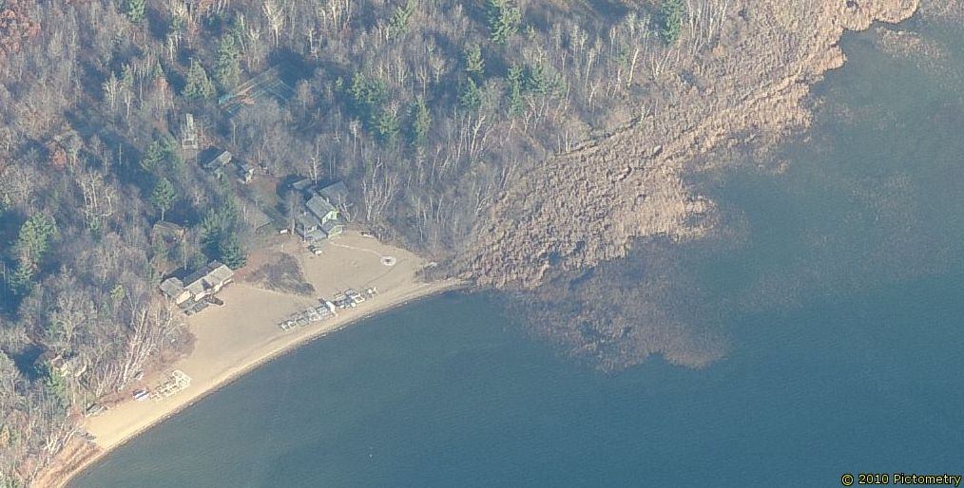
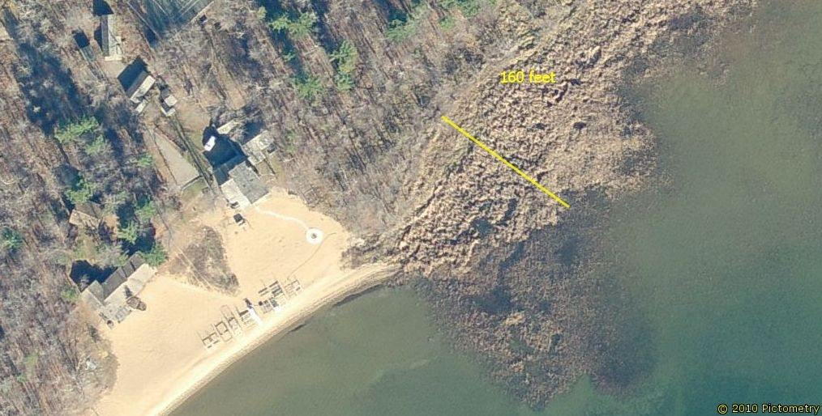
*Vegetation

Slide 15
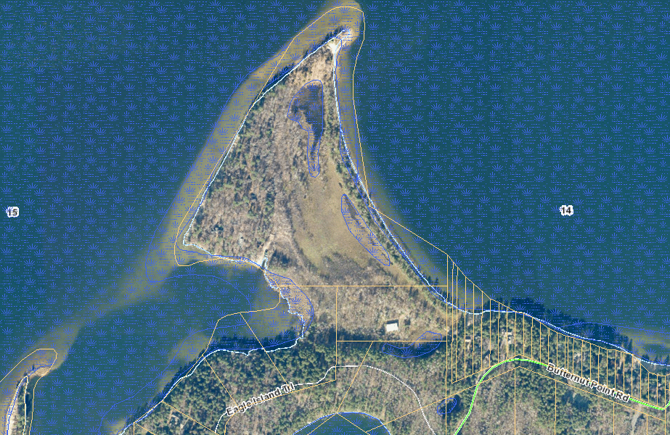
Wetlands or Swamps

Slide 16
Zoning Considerations

Slide 17
Lake Classifications
A lake classification system was developed by MN DNR so appropriate development standards could be applied on different types of lakes. The three classifications are:
NE – Natural Environment
RD – Recreational Development
GD – General Development
Natural Environment lakes usually have less than 150 acres per mile of shoreline, approximately 3 dwellings per mile of shore and are less than 15 feet deep. They usually have limited ability to absorb the impact of development and recreational use.
Recreational Development lakes usually have between 60 and 225 acres of water per mile of shoreline, between 3 and 25 dwellings per mile of shore and are over 15 feet deep. They often are characterized by moderate levels of recreational use and development.
General Development lakes usually have greater than 225 acres of water per mile of shoreline, over 25 dwellings per mile of shore and are over 15 feet deep. They are often extensively used for recreation and are heavily developed around the shore.

Slide 18
Crow Wing County’s lakeshore valuation model is comprised of four main steps. The first step of the process is to determine the base value of a lot. The base value is based on a value/front foot, which varies from lake to lake. The base rate is then adjusted for elevation, vegetation and utility. If a lot is deeper than 200’, the additional land is valued at a standard per acreage rate.
Base Value
Value/front foot
Excess Land
Elevation
Three base grades
5% - 20% adjustment
Vegetation
Four base grades
5% - 70% adjustment
Utility
Irregular Shape
Depth
Build ability
Usability
Privacy

Slide 19
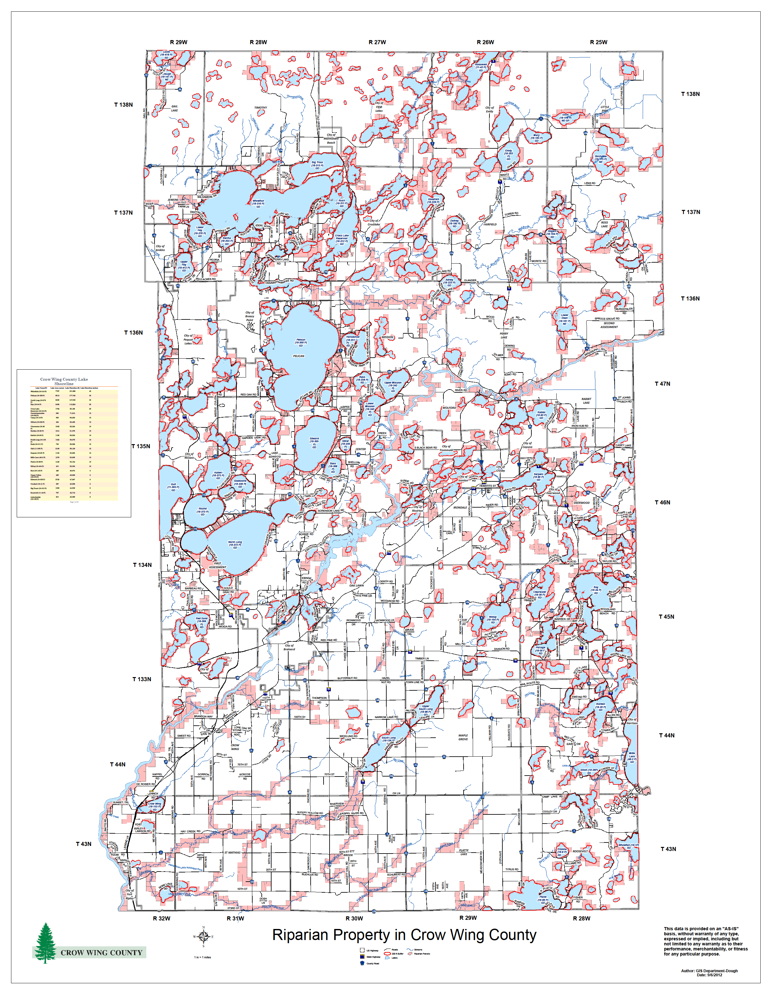

Slide 20
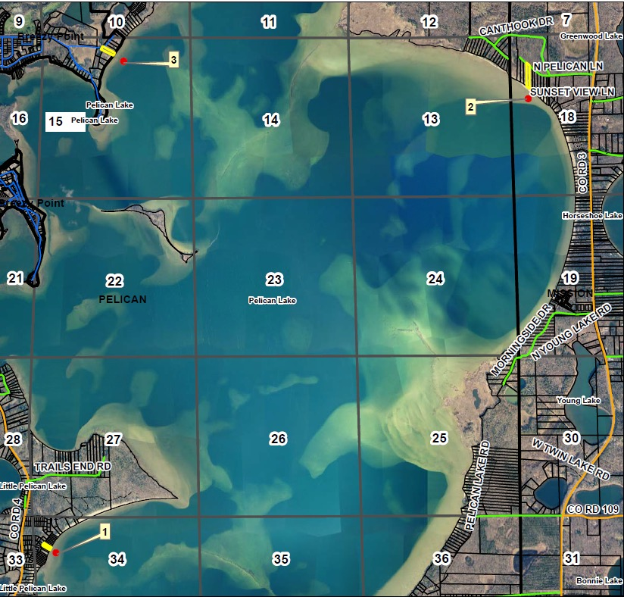
Vacant Land Sales

Slide 21
Bare Land Pelican Sales
Parcel Number | Sale Date | Sale Price | Front Feet | Indicated Value per Front Foot
82109000111009 + | xxx | $300,000 | 100 | $3,000
770182203I00009 | xxx | $365,000 | 100 | $3,650
101340000010009 | xxx | $500,000 | 100 | $5,000
Median Indicated Value Per FF | $3$3,650

Slide 22
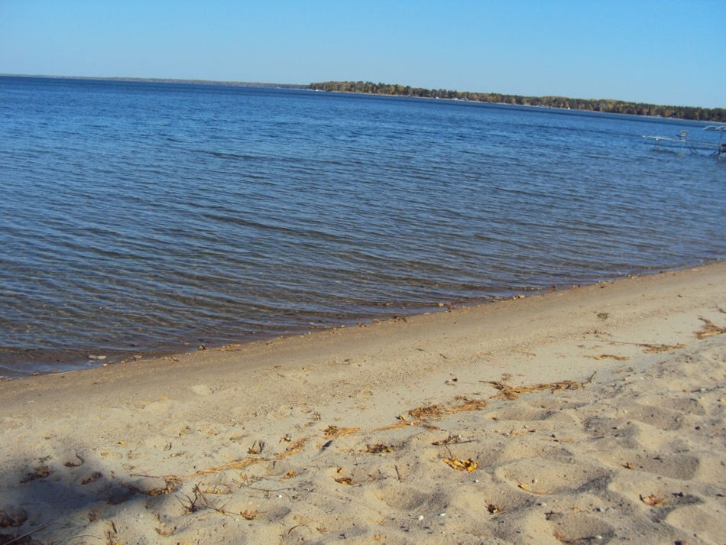
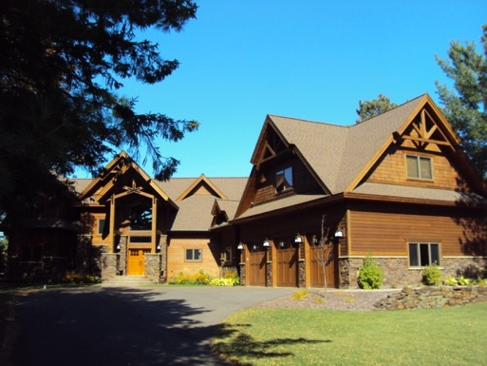
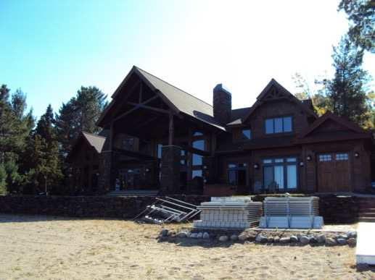
Bare lot 100ft.
sale price
$900,000

Slide 23
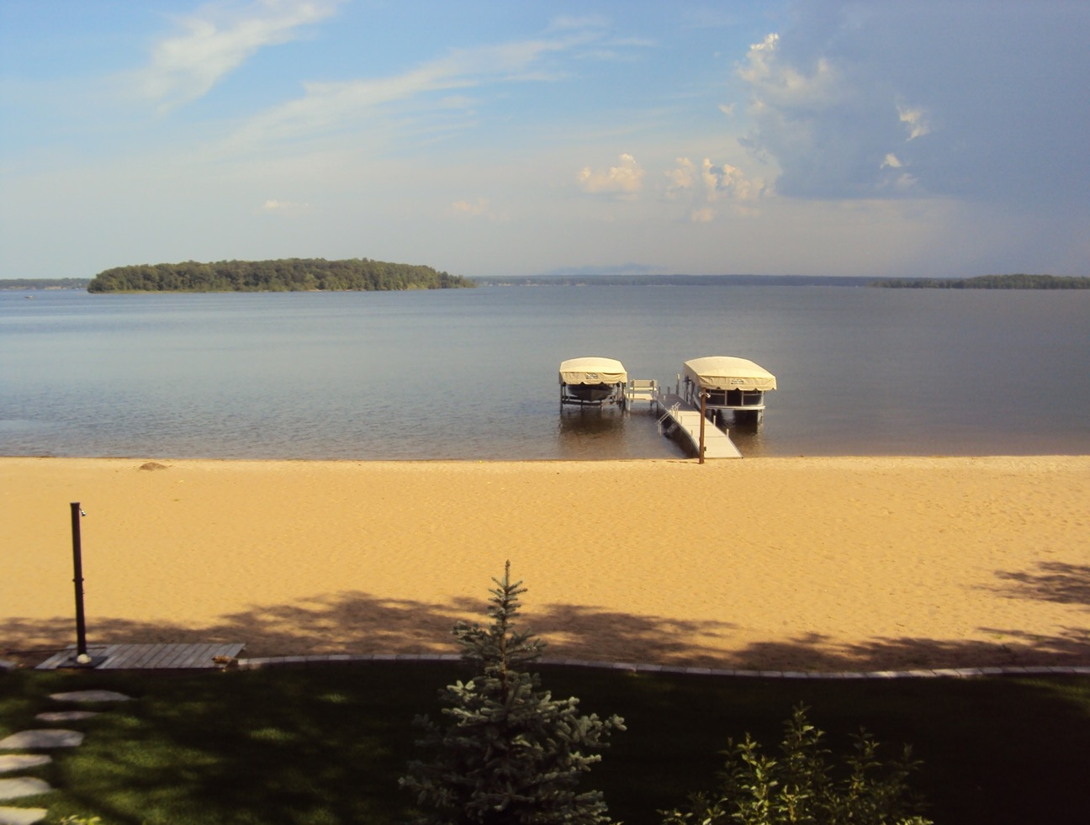
100 ft. bare lot. Sale price $800,000
$8,000 per front foot.

Slide 24
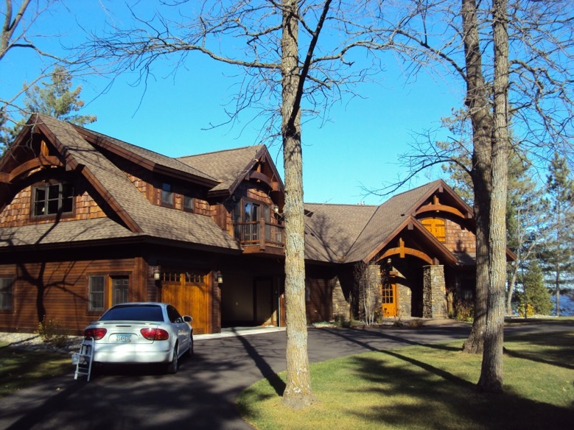
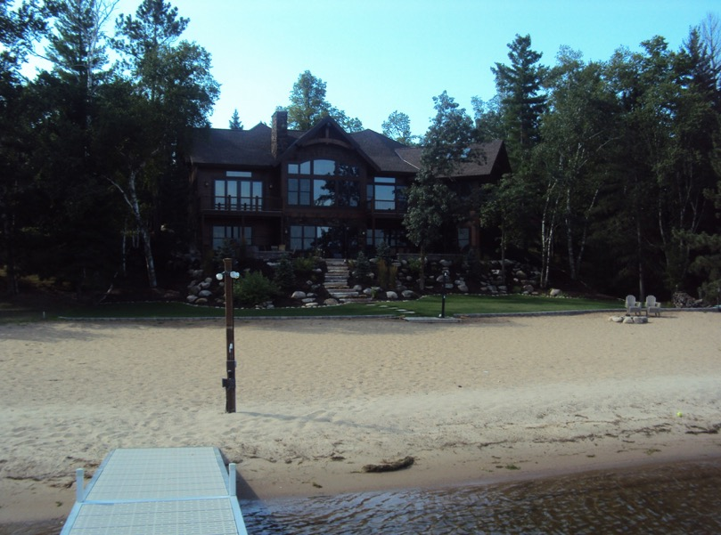

Slide 25
Pelican Lake Improved Sales
Parcel Number | Sale Date | Sale Price | Land Value | Bldg Value | Sale Price less Bldg value | Front Foot | Indicate Value per Front Foot | Quality Adjustments
100152101KA0009 | xxxx | $850,000 | 356,100 | 214,200 | $635,800 | 115 | $5,529 | 10% Vegetation
101270000220009 | xxxx | $233,600 | 181,800 | 119,500 | $114,100 | 100 | $1,141 | 30% Vegetation 30% Depth
10127000066A009 | xxxx | $200,800 | 169,200 | 70,800 | $130,000 | 50 | $2,600 | 30% Depth
770182203I00009 | xxxx | $353,500 | 387,700 | 149,400 | $204,100 | 100 | $3,535 | Prime (Dozer Bait)
770182404AAA009 | xxxx | $375,000 | 259,800 | 49,500 | $325,500 | 33 | $9,864 | Prime
101160000400009 | xxxx | $212,000 | 176,300 | 67,100 | $144,900 | 75 | $1,932 | 50% Vegetation
770183105B00009 | xxxx | $550,000 | 273,800 | 100,100 | $449,900 | 100 | $4,499 | Prime
820131101I00009 | xxxx | $598,800 | 331,500 | 164,500 | $434,300 | 100 | $4,343 | 10% Low
Median Indicated Value per FF | $3,939

Slide 26
no sales On A Lake?
Lake Grouping;
  Size of body of water
  Clarity of water (Water quality)
  Water Depth
  Location of lake

Slide 27
Lake Grouping
Group 1 : $4,000-5,500
Group 2: $3,000-4,000
Group 3: $2,000-2,500
Group 4: $1,500-1,800
Group 5: $1,100-1,400
Group 6: $700-1,000
Group 7: $400-600

Slide 28
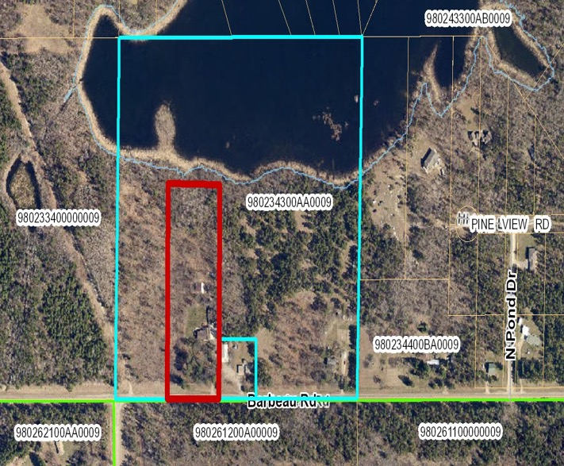
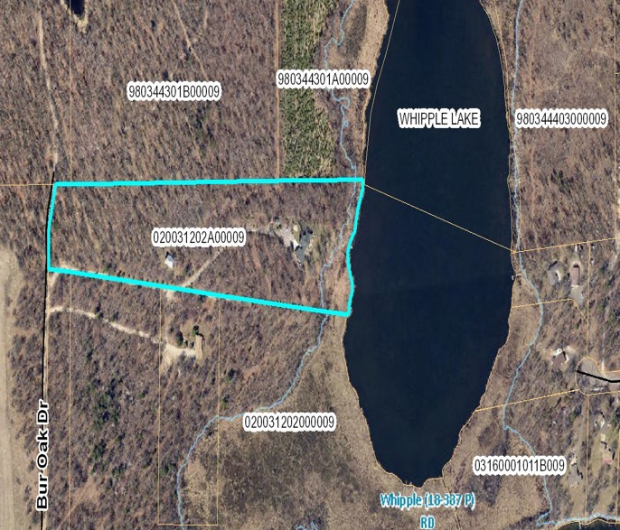
WATER INFLUENCE
WI1/20% - Privacy/ view of open water/ good access to waters edge.
WI2/10%- Privacy/ Limited view with NO or limited access to waters edge
WI2
WI1
WI1

Slide 29
SALES HISTORY FOR
PELICAN LAKE
85 Good Sales Since 2010
$380,651 Average Sale Price
$364,668 Average EMV
98% Median Sales Ratio
By Contrast
Whitefish Chain, another highly developed
Crow Wing County Lake has had:
259 Good Sales Since 2010
$600,402 Average Sale Price
$552,988 Average EMV
96% Median Sales Ratio

Slide 30
Starting Front Footage Rates per Lake
Gull – GD - $5,000 per foot
Whitefish – GD - $4,400 per foot
Pelican – GD - $3,700 per foot
Bay – RD - $3,100 per foot
Hubert – GD - $3,100 per foot
Round – GD - $3,000 per foot
Horseshoe – RD - $2,000 per foot
North Long – GD - $1,800 per foot
Lake Edward – GD - $1,600 per foot
Kimball – GD $1,900 per foot
Ossawinnamakee – GD $1,700 per foot
Serpent – GD - $1,500 per foot
Gilbert – GD - $1,300 per foot

Slide 31
Lakeshore Quantity Adjustments

Slide 32
Quantity Percentage Analysis
Frontage Totals | # of Sales | Median Ratio of Sales
0-79 Feet | 49 | 94%
80-100 Feet | 53 | 100%
101-200 Feet | 96 | 99%
201-300 | 19 | 99%
301+ | 4 | 101%

Slide 34
Front Footage Quantity Adjustments
Pelican
1st Tier Lakeshore - $3,700
2nd Tier Lakeshore - $2,220
3rd Tier Lakeshore - $1,665
4th Tier Lakeshore - $925
Whitefish
1st Tier Lakeshore - $4,600
2nd Tier Lakeshore - $2,760
3rd Tier Lakeshore - $2,115
4th Tier Lakeshore - $1,150

Slide 35
Exceptions to the quantity guideline

Slide 36
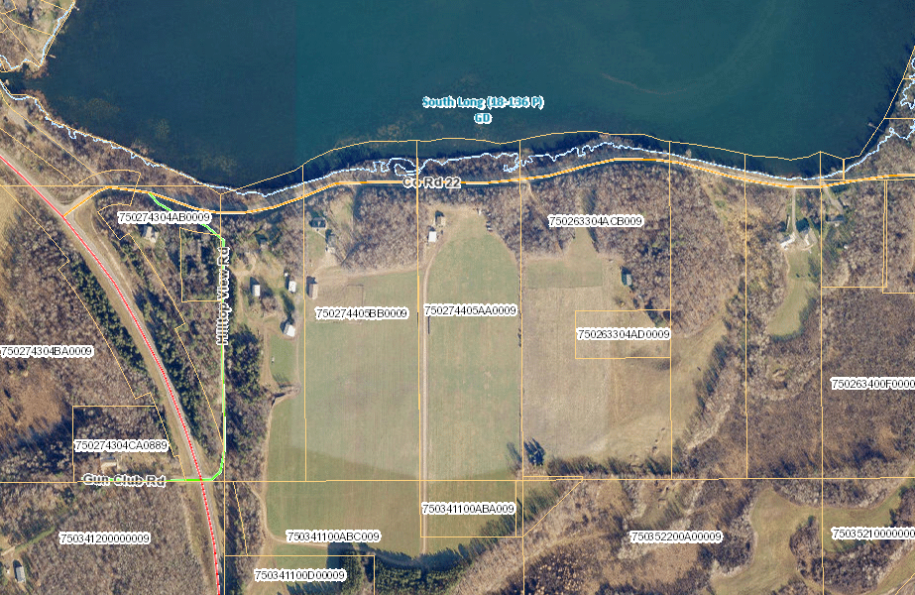
Road Between Lakeshore and Improvement

Slide 37
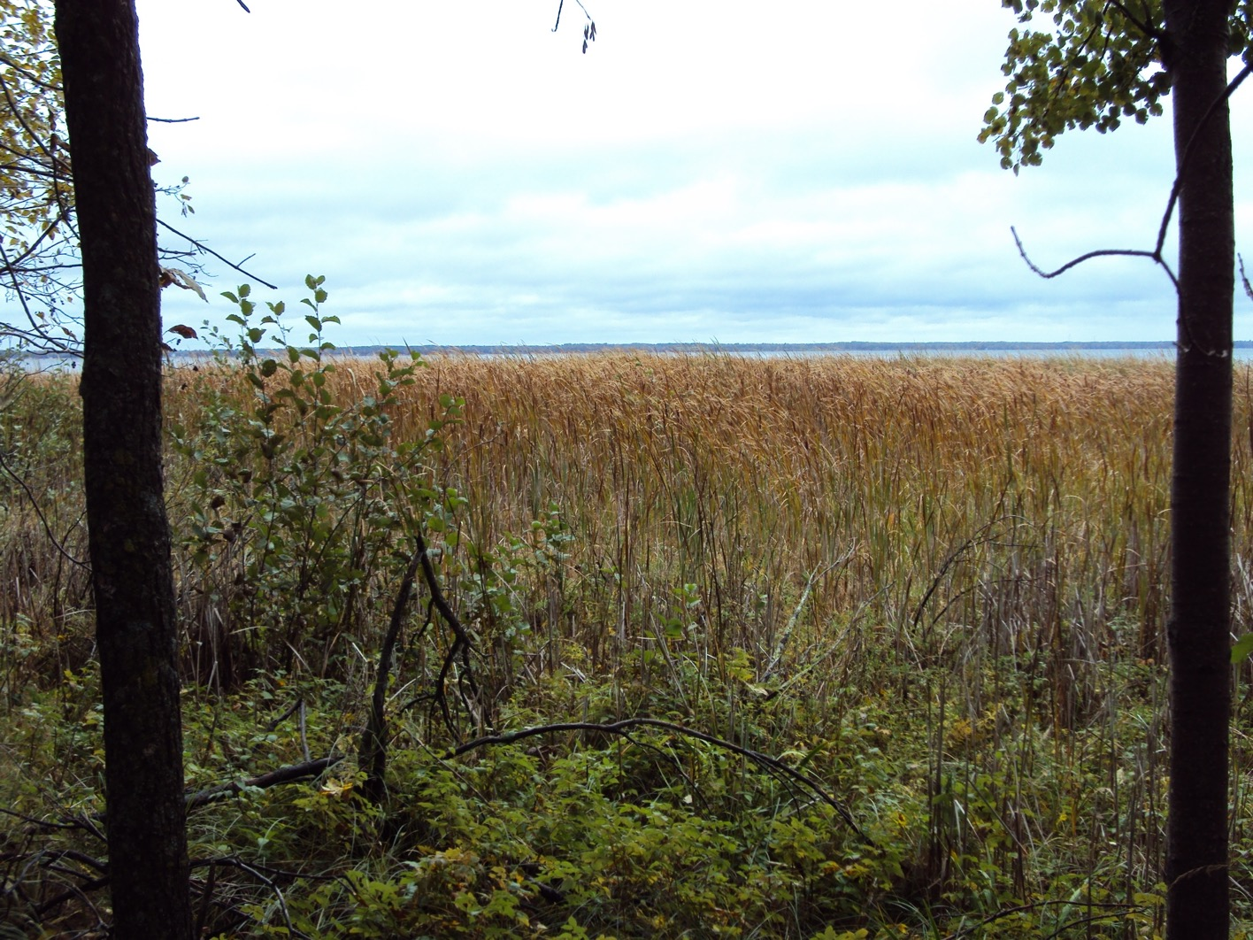
Extreme vegetation growth

Slide 38
Lakeshore Quality Adjustments
Prime
Elevation
Two Categories
5% - 15% adjustment
Vegetation
Four base grades
5% - 70% adjustment
Utility
Irregular Shape
Depth
Build ability
Usability
Privacy
No adjustment to front footage rate
6 Grades

Slide 39
Prime Lakeshore
Description
PRIME: Level elevation to moderate gentle slope to the waters edge of no more than 10’-12’ elevation, no stairs would be required. Would have a hard sand or gravel beach with hard sand or gravel bottom out to a normal dock end. Would be very usable for all water activities, swimming, boating, water skiing, etc. Little or no weed growth would exist within the beach area.

Slide 40
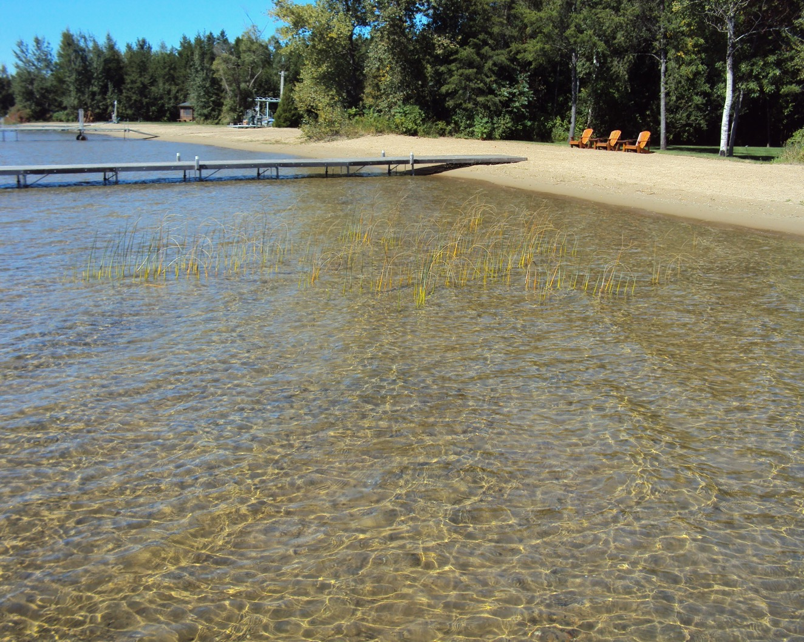

Slide 41
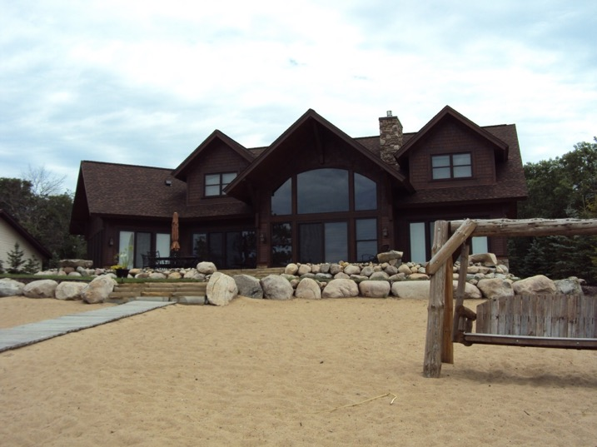
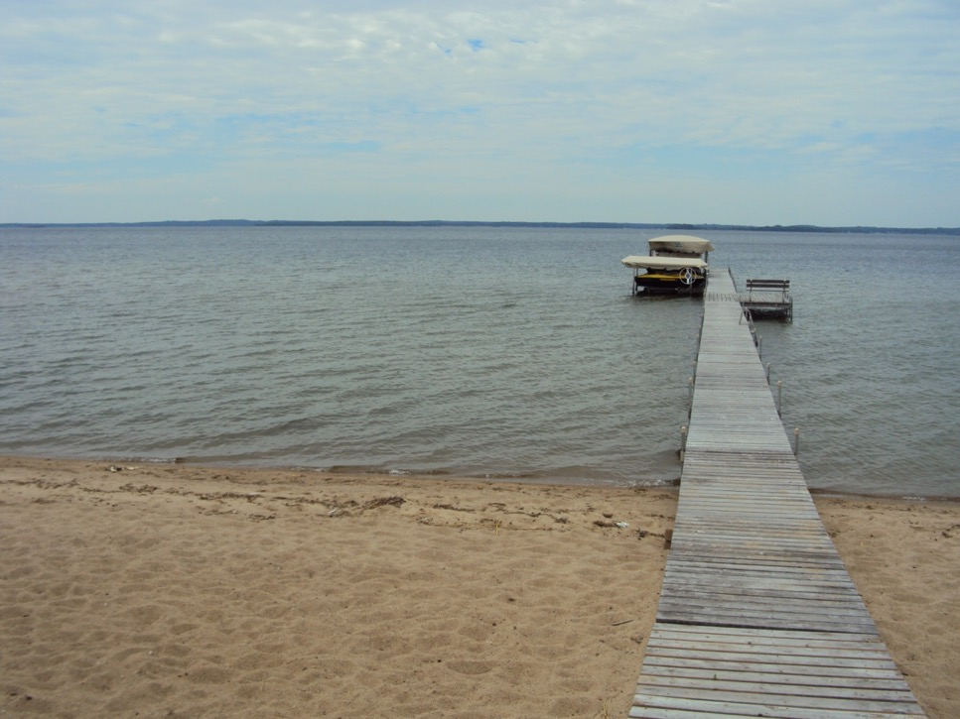

Slide 42
Lakeshore Quality Adjustments
Prime
Elevation
Two Categories
5% - 15% adjustment
Vegetation
Four base grades
5% - 70% adjustment
Utility
Irregular Shape
Depth
Build ability
Usability
Privacy
No adjustment to front footage rate
6 Grades

Slide 43
Categories of Elevation
The elevation of a lot is characterized by two categories:
    A slope is defined as the type of elevation that extends from the lakeshore towards the rear of the lot with a fairly consistent rise over the entire depth of the area being considered.
    A ridge is defined as the type of elevation that rises quickly over a smaller area of depth.

