Slide 1
Elevation Adjustments
Gradual Slope
0% to 14% Slope
No Adjustment
Moderate Slope
16% to 28% Slope
5% adjustment
Steep Slope
>30% Slope
10% adjustment
Moderate Ridge
Steep Ridge
At least 30% Slope, 6’ to 15’ height.
5% adjustment
10% adjustment
At least a 30% slope, 15’ to 25’ height
Very Steep Ridge
  At least 30% Slope, over 25’.
  15% adjustment

Slide 2
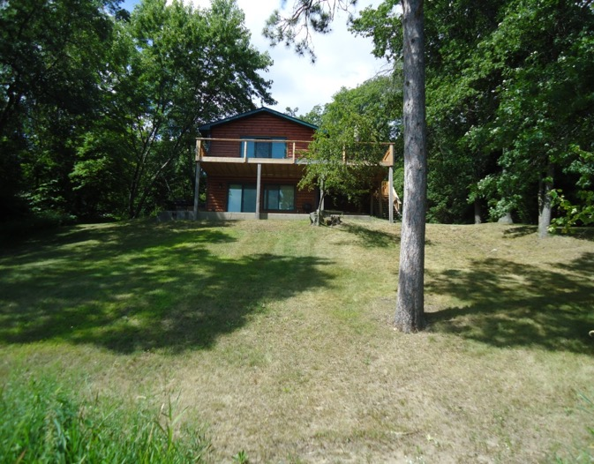
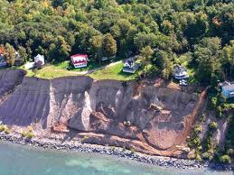
Examples
Slope
Ridge

Slide 3
Measuring Slope
To determine the elevation of a lake lot we will measure the slope of the lot. The slope is determined by dividing the rise, or height of the elevation by the run, or depth of the lot that is affected by a slope or a ridge.
Rise/Run= Slope

Slide 4
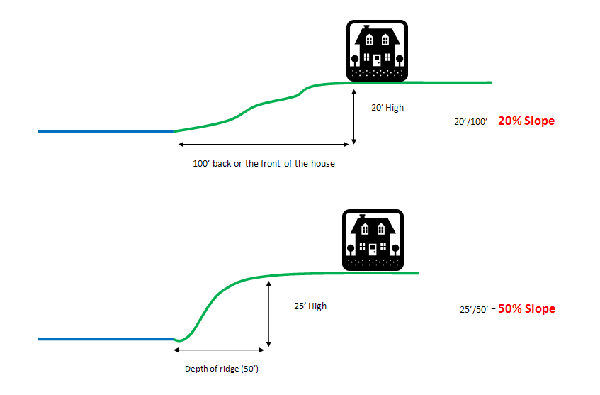

Slide 5
Measuring a Slope on GIS
To Determine slope on the GIS Map:
Measure the lot from the lakeshore to 100’ back, or to the house, whichever is nearer to the lake(run).
Subtract the elevation of the lake line from the back elevation(rise).
3. Divide the elevation by the depth
(1204-1194)/80 = 12.5% Slope
80’

Slide 6
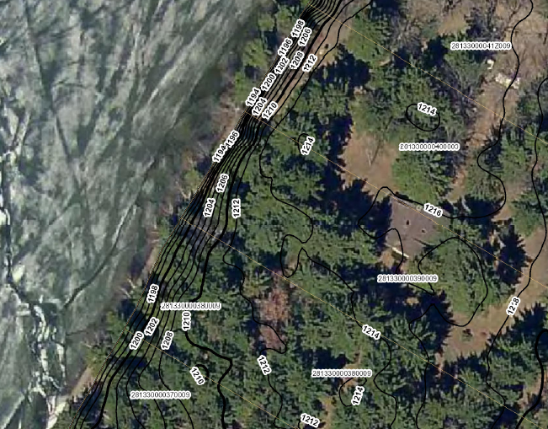
Measuring a Ridge on GIS
To Determine a ridge on the GIS Map:
Measure the lot from the lakeshore to the back of the ridge, where the land levels off.
Subtract the elevation of the lake line from the back elevation(rise).
3. Divide the elevation by the depth
(1212-1194)/25 = 72% Slope
18’ height

Slide 7
When does a slope become a ridge?
A ridge has at least a 30% slope
There are three grades of ridge. The grade is determined by the height of the ridge:
    Moderate ridge: 6’ to 15’ high
    Steep ridge: 15’ to 25’ high
    Very steep ridge: greater than 25’ high

Slide 8
Gradual Slope
A study of lakeshore sales on the Whitefish chain of lakes showed that lake lots that were level, or had a gradual slope did not need to receive any discount to value. A gradual slope is defined by a slope up to 14%.
0% -14%

Slide 9
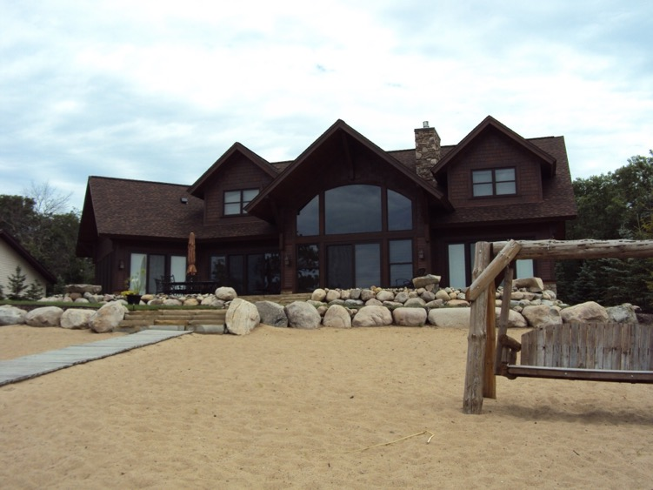
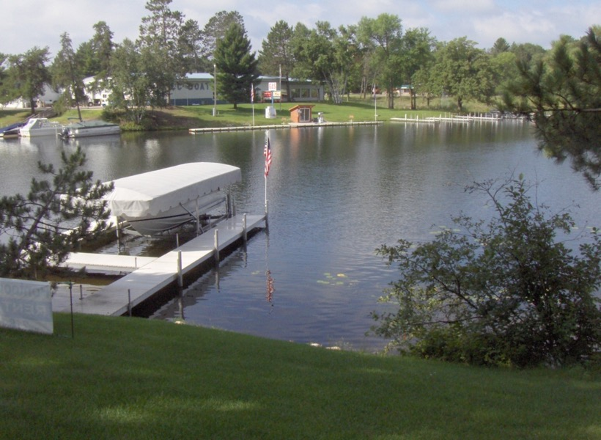
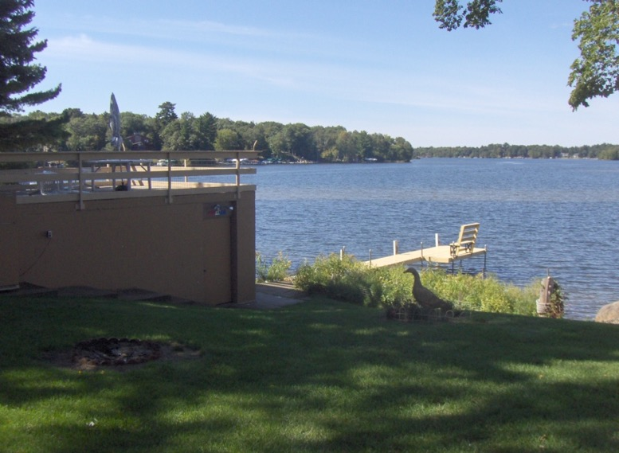

Slide 10
Moderate Slope
A moderate slope has a slope between 16% and 28%. It is common for moderate slopes to have no path to the lakeshore. However, many moderate slopes do have steps or a path to make the descent to the lake easier.
16% to 28%

Slide 11
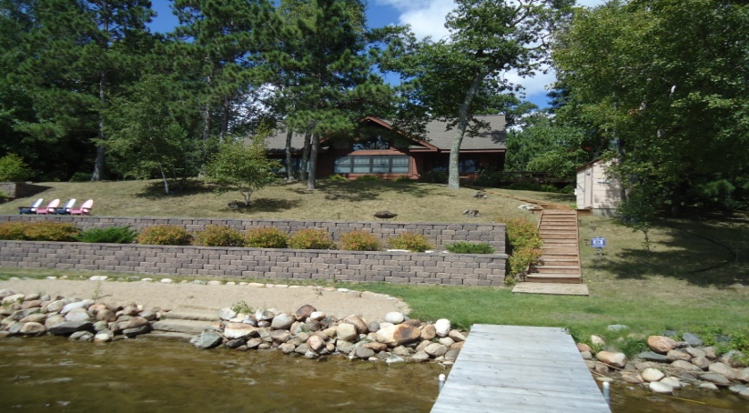
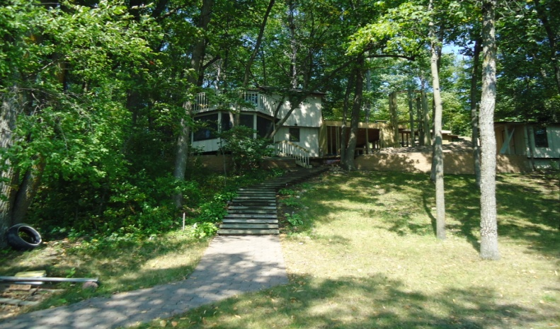
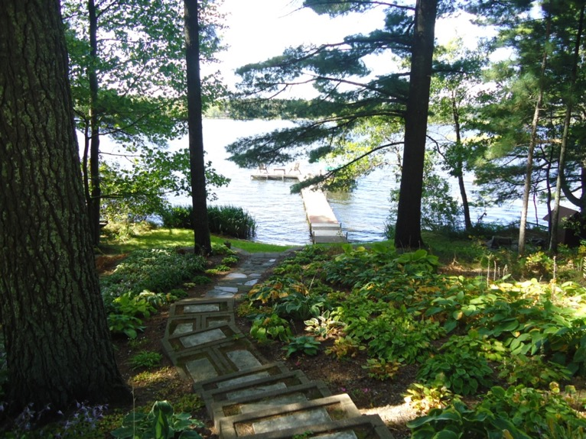

Slide 12
Steep Slope
A steep slope has a slope greater than 30%. Steep slopes may have natural access to the lake, but will often have some sort of path or stairs due to the steepness of the slope.
>=30%

Slide 13
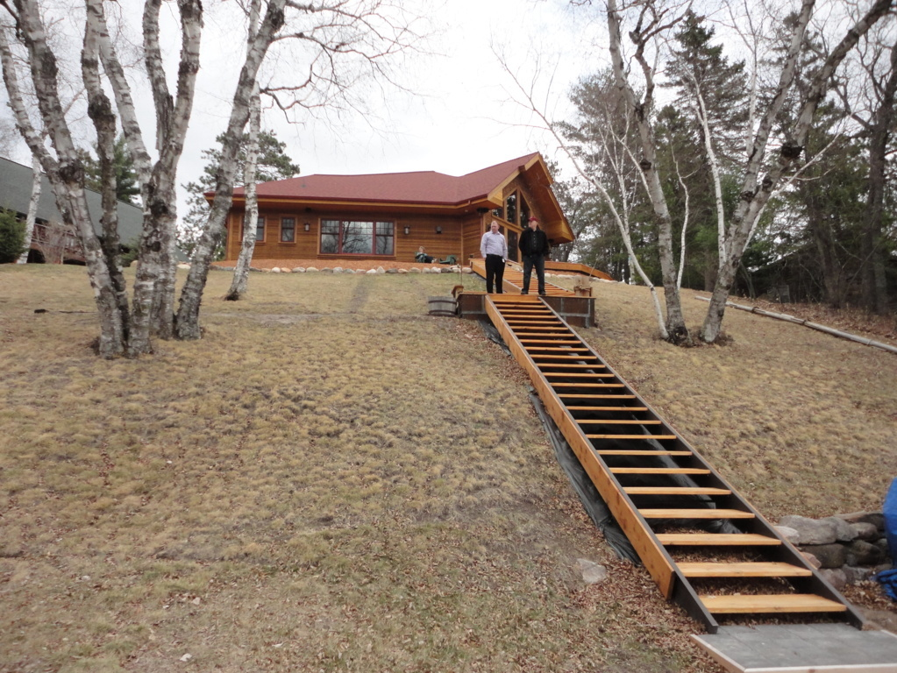

Slide 14
Moderate Ridge
A moderate ridge has a slope of at least 30% and a height of 6’ – 15’. Moderate ridges typically have steps, but it is not unusual for a moderate ridge to lack stairs.
6’ to 15’

Slide 15
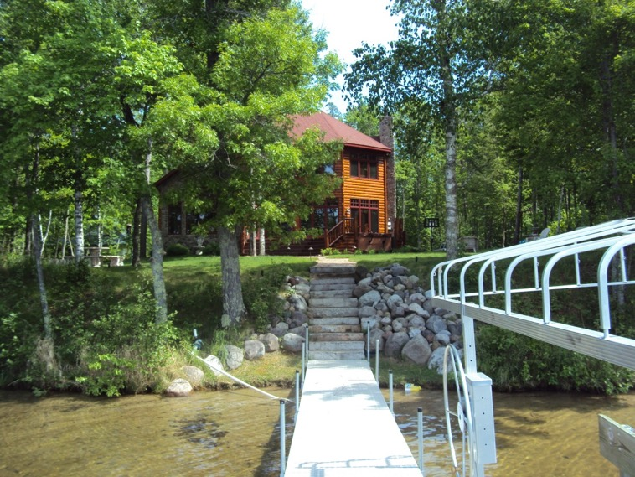
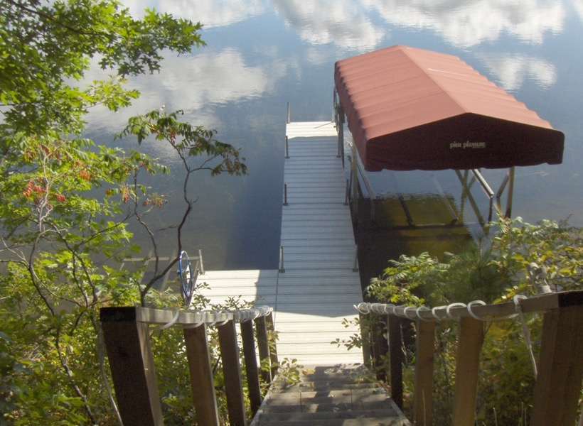
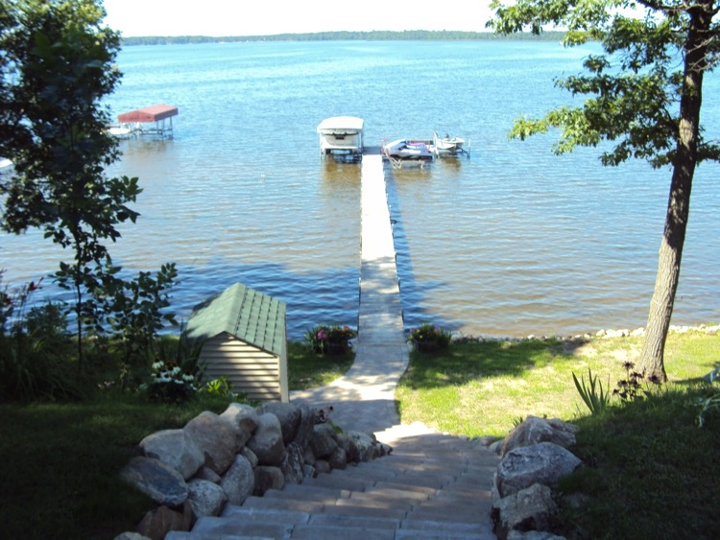

Slide 16
Steep Ridge
A steep ridge has a slope of at least 30% and a height of 15’ – 25’. Steep ridges typically have stairs to the lake, due to the higher elevation of the ridge.
15’ to 25’

Slide 17
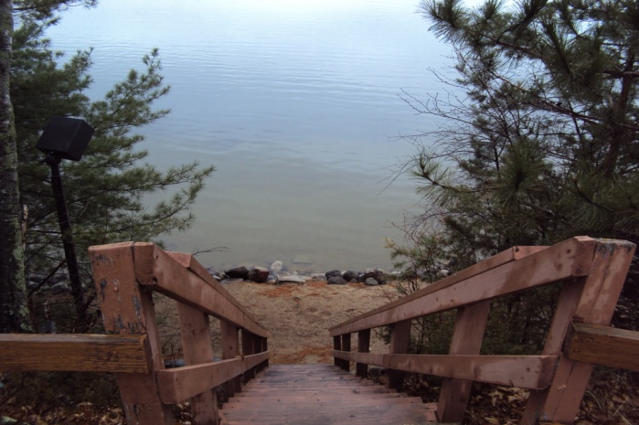
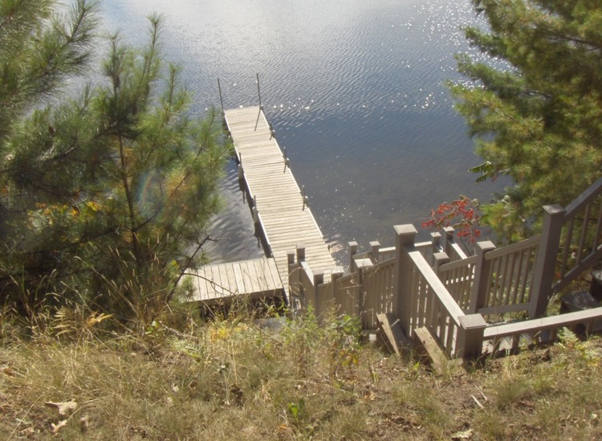
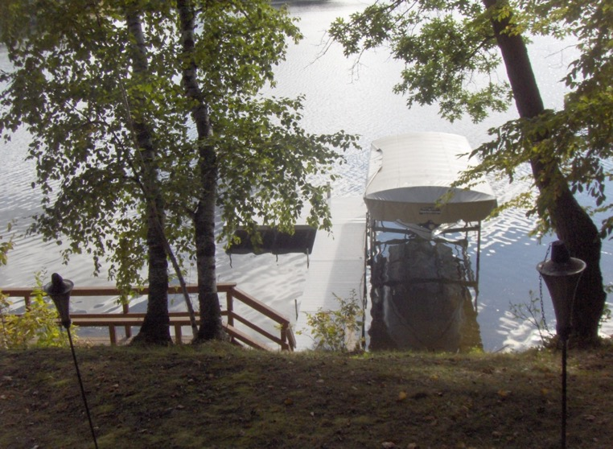

Slide 18
Very Steep Ridge
A very steep ridge has a slope of at least 30% and a height over 25 feet. Very steep ridges typically have stairs to the lake or a mechanical lift or elevator, due to the higher elevation of the ridge.
>= 25’

Slide 19
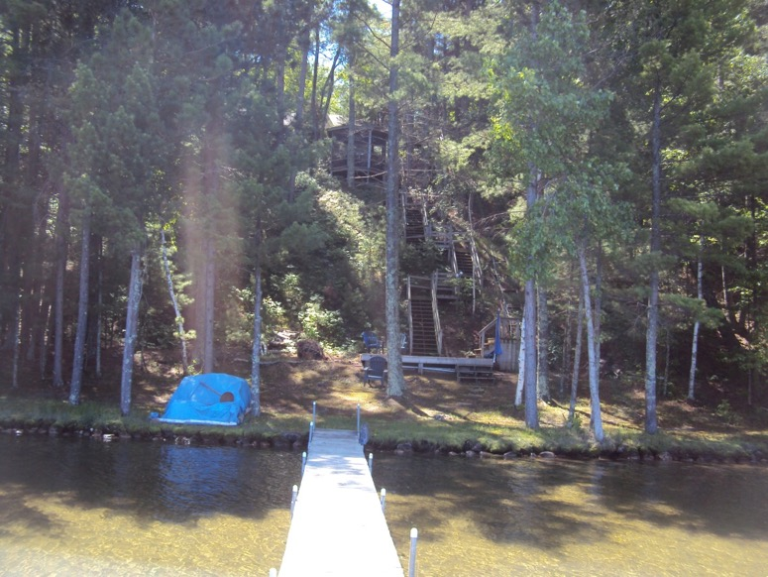
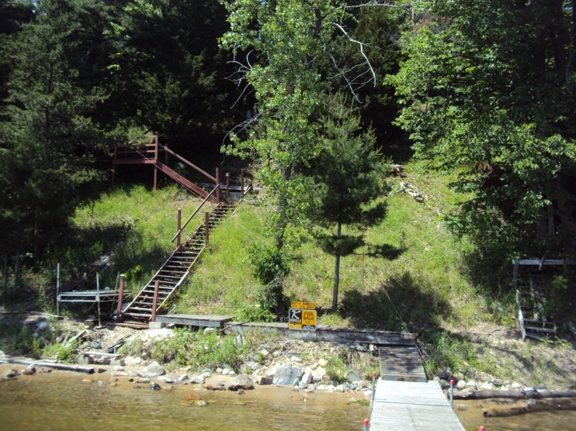
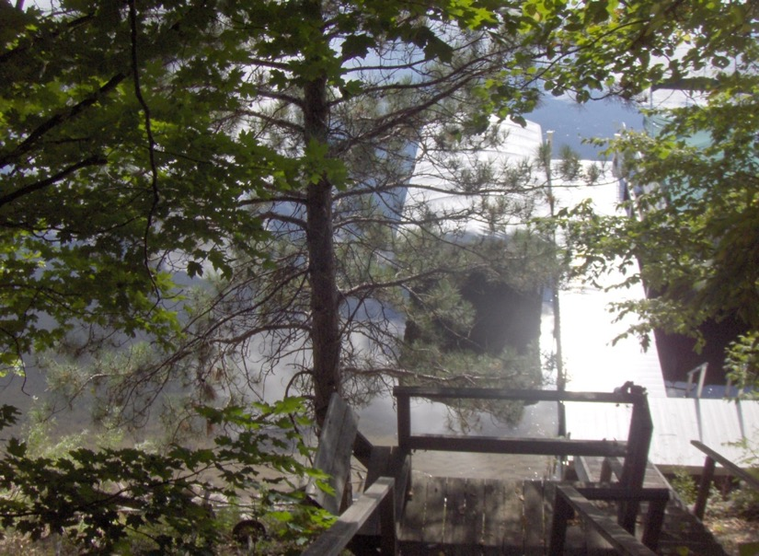

Slide 20
Landings
When a lot has a landing at the base of a steep slope or a ridge, the adjustment used for the elevation will be decreased to reflect the greater utility of a lot.
A landing is defined as a strip of land at the shore that is level or gradually slopes back to the ridge.
A landing should be at least 6’ deep to be considered.
There are two grades of landings:
  LD1: a landing 6’ to 14’ deep
  LD2: a landing >= 15’ deep

Slide 21
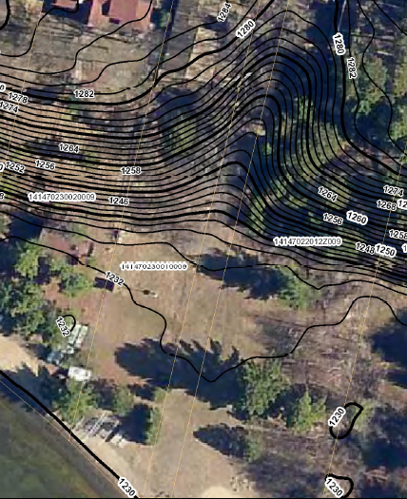
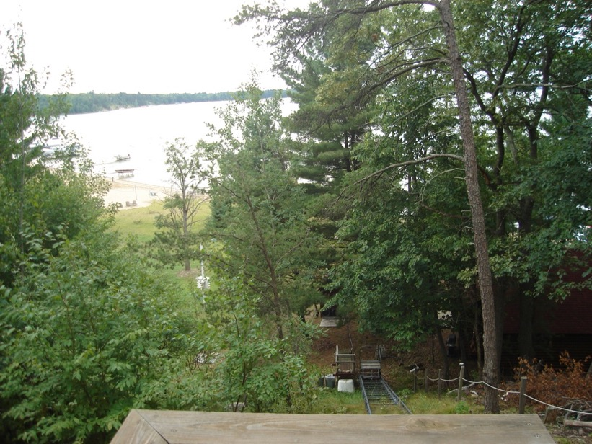
160’

Slide 22
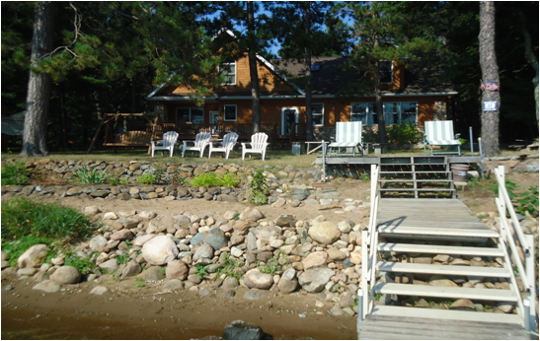
Close Calls
The goal is to be as objective as possible. Sometimes a lot will be difficult to classify and we will have to make a subjective call.
6’ high ridge
25% slope
Moderate Ridge?

Slide 23
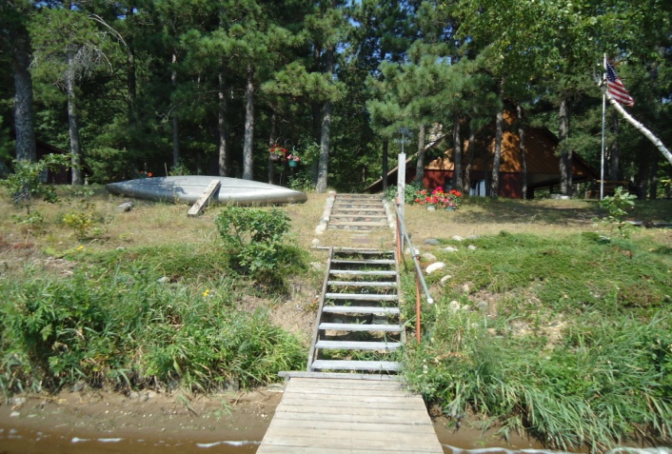
What if these lots are side by side?
6’ high ridge
25% slope
8’ high ridge
33.33% slope

Slide 24
Lakeshore Quality Adjustments
Prime
Elevation
Two Categories
5% - 15% adjustment
Vegetation
Four base grades
5% - 70% adjustment
Utility
Irregular Shape
Depth
Build ability
Usability
Privacy
No adjustment to front footage rate
6 Grades

Slide 25
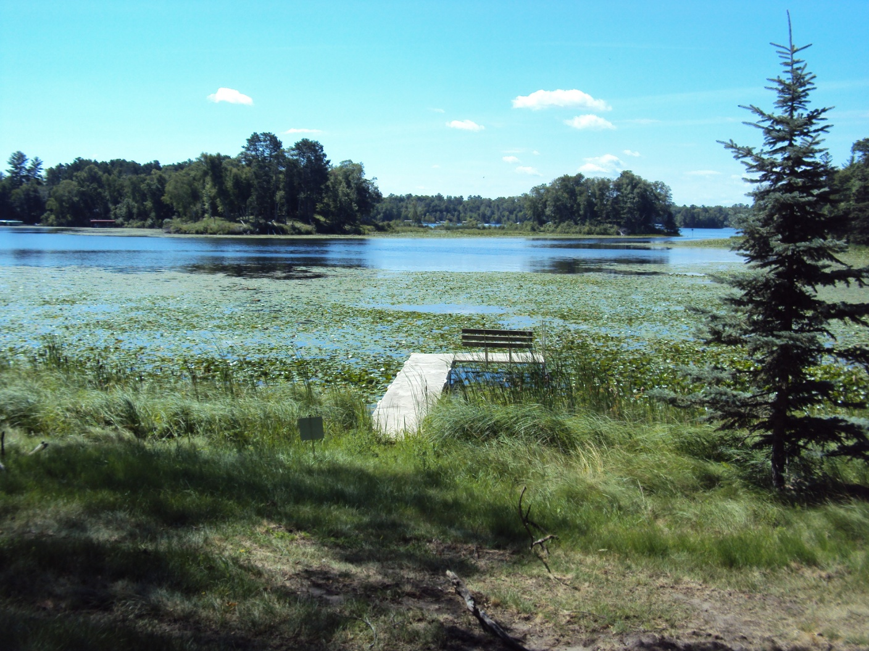

Slide 26
Areas of Consideration in Evaluating Lakeshore Vegetation
The process for grading lakeshore vegetation must be addressed in a multi-faceted manner due to the wide variety of vegetation, shoreline and lake bottoms. These factors can not only be found on different lakes, but also in various areas on the same lake.
Additionally, the considerations must be easily understood and applied by individual appraisers so there can be consistency county-wide.

Slide 27
Three Areas of Consideration of Lakeshore Vegetation
Vegetation in the Water
Vegetation on the Shore
Lake Bottom Quality

Slide 28
Vegetation in the Water
Emergent Vegetation
Floating Vegetation
Submerged Vegetation

Slide 29
Groups of Aquatic Plants Found in Minnesota Lakes Considered in the Lakeshore Valuation Process
Emergent Plants
Floating Leaf Plants and Algae
Submerged Plants
Adapted from MN DNR

Slide 30
Aquatic plants tend to change with the water depth.
Most emergent plants are located in shallower depths.
Floating leaf plants are in moderate depths.
Submerged plants grow in water depth up to _{approximately} 20 to 25 feet, depending on the water clarity.
The better the water clarity, the deeper in water the plants can grow.

Slide 31
Types of Plants Common to Crow Wing County Lakes
Emergent Plants
_{Cattails}
_{Purple loosestrife}
_{Bulrushes}
_{Wild rice}
Rooted in the lake bottom with most of their leaves and stems extending above the water surface.
Adapted from MN DNR

Slide 32
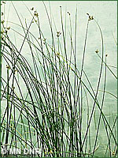
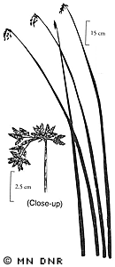
Bullrushes
MN DNR

Slide 33
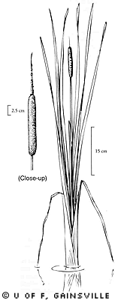
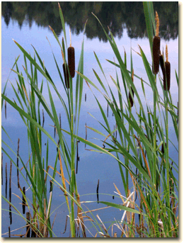
Cattails
MN DNR

Slide 34
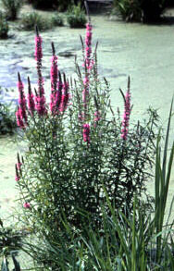
Purple Loosestrife
MN DNR

Slide 35
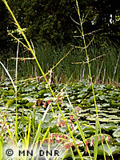
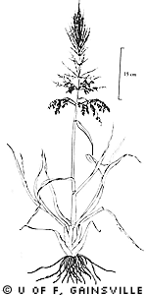
Wild Rice
MN DNR

Slide 36
Floating and Floating Leaf Plants
Anchored in the lake bottom with leaves, flowers or matter that floats on the surface
Water lilies
Filamentous Algae
Stonewort
Adapted from MN DNR

Slide 37
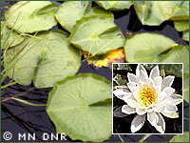
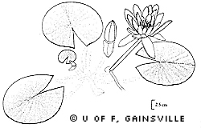
Water lily
MN DNR

Slide 38
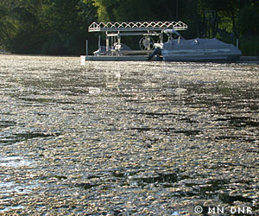
Filamentous Algae
MN DNR

Slide 39
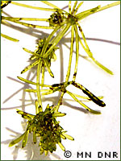
Stonewort
MN DNR

Slide 40
Submerged Plants
Pond Weeds (of various types)
Milfoil
Wild Celery
Stems and leaves that primarily grow under water.
May be short or tall with leaf shapes that include broad ovals, long and grass-like or finely dissected.
Adapted from MN DNR

Slide 41
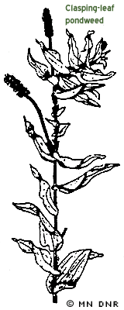
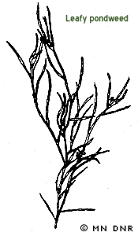
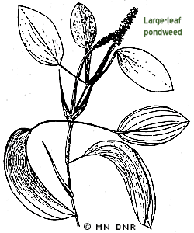
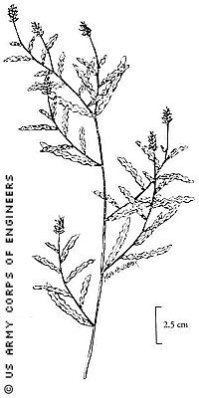
Pond Weeds
MN DNR

Slide 42
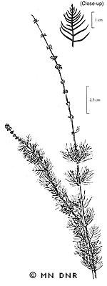
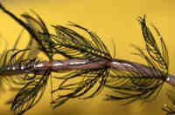
Milfoil
MN DNR

Slide 43
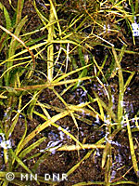
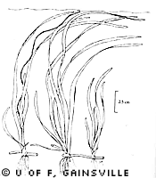
Wild Celery
MN DNR

