Slide 1
Lakeshore
Vegetation
Sparse
Moderate
Dense
Severe
Grading Vegetation
Sparse
Moderate
Dense
Severe

Slide 2
Emergent Vegetation
Heavy concentration. High ratio of emergent vegetation to open water.
Dense
Thicker in density, or may consume more area of the shoreline and water area extending out. May also have wide areas that are clear of weeds.
Moderate
Thin concentration; may be a gathering in a small area of the overall frontage. Does not impact lakeshore utility.
None / Sparse
Heavy, thick concentration.
Severe
May still be able to navigate a watercraft through.
May require long docks/boardwalks to access a more usable area of the lake
Not navigable by boat.

Slide 3
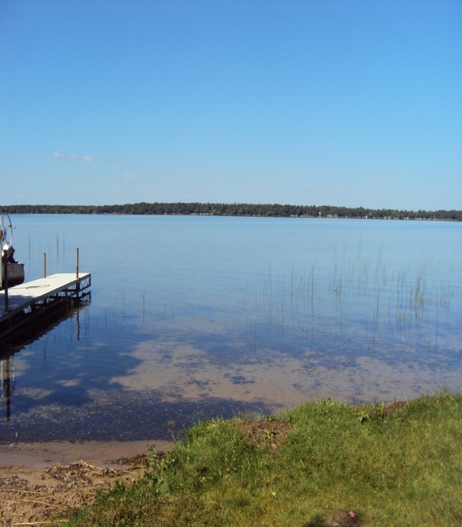
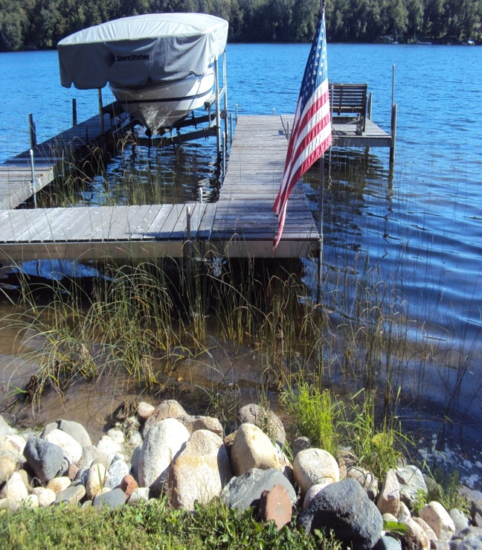
Emergent Vegetation
None / Sparse
  Thin concentration; may be a gathering in a small area of the overall frontage. Does not impact lakeshore utility.

Slide 4
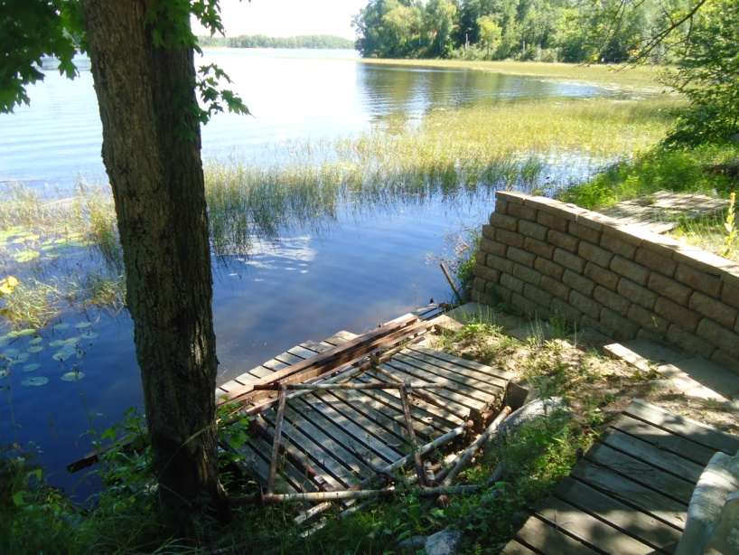
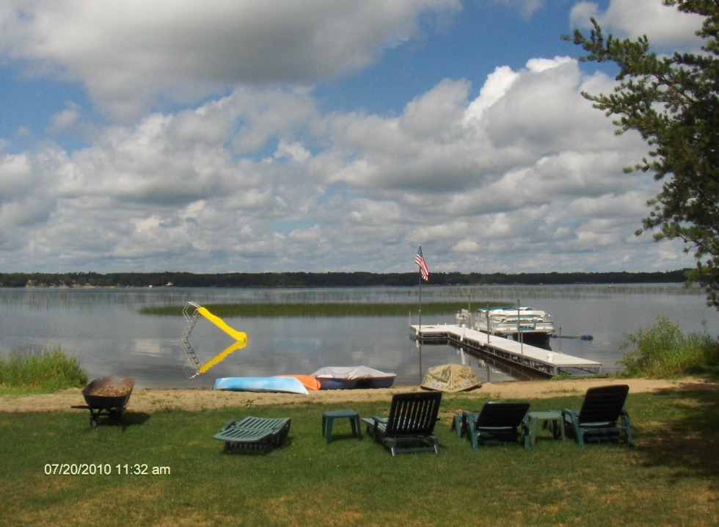
Emergent Vegetation
Moderate
  Thicker in density, or may consume more area of the shoreline and water area extending out. May also have areas without weeds.

Slide 5
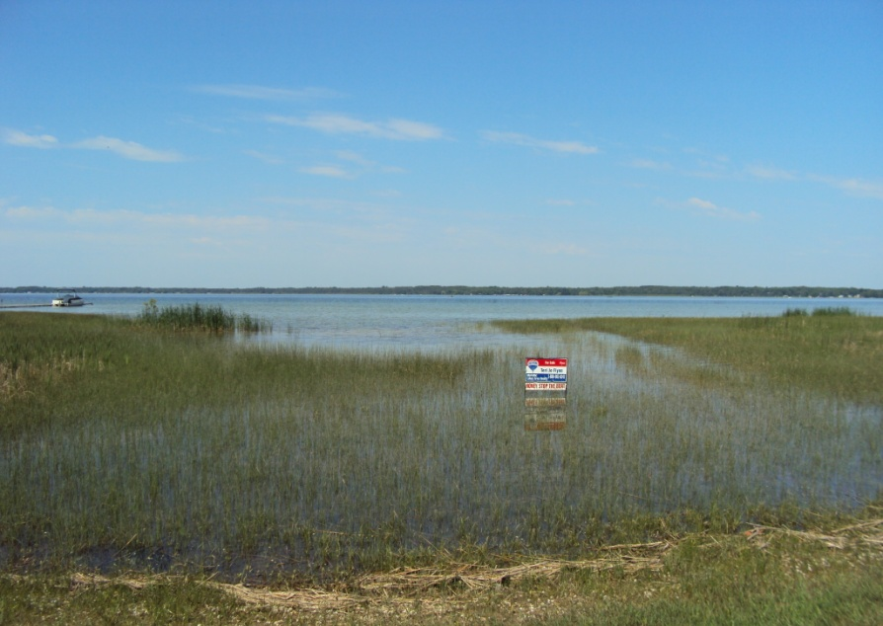
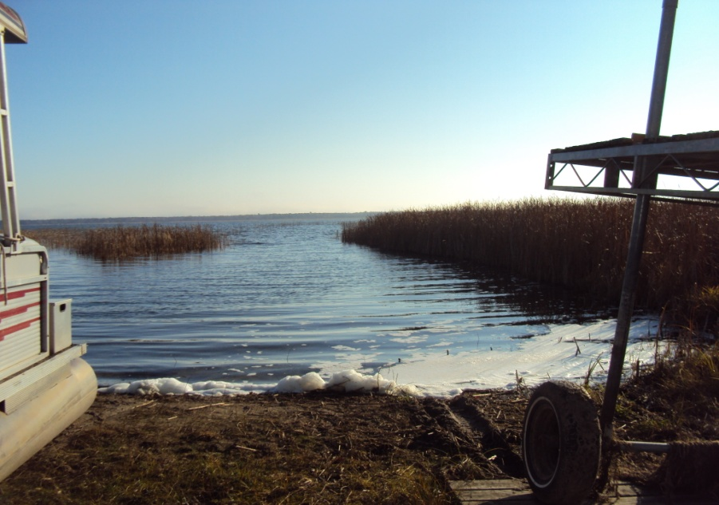
Emergent Vegetation
Dense
Heavy concentration. High ratio of emergent vegetation to open water. Vegetation may go out a distance from shore. May still be able to navigate a watercraft through.

Slide 6
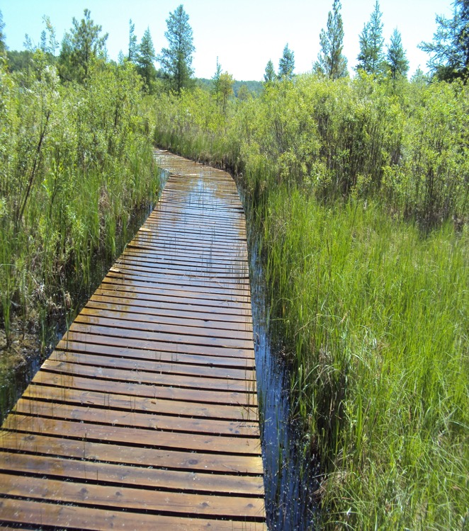
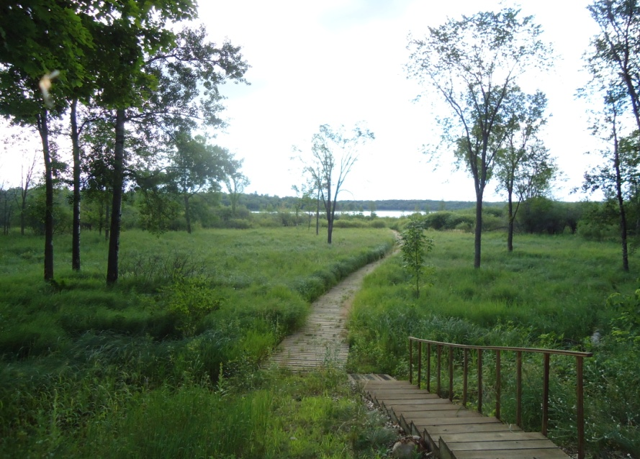
Emergent Vegetation
Severe

Slide 7
Floating Vegetation
Heavy concentration. High ratio of emergent vegetation to open water.
Dense
Thicker in density, or may consume more area of the shoreline and water area extending out. May also have wide, clear areas.
Moderate
Mostly clean lake bottom. Thinly concentrated or may have a patch of floating vegetation in a small area of the lake shore. Low vegetation to open water ratio.
None / Sparse
Heavy, thick concentration.
Severe
May still be able to navigate a watercraft through.
May require long docks/boardwalks to access a more usable area of the lake
May not be navigable by boat.

Slide 8
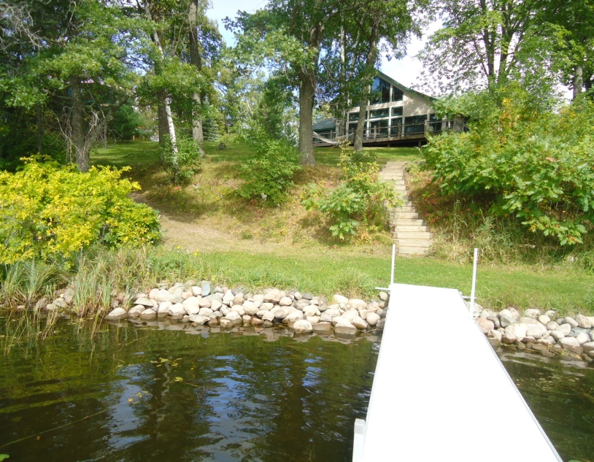
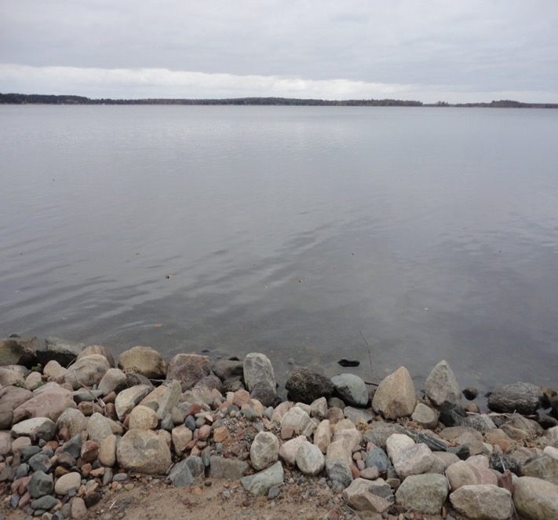
Floating Vegetation
None / Sparse
Mostly clean lake bottom. Thinly concentrated or may have a patch of floating vegetation in a small area of the lake shore. Low vegetation to open water ratio.

Slide 9
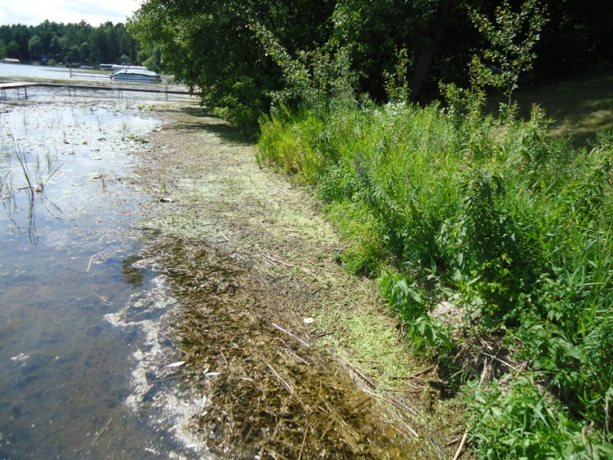
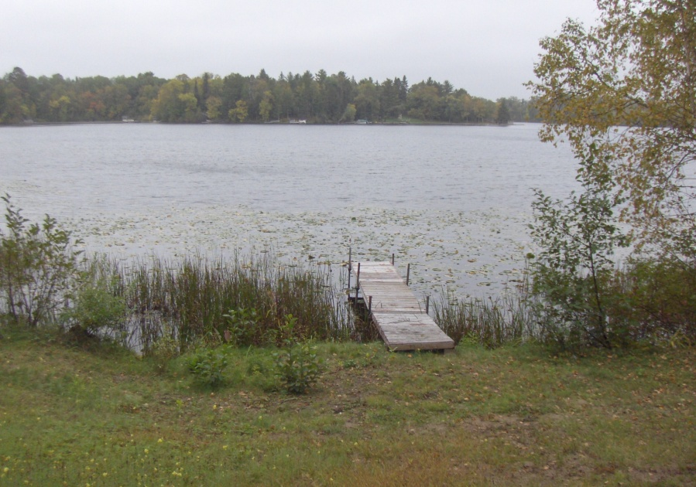
Floating Vegetation
Moderate
  Thicker in density, or may consume more area of the shoreline and water area extending out. May also have wide, clear areas.

Slide 10
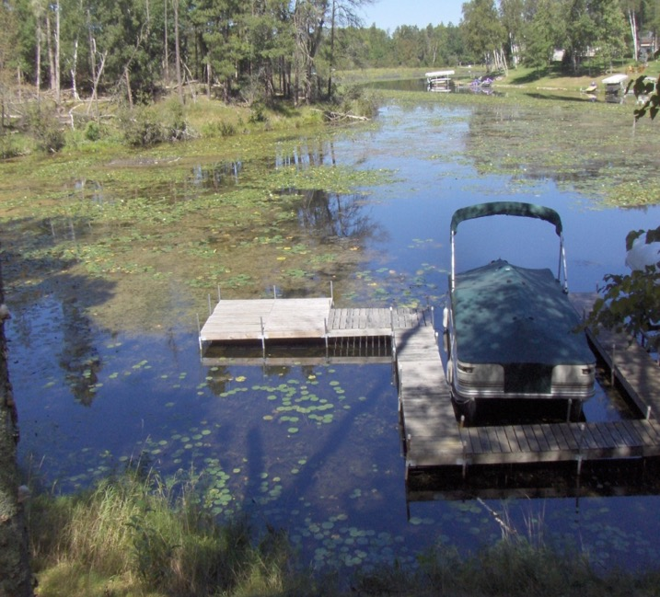
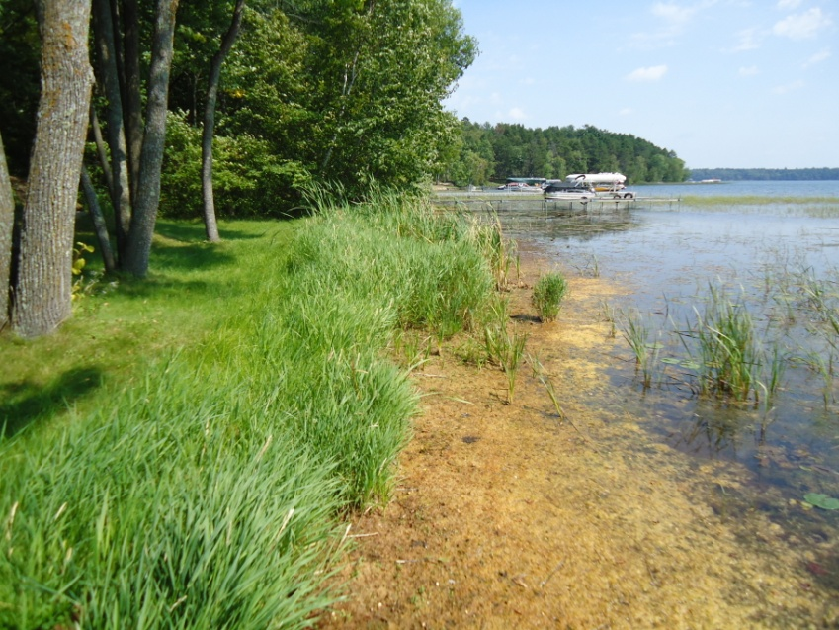
Floating Vegetation
Dense
  Heavy concentration. High ratio of emergent vegetation to open water. May still be able to navigate a watercraft through.

Slide 11
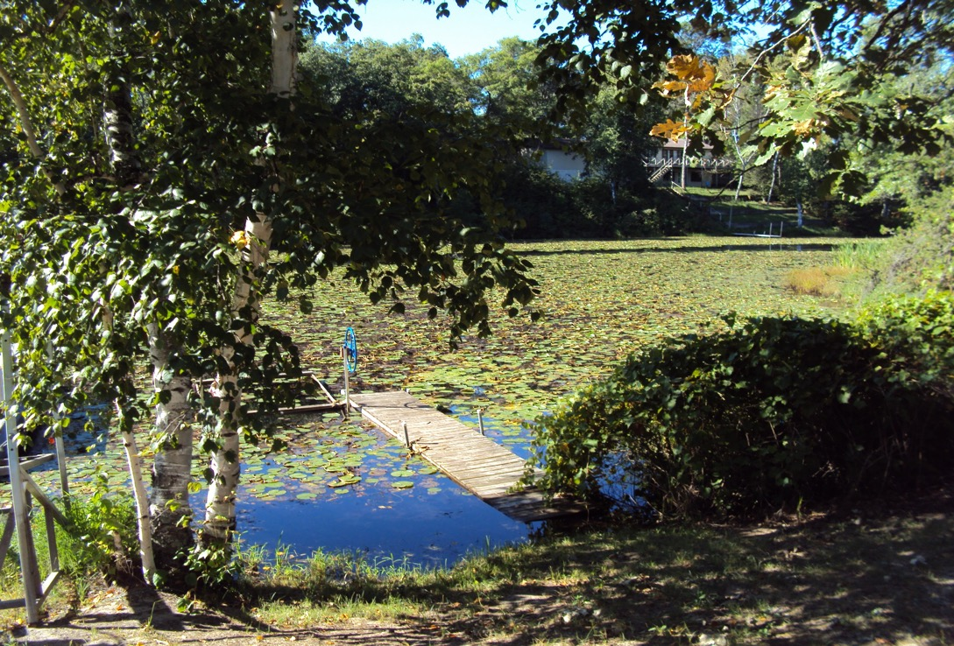
Floating Vegetation
Severe
Heavy, thick concentration. May require long docks/boardwalks to access a more usable area of the lake. May not be navigable by boat.

Slide 12
Submerged Vegetation
Heavy concentration. High ratio of emergent vegetation to open water.
Dense
Somewhat thicker in density.
Moderate
Mostly clean bottom with no vegetation or few weeds interspersed amongst a mostly clear bottom.
None / Sparse
Heavy, thick concentration.
Severe
Approximately 50-75% of lake bottom covered by vegetation.
May have areas of submerged vegetation and areas of clear lake bottom. Approximately 30-50% of lake bottom covered by vegetation.
Lake bottom appears heavily choked by weeds from shoreline extending out past typical dock lengths.

Slide 13
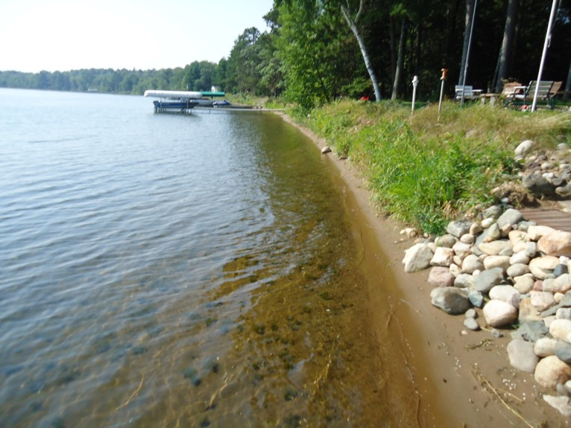
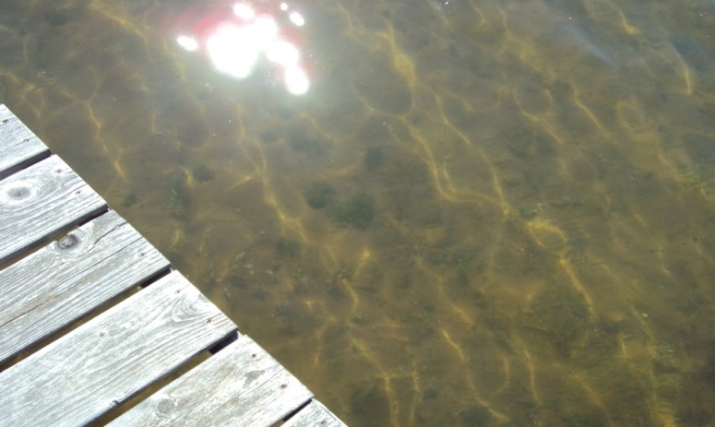
Submerged Vegetation
None / Sparse

Slide 14
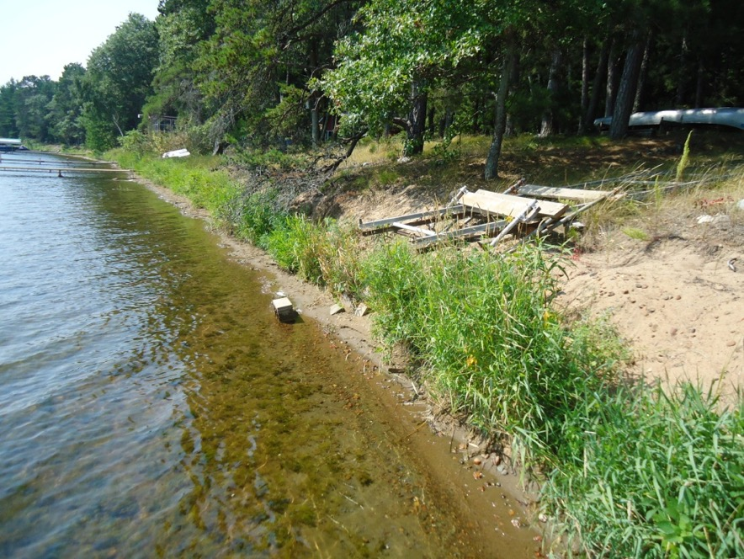
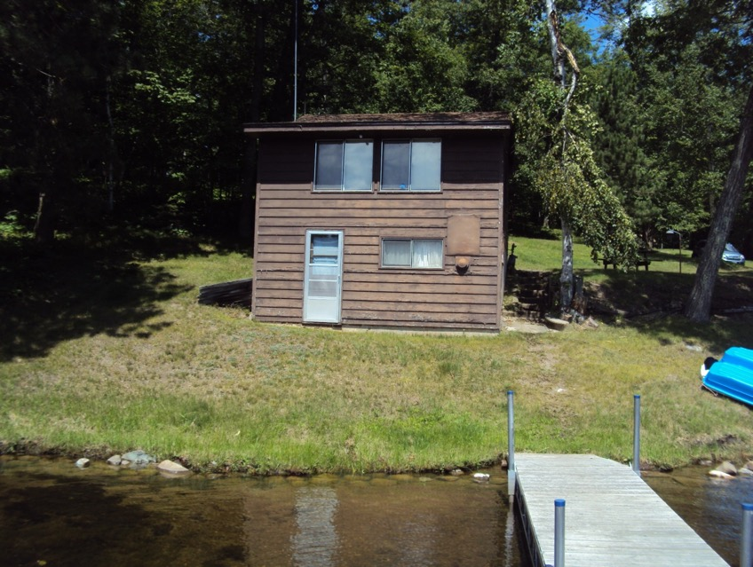
Submerged Vegetation
Moderate

Slide 15
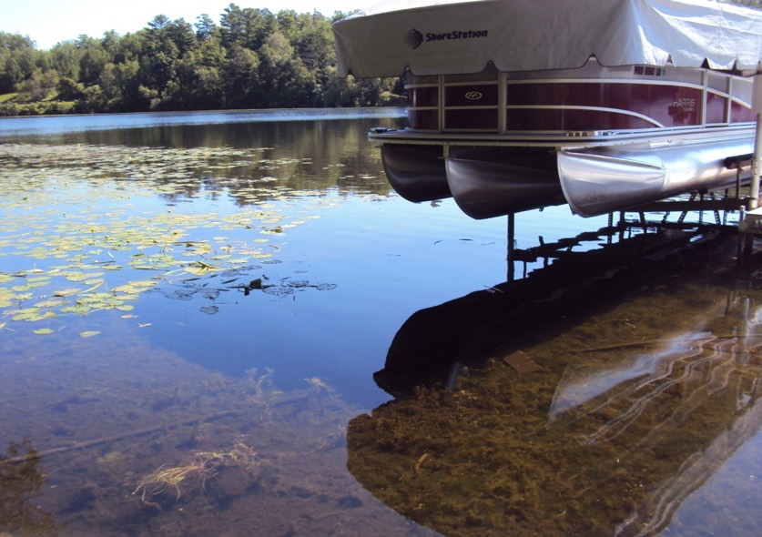
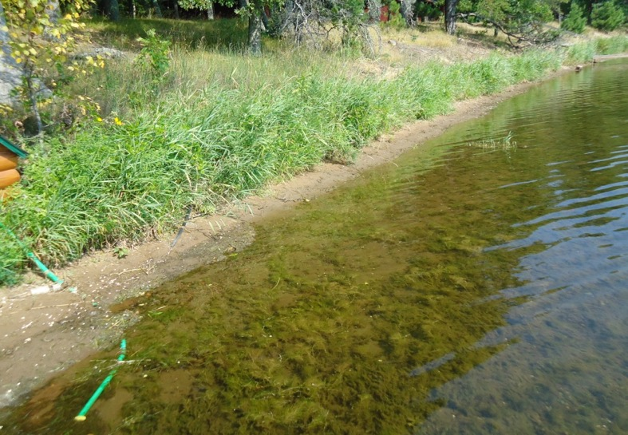
Submerged Vegetation
Dense

Slide 16
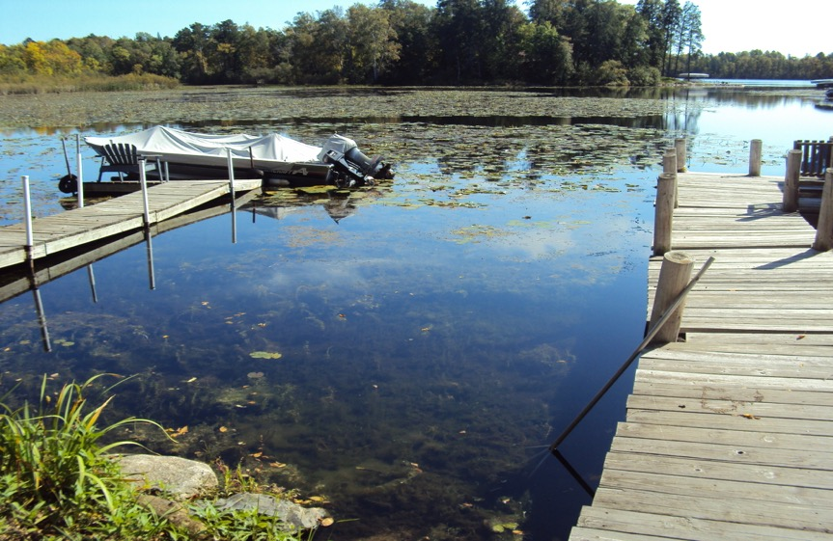
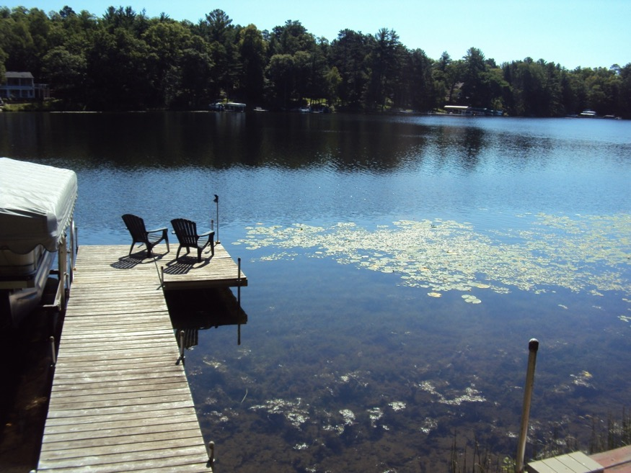
Submerged Vegetation
Severe

Slide 18
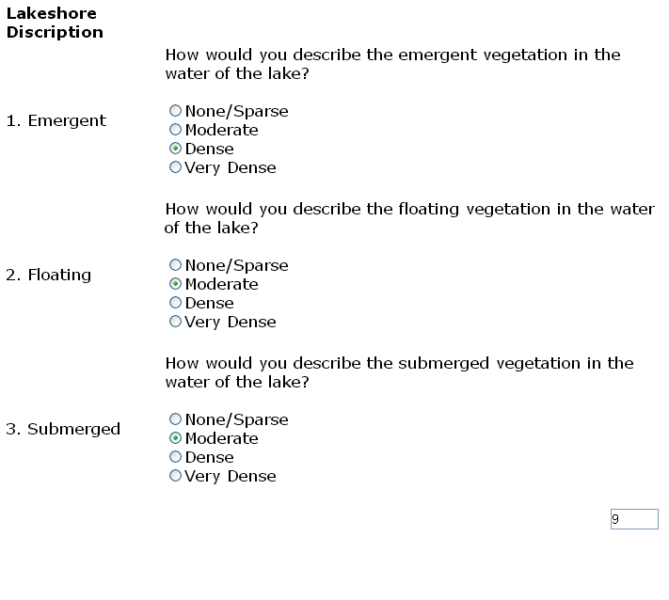
The Calculator

Slide 19
Prime
Elevation
Two Categories
5% - 15% adjustment
Vegetation
Four base grades
5% - 70% adjustment
Utility
Irregular Shape
Depth
Build ability
Usability
Privacy
No adjustment to front footage rate
6 Grades

Slide 20
Utility
There are a number of factors that impede or enhance the utility of lake lots. For this model they are categorized as:
    Road
    Depth
    Utility (Shape, Build ability)
    Low Land
    Harbors/Channels
    Peninsula lots
    Islands

Slide 21
Roads
Some lots have roads between the lakeshore and the home. Typically these lots sell at a discount to other lake lots and require an adjustment. The amount of the discount is related to the size of the road, the amount of traffic on the road and the overall impact of the road on the lot.
There are three levels of road adjustments
    UR1 – low usage road: sometimes private roads or easements, typically only used by local residents.
    UR2 – Medium usage road: typically public and paved, can be county roads with moderate levels of traffic.
    UR3 – High usage road: Paved, typically county roads or state highways with high levels of traffic.
    UR4- High usage road: Paved, State Highways, high level of traffic, 4 lanes

Slide 22
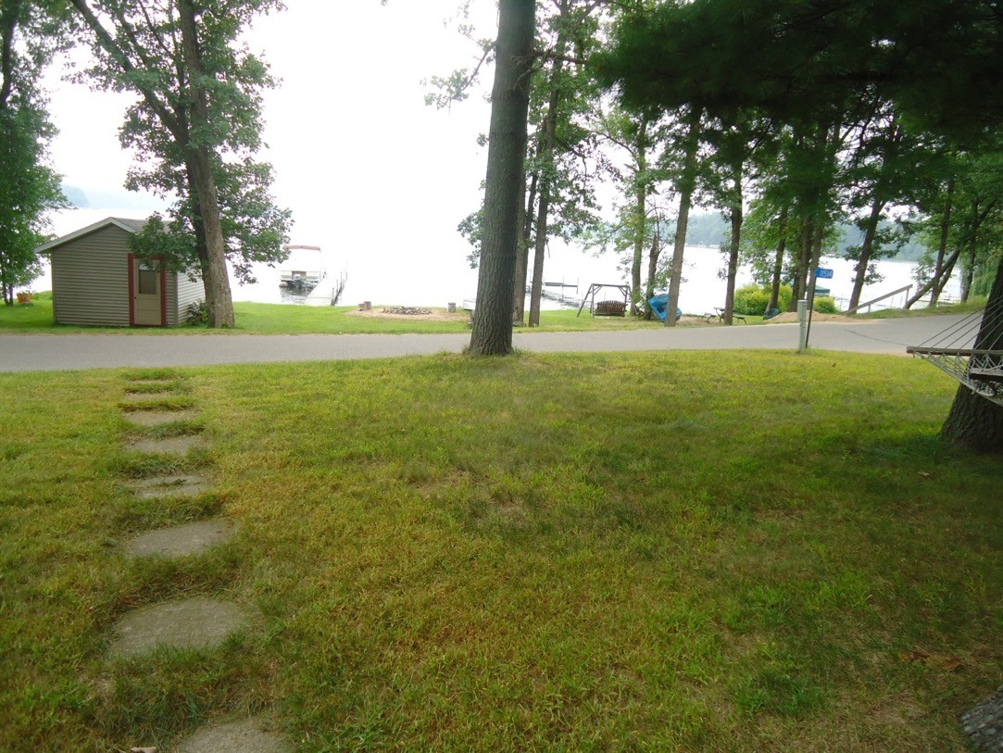
UR1: Leisure Lane (AADT Not Measured)

Slide 23
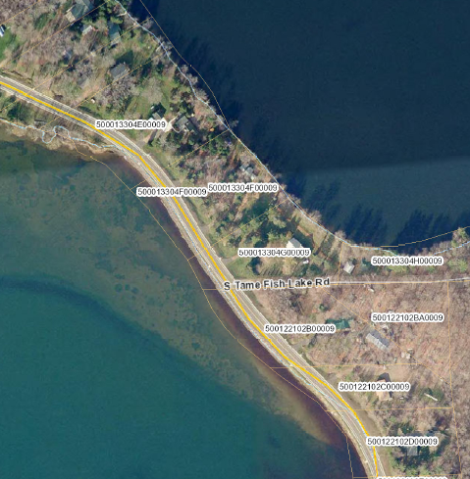
UR2: County Road 10 (AADT = 720)

Slide 24
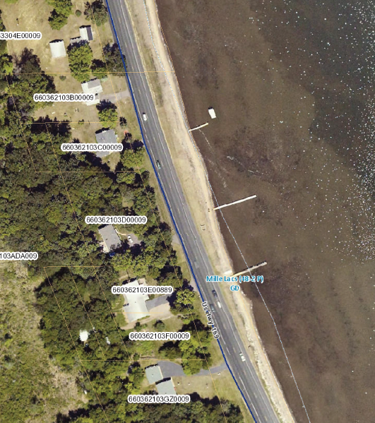
UR3
Highway 169 (AADT=4,000)

Slide 25
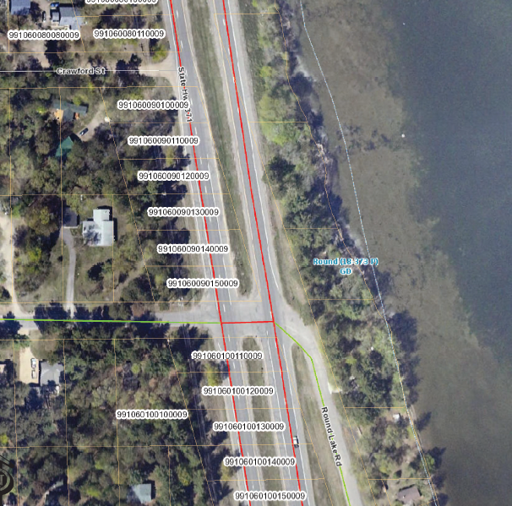
UR4 :Highway 371 (AADT=17,000

Slide 26
Depth
Our lakeshore model is based on a 200 foot depth. For lots less than 200 feet, adjustments are needed to reflect the decreased utility and build-ability of these lots. Lots with less than 200’ in depth are adjusted in 5’ increments. The smaller the depth, the larger the adjustment.

Slide 27
230’
ROAD
To determine the amount of the depth adjustment, measurements will be taken from the midpoint of the lake frontage.
Lots that have more than 100’ in frontage will have be measured additionally from each mid-point of each tiered area thereafter.
Lot 1
100’
175’
Lot 2
100’
15’
Lot 3
Lake
180’
105’
Lot 4
120’
85’

Slide 28
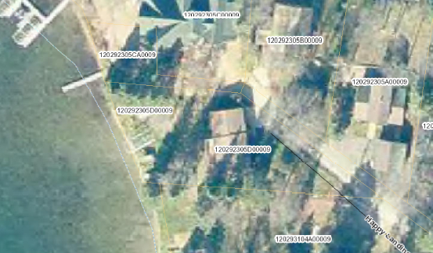
160’ depth

Slide 29
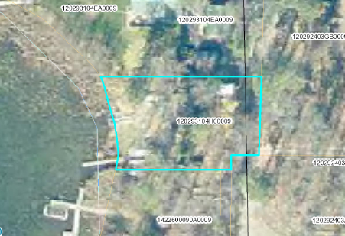
125’ depth

Slide 30
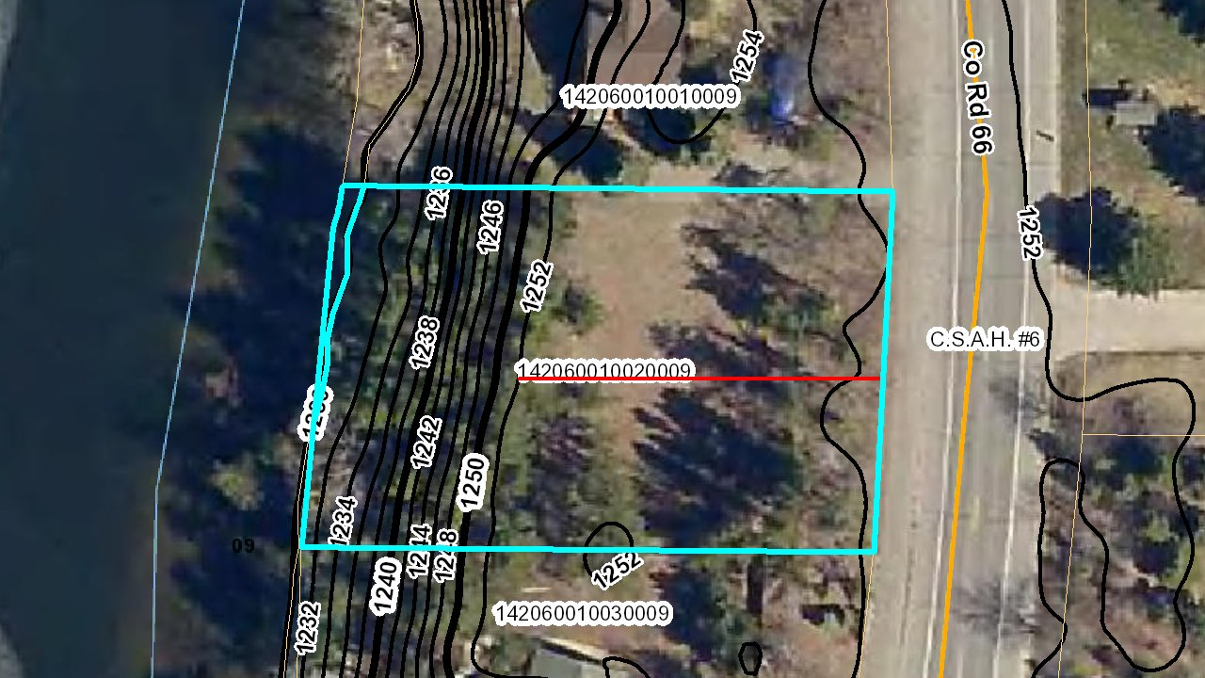
Depth & Elevation
When a lot is affected by a steep elevation, the depth would be calculated by going from the top of the ridge as shown below.
125 Ft

Slide 31
Utility
At times, lots will have issues such as irregular shapes that may impact build ability, privacy, views, parking or other aspects that impact the use of the lot, making these lots less desirable than rectangular lots.

Slide 32
Irregular Lakeshore Lots
Depending on the curvature and shape of the lake, irregular lots may be as common as rectangular lots. The following methodologies address some of the more common types of irregular lots.
Angled Lots
Angled lots are lots that are either wider on the front (lake-side) than on the back of the lot. Due to the curvature of the lake, a lot may have 150’ of frontage on the lake, but 100’ of width by the road. An angled lot with 150 feet of frontage does not have the same utility as a rectangular lot with 150 feet of frontage. The method to value angled lots is a two-step process that first determines the most valuable frontage, and then uses depth measurements to adjust the lesser valuable frontage. The process is described first, then it will be broken down step-by-step.

Slide 33
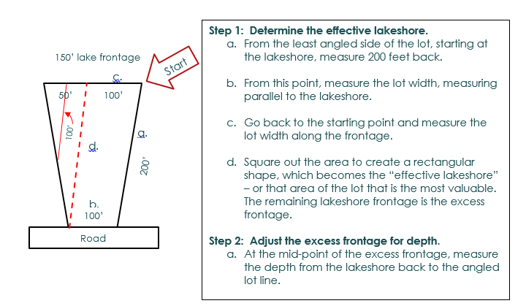

Slide 34
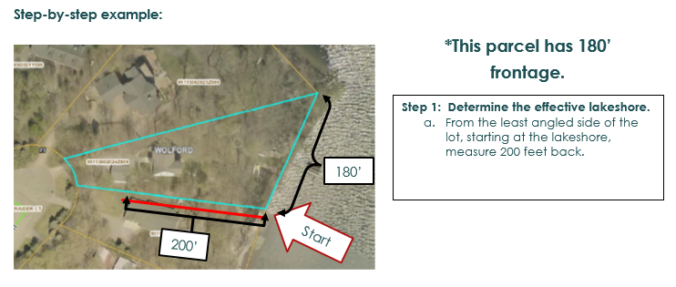
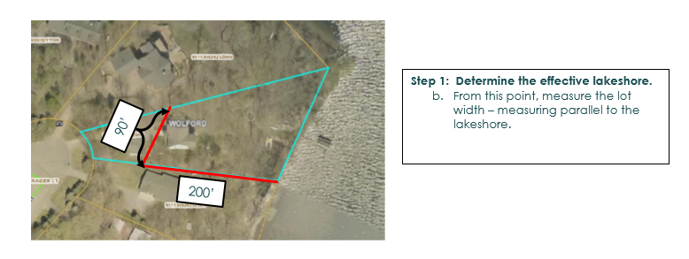

Slide 35
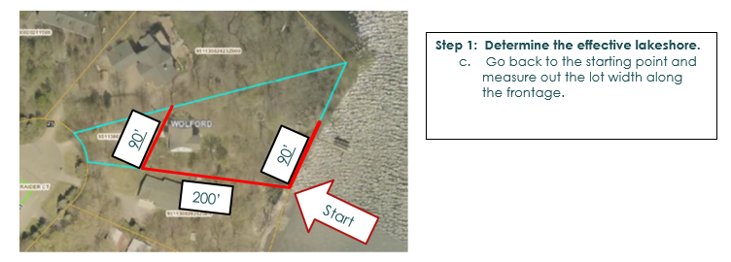
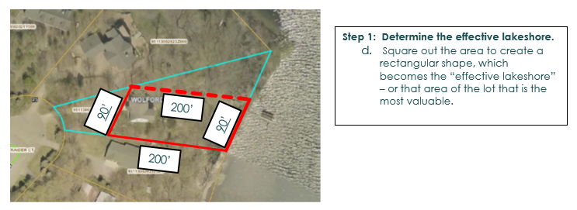

Slide 36
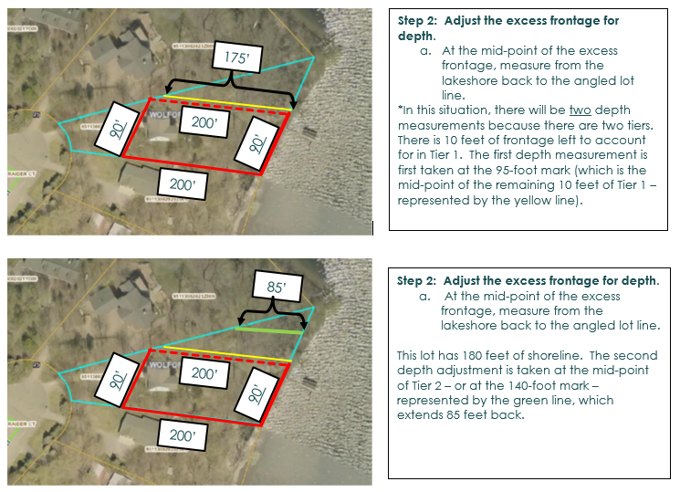

Slide 37
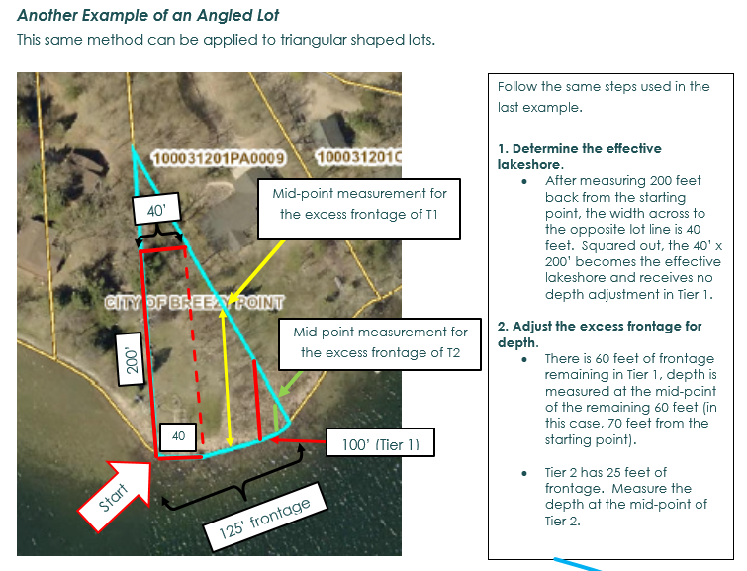

Slide 38
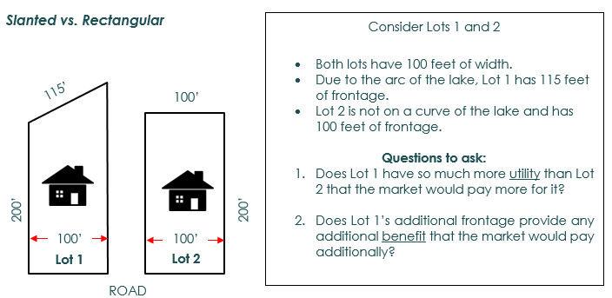
Slanted Lots (LS)
Slanted lots are often found where the lakeshore starts to round with the arc of the lake. The angle of the slant may vary the frontage from lot to lot, even when the lot widths are similar. Consideration is given to the additional value that is attributable to the excess frontage – in other words, what is the excess frontage actually worth? This method differentiates the effective lakeshore from the actual lakeshore.
Another way of approaching this question is from a value per front foot basis: If the lake is valued at $1,000/front foot, would the market pay $9,000 (based on the Tier 2 value) more for Lot 1 than it would for Lot 2? The answer to all of these questions is NO. The excess frontage does not provide enough additional utility or benefit that would cause a typical buyer to pay more for lot 1 than lot 2. Although all the lakeshore accounted, it is not valued the same. The excess frontage must be determined and valued differently from the effective frontage. The excess frontage is coded as LS in the property record so that when sales of these lots occur, they can be monitored and studied to determine the appropriate adjustments.

Slide 39
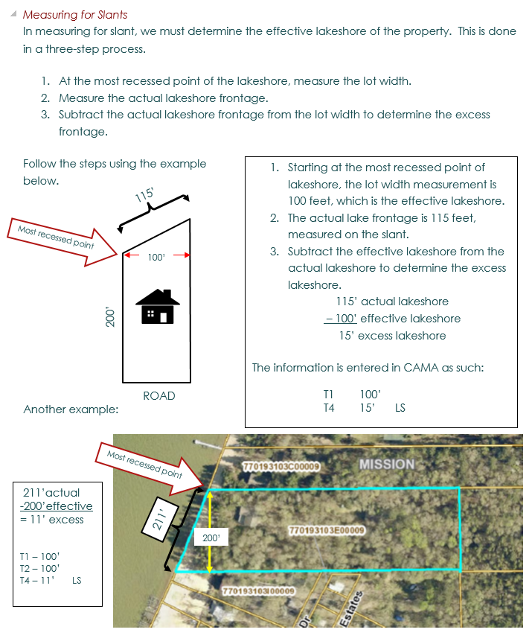

Slide 40
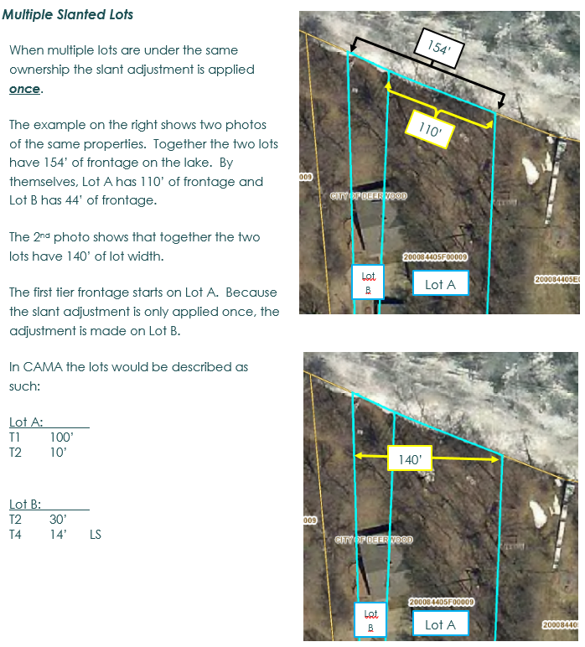

Slide 41
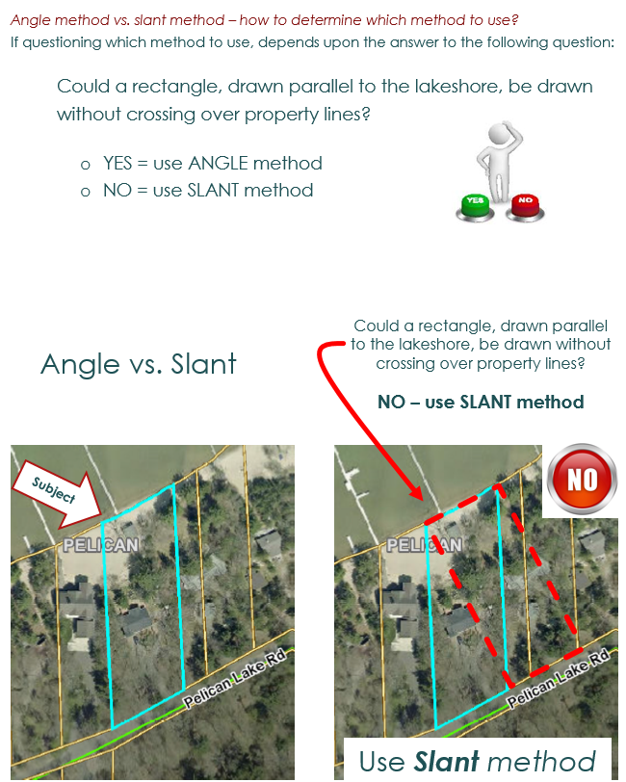

Slide 42
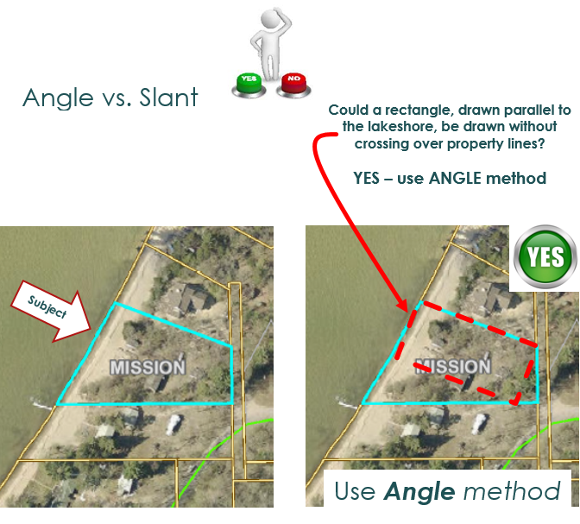

Slide 43
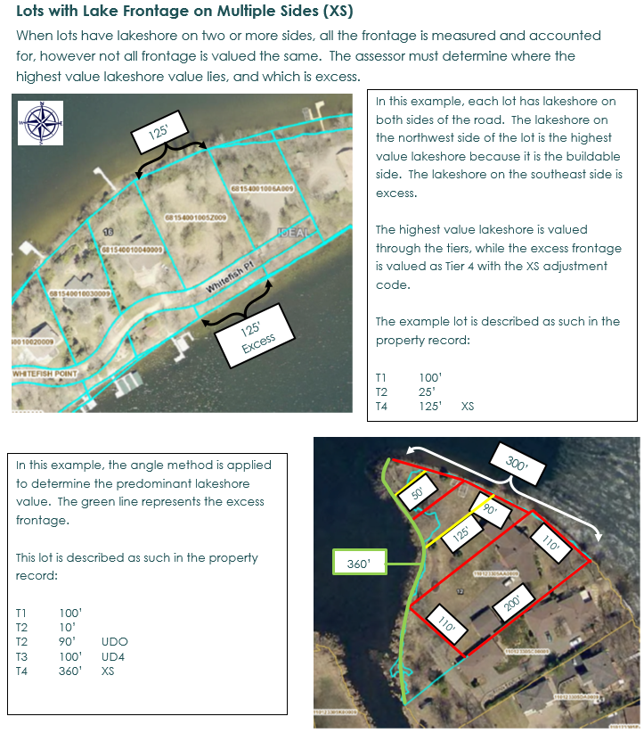

Slide 44
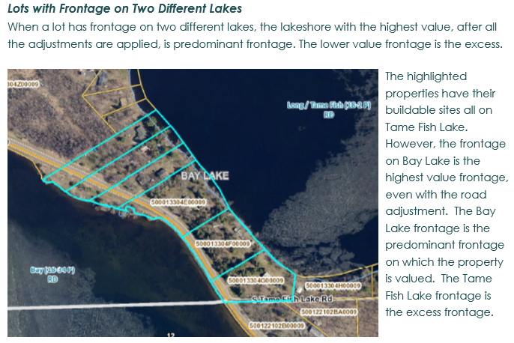

Slide 45
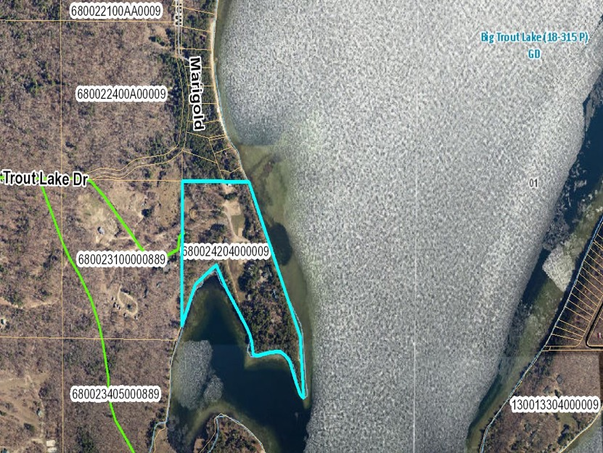
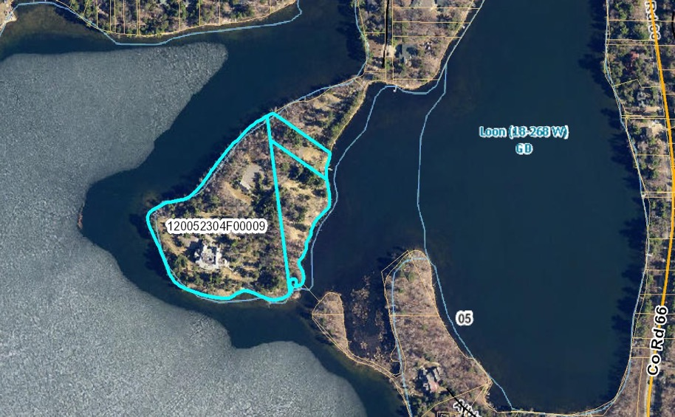
Peninsulas

Slide 46

Peninsula Lots and Protruding Lots (LP)
Peninsula lots are lots that are at the point of a peninsula while protruding lots have a segment of land that juts out into the water. The excess frontage for both types of lots coded as “LP” in CAMA in order to capture the sales in the market for on-going study to determine the worth of the excess frontage.
Peninsula Lots
Typically, peninsula lots have a significant amount of lakeshore frontage because they have water on three sides, attributing to the view, privacy, and the uniqueness of the lot. The assessor must discern which side of the lake to use as the highest value frontage – or the effective frontage, and how much frontage is excess. All of the lakeshore around the peninsula is measured to obtain the total front feet of the lakeshore. The effective front feet is subtracted from the total to determine the excess frontage.
In this example, the north side of the lot offers the best side to measure the lot width. The north side measures 515’ from the west property line to the east side, where the property line curves to the south. This is the most valuable frontage.
There is total of 1,291 feet of lakeshore frontage for this parcel. The excess frontage is calculated by subtracting the effective frontage from the total frontage.
1291’ total ff
- 515’ effective ff
=776’ excess ff
The CAMA entry is as follows:
T1 100’
T2 100’
T3 100’
T4 215’
T4 776’ LP
515’ Effective FF
776’ Excess FF

Slide 47
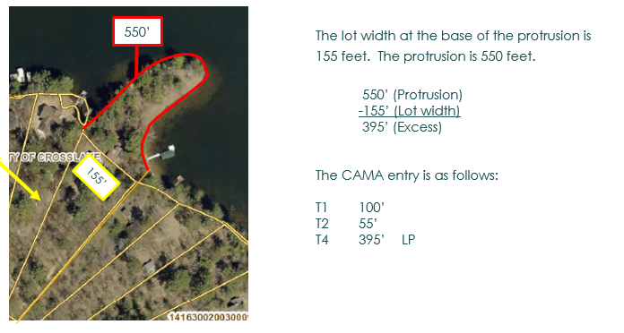
Protruding Lots
A protruding lot has a land formation that juts out into the water, but is otherwise relatively similar to the surrounding properties. The lots below are examples of protruding lots. The first step in valuing protruding lots is to determine the amount of frontage as if the protrusion did not exist – or the lot width closest to the base of the protrusion. Next, the frontage around the protrusion is measured. Lastly, the lot width is subtracted from the total frontage to determine the excess frontage. Examples:

Slide 48
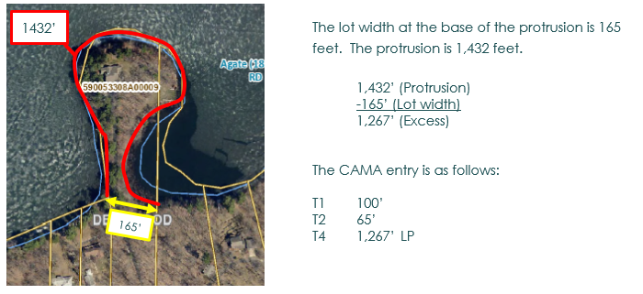
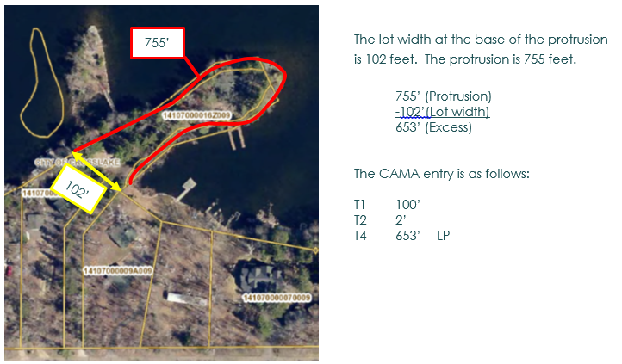

Slide 49


Island Properties

Slide 50
Islands
An island is a piece of land surrounded by water. When valuing island lots two main factors must be considered; buildability and accessibility.
Buildability
Buildability simply refers to the potentiality of a home being built on the island. If a home already exists, then it is buildable. If no home exists, but the island is large enough to meet all the current zoning setbacks and requirements, it’s considered buildable. If there is no building on the island and current zoning minimum standards would not allow enough for a modest building site, the island is considered unbuildable.
Accessibility
Accessibility refers to whether or not the property owner of the island owns another lot on the mainland where he/she could potentially park a car, or have a dock for boat travel to-and-from the island (an access lot), or some type of ownership situation that would be the equivalent of an access lot. An island without an access lot is when the property owner does not have a means to park a car and travel by boat other than from a public launch.

Slide 51
Adjustment Codes for Islands
Below are the four options identifying island lots.
I-1 Buildable with an access lot on the main land
I-2 Buildable with no access lot on the main land
I-3 Unbuildable with an access lot on the main land
I-4 Unbuildable with no access lot on the main land
Islands, either buildable or unbuildable, with access lots are the most common. Occasionally, the access lot is not always straightforward. When the access lot has a different parcel ID number than the island lot, the assessor must create a note referencing the island lot on the mainland lot, and the mainland lot on the island lot.
The access lot can, but may not always be, directly off the island. The parcel identification numbers of the island and the access lot must be referenced each parcel record.

Slide 52


