Slide 1
Low
Low land on lake lots affects the utility of the lot.
If the low land is within the 200’ impact zone, use GIS to determine the percentage of low land to high land.

Slide 2
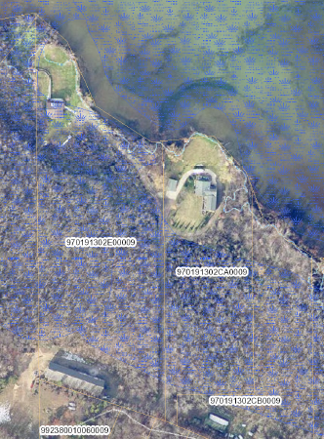
For this lot, the low land is behind the 200’ impact zone, therefore the adjustment would be made to the acreage portion of the lot, not the lake frontage section.
200’Impact Zone

Slide 3
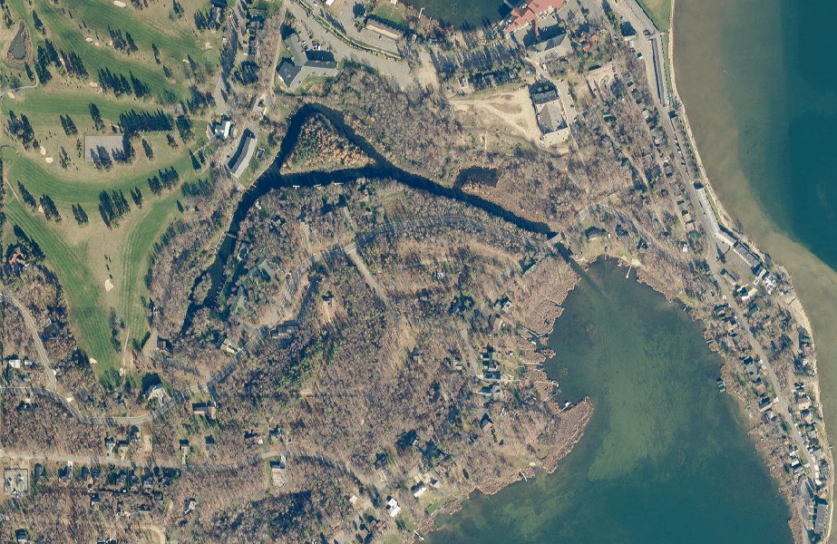
Channel or Harbor Access

Slide 4
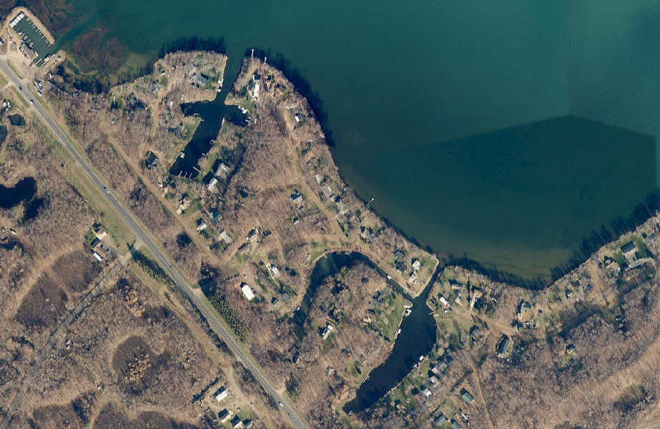

Slide 5
Examples of somewhat unique issues when valuing of lakeshore

Slide 6
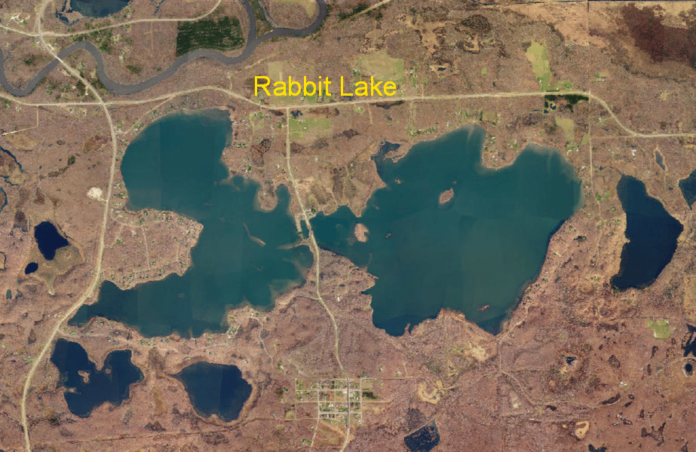
Mine Pit Lakes

Slide 7
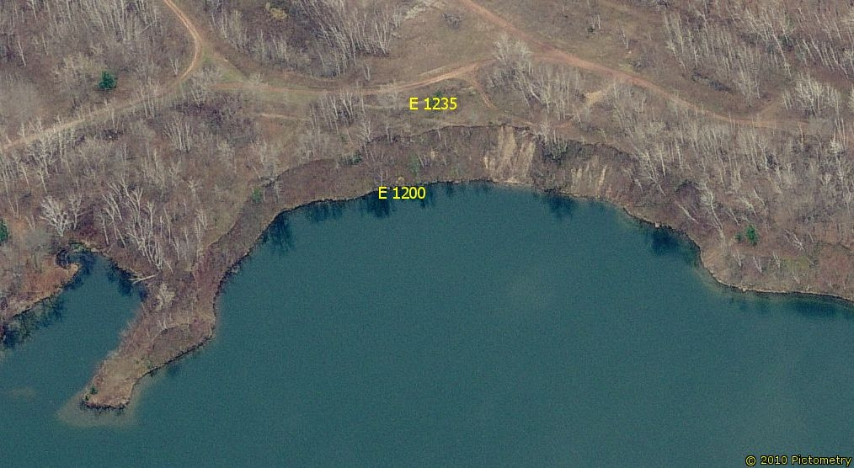
Over 300 ft. deep just 10 feet out

Slide 8
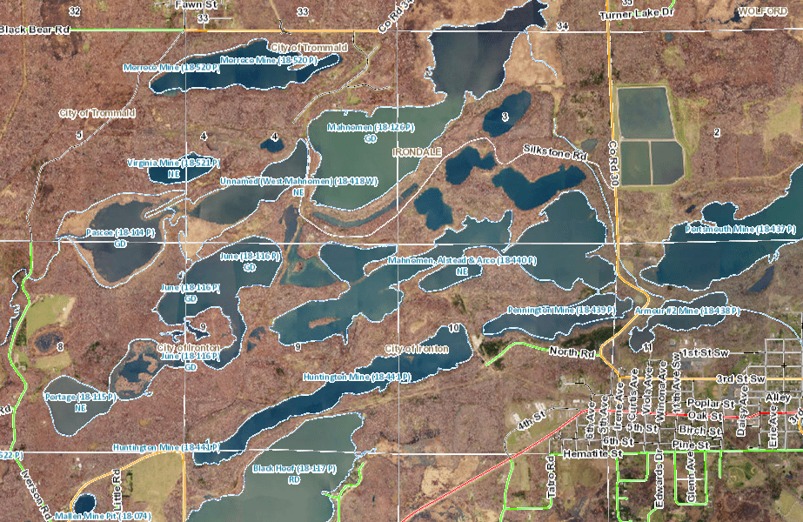

Slide 9
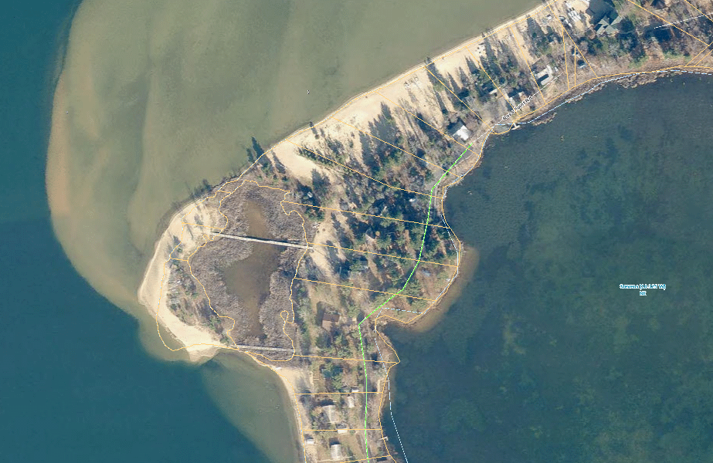

Slide 10
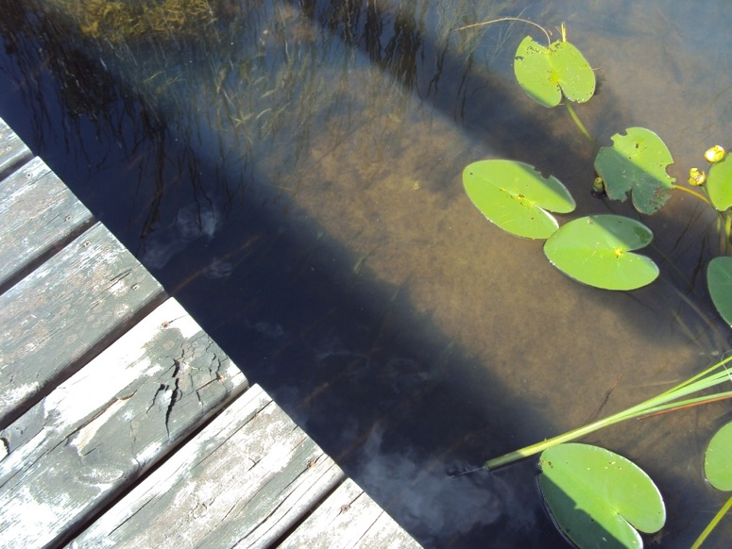
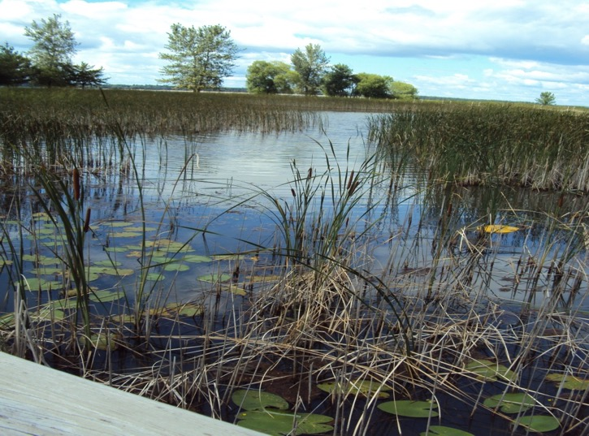
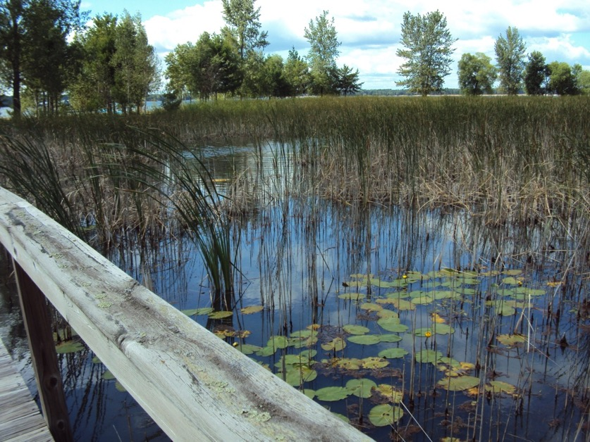

Slide 11
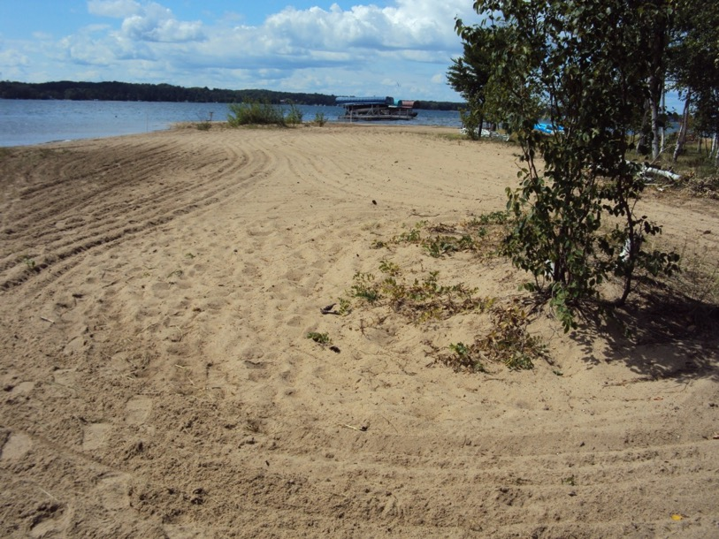
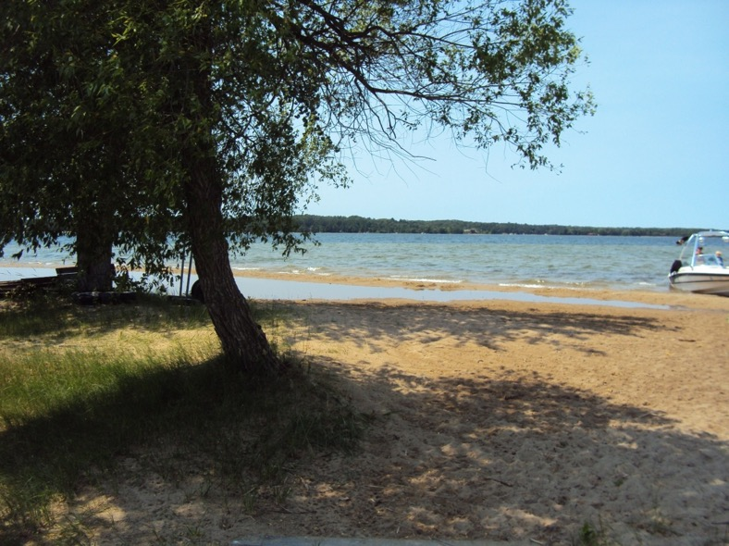

Slide 12
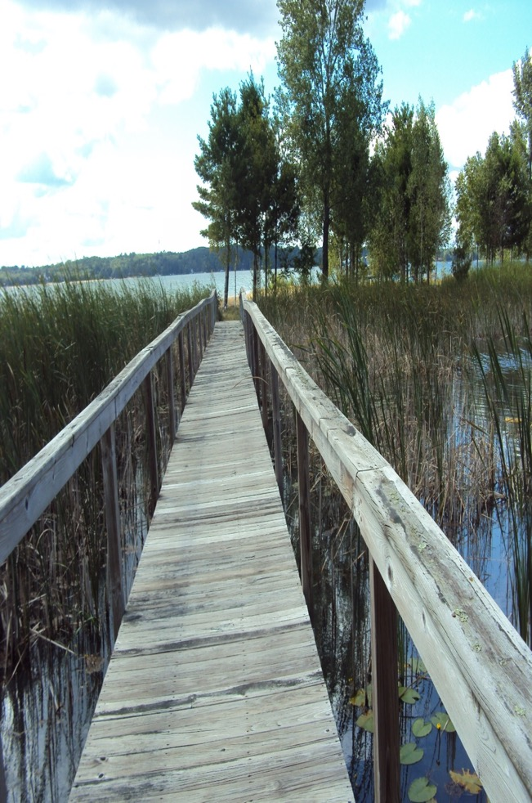
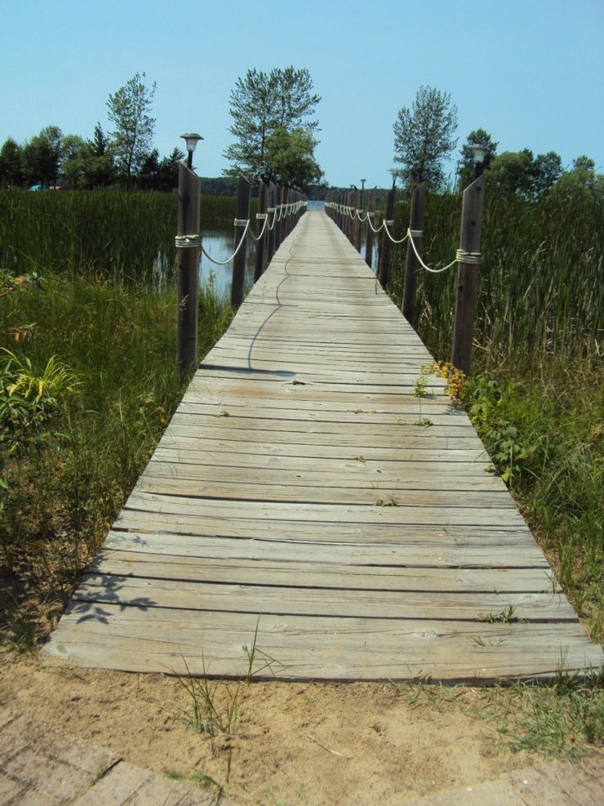
Boardwalk

Slide 13
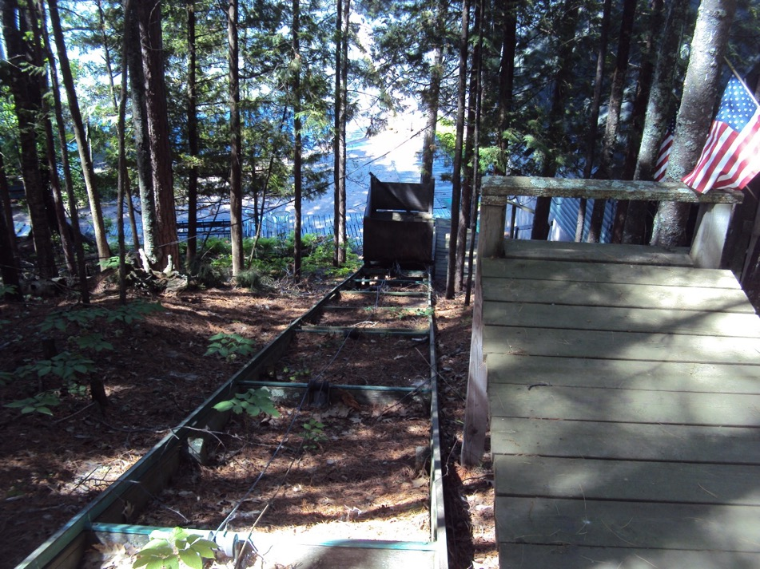
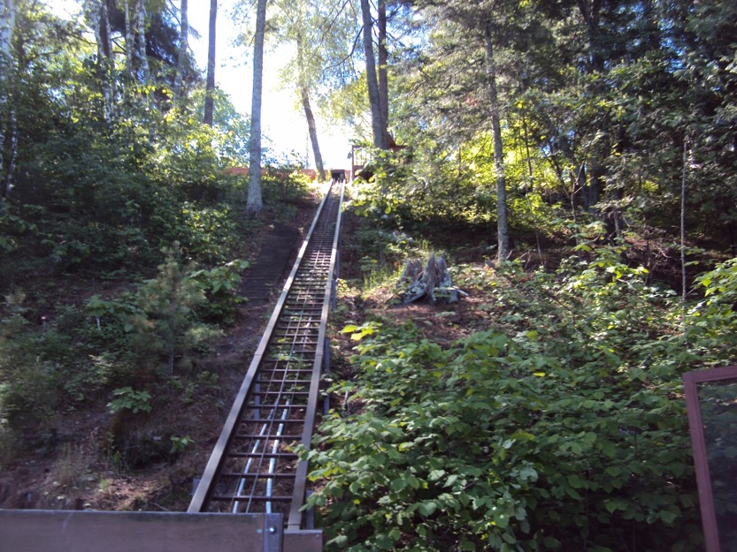
Hill Lifts

Slide 14
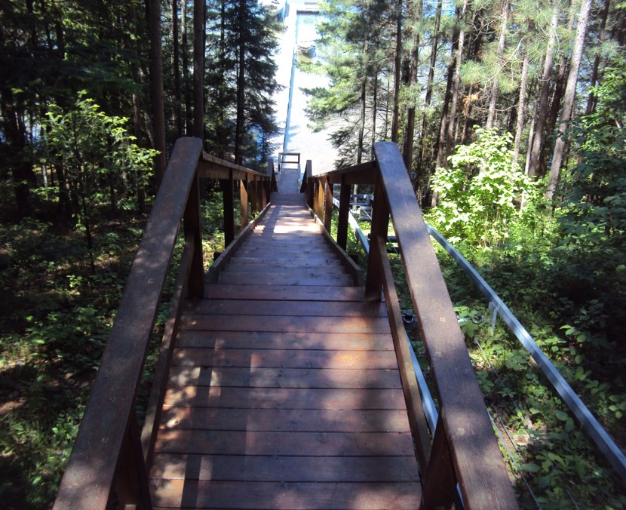
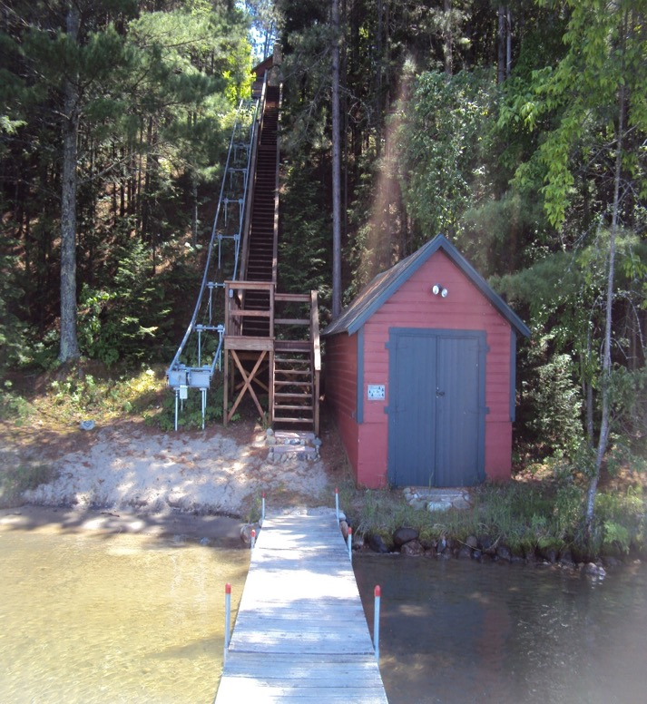
Stairs & Hill lift

Slide 15
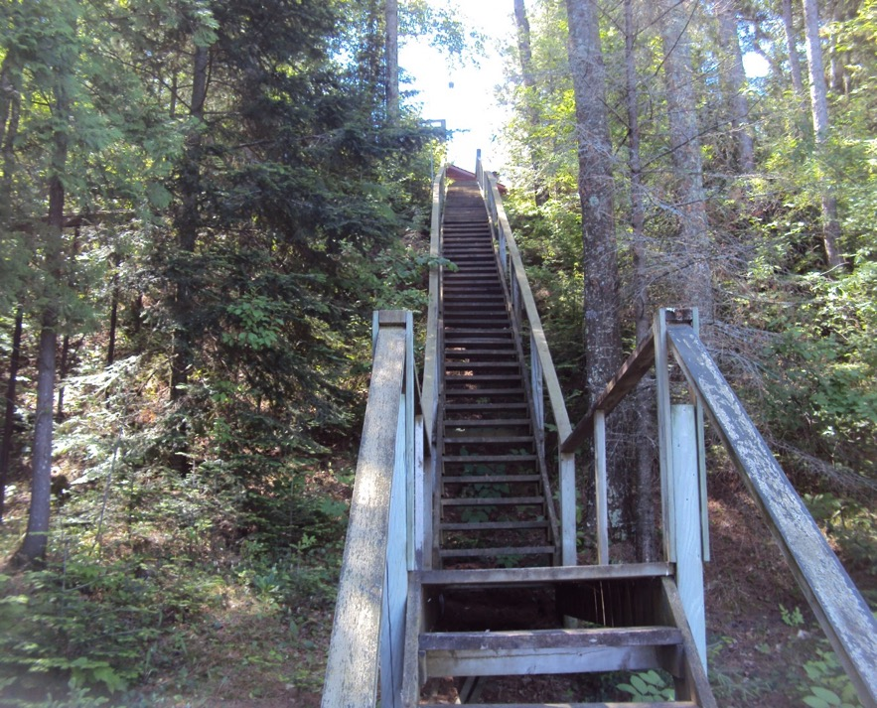
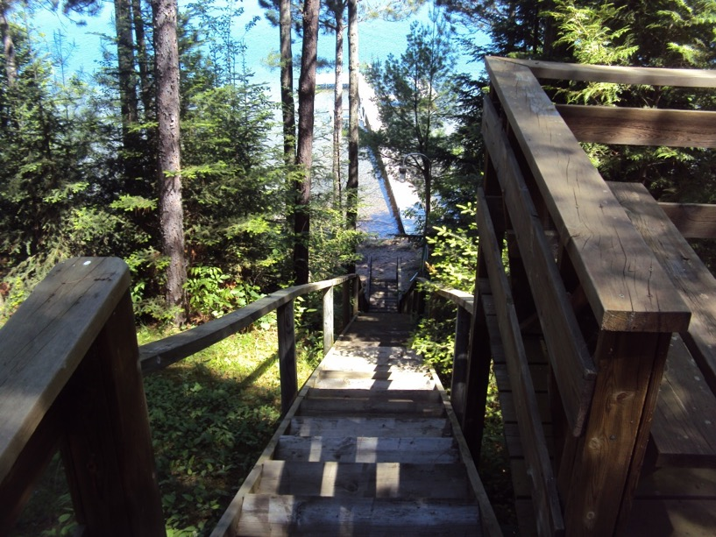
Stairs

Slide 16
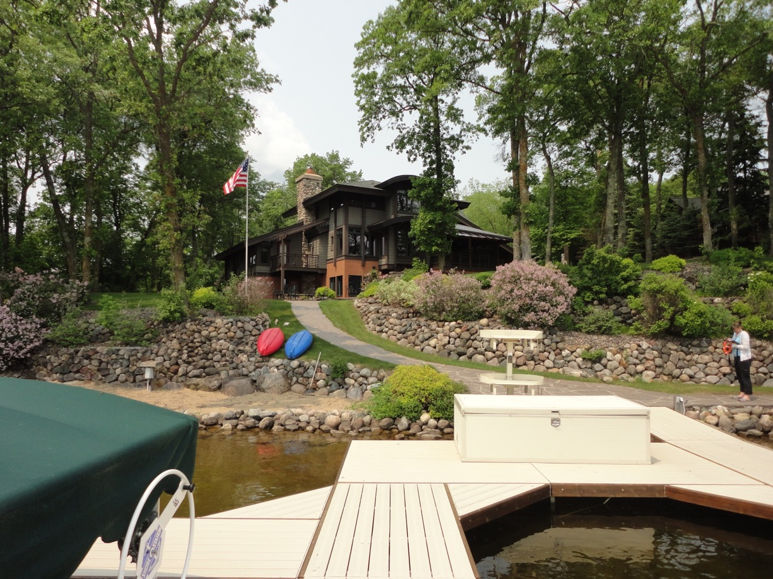
Landscaping and Physical Changes to a Lot

Slide 17
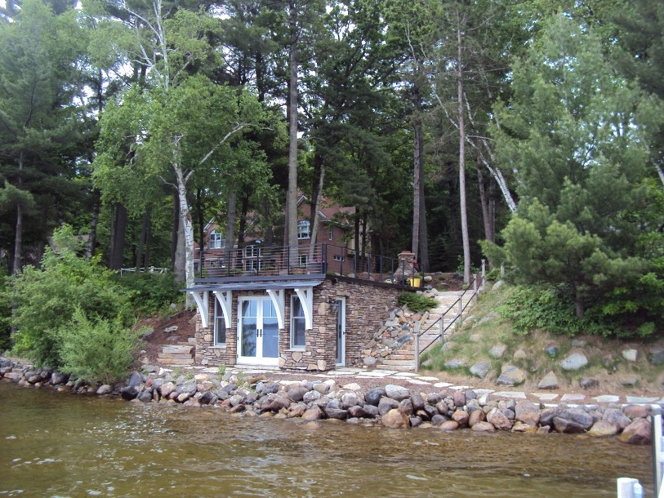
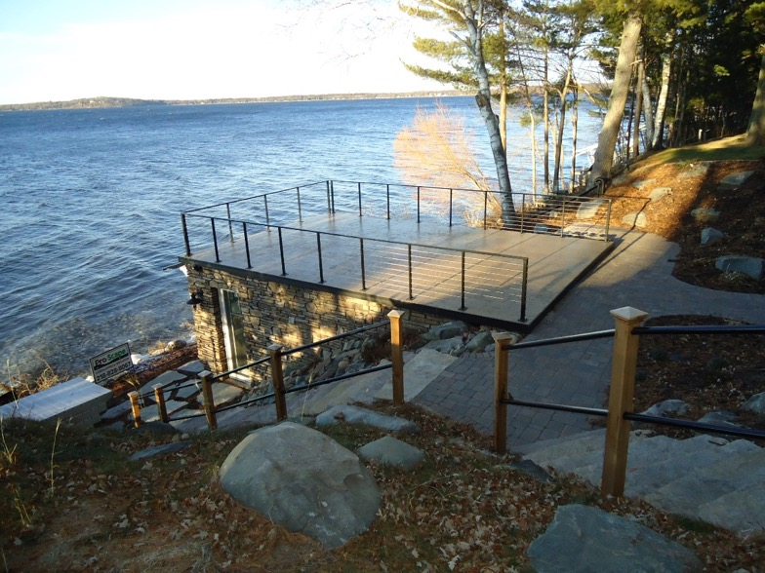
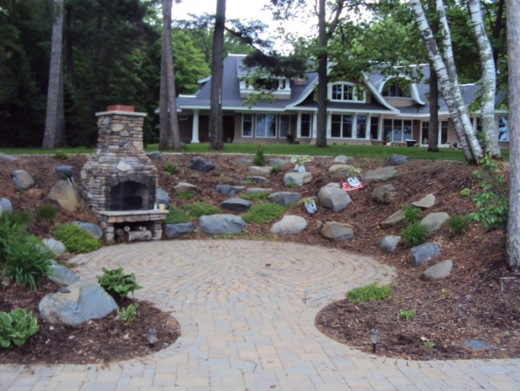

Slide 18
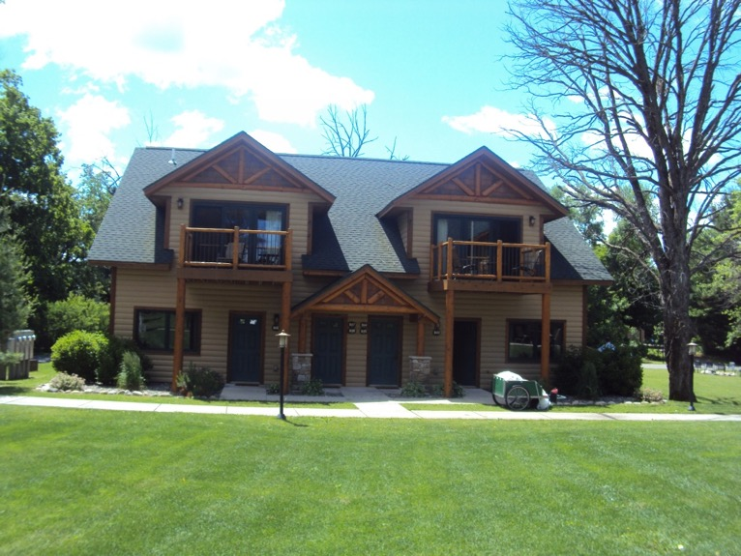
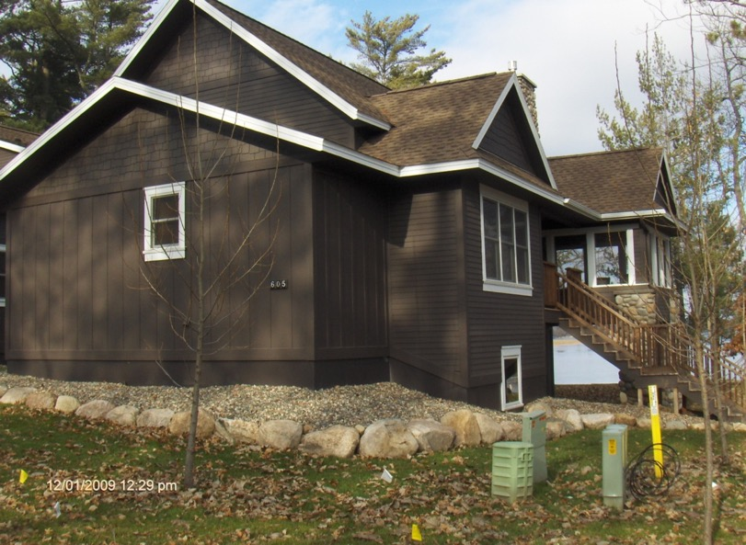
Trends
Private ownership with use of 5 weeks a year and the remaining weeks are in a rental pool with the resort

Slide 19
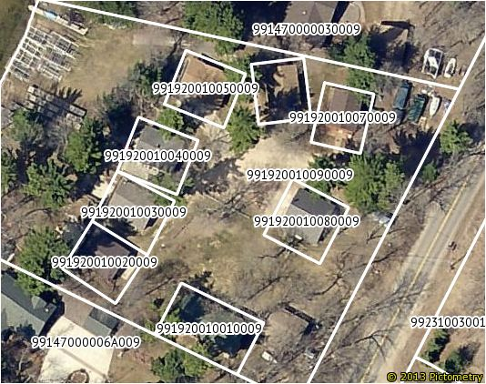
Common Interest Communities

Slide 20
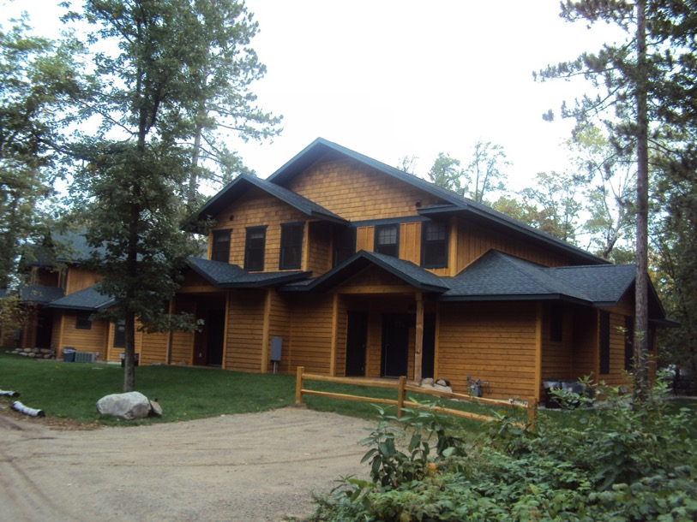
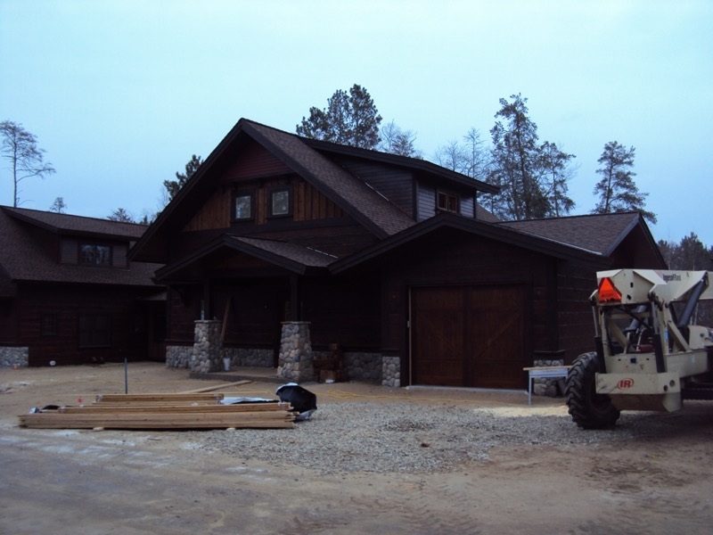
Fractional Ownership
And
Timeshares
1/10 Interest for $80,000
¼ Interest for $149,000

Slide 21
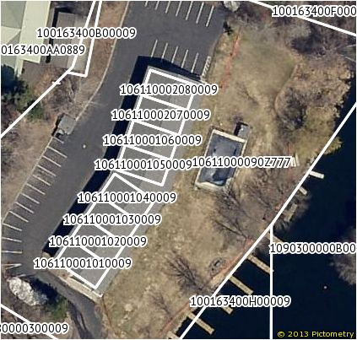
CONDOMINIUMS

Slide 22
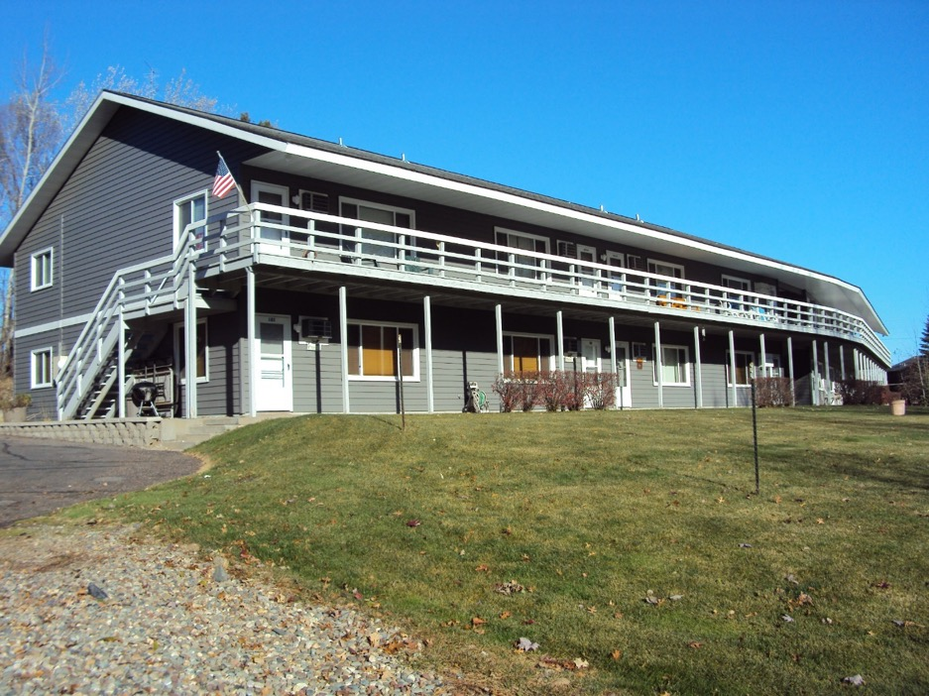
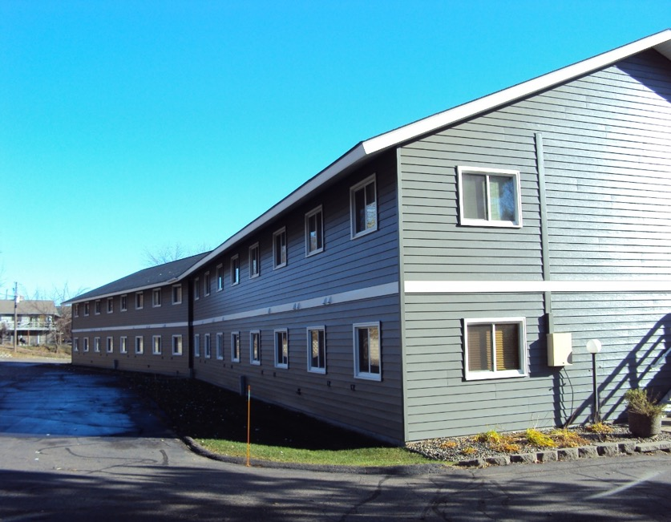

Slide 23
Aquatic Invasive Species (AIS)
Zebra Mussels
Eurasian Milfoil
Spiny Water Flea

Slide 24
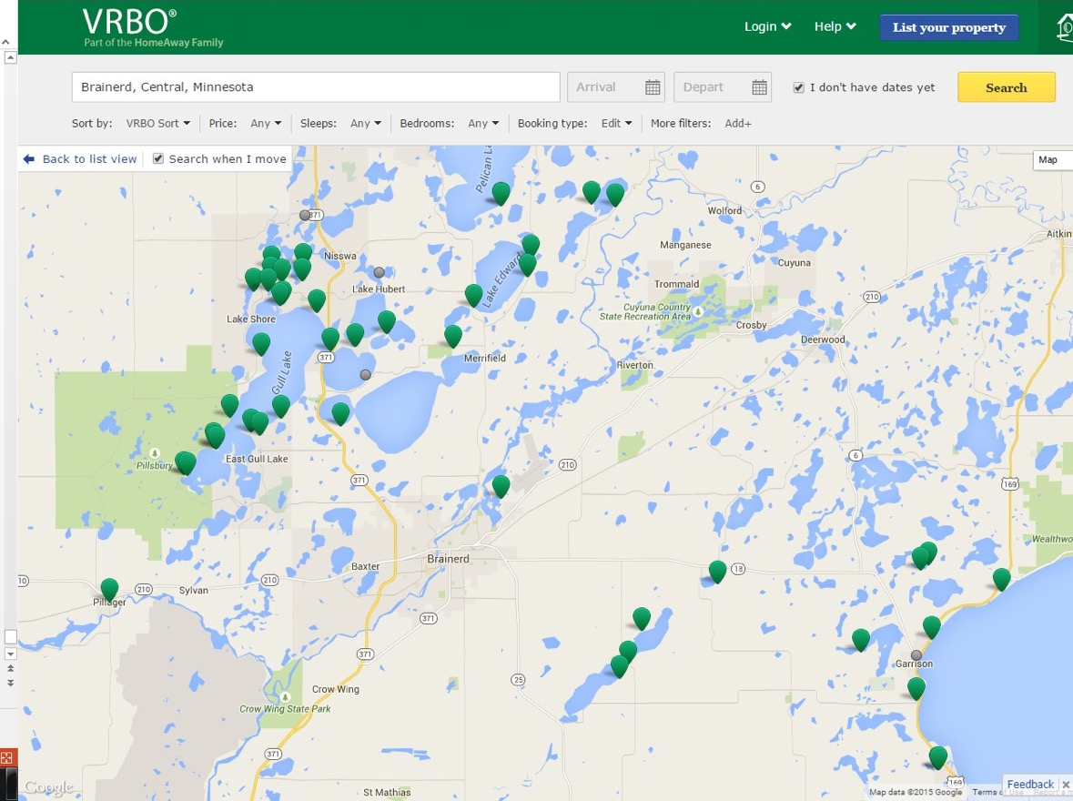
VRBO’s
Vacation rentals by owner

Slide 25
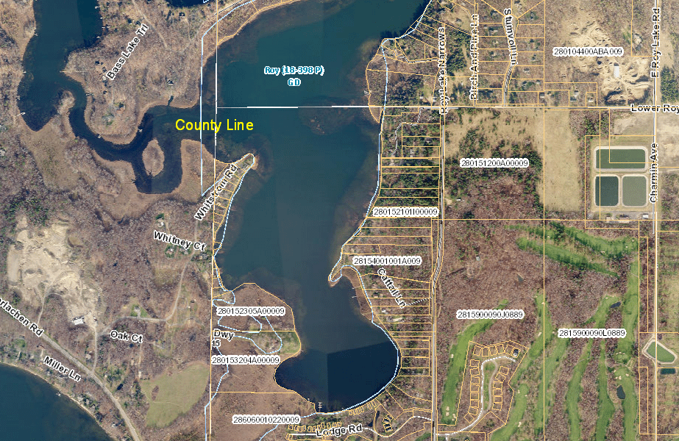

Slide 26
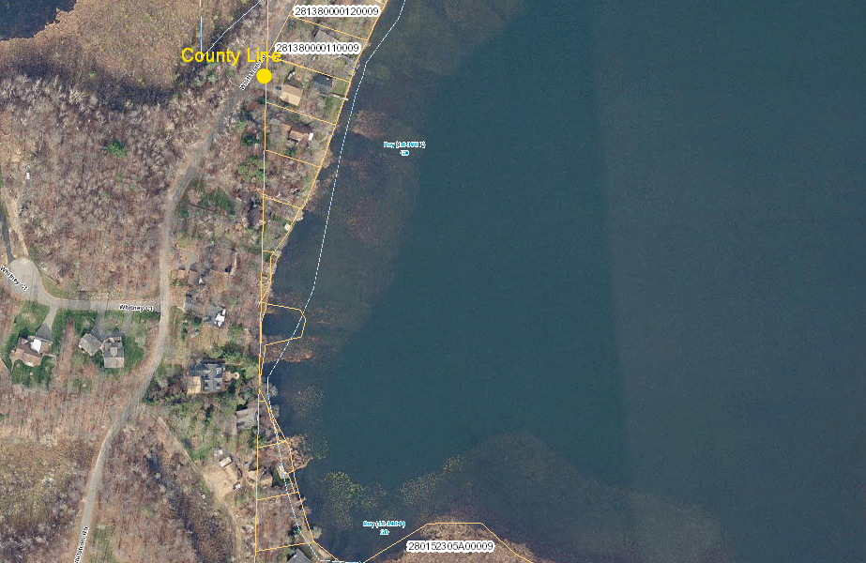

Slide 27
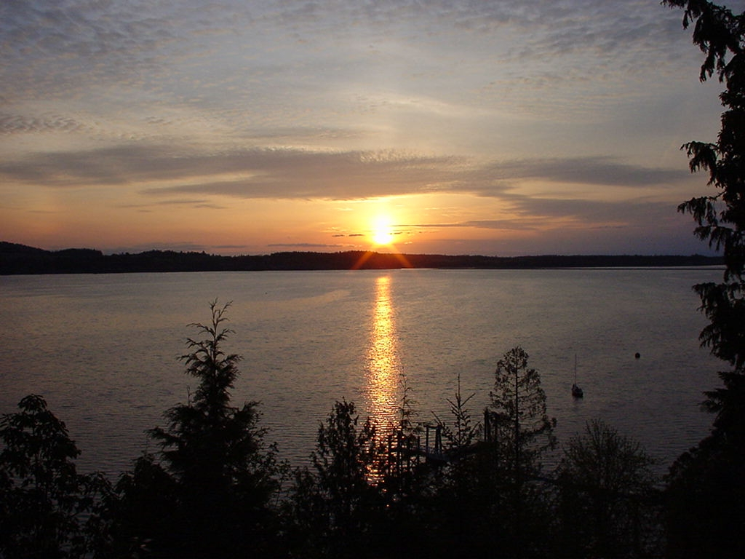
The End

